Slide 1
A GUIDE FOR WORKPLACE LIGHTING
WHAT IS LG7?
HELEN LOOMES

Slide 2
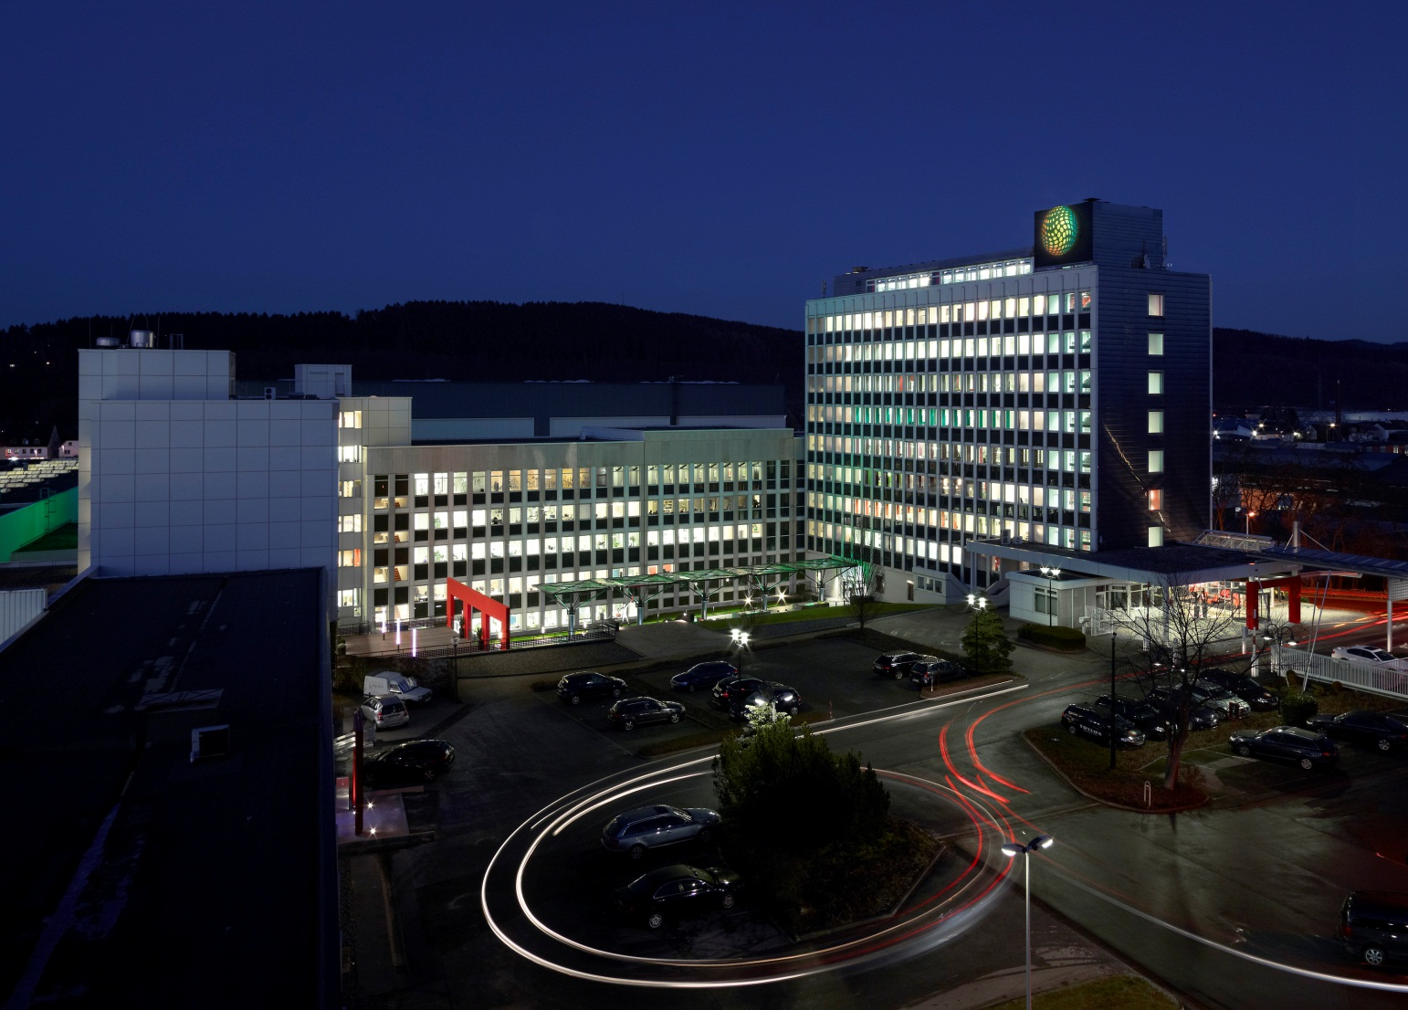
Facts & Figures
Founding year: 1912
Legal form: GmbH & Co. KG
(limited liability company)
Consolidated annual turnover 2015: 600 million euros
Global employees: > 5,000
Business partners and subsidiaries: 34 and 12
Service subsidiaries: > 50 countries
Helen loomes

Slide 3
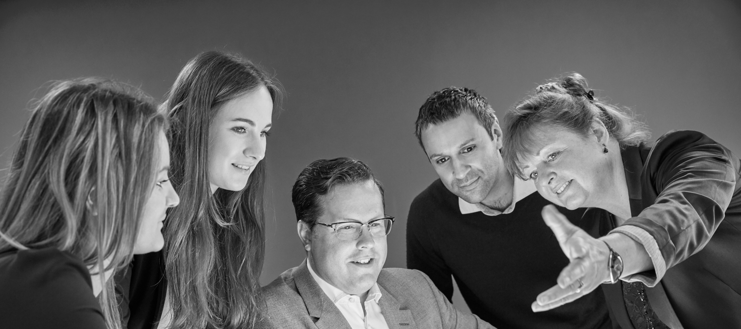
May I introduce myself
Helen Loomes FSLL
Business Development Director
International Projects
Akademie Presenter
Fellow of The Society of Light and Lighting

Slide 4
A GUIDE FOR WORKPLACE LIGHTING
WHAT IS LG7?
HELEN LOOMES

Slide 5
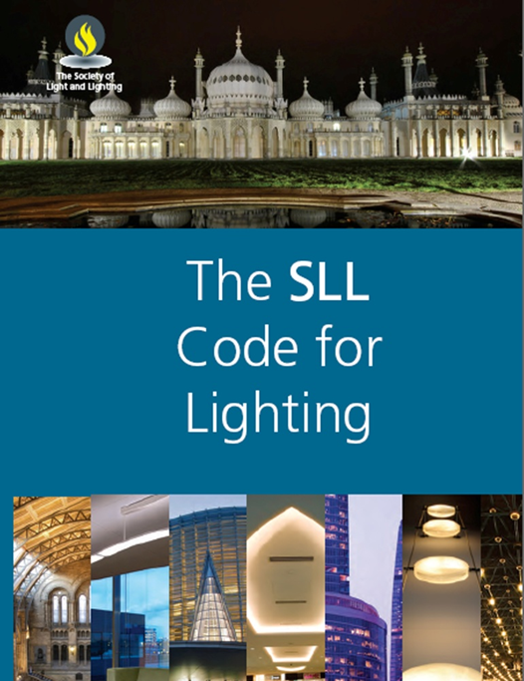
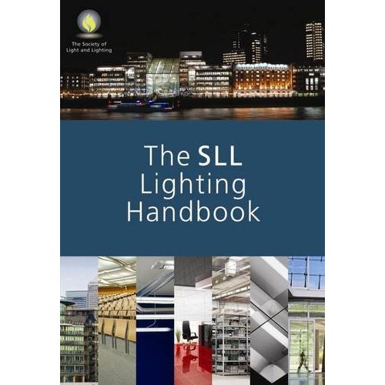
Published by the society of light and lighting part of cibse
Notes:
It is one of a series of publications written by the Society of Light and Lighting (which is part of CIBSE). They produce the Code for Lighting, The Handbook and …….

Slide 6
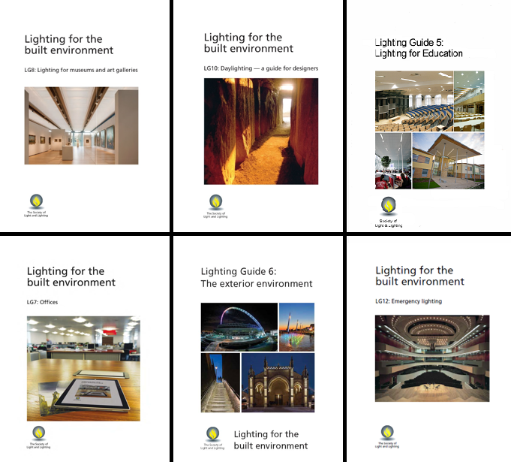
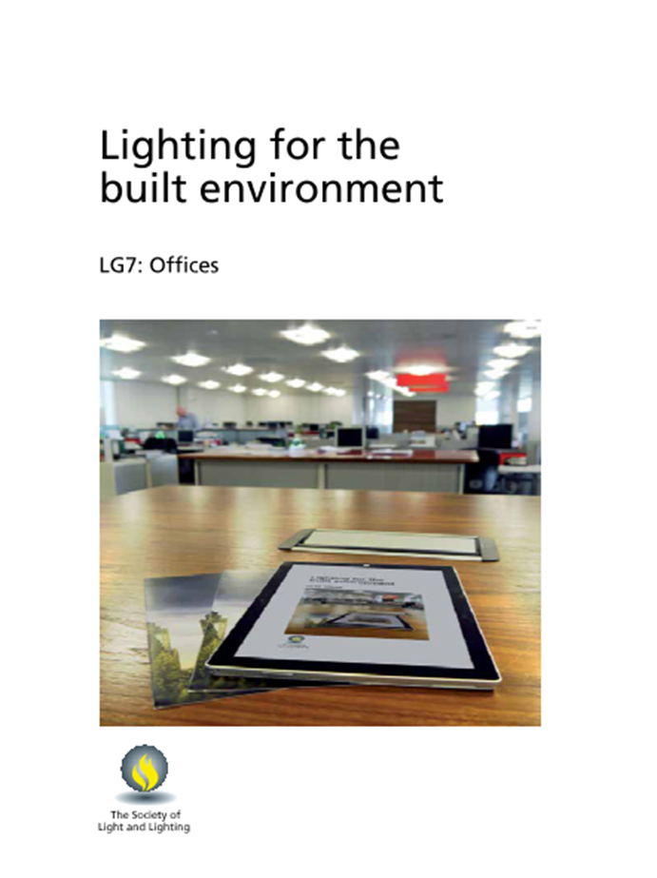
Notes:
....a whole range of guides for different applications. This particular guide to ‘Lighting for the Built Environment’ concentrates on offices.
Published in October 2015, it is primarily intended to provide guidance to those responsible for the design, installation, commissioning, operation and maintenance of building services. It will be necessary for the users of the guidance to exercise their own professional judgement when deciding whether to abide by all or depart from it.

Slide 7
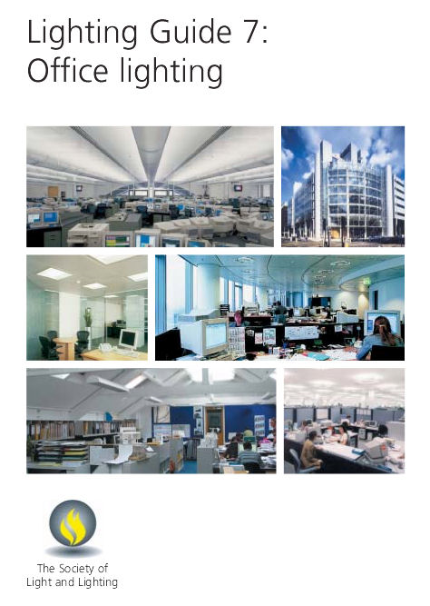
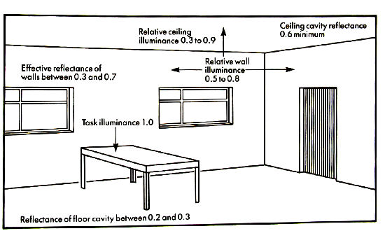
Previous edition of lg7
Notes:
It has been 10 years since the previous edition was issued when we were encouraged to think about vertical surfaces, contrast on the ceiling, the task and uniformity all while minimising energy use and maintaining a good visual environment for the occupants. This was nothing new, the previous 4 issues of The Code for Lighting showed this diagram in one form or another.
Whilst only a guide, LG7 was referred to in Part L of our building regulations, so it became something that should be ‘complied to’ - this resulted in some elements taking precedence over others i.e. ratios of ceiling luminance versus task levels and uniformity.
There is no such thing as an LG7 compliant luminaire.

Slide 8
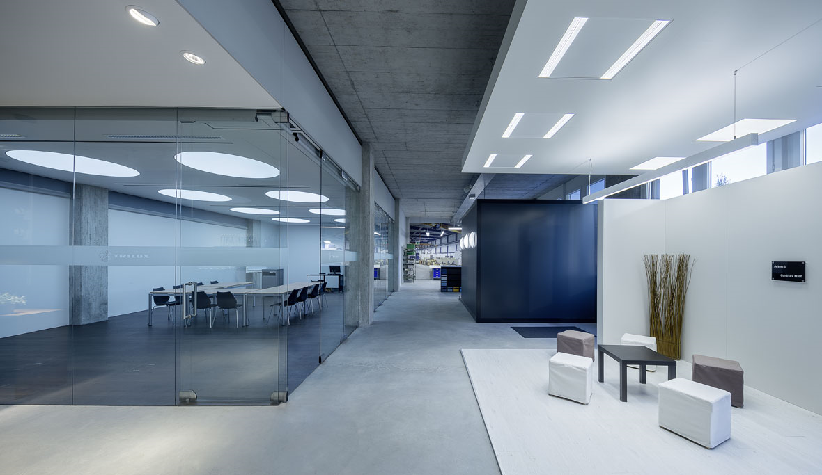
Notes:
The new guide tries to redress the balance. Where uniformity, both of the ceiling and the task, became all important, we can now use discretion and understanding of the space to create a more interesting visual environment and to not be afraid of the resultant slightly darker spaces.
The new guide also reflects the changes made to the European Standard for Indoor Workspaces (EN12464-1) and the SLL Code for Lighting, giving options and suggestions on how to use these standards.

Slide 9
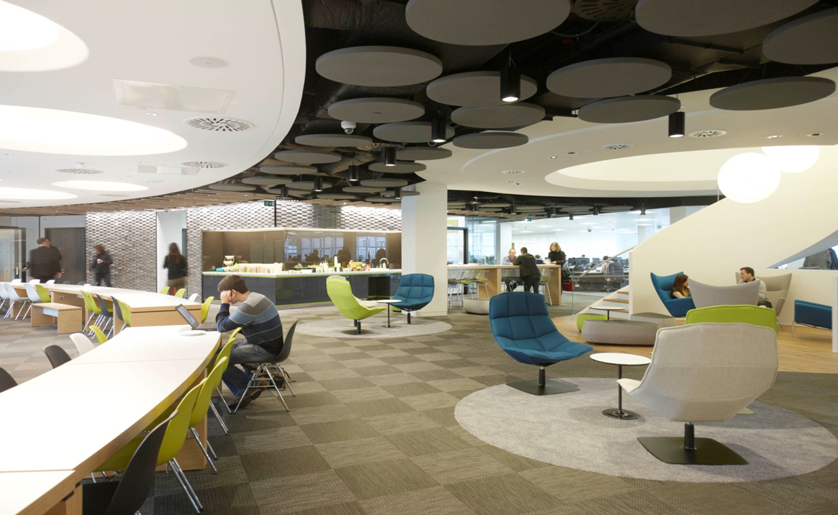
Skype HQ
GIA Equation
Notes:
The way we use office spaces has changed considerably in the last 10 years. Hot desking is no longer unusual and our use of desktop computer screens has also changed.
The modern office has to contend with laptops and tablets, informal discussions, telephone conference meetings or, at the other extreme, multi-screen work stations.

Slide 10
WHAT IS THE TASK?
?
Notes:
This simple question results in many more questions
Who is the user (an end client, a tenant or unknown)?
What function will they be doing?
Is it only screen based?
Is it the size of a desk or an A4 piece of paper?
Is it a fixed location?
Is it meeting based?
Formal or informal?
Or is it a speculative office where the whole space could be used for anything?

Slide 11
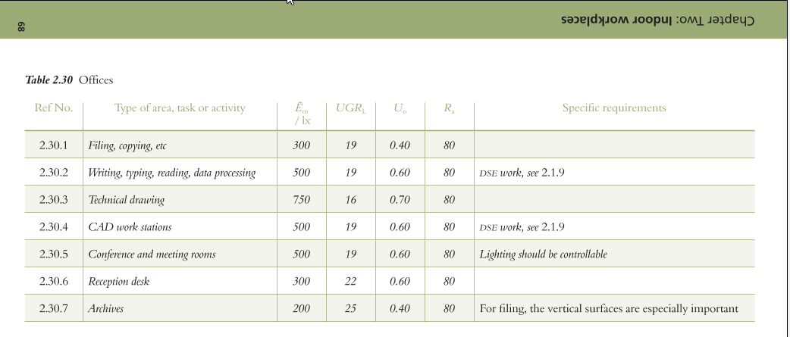
Correct levels for the task
Notes:
The ideal is to know the answers to all of these questions, look up the task in the tables, find out what illuminance levels are needed and go onto the next step.
But the reality is that one or more of the answers will not be known.
The new LG7 offers many considerations in these situations which could help to reduce the light levels and therefore energy consumption. So more of this later….

Slide 12
Lighting the task
HOWEVER THERE ARE MORE ASPECTS WE MUST CONSIDER
Example of illumination of desk area
Task area
Ēav ≥ 500lx U₀ ≥ 0.60/0.70
1,60
Surrounding area Ēav ≥ 300lx U₀ ≥ 0.40
min. 3m
0,80
Backround area (if necessary) Ēav ≥ 100lx U₀ ≥ 0.10
min.0,50m
min. 3m
12
Notes:
Assuming task is known we can decide what light level is needed over the defined area. The area surrounding this can be lit to a lower level as it is not so critical. This change to a lower level should be barely perceptible so we use the Scale of Illuminance to define what it should be.20 30 50 75 100 150 200 300 500 750 1000 1500 2000 3000 5000
If the task is 500 lux the immediate surrounding area can be 300 lux for a distance of 0.5m. Beyond this is the’ Background’ area which is usually circulation space, here the levels can drop to 33% of the ‘Surrounding’ area. This careful application of light can result in high energy savings but also creates a more visually interesting space.
However, there are other aspects we must consider.

Slide 13
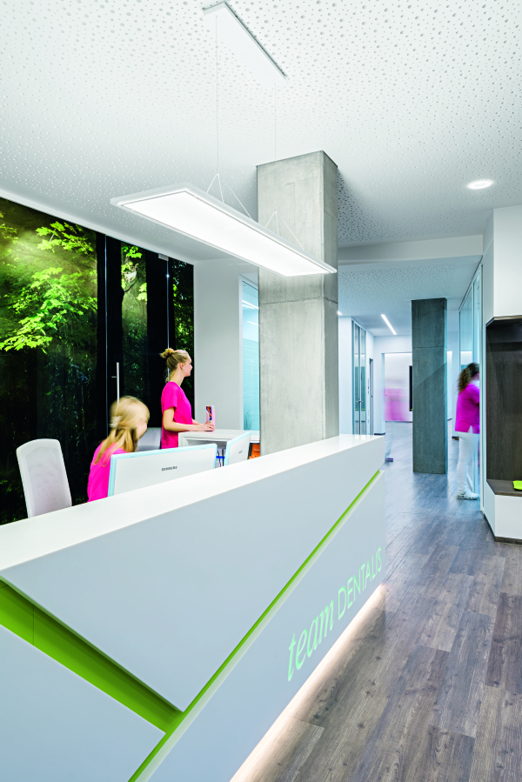
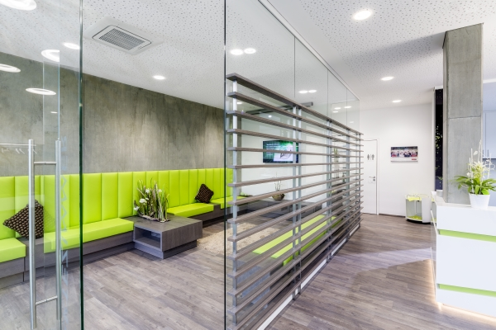
VERTICAL SURFACES
Notes:
Anyone sat performing an office task needs to regularly look into the distance to avoid eye strain. A long distance view is ideally out of a window but a far wall will also work. Therefore we should consider the lighting of internal surfaces including the ceiling.
The guide has minimum recommended levels and as the illuminance of walls and ceiling is no longer a percentage of the task light it is much easier to achieve: These are 75 lux on the walls and 50 lux on the ceiling, but it does advise that if there are no windows providing the long distance view higher illumination levels should be considered.
LG7 also gives guidance on balancing the light within a space so if there is a lot of daylight the contrast between window and the window reveals or surrounds should be considered, or adjacent walls might have to lit to a much higher level than the minimum.

Slide 14
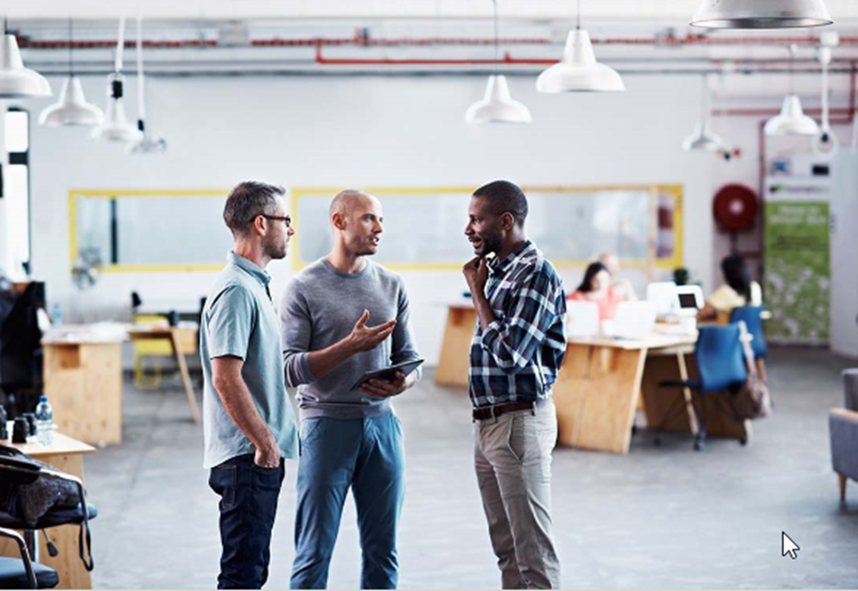
Cylindrical Illuminance
HELEN LOOMES
Notes:
Another vertical surface that is visually important are the faces of the occupants. Communication is an essential part of most people’s daily work and our facial expressions convey a lot of information.
Consequently it is now as important to address the illumination of a person's face as their working area, at a height of the normal sitting position 1.2 m and the normal standing height of 1.6 m. The preferred reference being the Cylindrical Illuminance Measurement.
However modelling also comes into this which is the balance between diffuse and direct light onto the face. Having a mixture of the two types will help to define shapes, contours and texture.

Slide 15
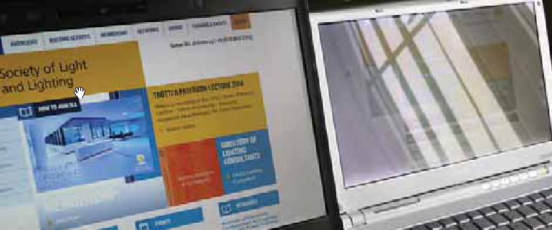
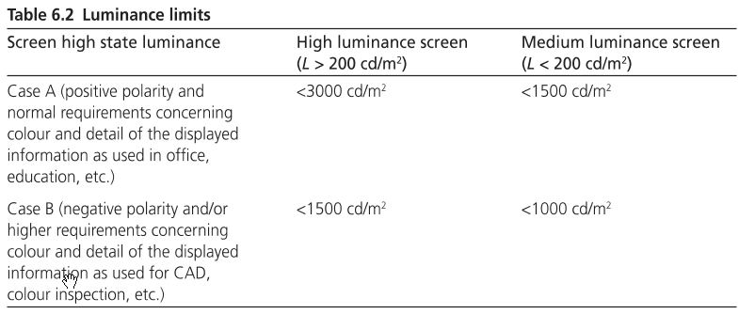
GLARE
Notes:
Discomfort or disability glare can be difficult to resolve if not considered early enough. This can come from windows, luminaires or reflections, which is getting harder to deal with if there is not a fixed task area i.e.. Hot desking, and the use of mobile devices.
The main object of a lot of glare in early years has now got easier. Computer screens have improved considerably so veiling reflections are not such a problem, but the new trend for glossy screens does bring this back into focus.
The guide mentions this and other issues to be wary of - there is a whole chapter on Tablets and Touchscreen Displays.
But all light is the source of glare and LED’s bring a new set of problems. LED’s are small area point sources and are getting more powerful every month. The control of this light source is critical but not impossible and the traditional methods of diffusers, reflectors and refractors are still just as effective – check the photometric data.

Slide 16
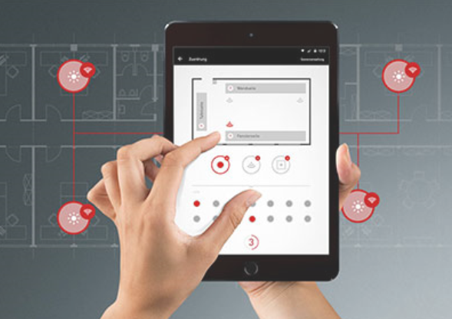
LIGHTING CONTROLS
Notes:
Building regulations in the UK acknowledge and encourage the use of automatic lighting controls. The guide offers explanations of different types of control and when it is appropriate. It also touches on making the operation as simple as possible so that the end user understands it and perceives that it is working with them. If they feel it is working against them they are more likely to disable it in some way.
The guide explains the principles of Constant Illuminance with the objective of not over illuminating a space initially and gradually increasing the output of the luminaire to compensate for lamp deterioration.
This can have a significant saving in energy use and overcomes the problem of what maintenance factor to use.

Slide 17
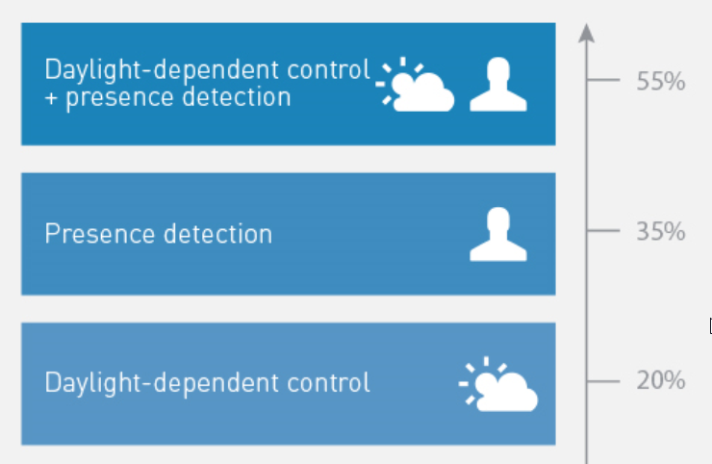
ENERGY USE
Luminaire Lumens per circuit watt Lighting Energy Numeric Indicator - LENI
Daytime + night time + parasitic loads
= kWh / m²
Floor area of the building
Notes:
The impact of energy use must be considered when designing an office lighting installation.
Building regulations across the UK require that the energy used by building be controlled within specific energy targets. Many organisations insist that the building they occupy has an environmental assessment rating such as that offered by the U.K.'s Building Research Establishment Environmental Assessment Method (BREEAM) or by LEED controlled by the US Green Building Council.
This can be achieved by not over specifying the number of luminaires, using effective lighting controls and using efficient luminaires.
The guide also explains how this can be assessed, either by using Luminaire Lumens per circuit watt, with a correction factor for utilising control systems, or by LENI.

Slide 18
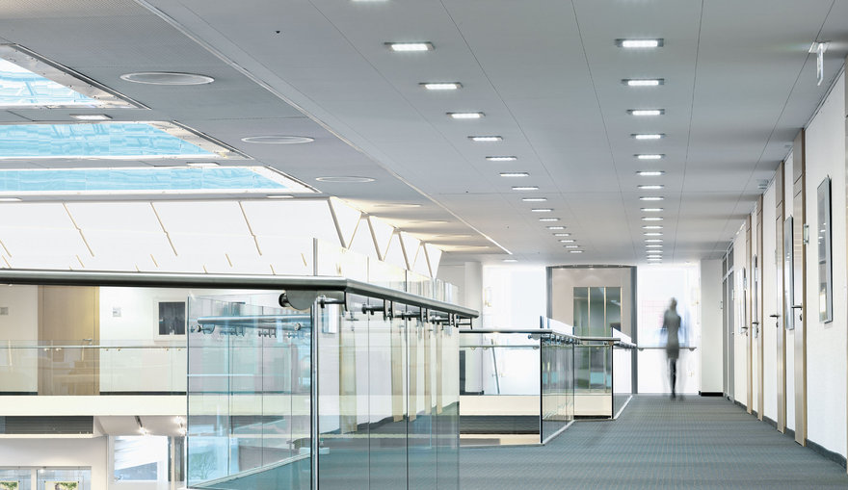
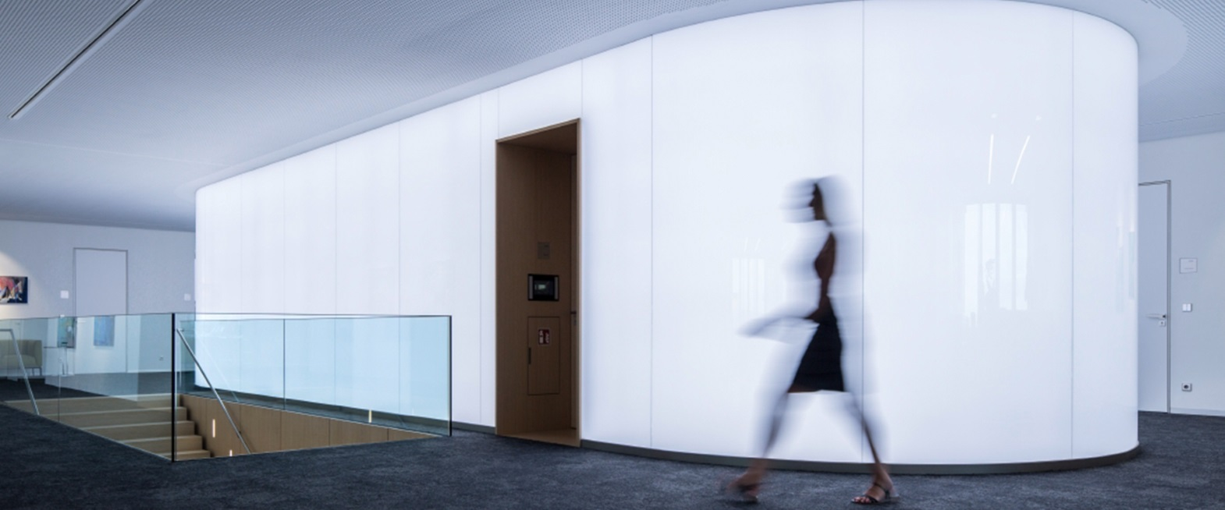
OTHER INFLUENCING FACTORS THE ARCHITECT
Notes:
The contribution of other members of the design team will have a big effect on the eventual lighting scheme and early collaboration is always recommended.
The architect will have an influence on the daylight entering the space and will have strong opinions on the overall look that is to be achieved.
There is a whole chapter on daylight and it is to be encouraged as a free source of energy and illumination, but uniformity into a deep space is difficult and therefore it has to be balanced with artificial light.
Glare can be a problem and various methods to control glare are discussed along with the resultant measures to bring back the balance.

Slide 19
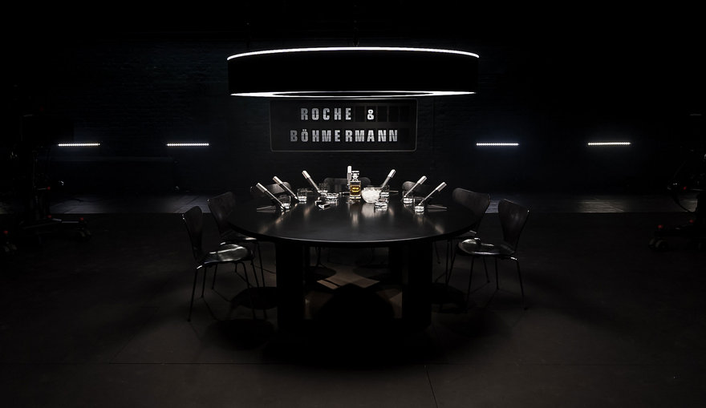
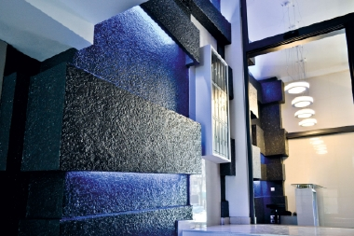
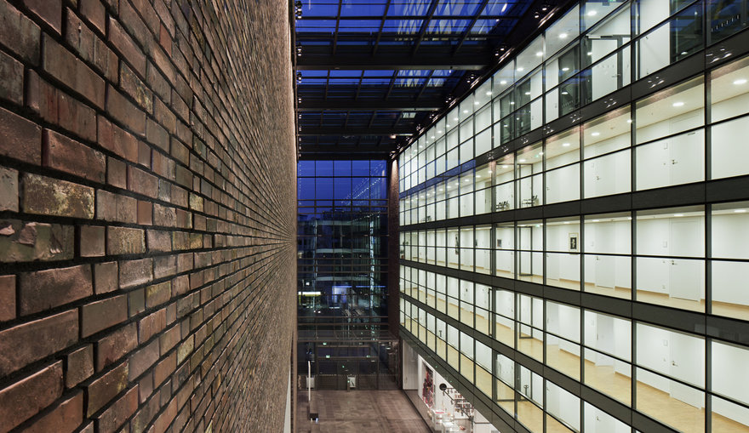
OTHER INFLUENCING FACTORS THE INTERIOR DESIGNER
Notes:
The interior designer will need to understand that extremes of colour and texture will have very different effects on the lighting.
There are recommendations for the reflectance factors of walls, ceilings and floor and it is important to understand how big a difference this can make.
The visual impact is still important so in some instances we need to work around a fixed problem; i.e. in historical buildings.
Techniques can be used to bring texture to life such as wall washing or grazing, and the colour temperature or colour rendering of a lamp might be dictated by the colour of the interior.

Slide 20
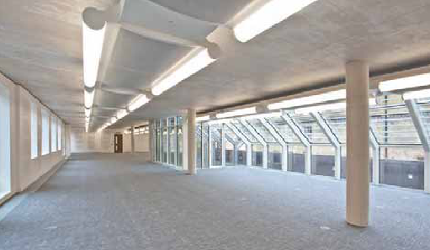
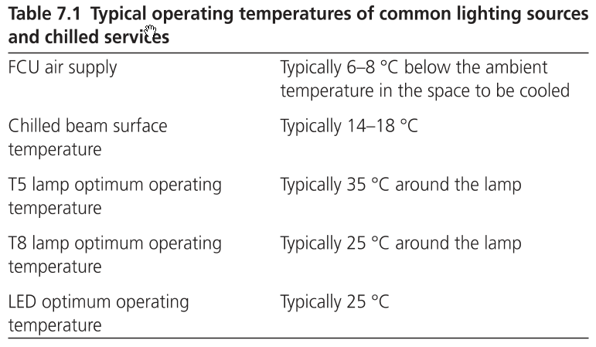
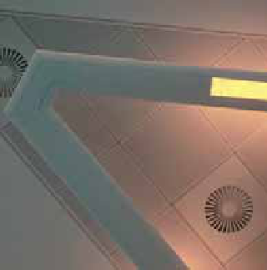
OTHER INFLUENCING FACTORS ENGINEERS
Notes:
The structural engineer or HVAC engineer will also have an influence on ceiling voids and the space that is available for luminaires. These spaces are getting tighter with more and more equipment being installed, so we need to understand the impact this will have.
Temperature is a critical factor for most luminaires, whether LED, fluorescent or discharge so air circulation will need to be considered. The chilled beam concept is becoming increasingly popular in office developments and integration of other cooling methods i.e. air handling luminaires is also common.
The new LG7 has a chapter on the integration with mechanical services that will be of interest to many building service engineers.

Slide 21
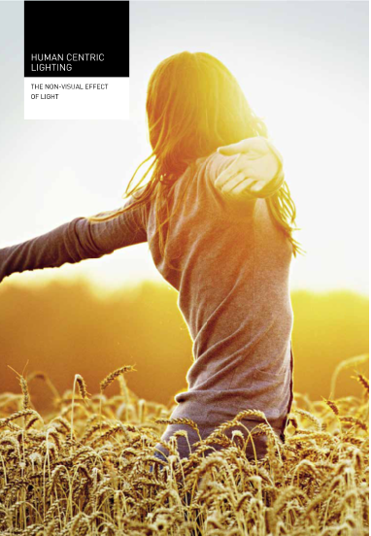
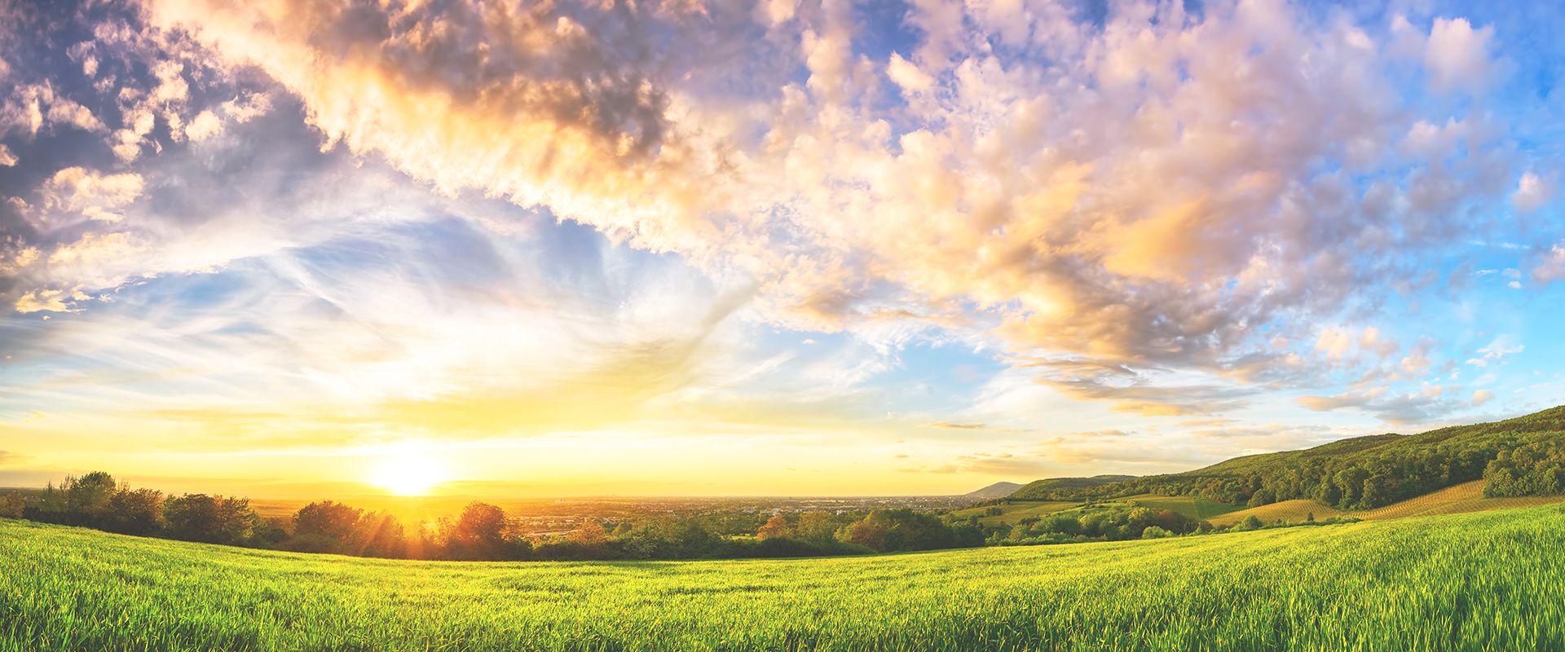
HEALTH AND WELLBEING
Notes:
The guide also touches on providing well-designed lighting to consider health and well-being.
While it can be relatively easy to design a lighting scheme that only illuminates a designated task area and cuts energy used to a minimum, such a scheme would ignore the occupational health and well-being of the user.
Background lighting and illumination of walls and ceilings will clearly use energy but such elements of the lighting design should not be omitted simply to satisfy energy saving goals.
Lighting can have a positive or negative impact on the occupants of an office. Our bodies are used to the lighting around us changing as the day progresses. Daylight is constantly changing due to sun position, height and intensity, as well as colour, particularly at the beginning and end of the day. Cloud cover can make such changes appear relatively quick and random.
It is possible with the appropriate control system and associated luminaires to mimic, in some degree, the change in sky and the lighting diversity it brings throughout the day - the theory being that this will have a positive impact on the occupants well-being.
While such systems are not common they may be appropriate in some situations.

Slide 22
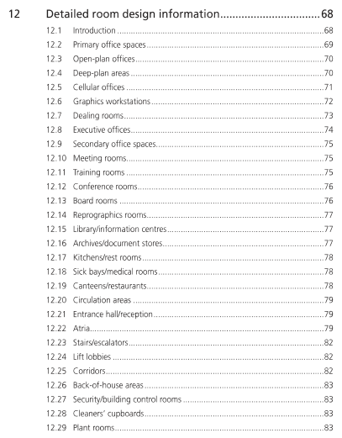
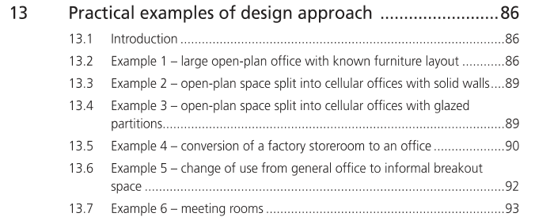
THE SPEC OFFICE
Notes:
There are detailed solutions for all office types and shapes, including the thorny subject of the speculative office development.
It shows how assumptions can be made to deal with balancing daylight, where a nominal corridor and break out spaces might be, how to cope with subsequent positioning of partitions and many other useful hints when designing a lighting scheme.

Slide 23
A practical example
Case study
Notes:
So lets look at a practical example

Slide 24
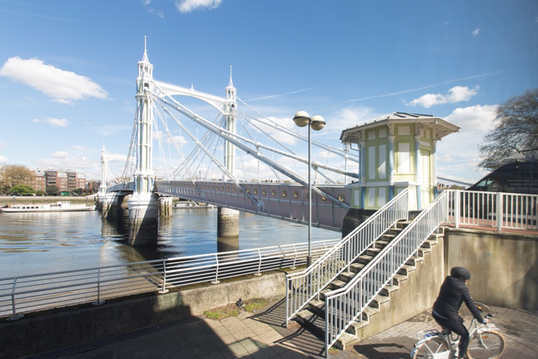
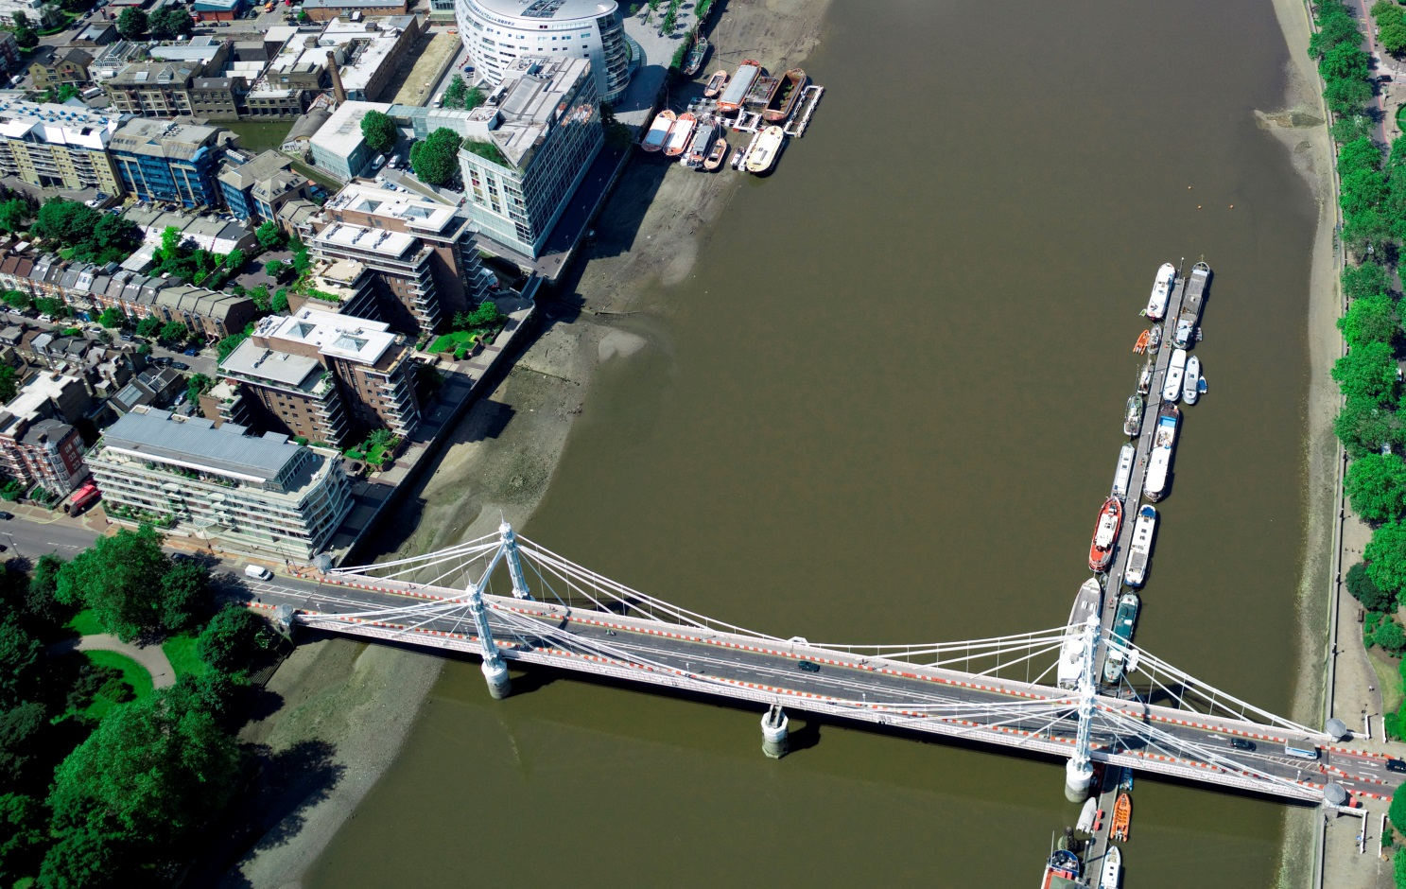
albert bridge house foster + partners
Notes:
A stunning Thames-side location with an unusual challenge gave TRILUX Lighting the opportunity to work with Foster + Partners on an office fit out which is part of their own London campus.
Located right next to the historic and very decorative Albert Bridge with views over the river and Battersea Park, this small office needed to reflect the values of Fosters with a calm, unobtrusive attention to detail.

Slide 25
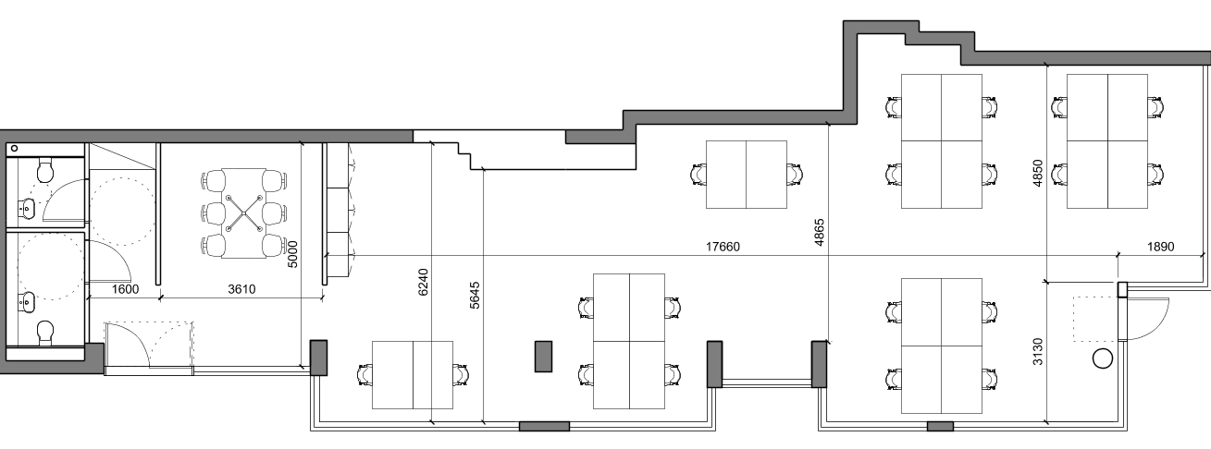
Notes:
Fosters were willing to depart from the norm and totally embrace the new LG7 (EN12464) ideals of just lighting the task without going for uniformity across the entire office.
We were fortunate in knowing where the desks would be but other items of furniture did change throughout the project.

Slide 26
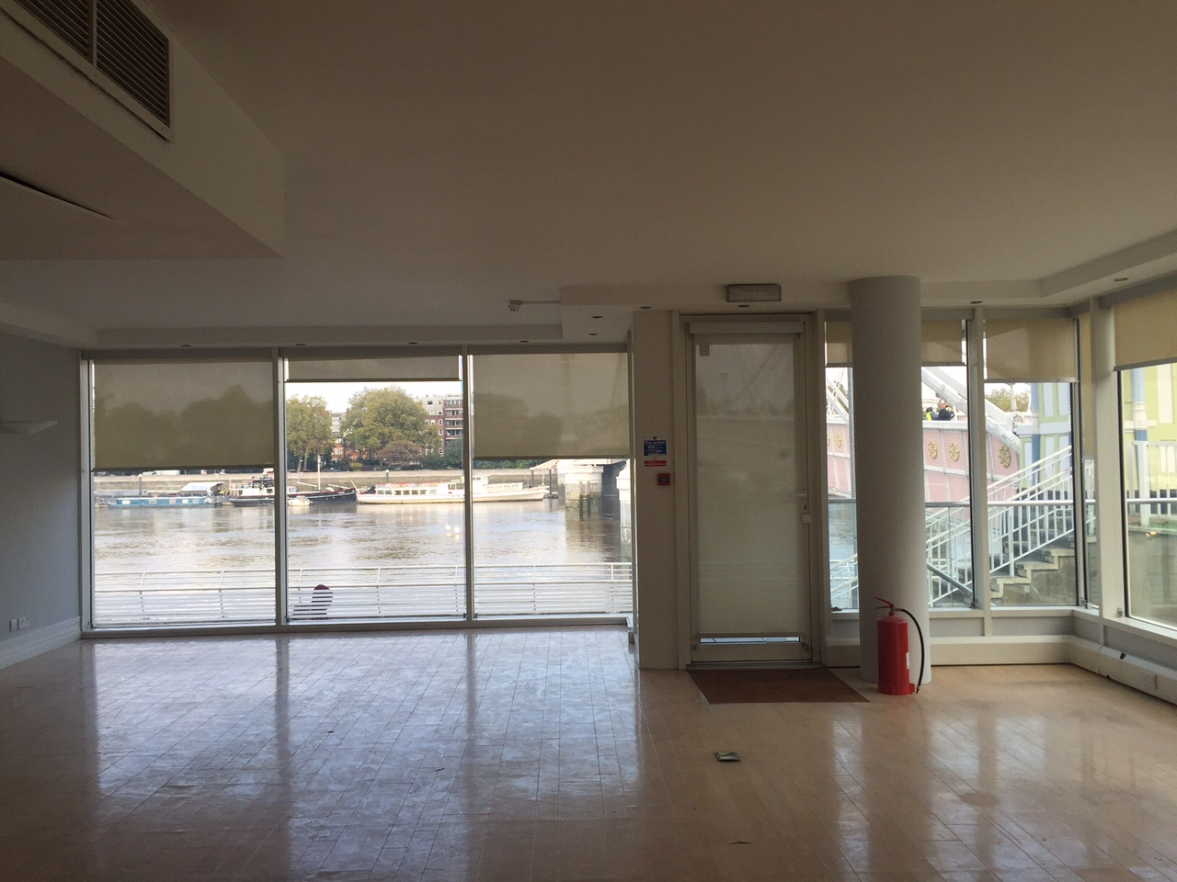
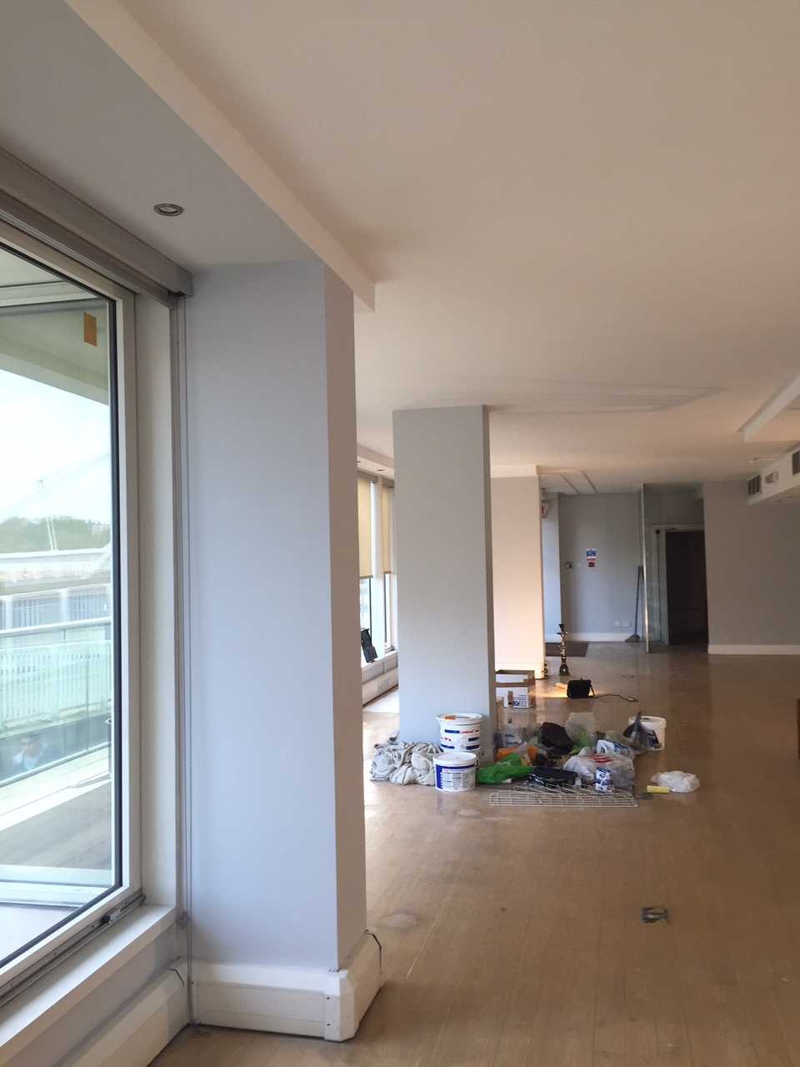
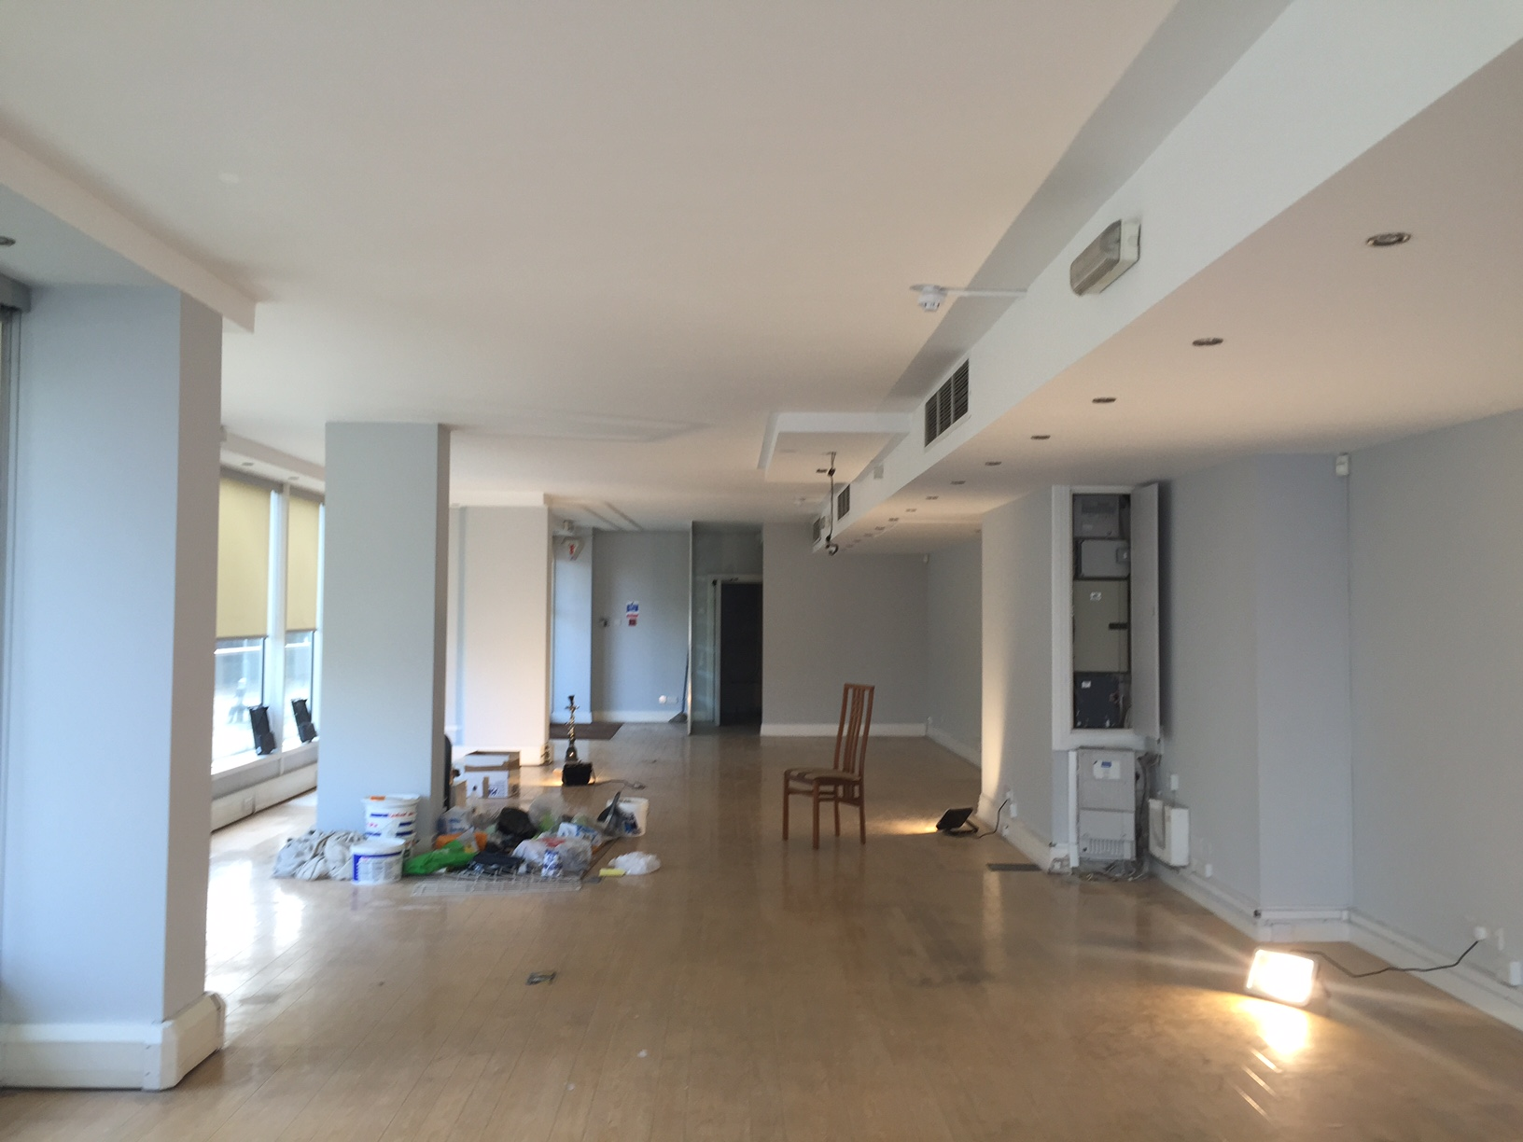
Notes:
The original concrete ceiling was to be kept and everything would be surface mounted. So we went through a variety of options from suspended direct/indirect to track mounted products as well as surface mounted circular fittings , but everything required conduit including the sensors, emergency fittings and CCTV.
The architect was very unhappy with all of the clutter on the ceiling and he decided to put in a suspended ceiling.

Slide 27
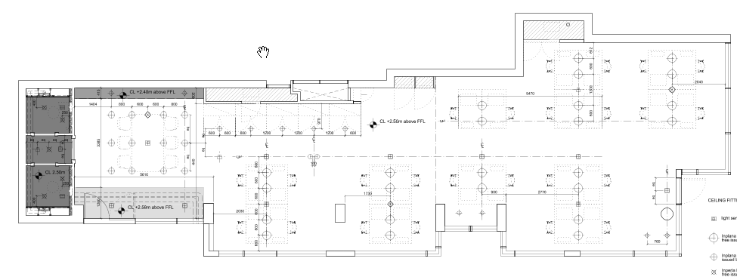
Notes:
The final scheme utilised the Trilux Inplana in rows of four over the desk areas and created a differential in space by having a grid of 9 slightly smaller ones over the conference table.
Vertical surfaces and cylindrical illuminance were considered along with balancing the internal wall illumination with the considerable amount of daylight coming through the two adjacent walls of glass.
Interest was added by using the Oktalite Quad recessed luminaire along a wall of cupboards …..

Slide 28
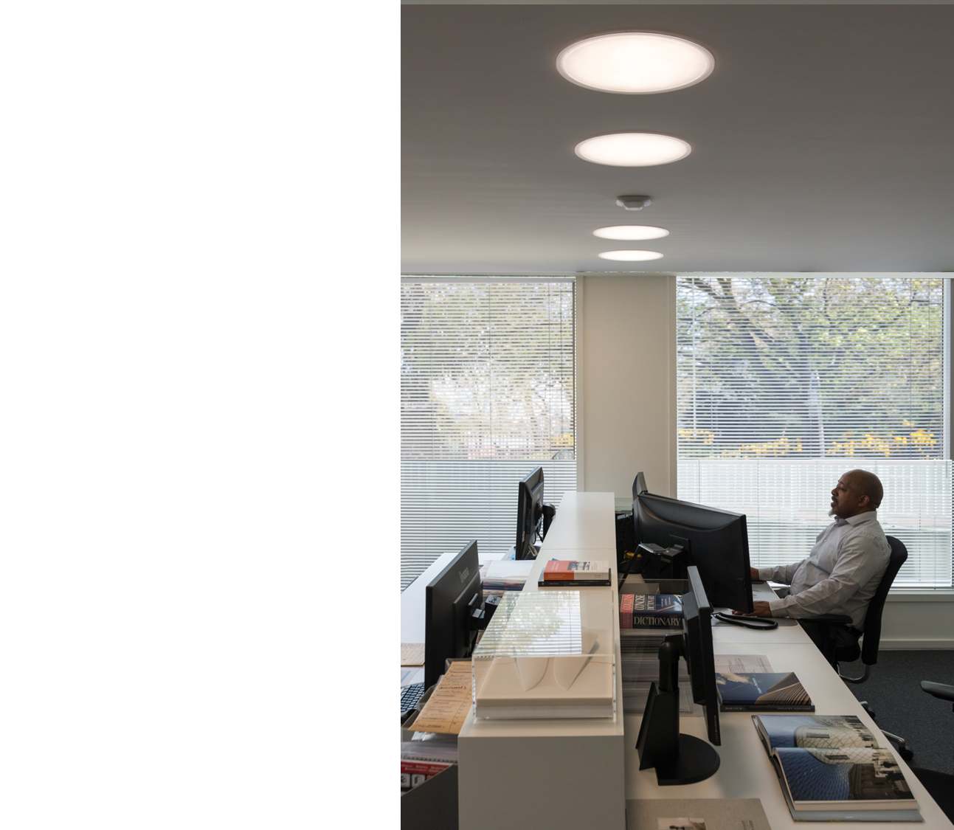
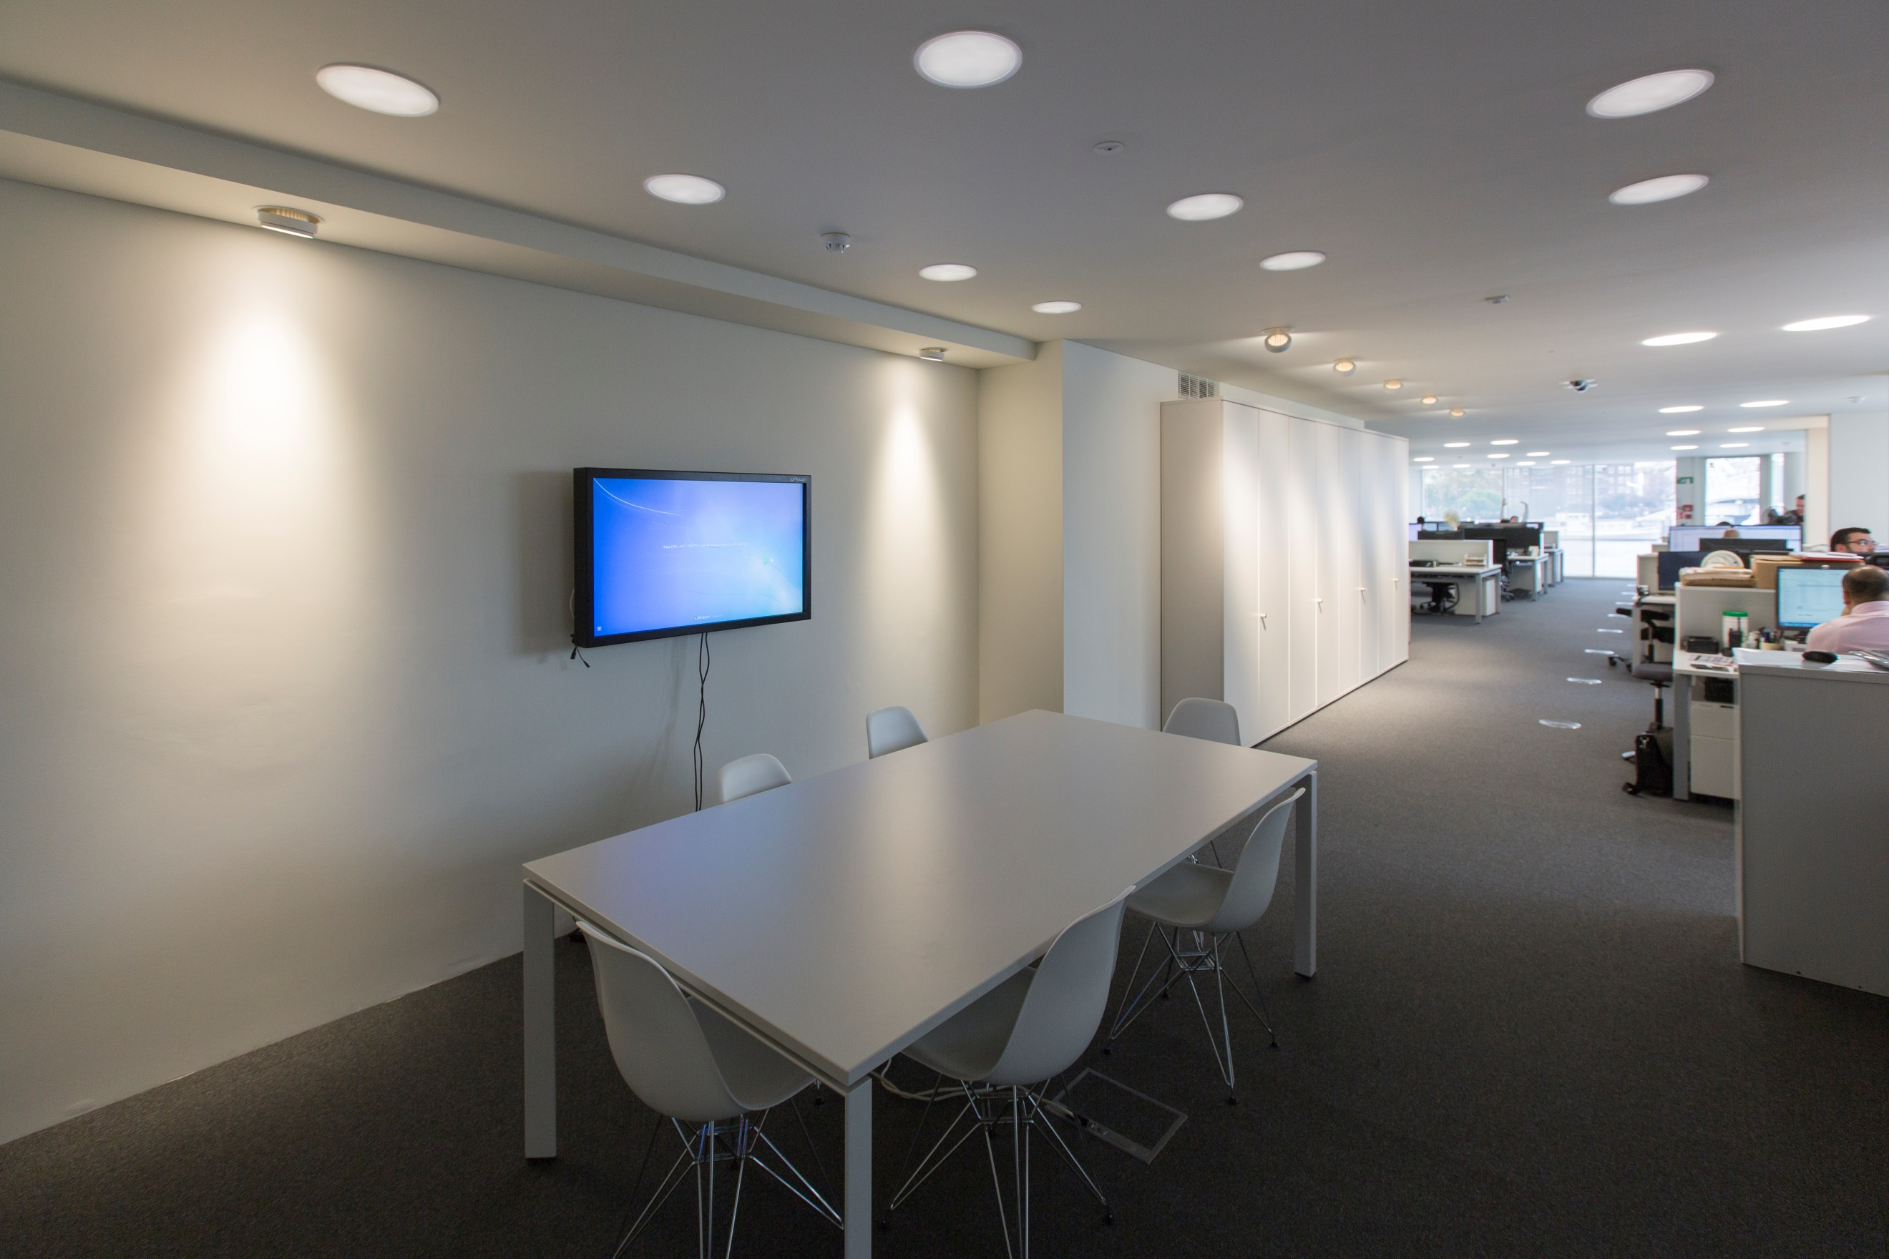
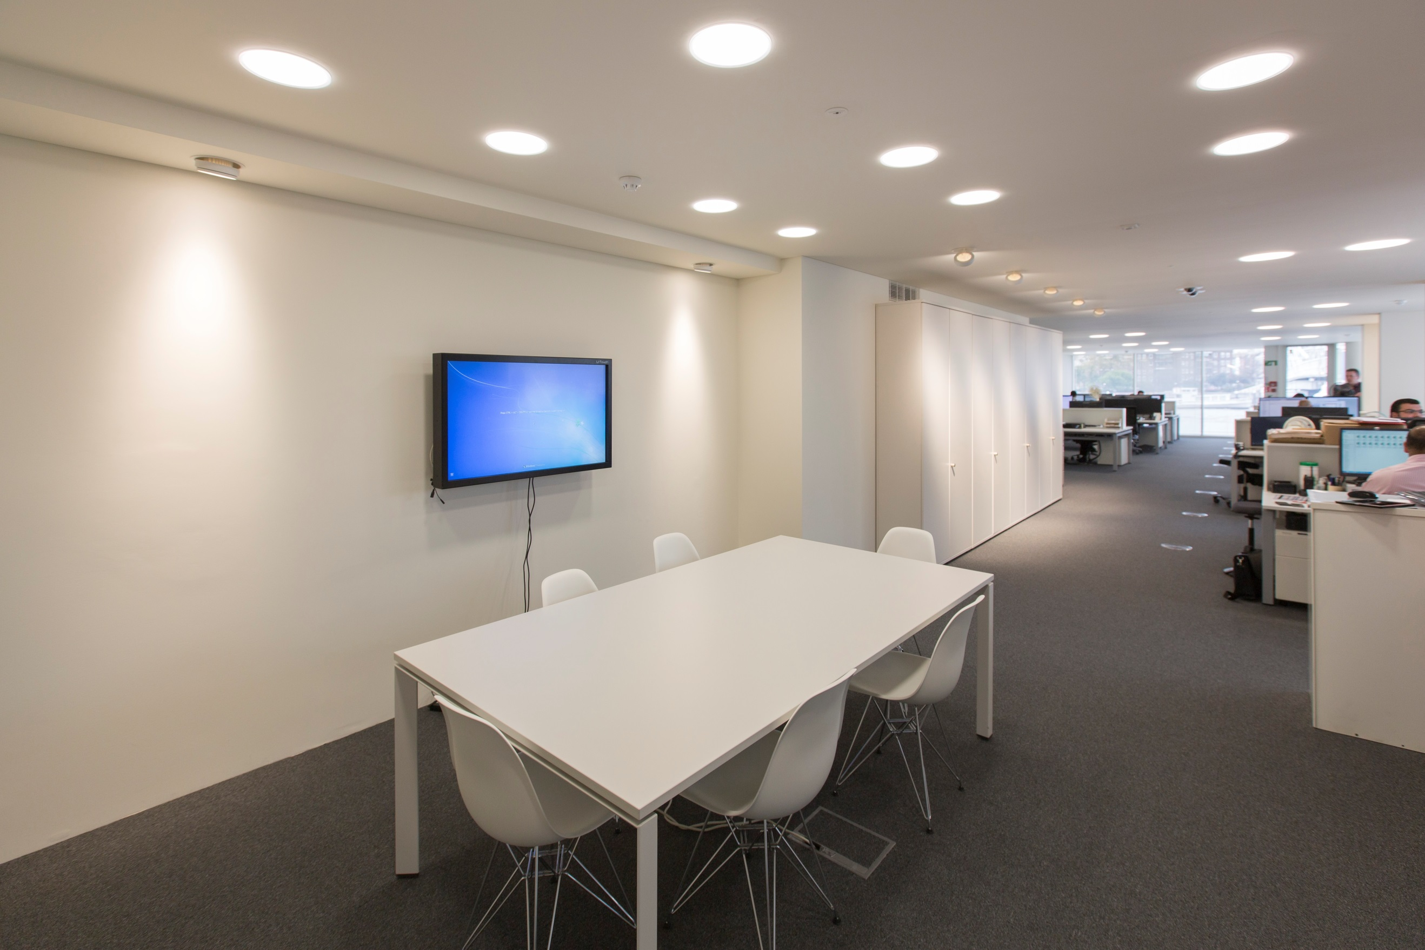

Slide 29
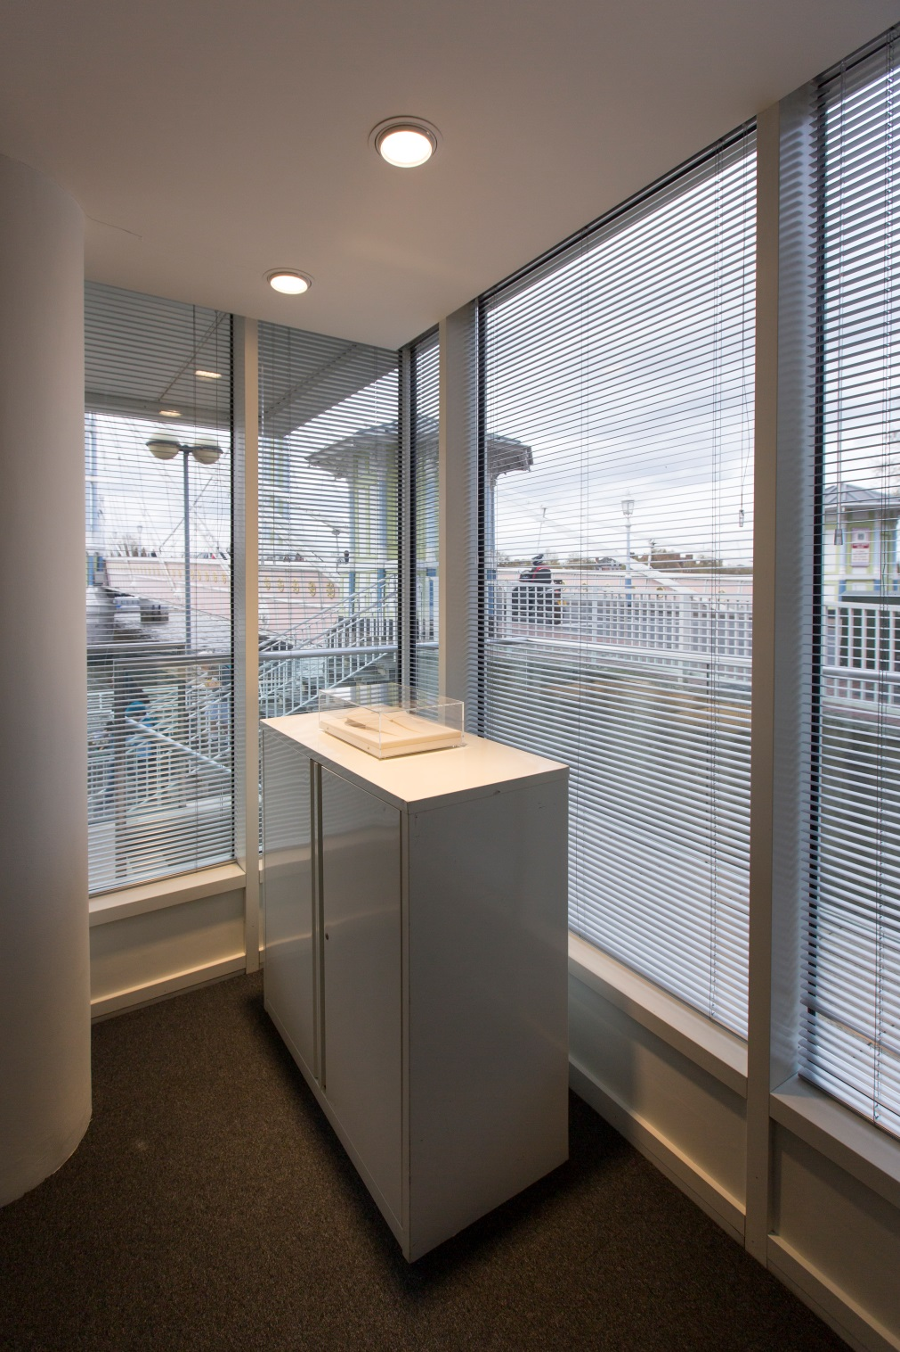
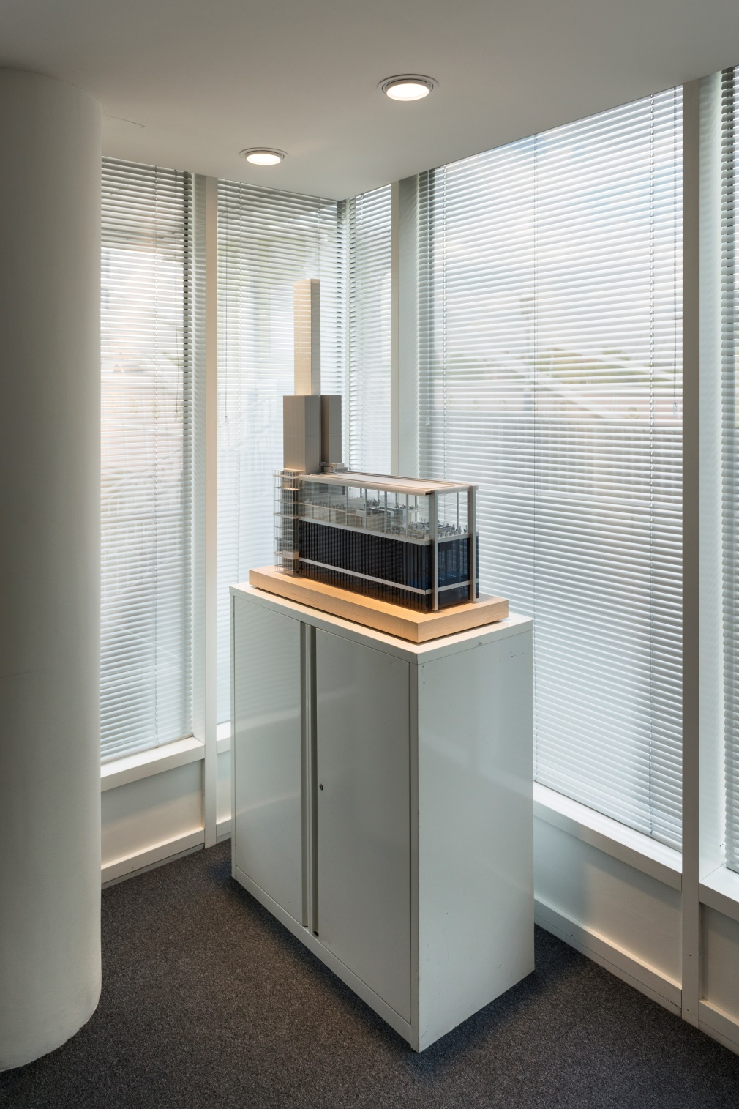
Notes:
The same Quad adjustable downlight provided high levels of accent light in 2 awkward corners which can now be used for display purposes.

Slide 30
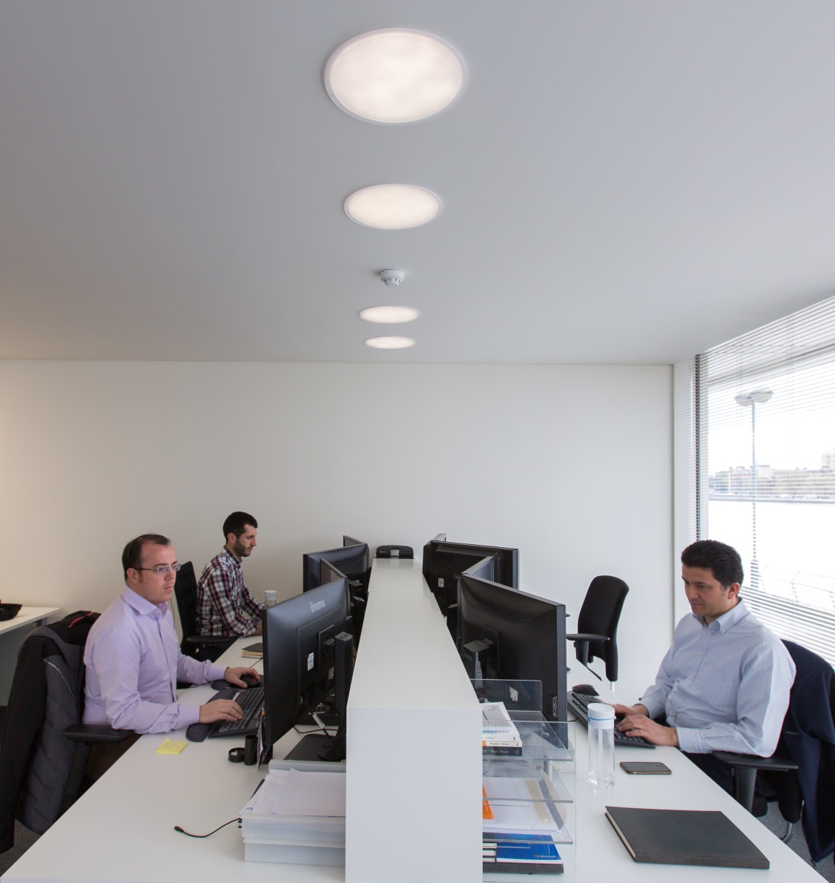
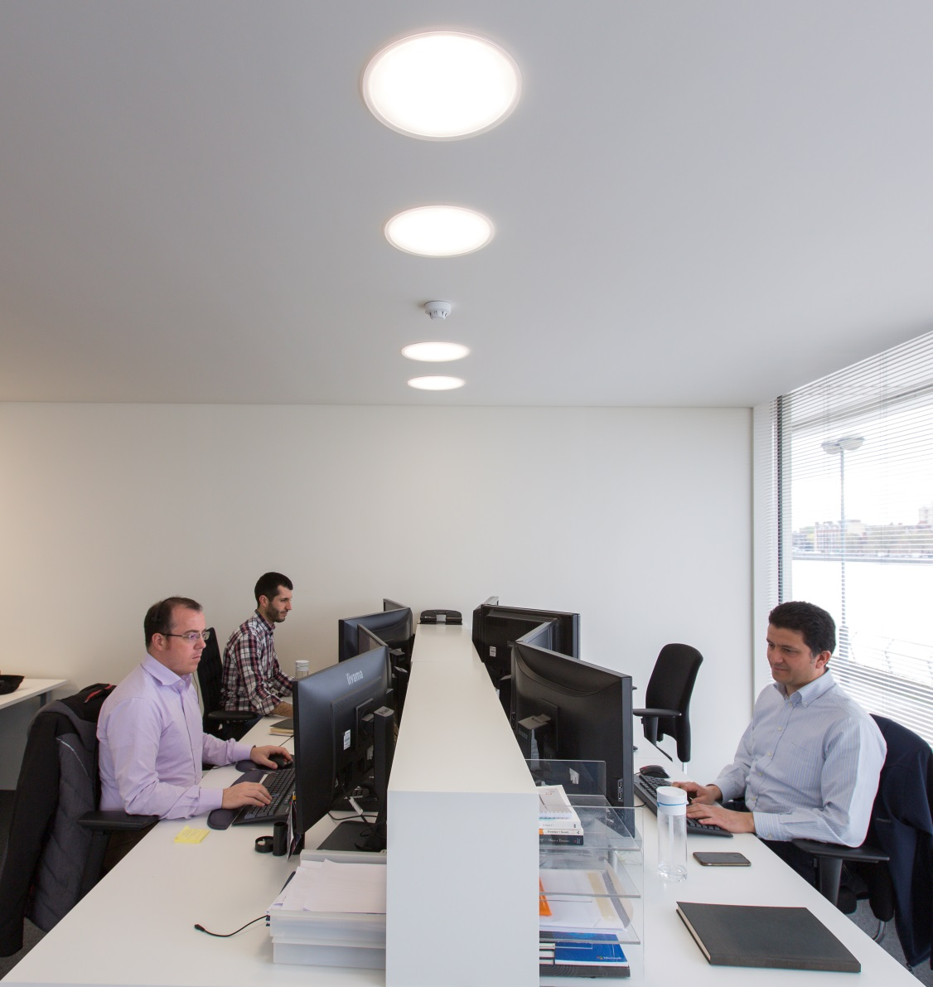
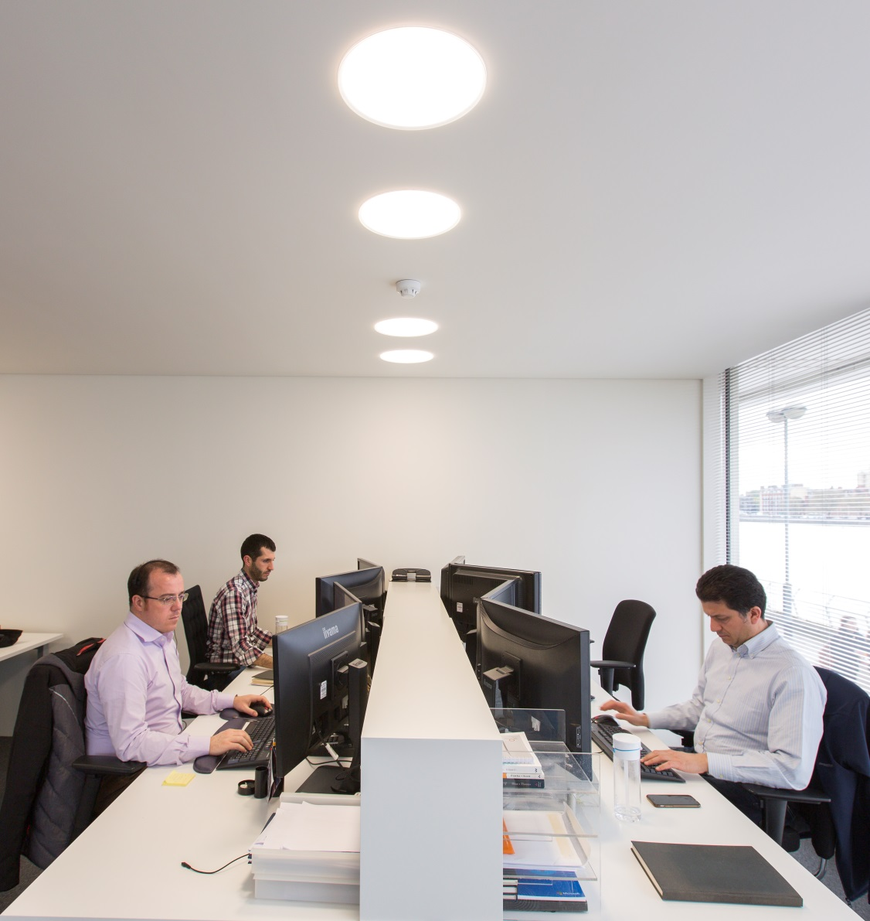
Notes:
The whole scheme is controlled by the new LiveLink wireless control system.
This allows the occupants to select their required lighting scene either from their smart phone or from pushbuttons on the wall.
As this system is so easy to commission it will allow a total change of usage in the future if required.

Slide 31
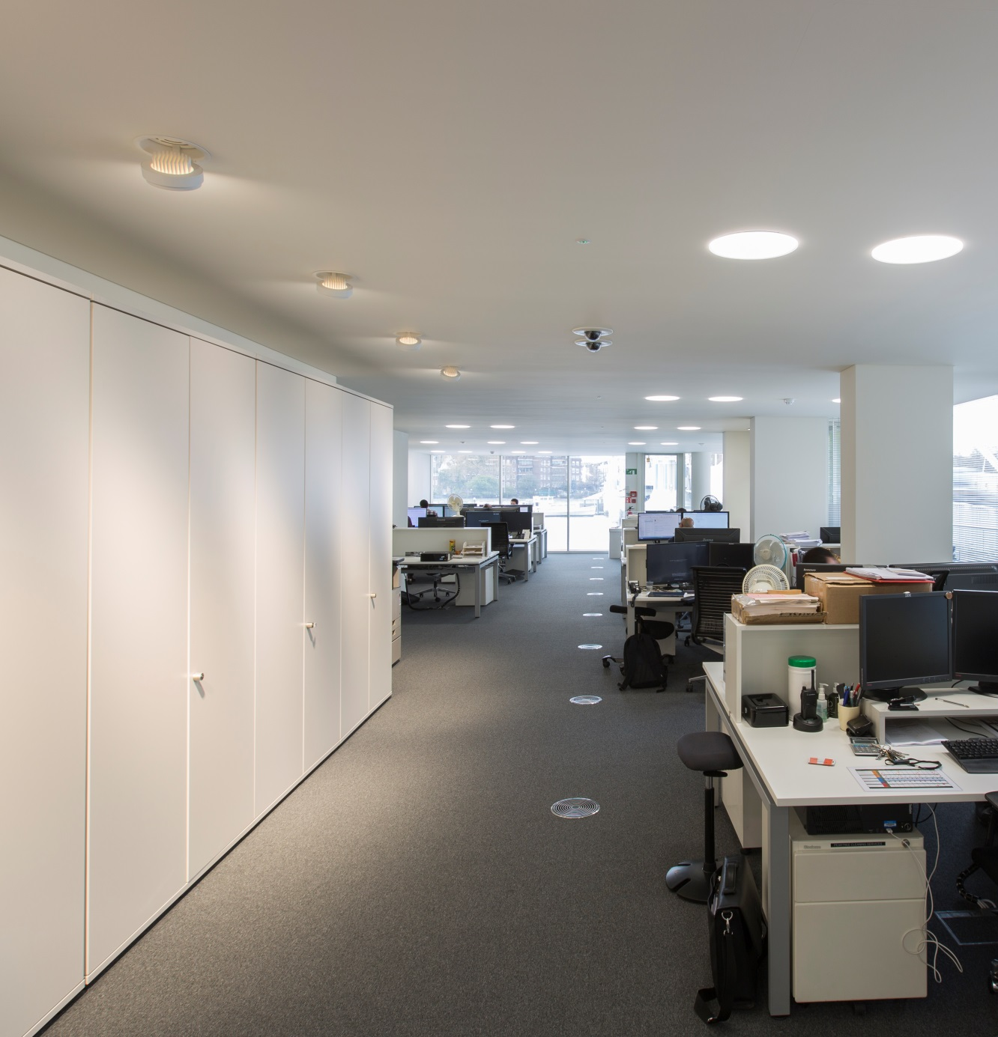
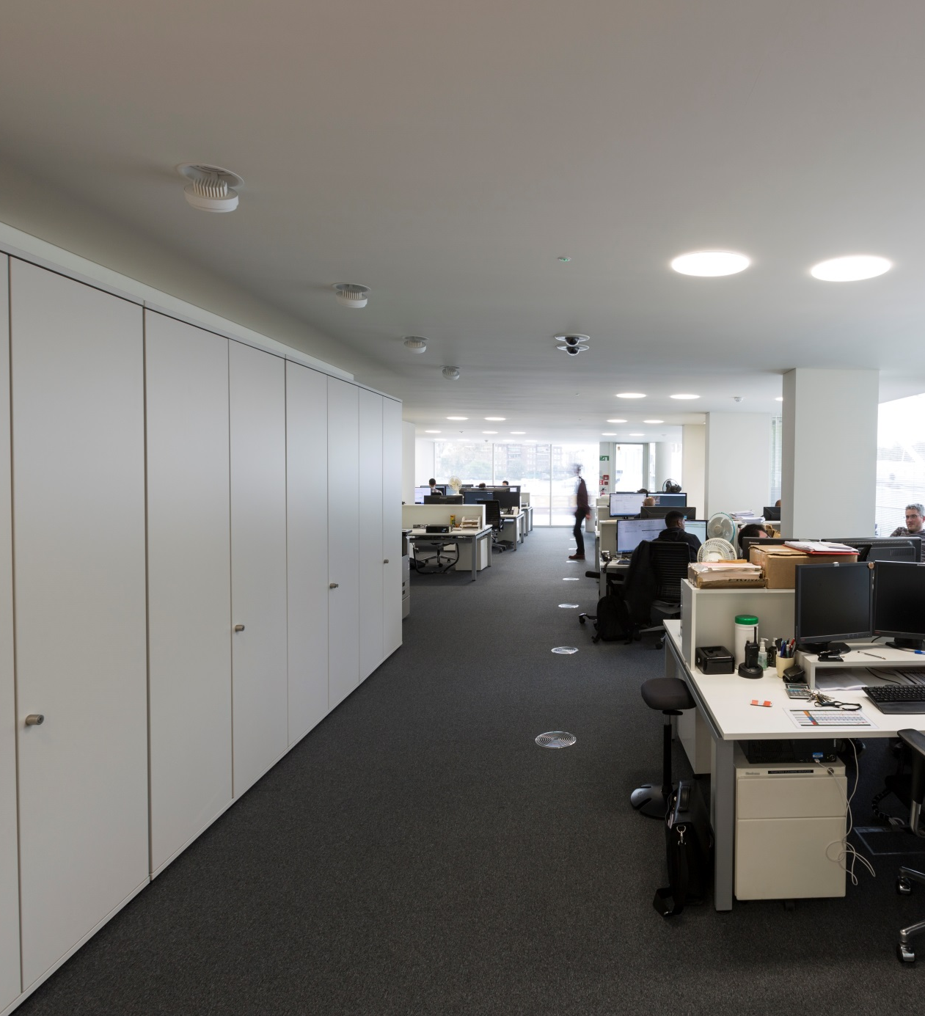
Notes:
These pictures show the big change that lighting the internal wall can make and why LG7 recommends vertical lighting so strongly.
Originally these cupboards were going to be half size so it was designed with a larger offset than we now have, but because the luminaires are adjustable we have been able to adapt; another key message from LG7 – liaise as much as possible with the design team and try to build in adaptability.

Slide 32
WILL YOU READ IT?
Notes:
This document is probably not one that most people will read from cover to cover, but is designed to dip into when needing the answer to a particular question.
It brings the guidance right up to date utilising the most recent legislation and reflects how we now use our office spaces.

Slide 33
THANK YOU FOR YOUR ATTENTION

