Slide 1
Well building standard:
An overview of the requirements for lighting
Notes:
Welcome to the TRILUX Akadamie and this presentation looking at the lighting requirements within the new WELL Building Standard.
Before we start please can I ask that if you have any questions, you should type in a question, we will take note of it and answer them at the end of the presentation.

Slide 2
May I introduce myself
Helen Loomes FSLL
Business Development Director
International Projects
Akademie Presenter
Fellow of The Society of Light and Lighting
BSI and ISO TC
Notes:
My name is Helen Loomes and I am the Business Development Director at TRILUX, looking after International Projects. I also get very involved with the lighting community, sitting on several committees where my prime interest is Human Centric Lighting or non-visual responses to light. Therefore I am watching with care the development of todays subject.

Slide 3
WELL BUILDING STANDARD
Notes:
The bar is being raised in the built environment. For all new buildings having a recognised measure of sustainability or energy efficiency is essential, and is also a good marketing tool for the letting agent, the added attraction of supporting human health is gaining ground. In an increasingly competitive labour market, employee retention has become a prime focus for businesses, and organisations are recognising that their staff are a prime asset that should be cared for.

Slide 4
Notes:
This has led to the launch by Delos Living in 2014 of the WELL Building Standard, the world’s first building certification that focuses exclusively on human health and wellness. This is looking beyond carbon reduction and energy efficiency.
It is worth looking at their website to understand this approach.

Slide 5
Notes:
It is an international assessment method that encourages healthy lifestyles promoting 7 concepts or features: air, water, nourishment, light, fitness, comfort and mind. To gain accreditation a building must pass the minimum requirement's (known as preconditions) in every area, they can then gain a higher rating, silver, gold and platinum, by adding optimisations.
You can also gain points with innovative features. Innovative features pave the way for project teams to develop unique strategies for creating a healthy environment. Innovative features must either address a novel concept or strategy not already included in well.

Slide 6
Notes:
WELL also tries to quantify these benefits, even in monetary terms, which will need the test of time. This makes it very tempting to the development team and reassuring to the accountants, so I am hearing much more about this standard and welcome some of the concepts behind it.

Slide 7
Notes:
BREEAM is a more familiar standard that is now very established and an agreement has just been announced between the WELL Building Standard™ (WELL) and BREEAM that will make it easier for projects pursuing both standards. Under the agreement, the organisations will mutually identify specific credits so that documentation will be recognised by both organisations, saving project teams the time and costs associated with submitting the documentation twice.
BREEAM and WELL are both evidence-based systems that have subsequent on-site post-occupancy performance testing. Continual improvement and the interest of both the environment and people at their heart.
Interestingly they have also said that they will do some joint research, so hopefully this is only the beginning.

Slide 8
Performance features for lighting
Visual lighting design.
Circadian lighting design.
Electric light glare control.
Solar glare control..
Low-glare workstation design.
Colour quality.
Surface design.
Dimming controls and automated shading.
Right to light
Daylight modelling and fenestration.
Notes:
Today I will just concentrate on the lighting Concept.
These are the features within this section that WELL requires
Visual lighting design. Establishes light levels for basic visual performance, acknowledging the balance of ambient and task illumination.
Circadian lighting design. Concentrates on the impact of melanopic (or non-visual) light and the way that illumination meets the eye.
Electric light glare control. Acknowledges that excessive brightness can cause visual discomfort, leading to fatigue, visual impairment and potential injury.
Solar glare control. Provides solutions for managing disruptive glare from sunlight via windows.
Low-glare workstation design. Considered spatial orientation to control excessive brightness at work stations.
Colour quality. Identifies the use of the Colour Rendering Index (CRI) to ensure good colour quality, supporting visual acuity and accurate rendering of colour tones.
Surface design. Establishes parameters for the reflective quality of surfaces, promoting higher reflectance values as a means of reducing energy.
Dimming controls and automated shading. Discusses the introduction of automatic control of lighting systems and shading devices as a means to promote visual comfort within the space.
Right to light. Acknowledges the importance of adequate levels of daylight and establishes a minimum distance from windows for regularly occupied spaces.
Daylight modelling and fenestration. Daylight reinforces the alignment of circadian rhythms and gives figures for minimum values of ‘spatial daylight autonomy’ and percentage values on window sizes .

Slide 9
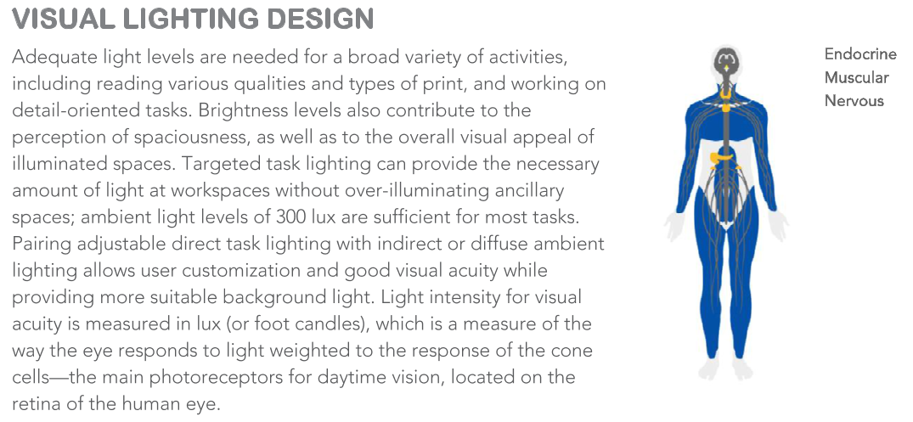
Notes:
I will go into each of the sections as detailed in the guide, some will require deeper explanations than others, and also some are outside my area of expertise, so I will welcome a discussion on these.
Lets start with Visual Lighting Design. The basic concept reflects the requirements of our European and British Standards BS EN 12464. The aim is to create an interesting space that is providing the correct light levels to perform our work, but also not overlighting which has the effect of reducing contrast and taking away the character.

Slide 10
Notes:
The ambient lighting is treated separately from the task lighting. As this is an American standard the required numbers might seem a little odd to us, for instance 215 Lux, this is because the original levels were set in Foot Candles and the height of the horizontal plane is 0.76m which equates to 30 inches. However this is a good background level of light for most situations. The guide also stipulates how this lighting is zoned which will lead into the control systems.
It then recognises that most people will need task lighting of at least 300 Lux but depending on age and health some will need higher levels of 500 Lux. It is good to see this documented as most lighting schemes default to the average human being.

Slide 11
Notes:
Part 2 of this precondition allows a lot of leeway. It asks for a narrative that describes a strategy looking at contrast between various surfaces. This achieves two things: it asks you to look at the relationship between the task and its immediate surround, this should reduce in level but not to the point where it is noticeable or disabling; and it asks you to consider the other surfaces within the room, such as walls and ceilings to create a visually interesting environment.

Slide 12
Notes:
This is perhaps the most innovative but controversial aspect of the lighting features and needs much more explanation.

Slide 13
Notes:
It asks for 250 Melanopic Lux at 75% of the workstations measured at eye level for at least 4 hours per day – on every day of the year.
Melanopic Lux is not a SI Unit of measurement but it is trying to quantify the biological or non-visual function of daylight - however it is defined in the Trends in Neurosciences 2014 paper by Lucas.
A better term would be the melanopic daylight equivalent illuminance.
To understand it you have to look at the function of our retina

Slide 14
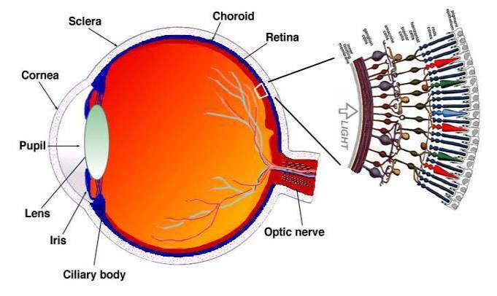
Melanopic lux
Cones for day/colour vision
Rods for night vision
Third receptors:
Intrinsically photosensitive retinal ganglion cells.
They respond to blue wavelengths of light at approx 460 - 480nm.
Notes:
Light enters via the lens into the eye and reaches the retina at the back of our eye-ball. When the light reaches the retina, it passes a layer of ganglion cells, bipolar cells and then the layer of where the cones and rods are. With the cones (red, blue, green) we can see colours, the rods are for low lux level vision (no colour recognition).
In 2002, a discovery was made of a 3rd receptor in addition to the rods and cones – the Intrinsically photosensitive retinal ganglion cells.

Slide 15
Melanopic lux
Blue cone
Melanopsin
Rods
Green cone
Red cone
Notes:
Each of these receptors responds to different wavelengths of light. Here you can see that the blue, green and red cones respond to these colours within the spectrum and the rods respond to wavelengths that are midway, but the melanopsin curve is the one that the ganglian cell responds to. It is called this because this is the name of the photopigment or protein that the ganglian cell produces to relay its message.
Until the discovery of this new cell all of our thinking about light was in response to how we see. The response of the ganglian cell is communicated directly to our peneal gland via the sympathetic nervous system and the Suprachiassmatic Nucleus.

Slide 16
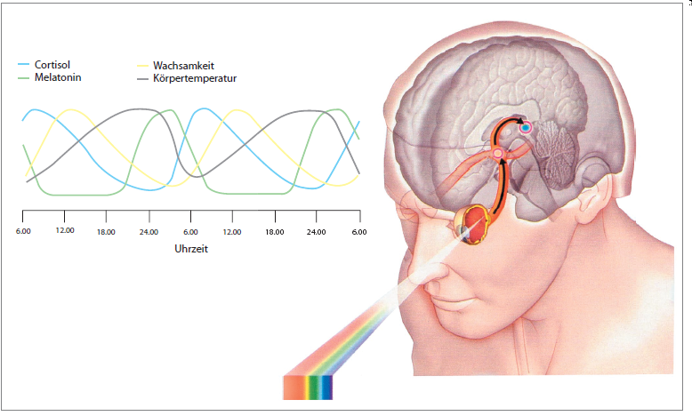
CYCLE OF DIFFERENT CIRCADIAN RHYTHMS
Notes:
16
These new receptors aren‘t responsible for visual responses like the rods and cones. Their function is to set your internal biological clock and control your release of hormones – known as the circadian rhythms.
These hormones make us feel more alert and able to concentrate, or prepare us for sleep depending on the time of day.
Increasing light levels in the morning signal the body to begin its active cycle. It responds by producing serotonin, adrenalin and cortisol. Hormone levels rise, along with temperature and metabolism and by mid-afternoon, the body has reached its peak metabolism. Two important hormones are cortisol that rises in the morning and makes us feel more alert and melatonin that rises in the evening and makes us feel more sleepy, but is also a powerful anti-oxidant.

Slide 17
Melanopic lux
Natural light changes in intensity, colour temperature and direction...
WELL has taken the wavelength of light that has an activating effect on our ‘Intrinsically Photoreceptive Retinal Ganglian Cells’, i.e.approx 460- 480nm. and calculated how much light you need for a natural biological response.
Notes:
These functions are triggered by daylight which also changes during the 24 hour day/night cycle.
Daylight changes during the course of the day from a warmer hue in the morning, bright and cooler light at mid day and warmer again in the evening. But this also varies according to the time of year and the weather pattern. Daylight has a much higher level of blue light in the middle of the day than the morning or evening and this is the wavelength that the ganglian cell responds to – the Zeitgeiber which keeps our body’s internal rhythms entrained.
WELL has used the wavelength of light that has an activating effect on our ‘Intrinsically Photoreceptive Retinal Ganglian Cells’, i.e.approx 460- 480nm. and calculated how much light you need for a natural biological response - Melanopic Lux. As I said earlier a better term would be melanopic daylight equivalent illuminance.
This is (unfortunately) not the same as melanopic lux. The numbers are almost the same but not quite (mel-dei is a bit higher). If you have 250 lux mel-dei you have slightly more than 250 melanopic lux.

Slide 18
Melanopic lux
Other light sources then have a multiplication factor to make sure the required level at this specific wavelength is achieved.
This can be calculated in a very detailed way using an excel based calculation tool developed by Professor Rob Lucas.
Or there is a basic table of ratios.
Notes:
So within the standard they ask for a specific level of Melanopic Lux, but this cannot be measured by a normal light meter, you would need a spectometer to measure individual wavelengths. Here you can see the spectrums of two different light sources, which are totally different. The requirement is to understand how much light you are getting at 460nm compared to daylight and then apply a multiplication factor to bring the light levels up to give the equivalent response by the ganglian cells, complicated but not impossible as a calculation tool has been developed to help. But by far the easiest option is to use a table.

Slide 19
Melanopic lux
LGHT SOUCE CCT (K) RATION
LED 2700 0.45
Fluorescent 3000 0.45
Incandescent 2800 0.54
Fluorescent 4000 0.58
LED 4000 0.76
CIE E (Equal Energy) 5450 1.00
Fluorescent 6500 1.02
Daylight 6500 1.10
Fluorescent 7500 1.11
x 500 Lux = 290 Equivalent Melanopic Lux
x 500 Lux = 550 Equivalent Melanopic Lux
Notes:
Here you can see that there is some relationship between colour temperature and the multiplication factor. i.e. the cooler the colour, the greater the amount of blue light. If the colour temperature is below the CIE reference illuminant the factor is below one and if it is above then the multiplication factor is greater than one.
You can use this multiplication factor with the amount of light you have using your chosen light source and this will give you the equivalent Melanopic Lux.
You can see that daylight is greater than one, and this is what I think is confusing because I would expect daylight to be the reference point.

Slide 20
Notes:
Discomfort or disability glare can be difficult to resolve if not considered early enough. This can come from windows, luminaires or reflections, which is getting harder to deal with if there is not a fixed task area i.e.. Hot desking, and the use of mobile devices.
The main object of a lot of glare in early years has now got easier. Computer screens have improved considerably so veiling reflections are not such a problem, but the new trend for glossy screens does bring this back into focus.

Slide 21
Notes:
Part 1 is referring to bare lamps or light bulbs. It has become a trend lately to have a decorative bare light source but not very often within an office environment, but if it is used then the glare must be considered and the usual optical methods can work, reducing the impact of the source by diffusion, refraction or reflection.
Part 2 is the limitation we are more used to. This refers to the surface brightness of a luminaire, whether it has a diffuse optic or even a louvre and is measured in the amount of brightness over the whole lit area in cd/m2. In our LG7 we are asked for a limit of 3000 cds/m2 where computers are being used, so this is not a difficult target.

Slide 22
Notes:
As I said earlier, glare can come from many sources and the sun is perhaps the oldest source of irritation.

Slide 23
Notes:
Physical shading is asked for whether it is internal blinds or external shading systems. Glazing has developed and the new systems can be effectively used to vary the transmission of the glass, thereby reducing glare.
The standard also recognised the value of light harvesting systems which also have a benefit of reducing glare. These systems use mirrors or internal shelves to redirect the light deeper into the space and reduce the direct view of the sun.

Slide 24
Notes:
This is a very good option now that our computers are more mobile. I am glad that we aren't being expected to limit the luminance at viewing angles that cause disability glare in computer screens. This solution in the Cat 2 days caused some very unpleasant environments.
So this approach of moving the computers is a better solution.

Slide 26
Notes:
Colour quality is the area of lighting where we can start to see vast improvements and it is sorely needed. I think this will become one of the most important topics over the next 5 years. We have got used to the effect of fluorescent lamps in our office spaces and have accepted the colour rendering that they give us, but we can do much better. With the advent of LEDs we can now create much better light sources but because the most efficient versions have a poorer spread of colour content these have dominated the market. Because LEDs have become so efficient we can start to sacrifice some efficiency in favour of better colour quality.
Daylight is the optimal source of light with a full spectrum of wavelengths which depict colour perfectly and we now know that we need the blue wavelength or lack of it, to regulate our circadian rhythms.
Of course we function at our best under beautiful sunny skies followed by balmy evenings and dark enchanting nights. But we can’t all live on a Pacific Island.
We now have the ability to specifically tailor the spectrum of LEDs to have a desired effect, but the basis should start with all wavelengths being present.

Slide 27
Notes:
WELL specifies the bottom line figure of Ra80 and mentions R9.
This is where it is pushing the boundaries. Án R9 >50 is not a common figure. Most of our standard luminaires are around 10-15.

Slide 28
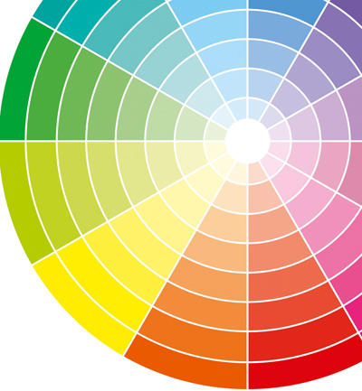
CRI is now getting a bit out of date
and has fundamental flaws by using the average of only 8 colours. Ra⁸
R1 to R8 does not include a true red
New methods include all 14 test colours , Colour Quality Scale and TM-30
Notes:
The Colour Rendering Index is commonly used to describe which colours or wavelengths make up the white that we see. So it tests colours under the light source and compares them to a standard light source – daylight being the perfect light source.
It only tests 8 colour samples and these do not include red, which is a very important colour to us – think of that skin tone! There are an additional 6 colour samples that can be used in the Ra14 version, which is a bit better.
But new systems are now being evaluated and it how detailed you need to get will depend upon your project.
WELL asking for R9 moving towards a better metrix.

Slide 29
Notes:
As stated here most of the light we receive at our eyes has reflected of other surfaces. This reflection will have an effect on the quality of the light both in intensity and the colour composition. As the aim is to provide lighting with enough blue light to have a non biological response we need to also make sure that the colours of the surfaces don’t absorb blue.

Slide 30
Notes:
These are similar reflectance values to those we are used to but the furniture systems are also mentioned. This is a good point because todays desk systems provide much of the surfaces that are nearest to the task.

Slide 31
Notes:
In addition to daylight dimming controls it is good to see an emphasis on automatic shading systems.

Slide 32
Notes:
The lighting controls should be both daylight responsive and detect the presence of people.

Slide 33
Notes:
This requirement takes the science one stage further which I think we all feel instinctively. In addition to the non biological response, we gain many other benefits from seeing daylight and a view.

Slide 34
Notes:
The next 3 preconditions all relate to window design and daylight factors, which is not a subject I know much about, but I have included them in the presentation as it is a fundamental part of the WELL Building Standard.

Slide 35
Notes:
Daylight modelling is a specialist skill but is gaining prominance.

Slide 36
Notes:
Again great to have these minimum requirements, but we should all consider going outside for at least 20 mins per day.

Slide 37
Notes:
Here the standard is combining the benefits of windows, balancing energy performance, thermal comfort and access to daylight, with limiting the glare by looking at the window design.

Slide 38
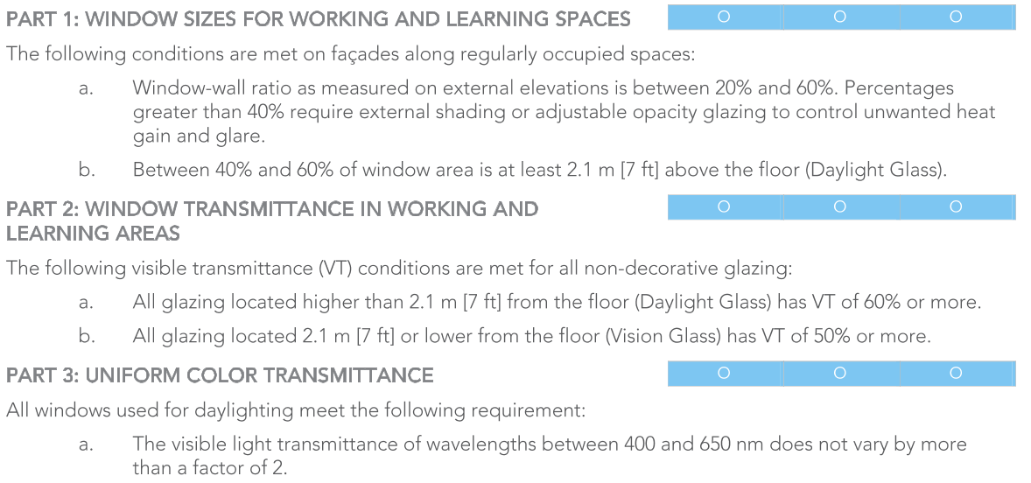
Notes:
In addition to the sizing, it also mentions the transmission factors of the glass.

Slide 39
WELL BUILDING STANDARD
Notes:
I feel this standard has a lot of useful intentions,
The Circadian Lighting Design has very specific requirements of melanopic lux which doesn’t seem to be backed up by research to this level and is using a metrix which is not yet proven or established.
In addition to that, whilst the use of daylight is promoted, in dense urban developments where daylight availability is lower, this requirement may enforce higher artificial illumination levels and thus compromise energy performance.
This has significant repercussions on design, and might be difficult to reconcile with approaches like Cat A office fitout design, where no furniture layout is provided.
I definitely support the general values of WELL building standard but hope its requirements will be adjusted and improved in future versions.

Slide 40
Linkedin discussion
Notes:
I will try to answer some of your questions but I would also like to draw your attention to a discussion group we have set up on the TRILUX Akademie LinkedIn page – it would be good to continue the conversation there and understand some of your thoughts.

