Slide 1

fresh – stimulating – light – neutral – cool

Slide 2
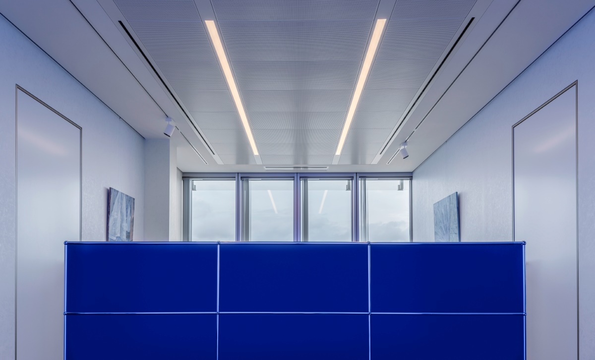
fresh – stimulating – light – neutral – cool

Slide 3
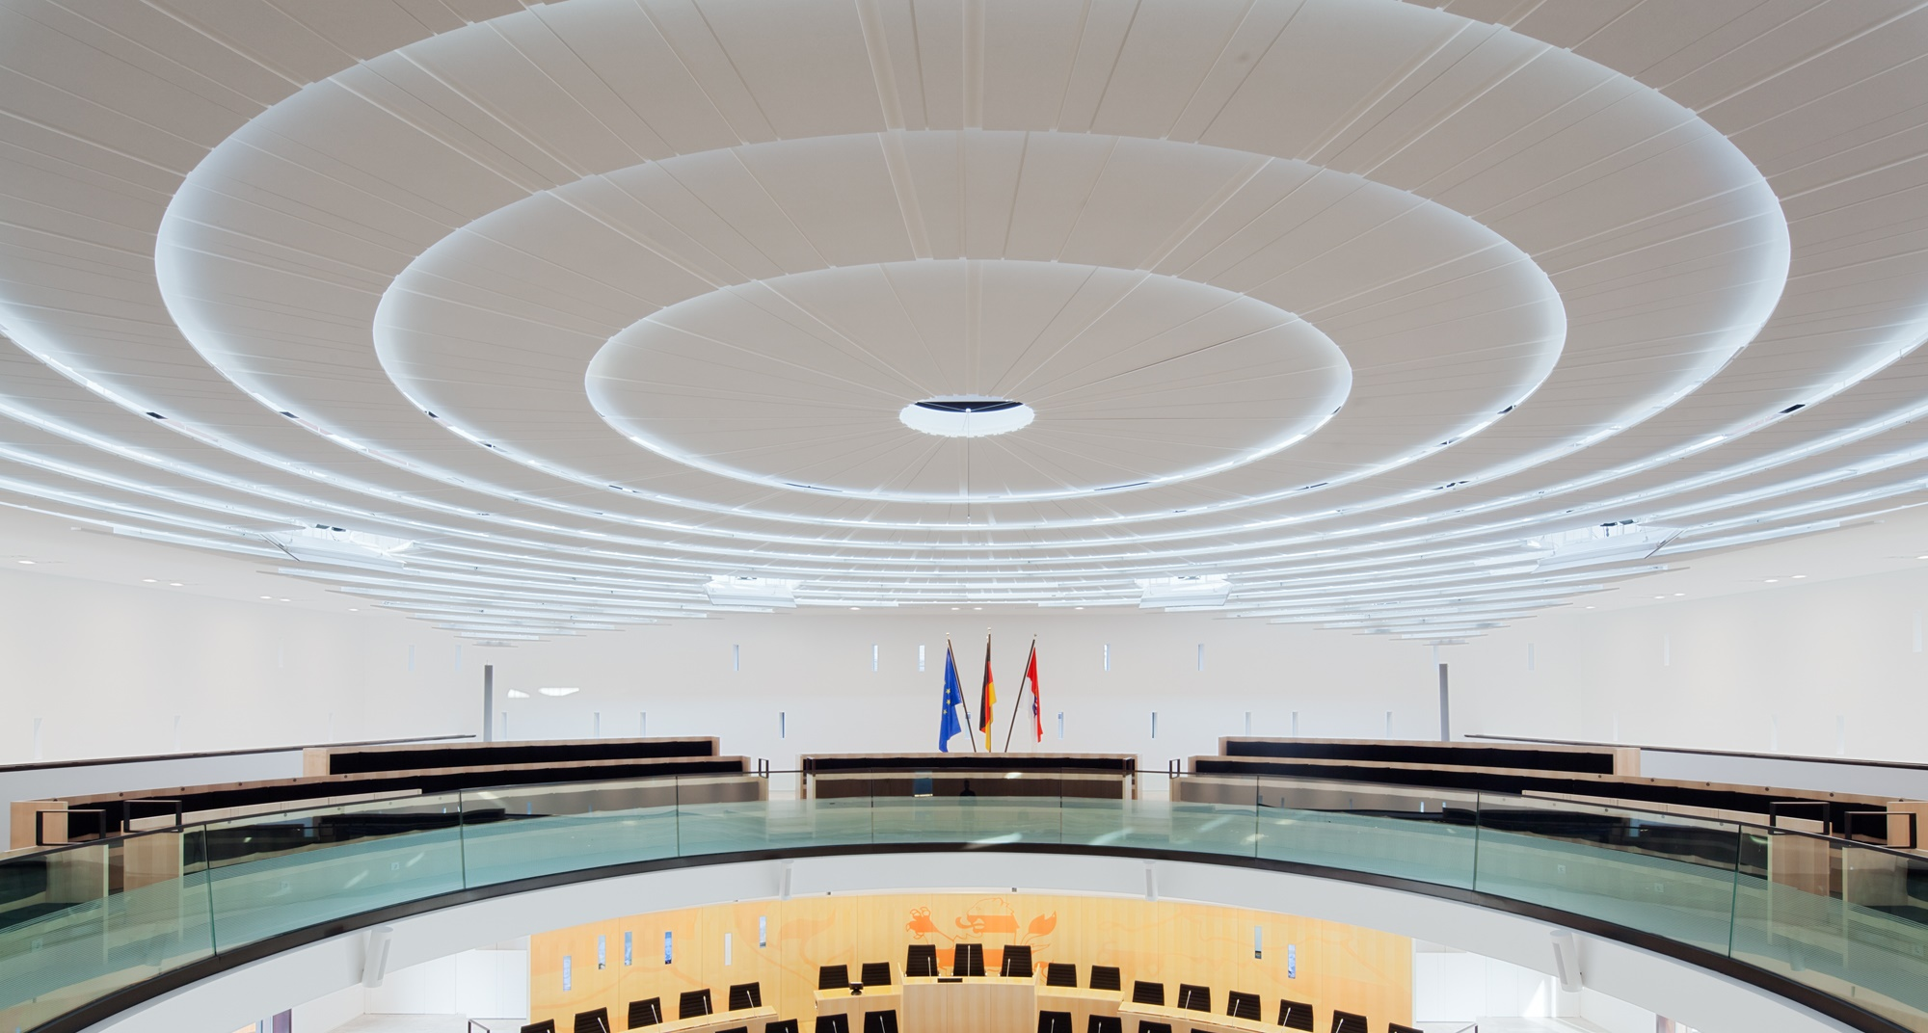
fresh – stimulating – light – neutral – cool

Slide 4
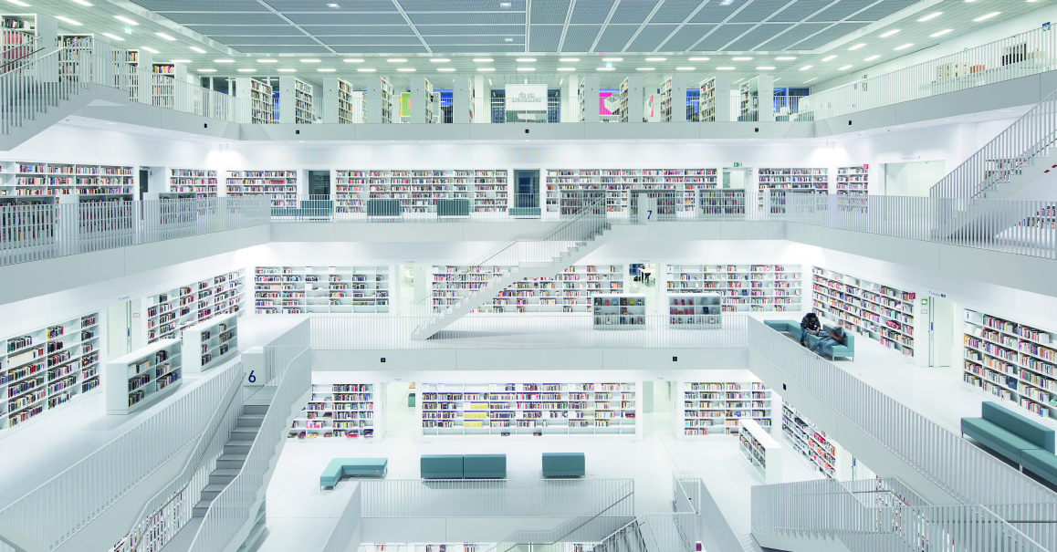
fresh – stimulating – light – neutral – cool

Slide 5
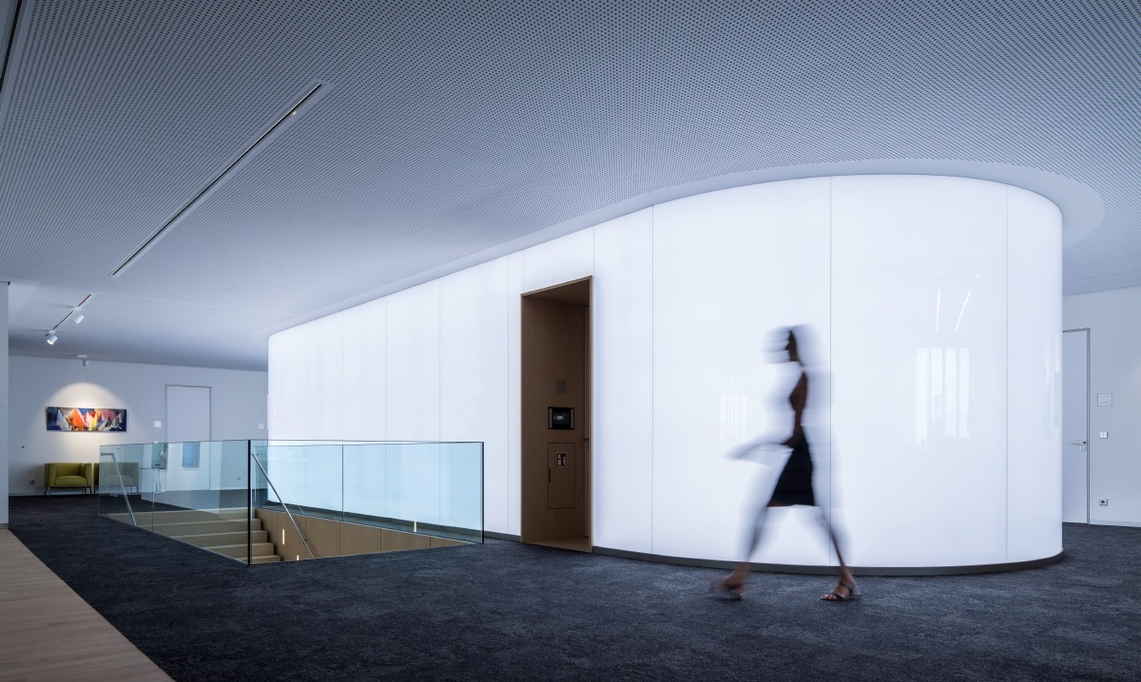
fresh – stimulating – light – neutral – cool

Slide 6

warm – relaxing – natural – comforting

Slide 7
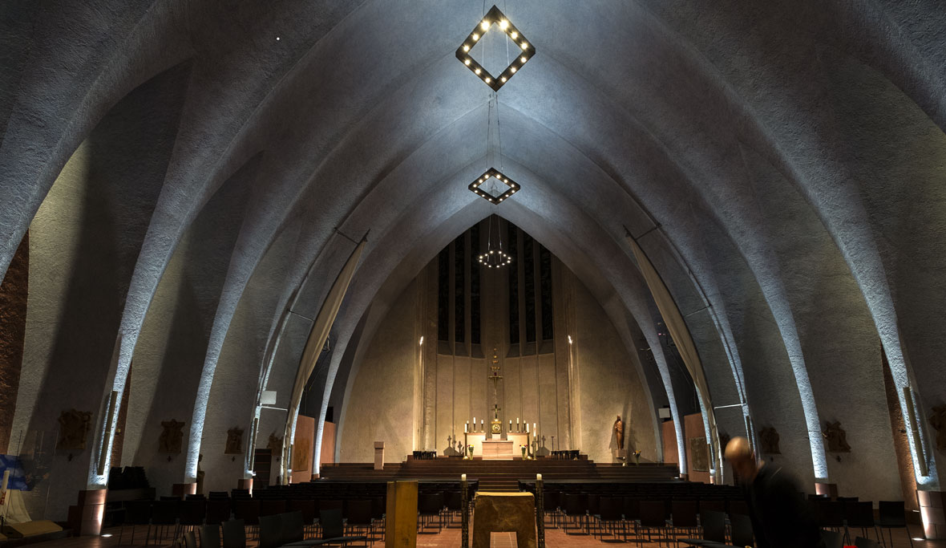
warm – relaxing– comforting

Slide 8
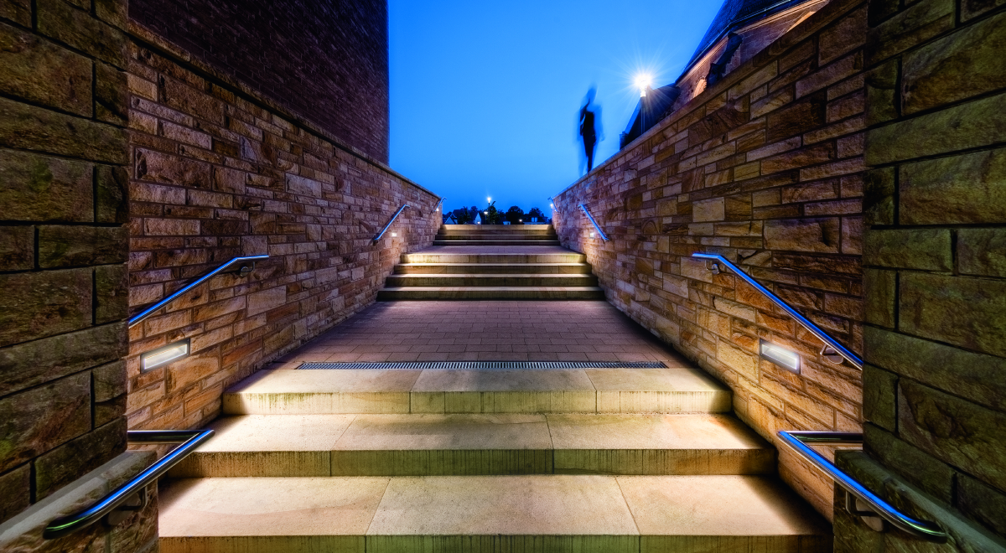
warm – relaxing–comforting

Slide 9
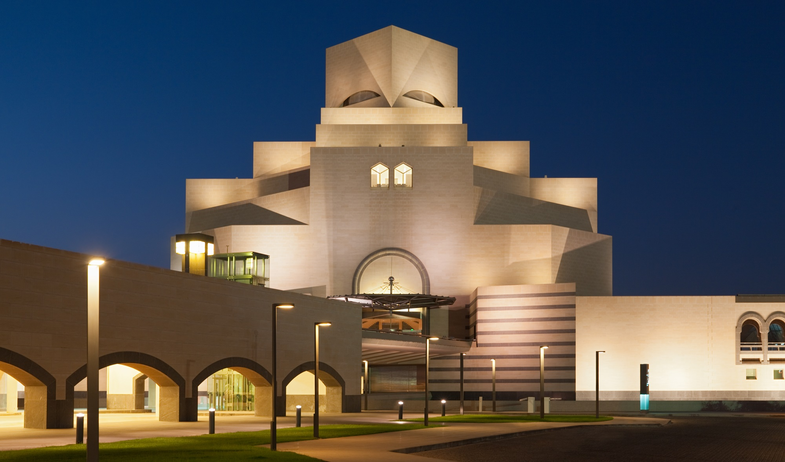
warm – relaxing–comforting

Slide 10
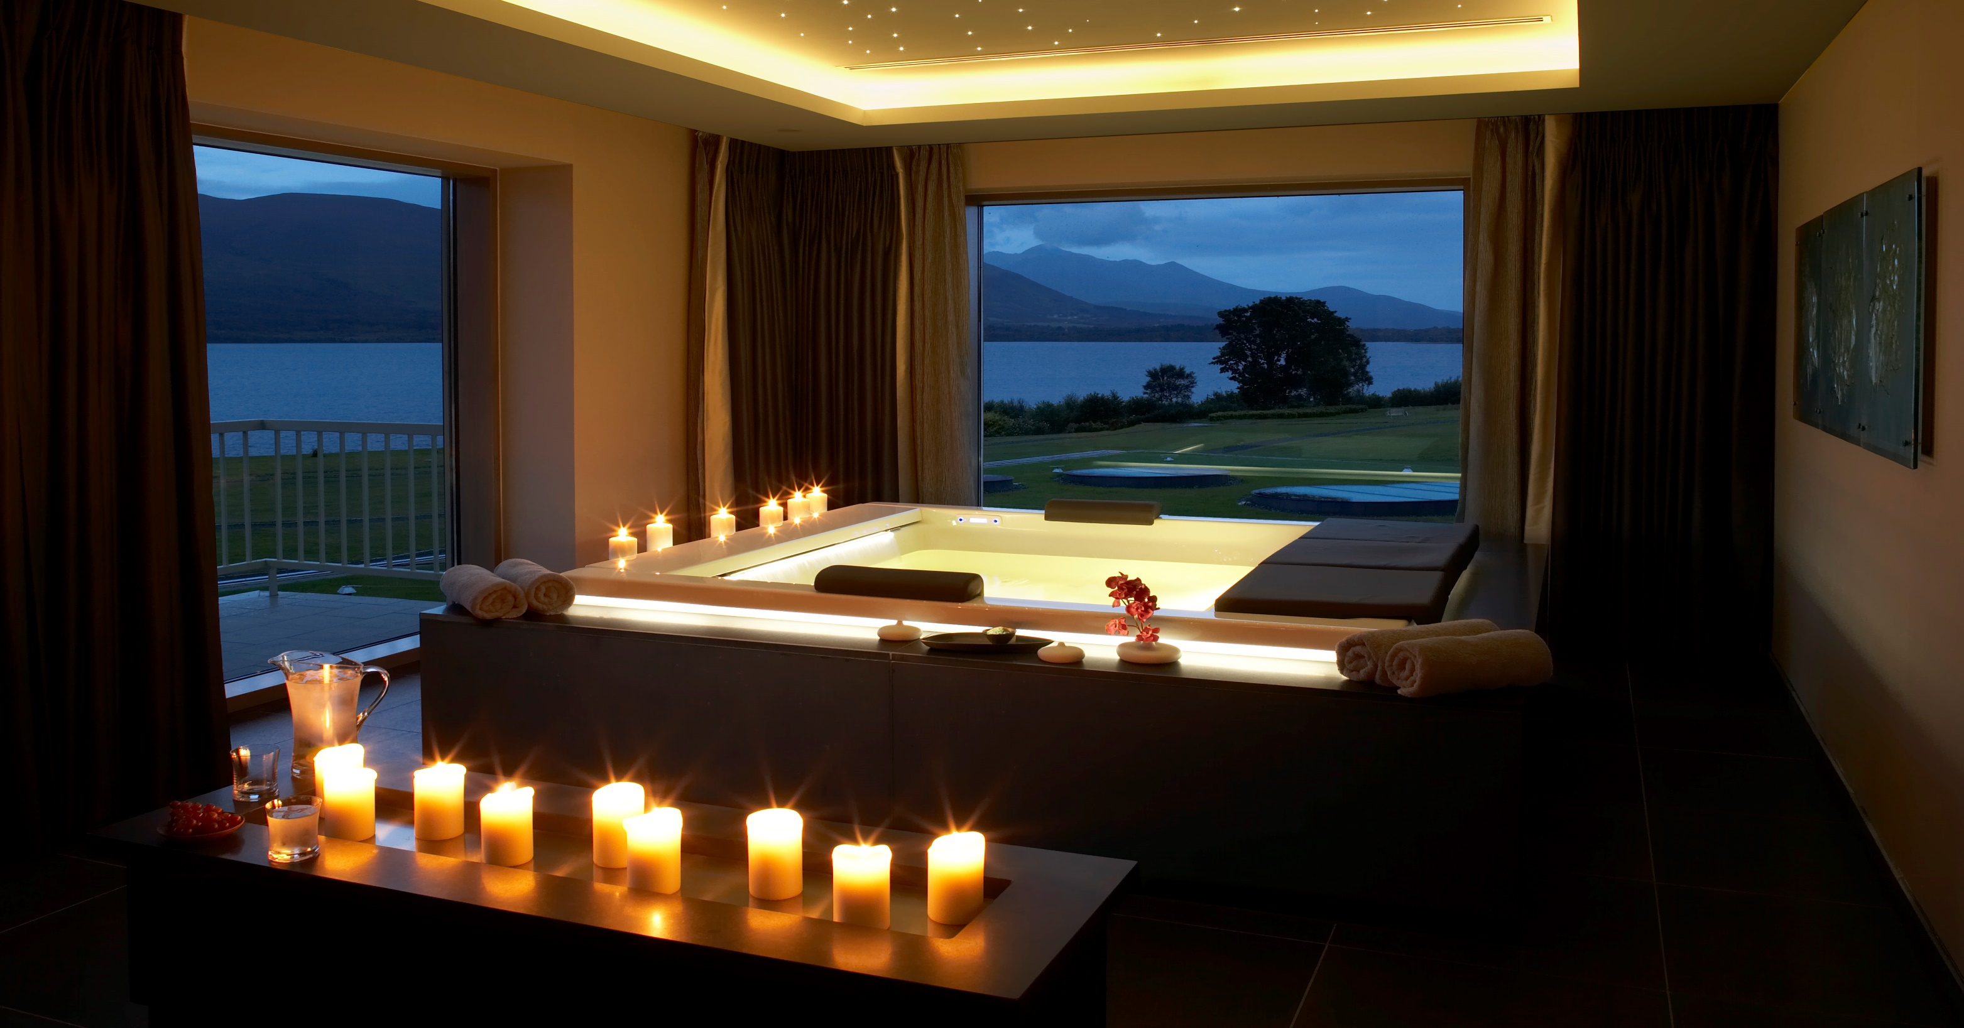
warm – relaxing – comforting

Slide 11
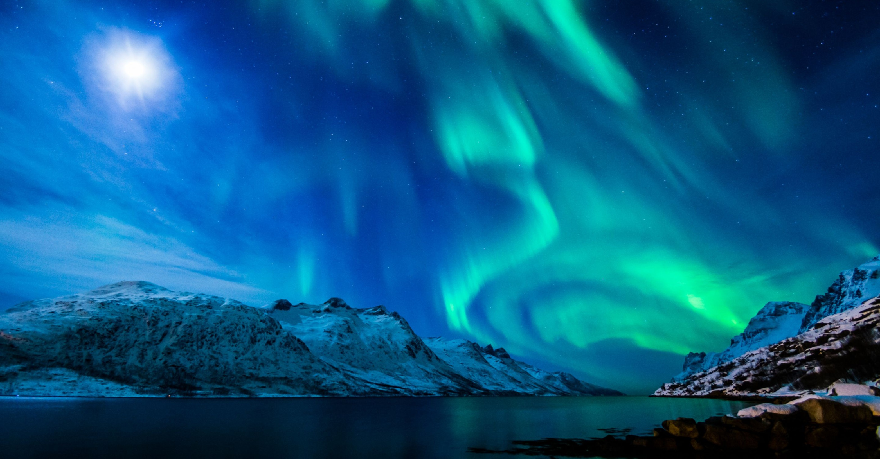
wow! – spectacular – euphoric – sublime – inspiring

Slide 12
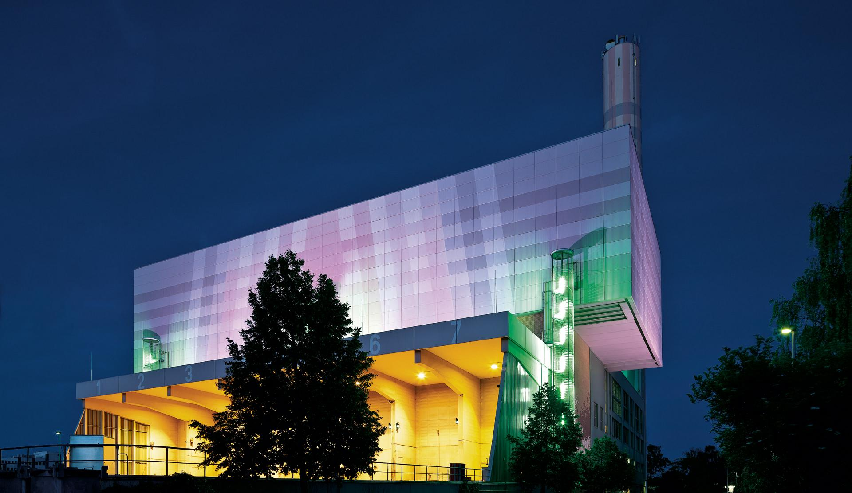
wow! – spectacular – euphoric – sublime – inspiring

Slide 13
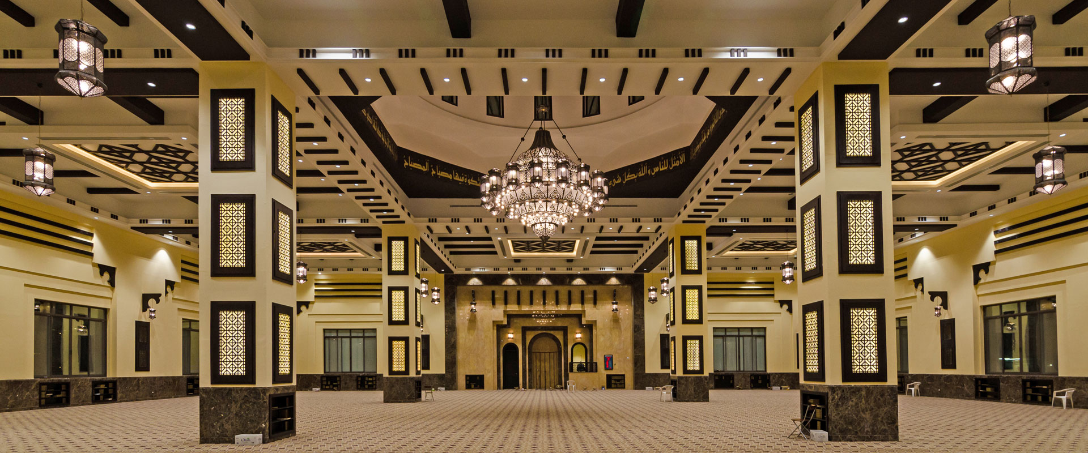
wow! – spectacular – euphoric – sublime – inspiring

Slide 14
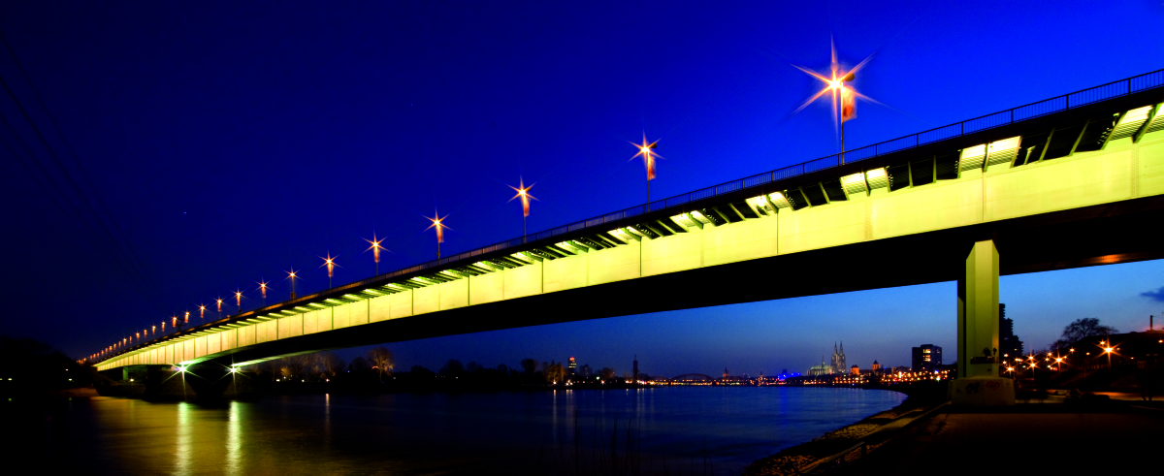
wow! – spectacular – euphoric – sublime – inspiring

Slide 15
wow! – spectacular – euphoric – sublime – inspiring

Slide 16
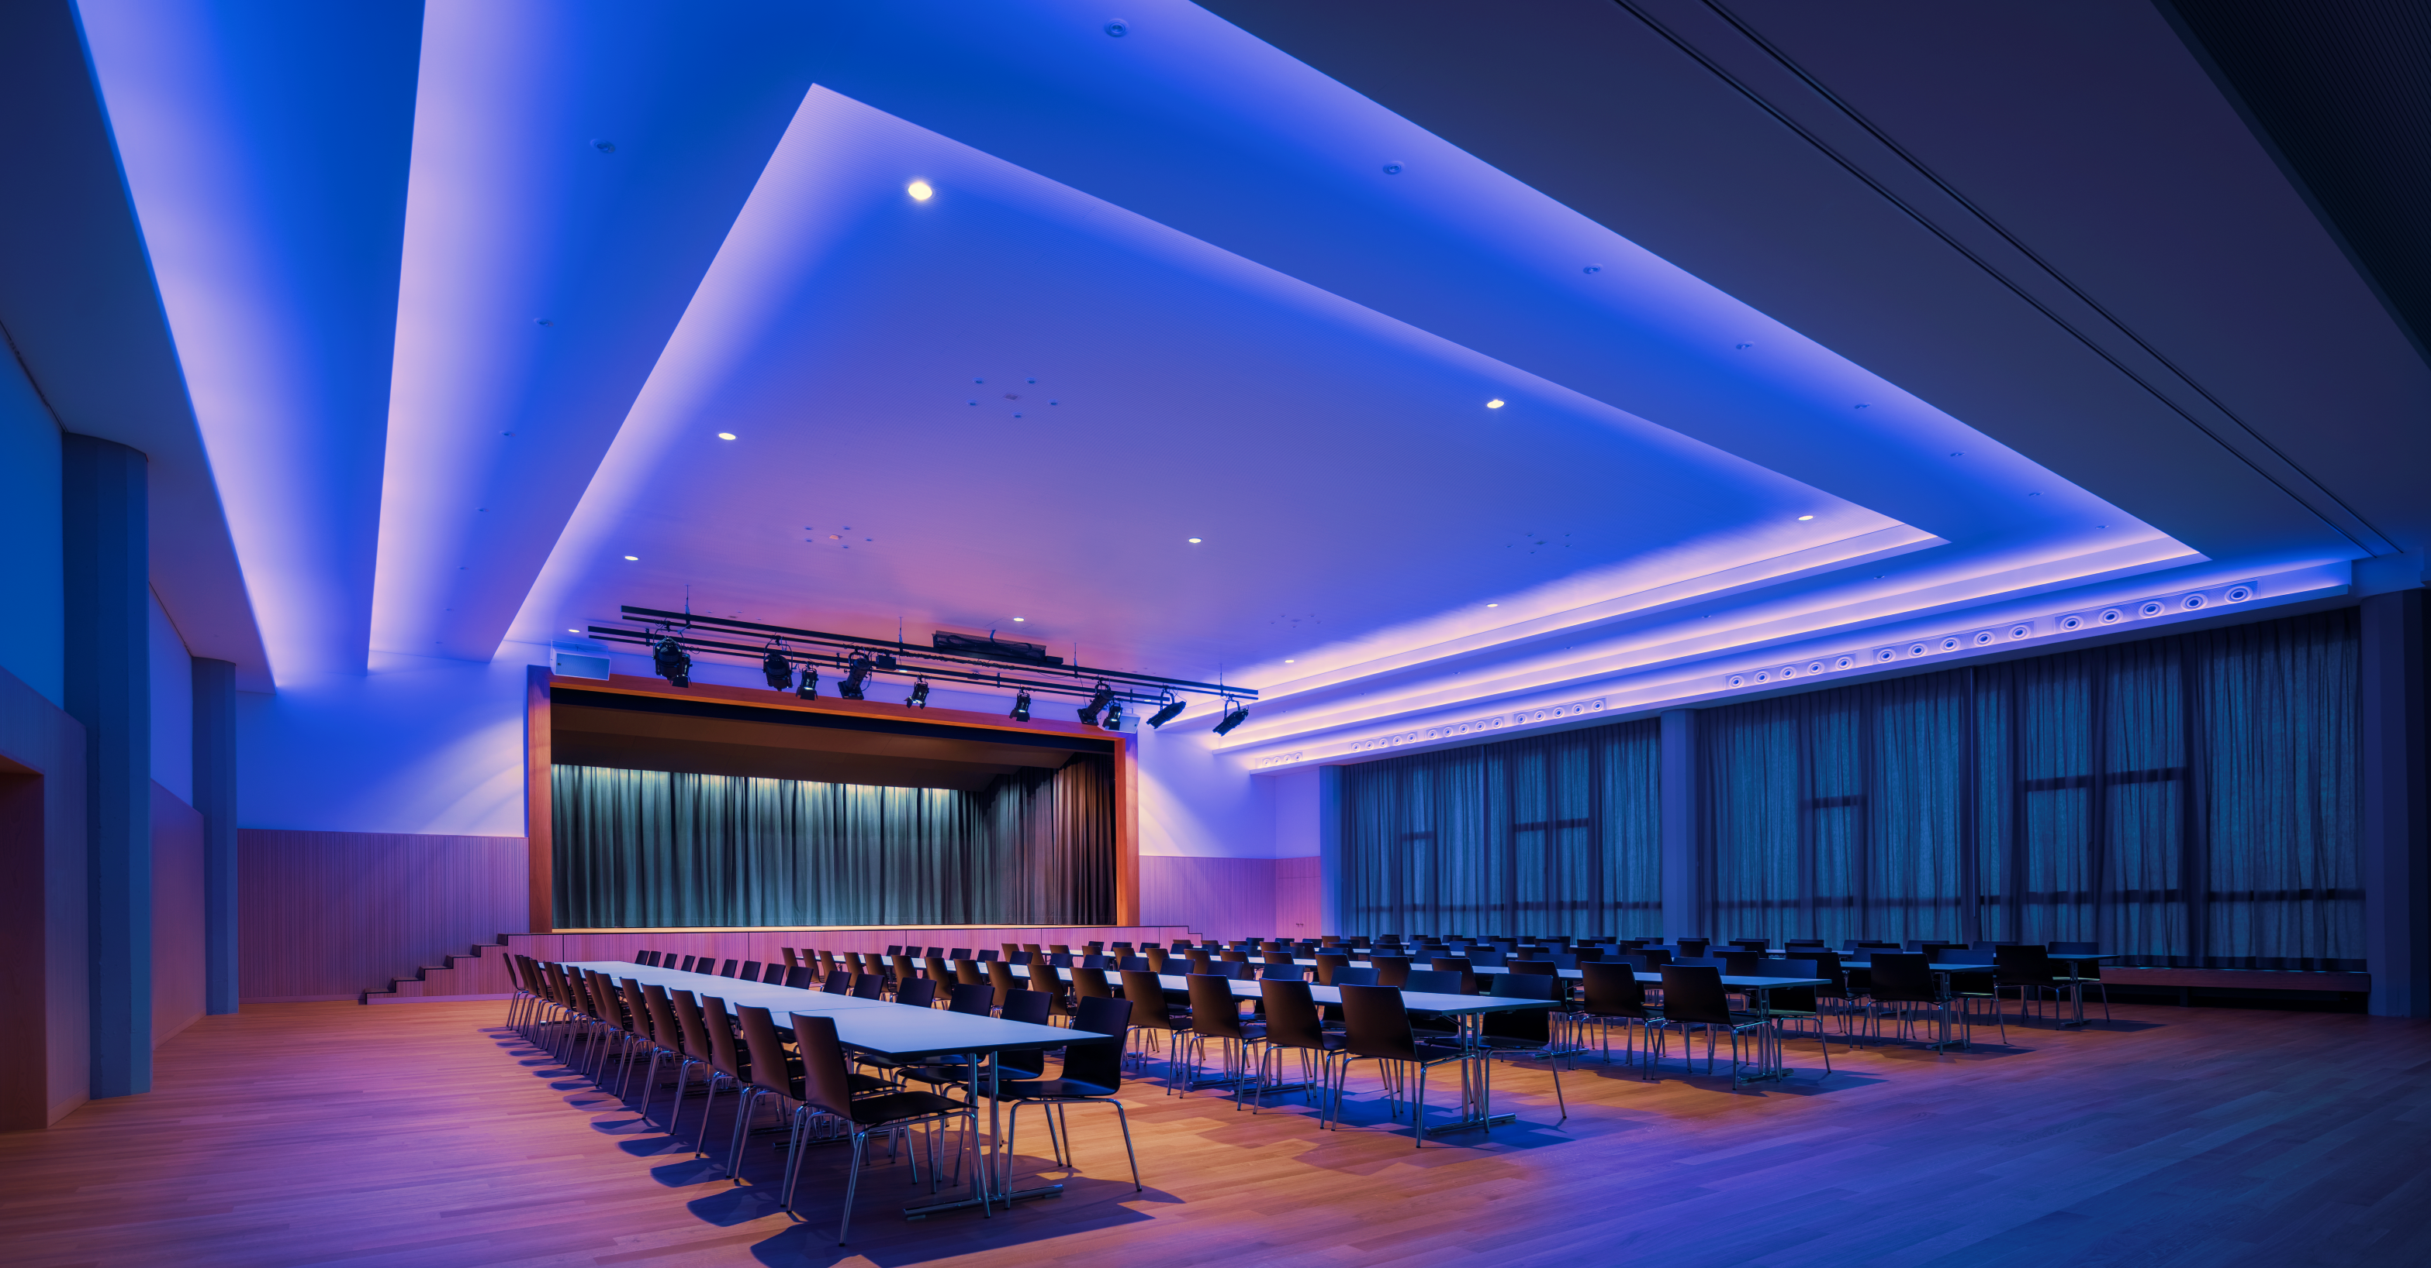
wow! – spectacular – euphoric – sublime – inspiring

Slide 17
Human responses to light
To do or not to do?
Or what to do?
HELEN LOOMES
Notes:
There is now a lot of information about the Human responses to light, but there are still a lot of unanswered questions.
I would also like to look at a very specific aspect of Human Centric Lighting – shiftwork.

Slide 18

May I introduce myself
Helen Loomes FSLL
Business Development Director
International Projects
Akademie Presenter
Fellow of The Society of Light and Lighting
BSI and ISO TC

Slide 19
Human responses to light
To do or not to do?
Or what to do?
HELEN LOOMES
Notes:
There is now a lot of information about the Human responses to light, but there are still a lot of unanswered questions.
I would also like to look at a very specific aspect of Human Centric Lighting – shiftwork.

Slide 20
What is Human Centric Lighting?

Slide 21
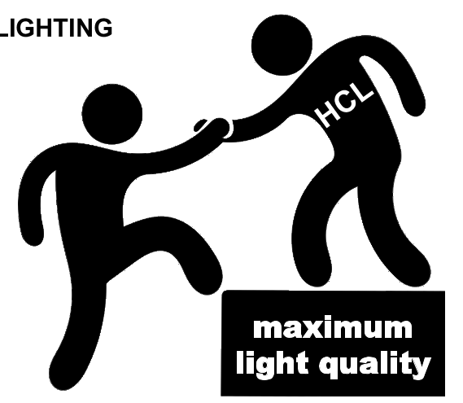
What is human centric lighting?
Brings the human in to focus
Adaptation of the lighting to individual needs
  Age
  Time of day
  application
Notes:
Good lighting design has always focused on the human needs but now we have the knowledge to take this a little further.

Slide 22
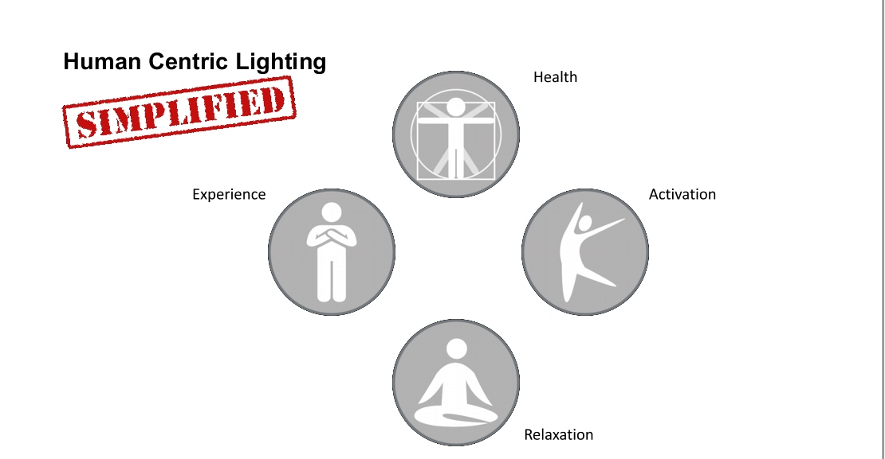
Human centric lighting
Notes:
We have a range of needs, states of mind and activities that all require applications of lighting, both from the ability to perform the task and the physical effect it has on us.

Slide 23
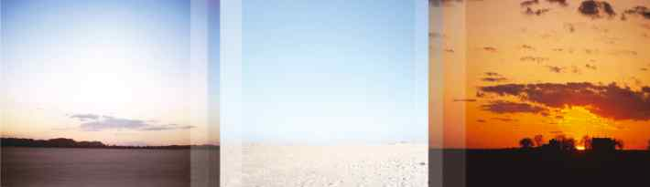
DYNAMIC LIGHT
Natural light changes in intensity, colour temperature and direction...
Notes:
These physical changes have evolved in response to natural daylight, which gradually varies with time of day, or season, but there is also the dynamic element usually due to the weather.

Slide 24
Theoretical Background

Slide 25
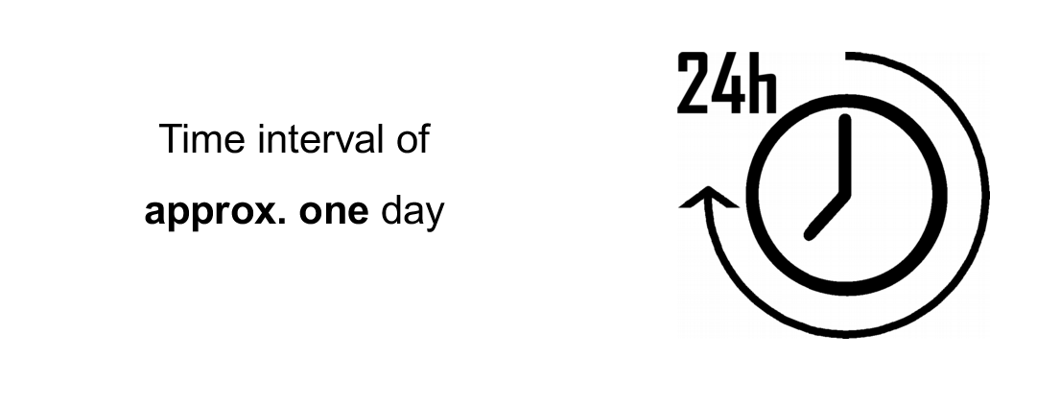
Circadian rhythms
Notes:
Our natural body clock keeps time with the day/night cycle.

Slide 26
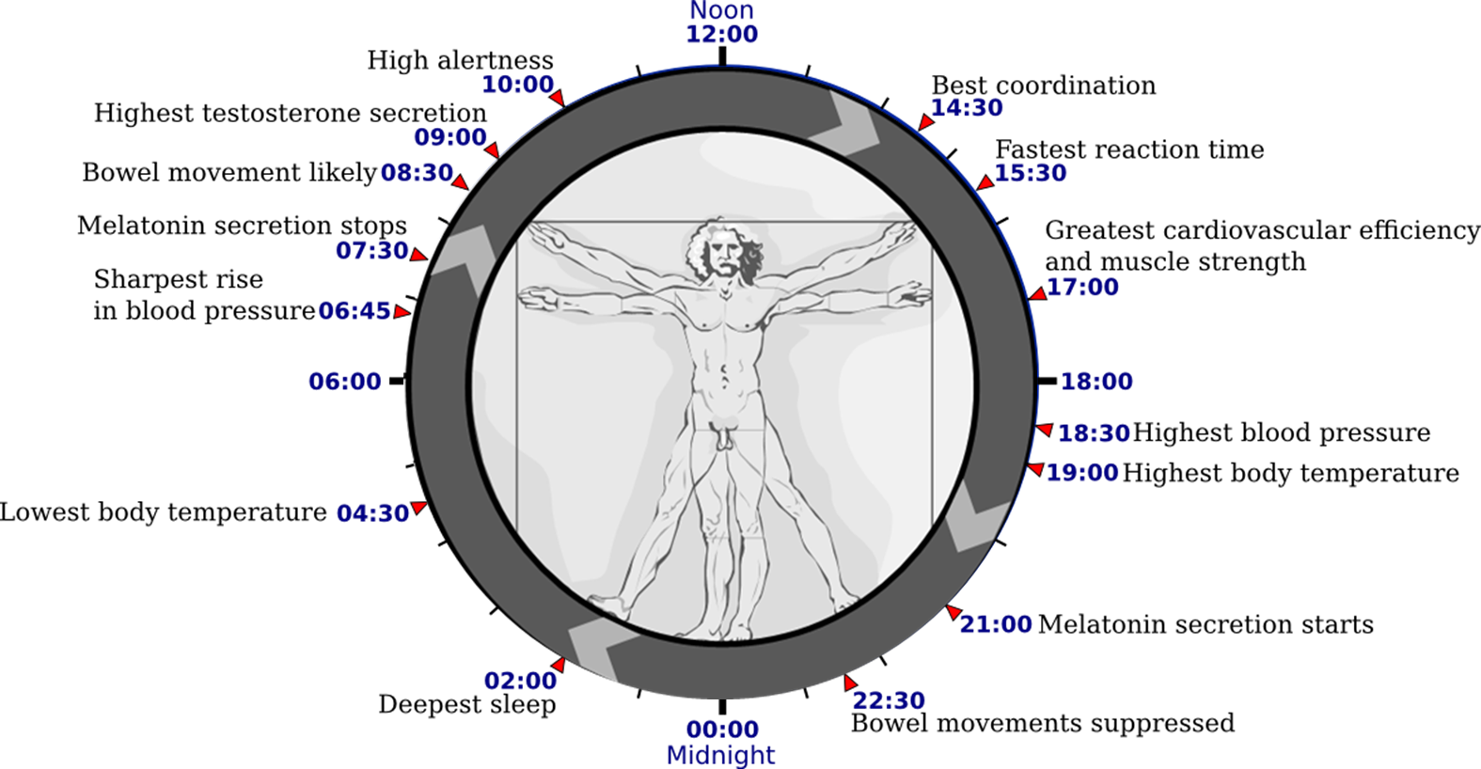
Circadian rhythms
Notes:
And goes through a regular cycle of hormone production, temperature fluctuations and levels of alertness.
But we mustn't forget that we are all slightly different.

Slide 27
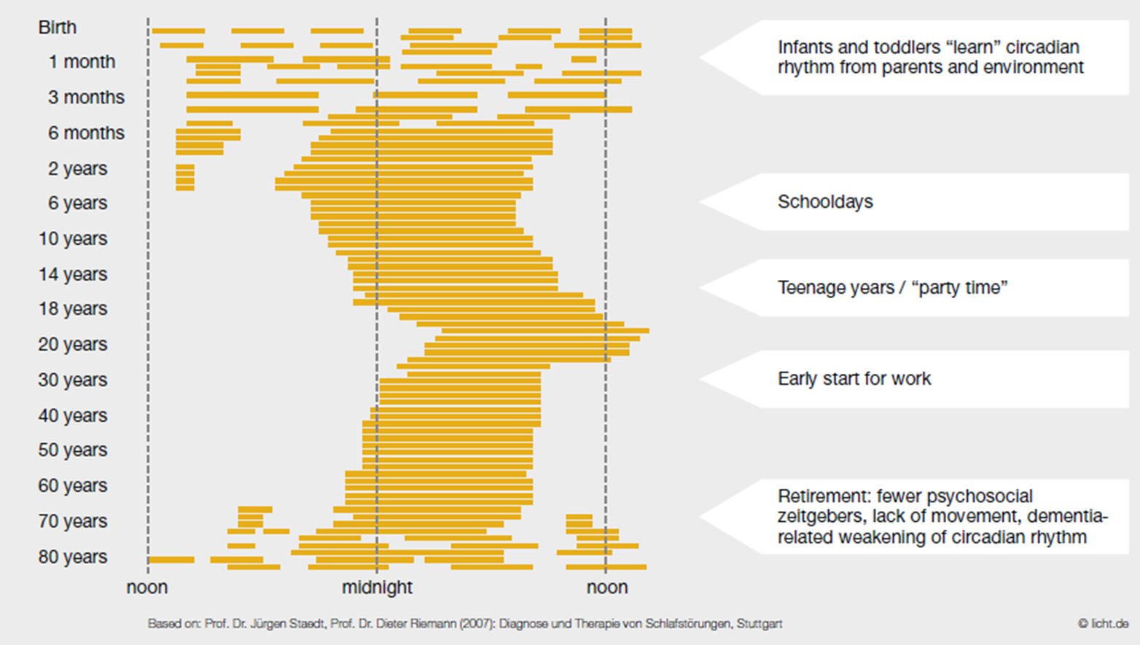
Development and synchronisation of sleep
Notes:
The most obvious cycle is sleep.
These patterns change throughout our lifetime, the extremes being in small children and the elderly.
We also have different chromaticity types, larks and owls – those small differences I mentioned earlier.

Slide 28
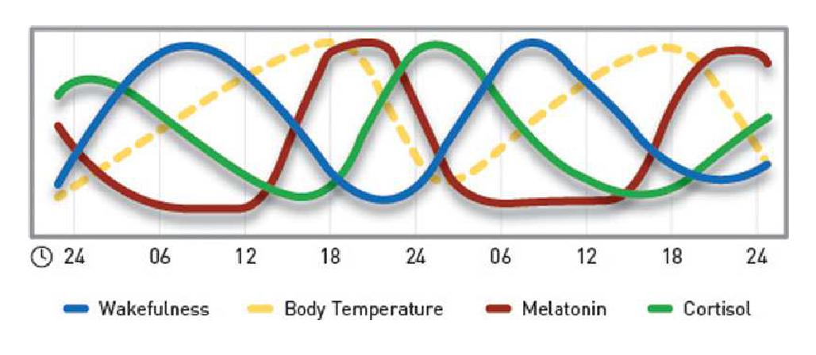
Circadian rhythms
Notes:
These rhythms cycle over this 24 hour period, some working in opposition to each other such as our levels of wakefulness and production of Melatonin.
Melatonin is important not only because it prepares us for sleep, but it is also a powerful antioxidant so vital for our health.

Slide 29
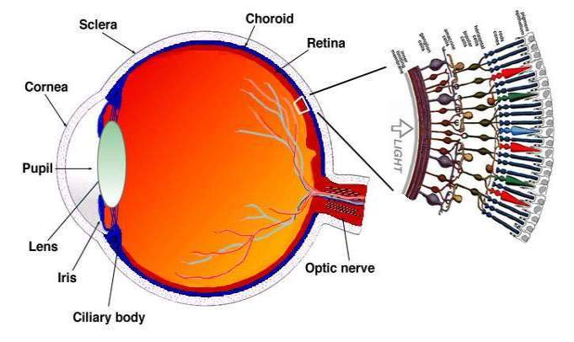
Cones for day/colour vision
Rods for night vision
Third receptors:
Intrinsically photosensitive retinal ganglion cells.
They respond to blue wavelengths of light at approx 460nm.
Notes:
First we have to understand how this works. Light enters via the lens into the eye and reaches the retina at the back of our eye-ball. When the light reaches the retina, it passes a layer of ganglion cells, bipolar cells and then the layer of where the cones and rods are. With the cones (red, blue, green) we can see colours, the rods are for low lux level vision (no colour recognition).
In 2001 a 3rd receptor was discovered, and are now known as Intrinsically photosensitive retinal ganglion cells. These cells only respond to blue wavelengths of light at approx 460nm.

Slide 30
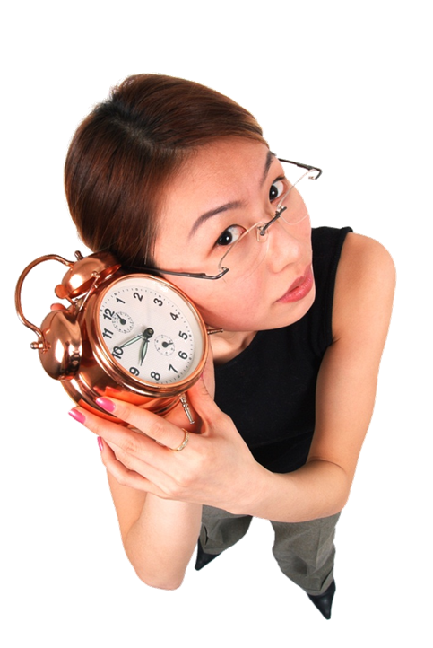

Visual Cortex
Suprachiassmatic Nucleus
Pineal
Gland
LIGHT
Superior
Cervical
Ganglia
Preganglionic Sympathetic Neurons
Notes:
The stimulation of the Intrinsically photosensitive retinal ganglion cells does not go through the optic nerve.
It goes through the Sympathetic nervous system, then through the Suprachiassmatic Nucleus to the Pineal Gland. Here the circadian rhythym is entrained. Adrenalin and Cortesol are stimulated and melatonin is supressed in response to the blue light.

Slide 31
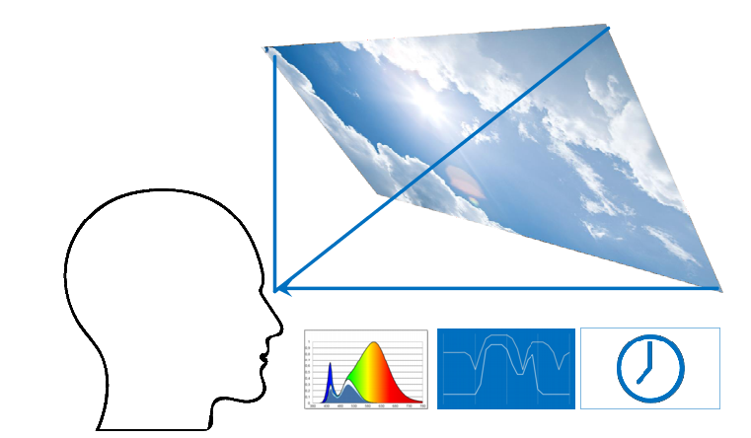
Many aspects of light effect our hormone production
Spectral composition
Illumination at eye level
Exposure time
Direction of light
Surface size
Light history
Notes:
We now know how the eye responds to particular wavelengths of blue light, but there are other aspects of the light we receive which will contribute to entraining our circadian rhythms including:
The amount of light;
The length of time we are exposed to it.
To a lesser extent the direction of light, the surface area of the illuminated element and it also seems our light history – the amount of light we received in the previous 24 or even 48 hours.

Slide 32
Can we influence this biological effect?
Ideal conditions are daylight, preferably in the summer
Artificial light can supplement this indoors
We can deliberately increase alertness, concentration and delay sleep.
Conversely we can improve wellbeing and improve sleep
Notes:
Of course we function at our best under beautiful sunny skies followed by balmy evenings and dark enchanting nights. But we can’t all live on a Pacific Island.
We now have the ability to supplement our daylight indoors and we can specifically tailor it to have a desired effect.

Slide 33
The moral question
When is too much?
Are we messing about with people’s natural rhythms?
Can we help the people we already ask to lead very unnatural lives?
Notes:
But should we?
There is always someone who will want to use this knowledge to improve productivity and make us work harder, but this could backfire because the correct rest and sleep conditions are also necessary to contribute to alertness the following day.
But what about the people we already ask to work in a totally unnatural way?

Slide 34









Shift workers
Notes:
These days it is not just factory workers. What about the airline pilot, chefs, hospital staff, call centres – our 24 hour economy?
Delivery drivers have a very difficult task, they need to be alert but the monotony of a motorway can really cause drowsiness. There was a radio documentary recently that featured an American fleet owner who was devastated after 3 drivers died in accidents over a 3 month period, so after some research he changed his 2 shift system to a 3 shift rotation with carefully timed changes onto the next period of work. So far there are no accidents and I will also tell you of some more research to back this up.
Another large body of research has been with oil rig workers who stay on the platform for 2 week shifts and then try to adapt back to normal life.

Slide 35


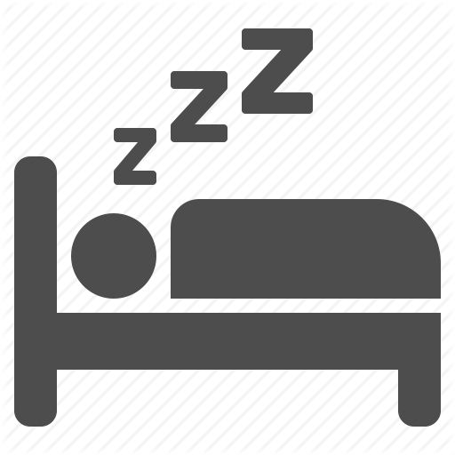



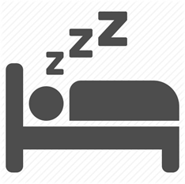





Shift workers
Notes:
When the rest of us are just getting up to face the day, our typical shiftworker is on his bike cycling home. Here he is receiving a good dose of daylight sending signals to his brain to wake up and be alert.
But he is going to ask his body to work against that and go to sleep. Not only is he trying to sleep through the brightest part of the day but it is also probably the warmest which is another factor to consider. At some point he's going to wake up and hopefully have some leisure time. He could also eat at a normal time with the rest of the family but then he's back on the bike to go to work. His body is feeling sleepy after the food and the lack of blue light is allowing his melatonin to start production, but everything is getting a little confused because of the exercise he is getting on his bike and he knows he is going to work. Maybe a cup of coffee will help? Or he could resort to some kind of medication.
Some research shows a short nap is beneficial but the period after waking is when mistakes can happen easily and levels of alertness are at their lowest so this is not helpful for someone whose job is a matter of life and death i.e a doctor. But traditionally this is what doctors on call will do.

Slide 36
Shift workers
Notes:
Relative to day workers, rotating or permanent night-shift workers have increased incidence of cardiovascular disease and other known risk factors; gastro, metabolic and reproductive dysfunction; obesity and cancer.
In fact, the evidence in support of a causal link between shift work and cancer is strong enough that the International Agency for Research on Cancer recently classified shift work as a “probable carcinogen.”
Data from some of these studies suggest that working as few as three night shifts per month for multiple years is associated with increased disease risk.

Slide 37
WHAT CAN WE DO?
We can advance the circadian rhythms by an hour fairly easily
It is harder to delay them
For people with an erratic shift pattern we can provide melanopic supporting lighting
Notes:
We can advance circadian rhythms fairly easily by a short amount. It is very natural for us to stay up just that little bit later and then stay in bed a bit longer in the morning.
It is harder to delay our body clock but the key aspect here is the time of night when our body temperature is at its lowest. This conveniently coincides with our deepest sleep. If we suppress melatonin before this time we can delay sleep, and if we suppress melatonin after this time we effectively advance the circadian rhythm by ending sleep and promoting daytime wakefulness. But this only works for a shift pattern of several days as it takes time to adjust to the new rhythm and then we ask them to change it back again for the weekend! A change in shift pattern or on days off would result in having trouble sleeping at night and being alert during the day.
For people with an erratic shift pattern it might be better to provide lighting to do their job but without resetting their body clock, but they would feel tired and wouldn’t be able to sustain it for long. This is lighting without the blue content and has earned the name of Melanopic Lux.

Slide 38


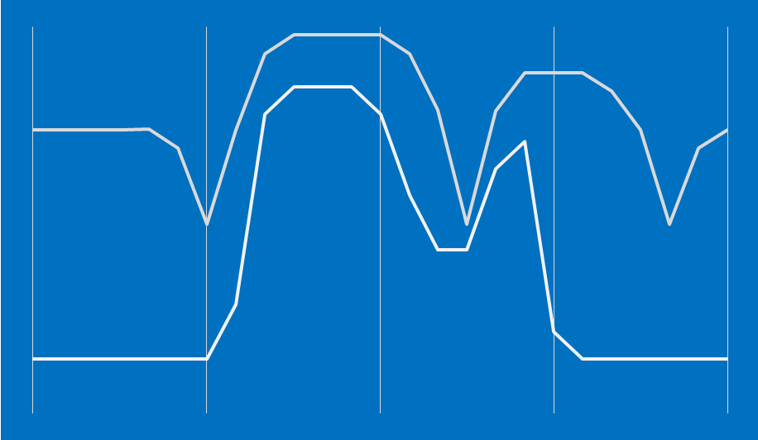
Is light the saviour?
Notes:
A number of laboratory and field studies have shown that light exposure at night reduces sleepiness, whilst improving alertness and performance. Most of these studies used bright light of greater than 1000 lux, but these effects of light may be present at room light levels of only 100–200 lux and are more pronounced with blue light than longer-wavelength light.
The acute alerting effects of light are extinguished soon after light exposure ends but suppression of Melatonin will last longer.

Slide 39
research
Assessment of a new dynamic light regimen in a nuclear power control room without windows on quickly rotating shift workers -- effects on health, wakefulness, and circadian alignment;
A pilot study by ARNE LOWDEN, Stress Research Institute, Stockholm University
Prevention of fatigue and insomnia in shift workers-a review of non-pharmacological measures
RICHTER K, ACKER J, ADAM S, NIKLEWSKI G
Improving wellbeing with blue enriched light in rotatiing shiftworkers.
MIDDLETON B, VANDENBOSSCHE E, MORGAN PL, ROUSSEAU A, KANTERMANN T, HAUBRUGE D, SCHLANGEN LJM, KERKHOFS M, SKENE DJ.
Returning from night shift to day life: Beneficial effects of light on sleep.
THORNE CH, HAMPTON SM, MORGAN LM, SKENE DJ, ARENDT J.
Notes:
There is a lot of very interesting research on the effects of shift work, I am listing these particular ones because I have read them and they all have something interesting to say. They agree on the problems and some of the solutions, but definitive and numeric answers are much harder to find.

Slide 40
research
Shift work: health, performance and safety problems, traditional countermeasures, and innovative management strategies to reduce circadian misalignment.
By Mark R. Smith, PhD & Charmane Eastman, PhD, Nature & Science of Sleep, 2012
Notes:
I found this paper particularly useful and nearest to the area I am interested in. It looks at the three mechanisms that may contribute to the health, performance, and safety problems associated with night-shift work: (1) circadian misalignment between the internal circadian clock and activities such as work, sleep, and eating, (2) chronic, partial sleep deprivation, and (3) melatonin suppression by light at night. The typical countermeasures, such as caffeine, naps, and melatonin (for its sleep-promoting effect), along with education about sleep and circadian rhythms, are the components of most fatigue risk-management plans.
And, while better than nothing these measures do not address the underlying problem.

Slide 41
research
Shift work: health, performance and safety problems, traditional countermeasures, and innovative management strategies to reduce circadian misalignment.
By Mark R. Smith, PhD & Charmane Eastman, PhD, Nature & Science of Sleep, 2012
Notes:
In this research the goal was to phase-shift, or reset, the circadian clock so that the sleepiest time, conveniently marked by the minimum temperature (Tmin), moves out of the night shift and into the daytime sleep period. The minimum temperature typically occurs 2–3 hours before the end of sleep under normal, entrained conditions. And it appears that normal sleep quality and quantity can be obtained when the Tmin falls somewhere from the beginning of sleep to about 2 hours before the end of sleep.
In order to phase-shift the circadian clock, and therefore all the circadian rhythms (sleepiness, performance, temperature, and melatonin), it is important to create a strong shifted 24-hour Light/Dark cycle. This can be done by scheduling sleep in a very dark bedroom and (in this experiment) giving pulses of light and melatonin when needed for the shift.
This can be complicated by exposure to bright outdoor light on the way home from work, which “hits” the phase-advance portion of the light response curves. This outdoor light is a powerful phase shifter, because it is much more intense than indoor light, even on a cloudy day.

Slide 42
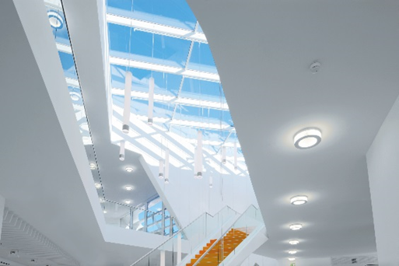
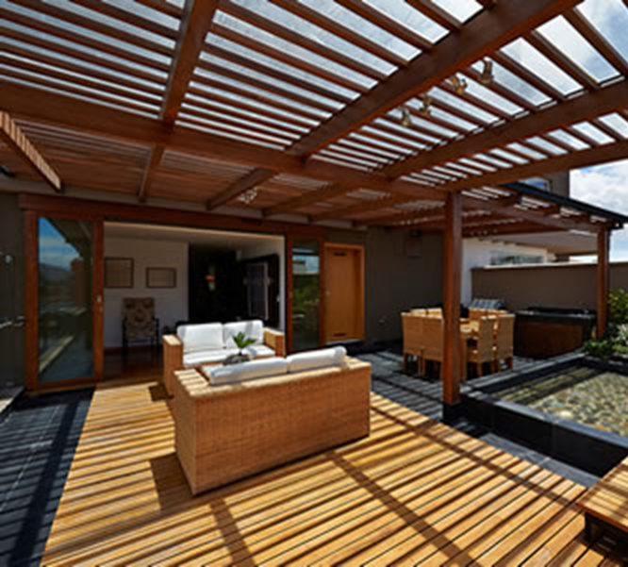
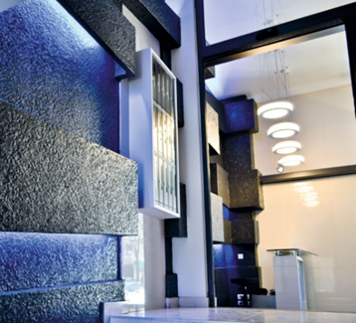
Research - Sleep and light schedule to reduce circadian misalignment in night workers
5,000 Lux 1,200 Lux 250 Lux
Notes:
Light was used during night shifts to promote delays and align the circadian clock with daytime sleep. Three light intensities were tested: high (5000 lux), medium (1200 lux) and low (250 lux). Subjects wore sunglasses on the way home and followed a regular daytime sleep schedule in very dark bedrooms.
There was no significant difference between the groups who received high- and medium-intensity light; most of whom delayed their Tmin into daytime sleep. In contrast, only 42% of those in the low-intensity group delayed that far.
Therefore, very bright light was not necessary to reduce circadian misalignment significantly.
I cannot find a reference to what colour temperature the light was in this experiment.

Slide 43
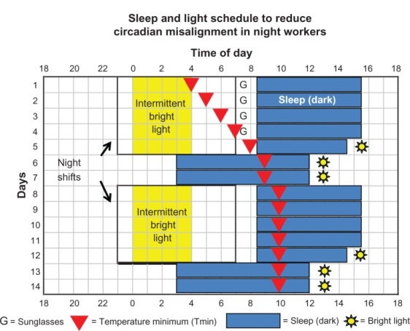
Research - Sleep and light schedule to reduce circadian misalignment in night workers
Notes:
This study showed that partial alignment to daytime sleep and night work was sufficient for improving alertness and performance. So this compromise works to shift the minimum temperature into both sleep periods in order to accommodate days off. It would be at the beginning of sleep after night work and near the end of sleep on days off.
The combination of light, sunglasses and very dark sleep conditions pushed the Tmin back 6 hours to 10am, which fits, as sleep on days off was from 3:00 am to noon.
During the last night shift and before days off, shorter sleep episodes were designed to build up a little sleep deprivation – to help subjects fall asleep earlier on the subsequent days off.
They also went outside for 15 minutes of afternoon light exposure within 2 hours of their scheduled wake times. This advancing light exposure, the “light brake,” was intended to stop their circadian clocks from delaying too far.

Slide 44
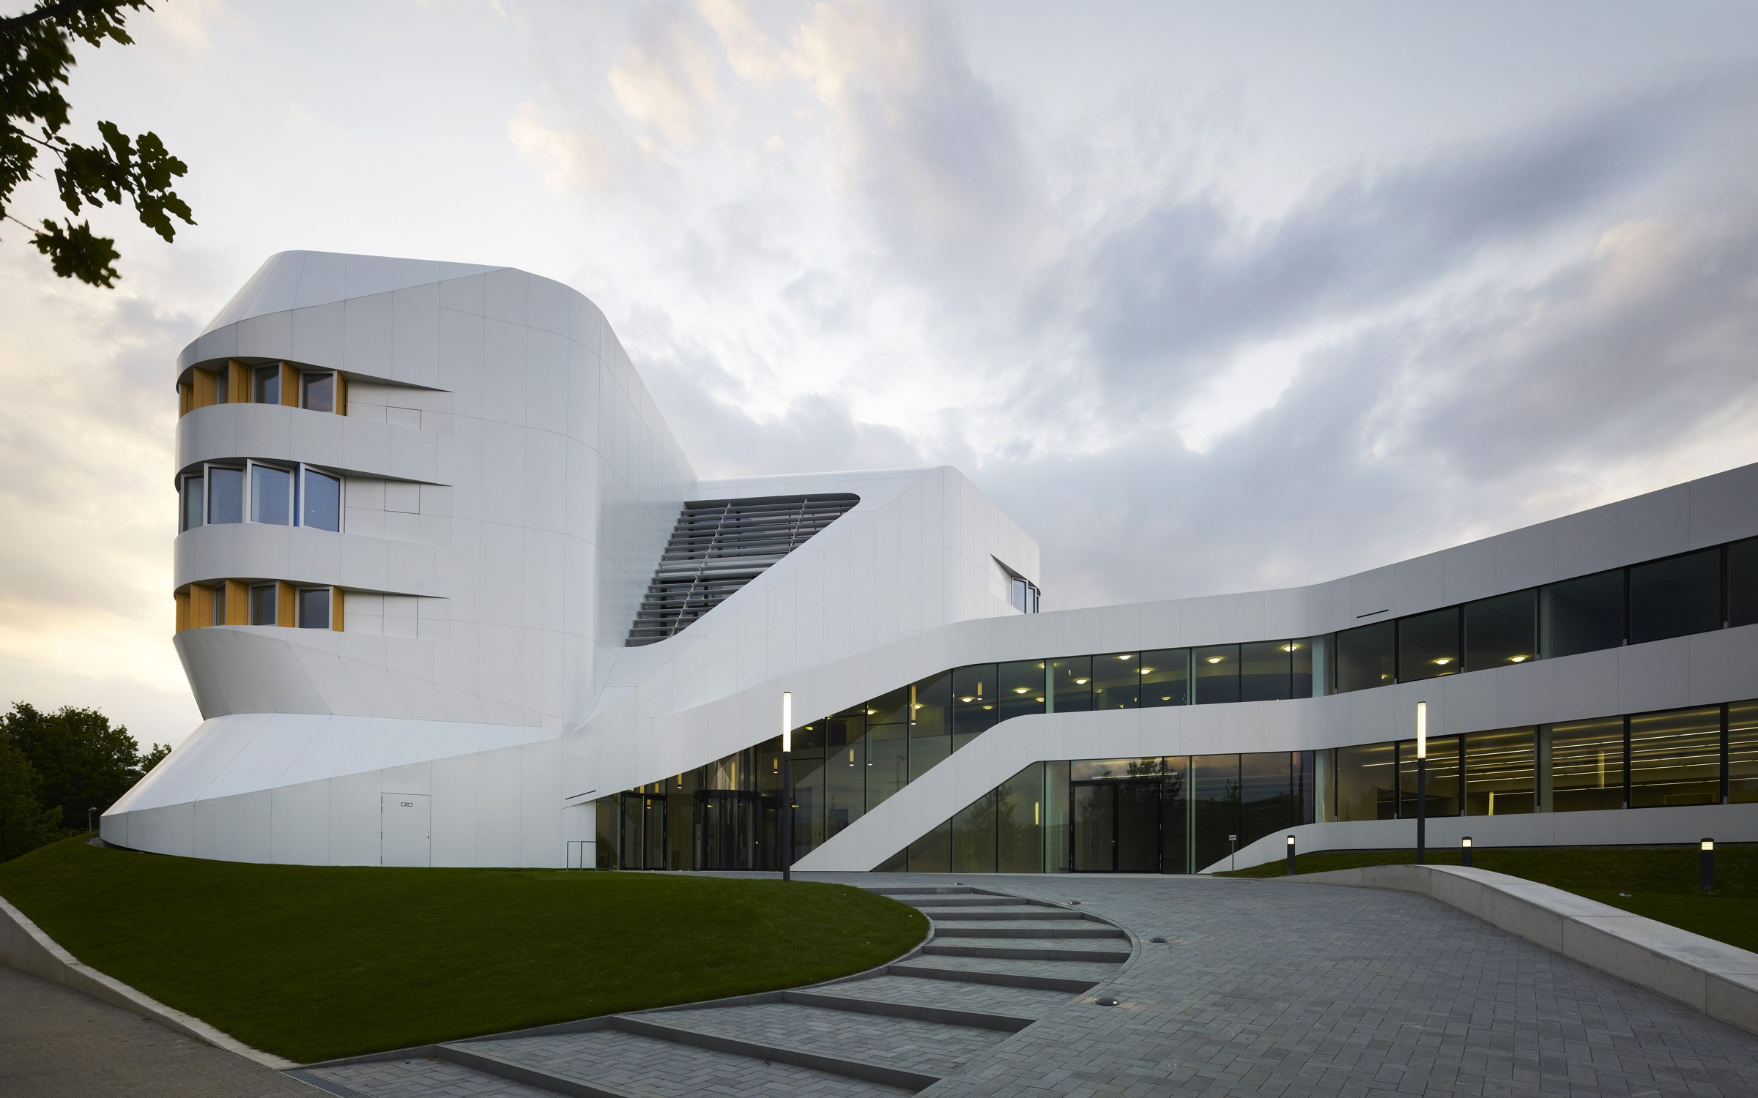
IAO Stuttgart, Fraunhofer Institute ZVE
Notes:
This is the Centre for Virtual Engineering for Fraunhofer Institute, which is Europe’s largest application-oriented research organisation.
Their research is geared entirely to people’s needs; health, communication, energy and the environment. TRILUX are now involved on a research programme with them.

Slide 45

Olive Research Project in conjunction with German Federal Ministry for Education and Research (BMBF)
Notes:
This collaborative research is being carried out by a specialist department in TRILUX, our think tank, ITZ, and with other partners under the acronym OLIVE aiming towards "optimised light systems for improvements in performance capability and health".
It is a three year programme to June 2017 with a budget of nearly 6million Euros and is overseen by the German Federal Ministry.
It is exploring the bio-medical factors which will then be developed upon to create solutions (light fittings and controls) that have freely selectable light spectra.

Slide 46
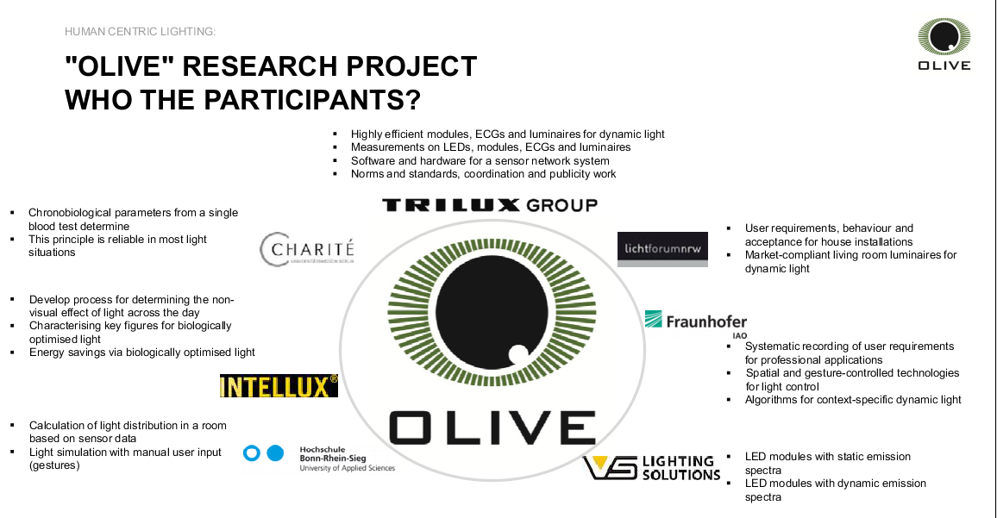
Olive Research Project in conjunction with German Federal Ministry for Education and Research (BMBF)
Notes:
The participants divide into academic and practical areas of expertise. Charite de Berlin and Intellux are developing the testing program; Franhofer are looking at the ergonomic requirements and automated control; TRILUX and VS are providing the hardware and also software that will make it more responsive to human interaction.

Slide 47
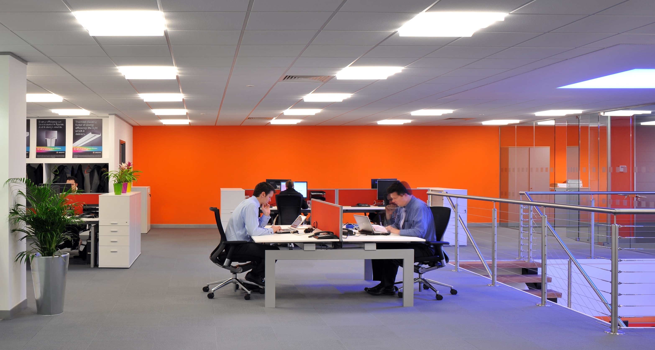
Our own research
Notes:
Closer to home, we have just started a small pilot study at our own offices in Chelmsford.
These luminaires have the capability to change from 2,700K to 6,000k and although there are some windows they are quite a distance away from the participants of the study.
One week will be spent under the warm setting of the luminaires for the duration of the working day, and another will be under the cool conditions. The final week will encompass a daylight simulating change in colour temperature and intensity.
This will then be repeated in February when we will have totally different daylight conditions.

Slide 48
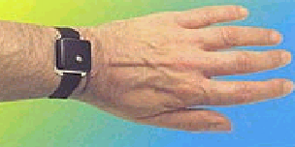
measurability
Actiwatches 24 hours per day
Sleep diaries
Mood/alertness VAS
KSS –Karolinska sleepiness scales
Notes:
My very helpful colleagues have agreed to wear Actiwatches for the full duration of the study. These measure light received and also detect movement.
They will also be completing sleep diaries and questionnaires on levels of alertness and comfort.

Slide 49
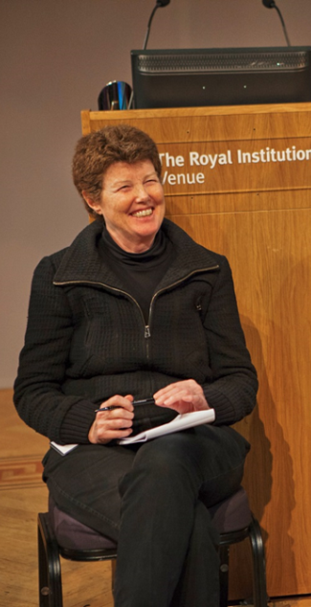

Professor debra j. skene
Chronobiology
Faculty of Health and Medical Sciences
University of Surrey, Guildford, UK
Notes:
This study is being moderated by Professor Debra Skene of Surrey University who has very kindly provided tried and tested questionnaires and is making sure we stick to all of the required protocols.

Slide 50
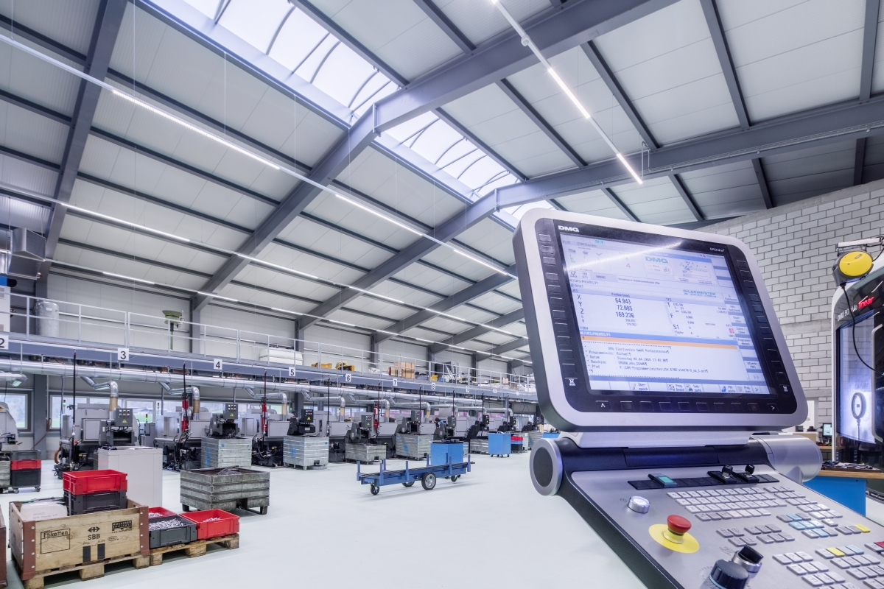
Our own research
Notes:
In Germany at our own factory we have just started recording baseline measurements for 6 months in an area where they work a 3 shift pattern.
The new lighting protocol will start in February and will be a further 6 month study.

Slide 51
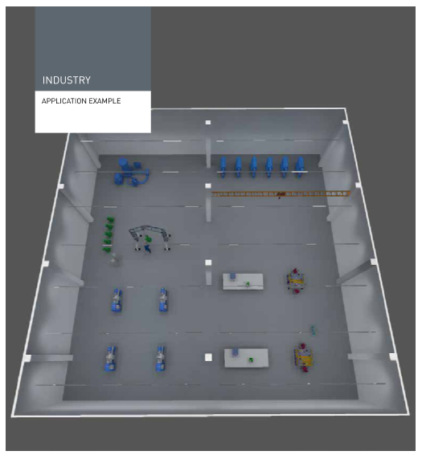
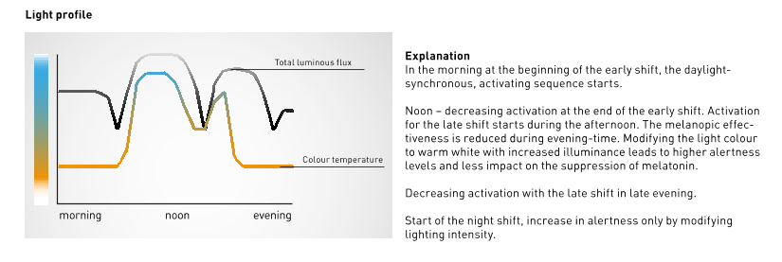
An example
Notes:
I think the light profile will be similar to this, but the final decision hasn’t been made yet. There are lots of discussions going on about increasing light levels but not the colour temperature to keep people alert at night but not entrain their circadian rhythms, this makes it suitable for shorter shift times or regularly rotating shift patterns.
6am – 2pm First shift Increase of alertness due to higher illuminance levels and increase of CT to support the circadian rhythm. Then there is a reduction of CT and illuminance to calm down before the finishing time.
2pm -10pm Second Shift Follows daylight synchronous CT until 6pm “sunset”. Illuminance levels stay higher to increase alertness but then lowers down towards the end of the shift.
10pm-6am Third shift Increase illuminance but with a warm CT to increase alertness without influencing the inner clock (melatonin levels).

Slide 52
conclusions
There are several possibilities for the use of light in the workplace, depending on the time schedules.
There is still a lack of standardised recommendations for light use, however much research has shown that light in the workplace mitigates sleepiness, lifts the mood, and improves the mental status in general.
Effective use of light may lead to an adaptation to the extended night work period and facilitate the subsequent re-adaptation to daytime life.
Much research is still needed but should also canvass the genetic predisposition for maladaptive circadian phase in night shift workers.

Slide 53
ARE YOU STILL FEELING AWAKE?

