Slide 1
Outdoor luminaires
LIGHT IN and AROUND THE BUILDING

Slide 2
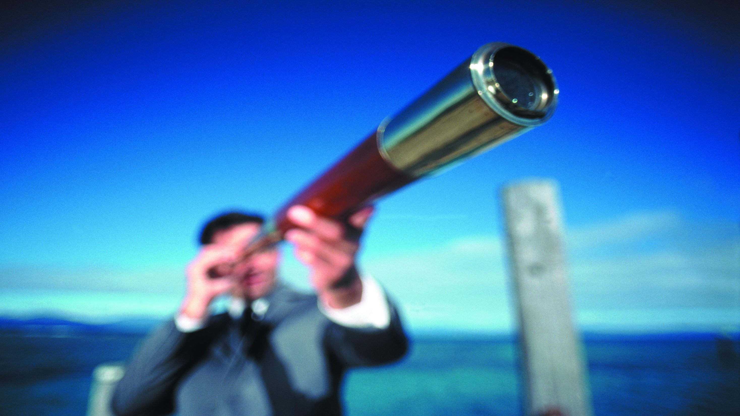
TARGET
STRATEGY – LIGHT AROUND THE BUILDING
IN 2020 EVERY 10th TURNOVER EURO IS AN OUTDOOR LUMINAIRE EURO

Slide 3
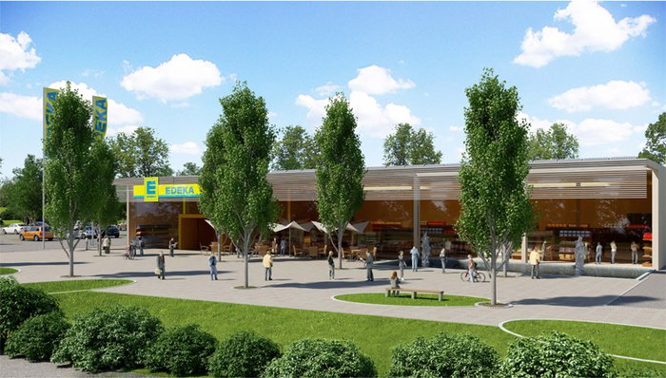
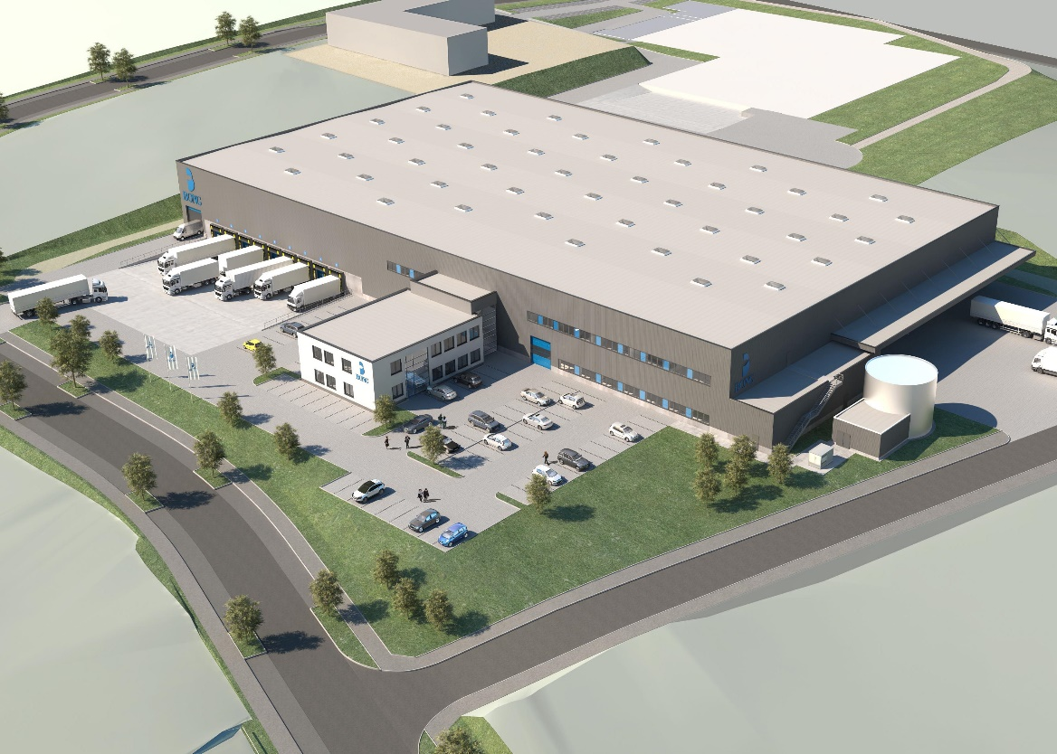

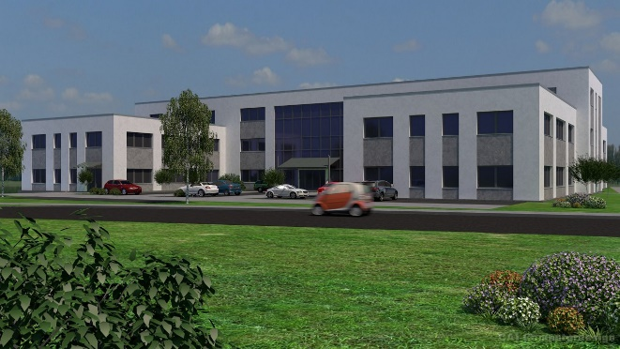


WE FIND AN OUTDOOR AREA IN EVERY APPLICATION
PRODUCT LAUNCHING Q1 | 2017

Slide 4
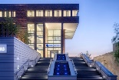
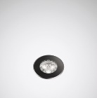
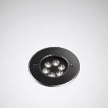
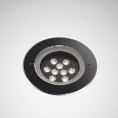
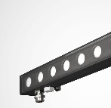
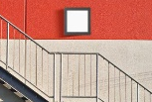
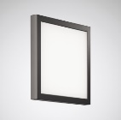
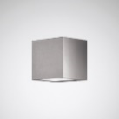
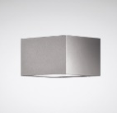
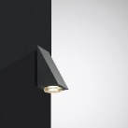
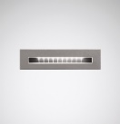
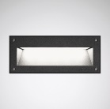
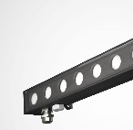
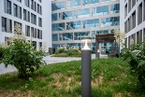
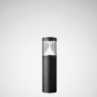
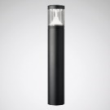
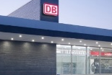
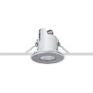
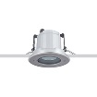
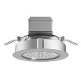
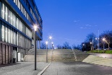
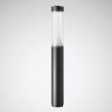
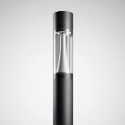
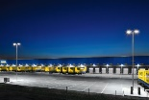
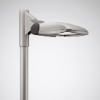
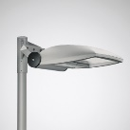
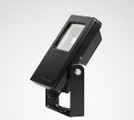
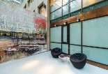
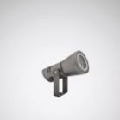
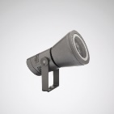
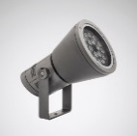
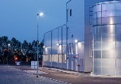
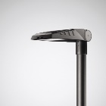
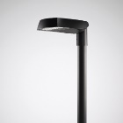
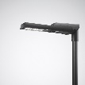
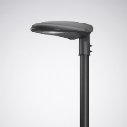
PRODUCT LAUNCHING Q1 | 2017
GROUND RECESSED LUMINAIRES
WALL AND CEILING LUMINAIRES
8501
8511
8521
ALTIGO G2
SKEO PURA
SKEO Q
SKEO R
HS
PAREDA SLIM
PAREDA
ALTIGO G2
BOLLARD LUMINAIRES
CEILING-RECESSED LUMINAIRES
8841K
8841
LUTERA 90 C
LUTERA 100 C
LUTERA 200 C
LIGHT COLUMNS
PROJECTORS
8841LS
CS20
CS23
LnStar 40
LnStar 70
COMBIAL
SPOTLIGHTS
POST LUMINAIRES
FACIELLA 08
FACIELLA 15
FACIELLA 20
LUMEGA IQ
CUVIA
VIACON
ONTRIA

Slide 5
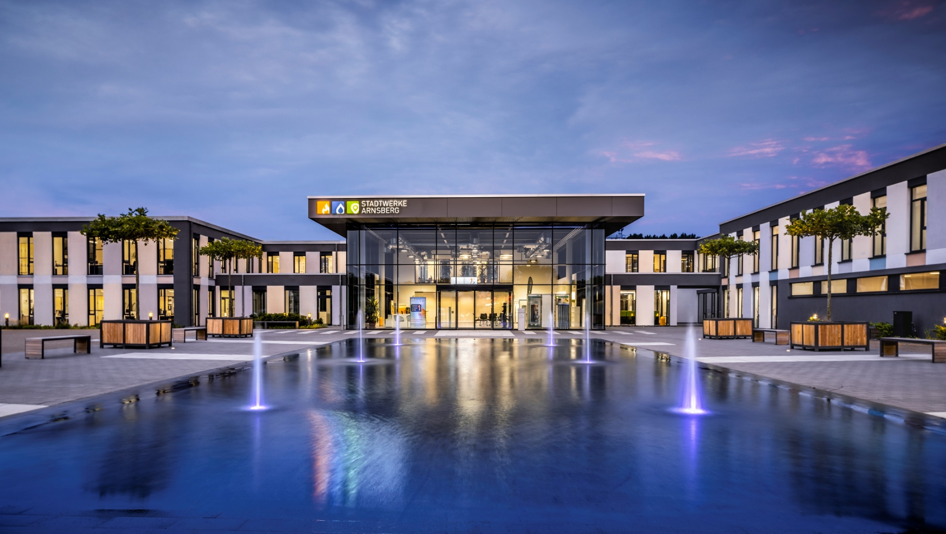
GROUND RECESSED LUMINAIRES

Slide 6
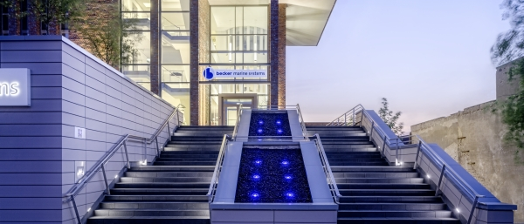
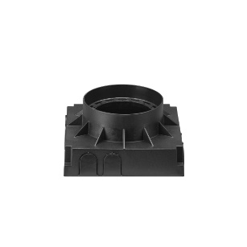
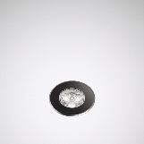
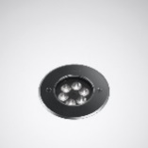
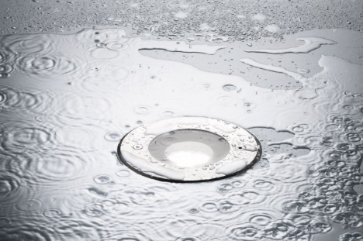
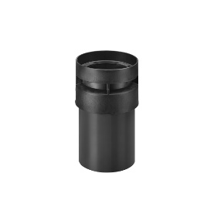
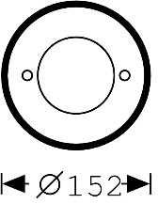
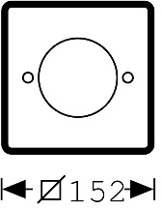
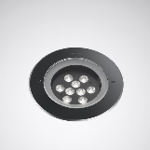

LUTERA
THE COMPLETE RANGE FOR PERFECT PRESENTATIONS
PRODUCT LAUNCHING Q1|2017
Luminaire luminous flux | 500lm – 2,900lm
Connected load/efficiency | 5W – 26W / up to 112lm/W
Service life | L80 50,000 h
Colour temperature | 3000K, 4000K, blue, red, green, amber, RGB
Electrical version | ET, Dali (on request for 8521)
Roll-over capacity | 8501 & 8521: 2,000kg | 8511: 3,000kg
Protection rating | safety class | IP68 / safety class I
Impact resistance | IK10
Tiltable LED PCB | 8501: no | 8511: to 10° | 8521 to 15°
Additional information
MOUNTING HOUSINGS
COVER PLATES
3 CONSTRUCTION SIZES
WATER-TIGHT

Slide 7





ALTIGO G2
THE COMPLETE RANGE FOR PERFECT PRESENTATIONS
PRODUCT LAUNCHING Q1|2017
Luminaire luminous flux | 500lm – 4,000lm
Connected load/efficiency | 11W – 36W/ up to 111lm/W
Service life | L80 50,000 h
Colour temperature | 3000K, 4000K
Electrical version | ET, DALI (on request) RGB
Load bearing capacity | 500kg
Protection rating | safety class | IP65 / safety class II
Light distribution | Rotationally symmetric Asymmetric
Additional information
LOAD BEARING CAPACITY: 500kg
LIGHT COMFORT
2 CONSTRUCTION SIZES
DELIVERY CAPABILITY 04/2017

Slide 8

BOLLARD LUMINAIRES & LIGHT COLUMNS

Slide 9







8841 | 8841 LIGHT COLUMN
SPECIFICALLY HIGH PERFORMANCE
PRODUCT LAUNCHING Q1|2017
Luminaire luminous flux | 8841: 700lm | 850lm 8841LS: to 3,500lm
Connected load/efficiency | 8841: 10W 8841LS: to 41W | 85 – 100 lm/W
Service life | L80 100,000 h
Colour temperature | 3000K, 4000K
Electrical version | ET, DALI (on request)
Protection rating | safety class | IP65 / safety class II
Light distribution | asymmetric wide distribution rotationally symmetric wide distribution MLTIQ
Additional information
FAMILY PHILOSOPHY
SUCCESS STORY
EXTREME SPACING
MLT IQ

Slide 10


Slide 11





CONSTELA
SPECIFICALLY HIGH PERFORMANCE
PRODUCT LAUNCHING Q1|2017
Luminaire luminous flux | 1,650lm – 5,600lm
Connected load/efficiency | 16W to 49W / up to 117 lm/W
Service life | L80 100,000 h
Colour temperature | 3000K, 4000K
Electrical version | ET, (LR, LRA, DALI on request)
Diameter | 200mm & 230mm
Protection rating | safety class | IP65 / safety class II
Light distribution | asymmetric wide distribution rotationally symmetric wide distribution; MLT IQ
Additional information
MODULAR SYSTEM
VARIOUS DESIGNS
SPOTLIGHT MODULES
CUSTOMER REQUESTS

Slide 12

SPOTLIGHTS

Slide 13





FACIELLA
ONE SPOTLIGHT. THREE MODULES: ALL POSSIBILITIES.
PRODUCT LAUNCHING Q1|2017
Luminaire luminous flux | 500lm – 4,200lm
Connected load/efficiency | 7W – 43W / up to 102lm/W
Service life | L80 50,000 h
Colour temperature | 3000K, 4000K, blue, red, green, amber, RGB
Electrical version | ET, DALI (on request Faciella 15 & 20)
Protection rating | safety class | IP65 / safety class II
Light distribution | rotationally symmetric narrow rotationally symmetric medium wide rotationally symmetric wide
Additional information
POST CONNECTIONS
DIVERSE ACCESSORIES
3 CONSTRUCTION SIZES
HIGH LUMEN OUTPUT

Slide 14





SKEO PURA
FLAT SQUARES FOR ATTRACTIVE FACADE LIGHTING
PRODUCT LAUNCHING Q1|2017
Luminaire luminous flux | 500lm – 1,650lm
Connected load/efficiency | 10W – 25W | max. 70 lm/W
Service life | L80 50,000 h
Colour temperature | 3000K, 4000K
Electrical version | ET, DALI (Skeo Pura 40 on request)
Impact resistance | IK07
Protection rating | safety class | IP65 / I
Light distribution | rotationally symmetric wide distribution
Additional information
FLEXIBILITY OF DESIGN
TWO CONSTRUCTION SIZES
WALL/CEILING LUMINAIRE
DELIVERABLE

Slide 15





SKEO Q
FILIGREE RECESSED LUMINAIRE FOR LARGE LIGHT ACCENTS
PRODUCT LAUNCHING Q1|2017
Luminaire luminous flux | 20lm – 3,200lm
Connected load/efficiency | 4W to 28W / up to 107 lm/W
Service life | L80 50,000 h
Colour temperature | 3000K, 4000K
Electrical version | ET
DC voltage compatibility | yes
Protection rating | safety class | IP65 / I
Light distribution | asymmetric wide distribution rotationally symmetric wide distribution
Additional information
2 CONSTRUCTION SIZES
FLEXIBLE USES
SIMPLE INSTALLATION
DELIVERABLE

Slide 16





SKEO Q – A CUBE SETS ACCENTS
PHOTOMETRIC OPTIONS
PRODUCT LAUNCHING Q1|2017
Lighting technology:
AMxR
Lighting technology:
RBxR
Lighting technology:
AMxR-AMxR
Lighting technology:
RBxR-RBxR
Lighting technology:
AMxR-RBxR

Slide 17




SKEO R
FILIGREE RECESSED LUMINAIRE FOR LARGE LIGHT ACCENTS
PRODUCT LAUNCHING Q1|2017
Luminaire luminous flux | 20lm – 3,000lm
Connected load/efficiency | 4W to 28W / up to 107 lm/W
Service life | L80 B10 50,000 h
Colour temperature | 3000K, 4000K
Electrical version | ET
DC voltage compatibility | yes
Protection rating | safety class | IP65 / I
Light distribution | asymmetric wide distribution rotationally symmetric wide distribution
Additional information
2 CONSTRUCTION SIZES
FLEXIBLE USES
WALL & CEILING SURFACE-MOUNTING
DELIVERY CAPABILITY 04/2017

Slide 18





HS
DECORATIVE WALL LUMINAIRE WITH TRIANGULAR CHARACTER
PRODUCT LAUNCHING Q1|2017
Luminaire luminous flux | 300lm
Connected load/efficiency | 4W / 75lm/W
Service life | L80 50,000 h
Colour temperature | 3000K, 4000K
Electrical version | ET
Protection rating | safety class | IP54 | safety class I
Light distribution | rotationally symmetric medium wide
Additional information
NEW LED VERSION
BOLLARD LUMINAIRE
WALL LUMINAIRE
DELIVERABLE

Slide 19





ALTIGO G2
FILIGREE RECESSED LUMINAIRE FOR LARGE LIGHT ACCENTS
PRODUCT LAUNCHING Q1|2017
Luminaire luminous flux | 300lm – 4,000lm
Connected load/efficiency | 3W – 36W / up to 111 lm/W
Service life | L80 50,000 h
Construction sizes | 100mm | 300mm | 600mm | 900mm | 1200mm
Colour temperature | 3000K, 4000K
Electrical version | ET, DALI & RGB (on request)
Protection rating | safety class | IP65 / safety class II
Light distribution | asymmetric rotationally symmetric
Additional information
5 CONSTRUCTION SIZES
WALL SURFACE-MOUNTED LUMINAIRE
RECESSED CEILING LUMINAIRE
DELIVERABLE 04/2017

Slide 20





PAREDA
FILIGREE RECESSED LUMINAIRE FOR LARGE LIGHT ACCENTS
PRODUCT LAUNCHING Q1|2017
Luminaire luminous flux | 30lm | 110lm
Connected load/efficiency | 3W | 6W
Service life | L80 50,000 h
Colour temperature | 3000K, 4000K
Electrical version | ET
Impact resistance | IK09
Protection rating | safety class | IP65 / I
Light distribution | asymmetric medium wide
Additional information
HIGH PRODUCT QUALITY
2 CONSTRUCTION SIZES
FLUSH & RAISED
DELIVERABLE 04/2017

Slide 21





PAREDA SLIM
FILIGREE RECESSED LUMINAIRE FOR LARGE LIGHT ACCENTS
PRODUCT LAUNCHING Q1|2017
Luminaire luminous flux | 110lm
Connected load/efficiency | 5W / up to 22 lm/W
Service life | L80 B10 50,000 h
Colour temperature | 3000K, 4000K
Electrical version | ET
Impact resistance | recess depth | IK07 | 72mm
Protection rating | safety class | IP65 / I
Light distribution | asymmetric medium wide
Additional information
HIGH PRODUCT QUALITY
LOW RECESS DEPTH
SIMPLE INSTALLATION
DELIVERABLE 04/2017

Slide 22

CEILING-RECESSED LUMINAIRES

Slide 23





LUTERA C
FILIGREE RECESSED LUMINAIRE FOR LARGE LIGHT ACCENTS
PRODUCT LAUNCHING Q1|2017
Luminaire luminous flux | 100 lm – 2,000 lm
Connected load/efficiency | 3W – 23W / up to 100 lm/W
Service life | L80 50,000 h
Colour temperature | 3000K, 4000K
Electrical version | ET, DALI & RGB (on request)
Protection rating | safety class | IP65 / I
Light distribution | asymmetric rotationally symmetric
Additional information
3 CONSTRUCTION SIZES
TRANSPARENT GLASS
LIGHT COMFORT
DELIVERABLE 04/2017

Slide 24
ALTIGO G2
FILIGREE RECESSED LUMINAIRE FOR LARGE LIGHT ACCENTS
PRODUCT LAUNCHING Q1|2017
Luminaire luminous flux | 300lm – 4,000lm
Connected load/efficiency | 3W – 36W / up to 111 lm/W
Service life | L80 50,000 h
Construction sizes | 100mm | 300mm | 600mm | 900mm | 1200mm
Colour temperature | 3000K, 4000K
Electrical version | ET, DALI & RGB (on request)
Protection rating | safety class | IP65 / safety class II
Light distribution | asymmetric rotationally symmetric
Additional information
5 CONSTRUCTION SIZES
WALL SURFACE-MOUNTED LUMINAIRE
RECESSED CEILING LUMINAIRE
DELIVERABLE 04/2017

Slide 25




COMBIAL LED
PRODUCT LAUNCHING Q1|2017
Luminaire luminous flux | 3,500lm – 12,000lm
Connected load/efficiency | 35W – 120W | max. 100lm/W
Service life | L80 50,000h
Colour temperature | 3000K, 4000K
Electrical version | ET
Construction sizes | 3
Protection rating | safety class | IP65 / I
Light distribution | symmetric wide distribution
Additional information
ENTRY SEGMENT
CLEAR DIFFERENTIATION
3 CONSTRUCTION SIZES
DELIVERABLE 04/2017

Slide 26

LIGHT
ON
AND
AROUND
THE BUILDING

Slide 27


ALTIGO
500lm – 4,000lm
3W – 36W / up to 111 lm/W
L80 50,000 h
600mm | 1200mm
3000K, 4000K
ET, DALI & RGB
IP65
asymmetric / rotationally symmetric

Slide 28

ALTIGO
500lm – 4,000lm
3W – 36W / up to 111 lm/W
L80 50,000 h
600mm | 1200mm
3000K, 4000K
ET, DALI & RGB
IP65
asymmetric / rotationally symmetric

Slide 29


LUTERA
500lm – 2,900lm
5W – 26W / up to 112lm/W
L80 50,000 h
3000K, 4000K, blue, red, green, amber, RGB
ET, DALI (on request for 8521)
8501 & 8521: 2,000kg | 8511: 3,000kg
IP68 | IK10
TILT 8501: no | 8511: to 10° | 8521 to 15°

Slide 30


FACIELLA
500lm – 4,200lm | 7W – 43W / up to 102lm/W
L80 50,000 h
3000K, 4000K, blue, red, green, amber, RGB
ET, DALI (on request Faciella 15 & 20)
IP65
rotationally symmetric narrow
rotationally symmetric medium wide
rotationally symmetric wide

Slide 31


ALTIGO
500lm – 4,000lm
3W – 36W / up to 111 lm/W
L80 50,000 h
600mm | 1200mm
3000K, 4000K
ET, DALI & RGB
IP65
asymmetric / rotationally symmetric

Slide 32


SKEO D
400lm – 2,600lm
3W – 20W / up to 130 lm/W
L80 50,000 h
100mm | 150mm
3000K, 4000K
IP65
rotationally symmetric

Slide 33


LUTERA C
100 lm – 2,000 lm
3W – 23W / up to 100 lm/W
L80 50,000 h
3000K, 4000K
ET, DALI & RGB (on request)
IP65
asymmetric
rotationally symmetric

Slide 34


Slide 35


SKEO W
20lm – 3,200lm
4W to 28W / up to 107 lm/W
L80 50,000 h
3000K, 4000K
IP65
asymmetric wide distribution
rotationally symmetric wide distribution

Slide 36


PAREDA SLIM
110lm
5W / up to 22 lm/W
L80 B10 50,000 h
3000K, 4000K
72mm
IK07 | IP65
asymmetric medium wide

Slide 37

PAREDA SLIM
110lm
5W / up to 22 lm/W
L80 B10 50,000 h
3000K, 4000K
72mm
IK07 | IP65
asymmetric medium wide

Slide 38



PAREDA SLIM
100 lm
3000K
Asymmetric medium wide beam AM5L
5 lux average
1 lux minimum
2m
3m

Slide 39


CONSTELA
1,650lm – 5,600lm
16W to 49W / up to 117 lm/W
L80 100,000 h
3000K, 4000K
ET, (LR, LRA, DALI on request)
DIA 200mm & 230mm
IP65
asymmetric wide distribution
rotationally symmetric wide distribution; MLT IQ

Slide 40

CONSTELA
1,650lm – 5,600lm
16W to 49W / up to 117 lm/W
L80 100,000 h
3000K, 4000K
ET, (LR, LRA, DALI on request)
DIA 200mm & 230mm
IP65
asymmetric wide distribution
rotationally symmetric wide distribution; MLT IQ

Slide 41

LUTERA
500lm – 2,900lm
5W – 26W / up to 112lm/W
L80 50,000 h
3000K, 4000K, blue, red, green, amber, RGB
ET, Dali (on request for 8521)
8501 & 8521: 2,000kg | 8511: 3,000kg
IP68 / IK10
8501: no TILT | 8511: to 10° | 8521 to 15°

Slide 42


SKEO W
20lm – 3,200lm
4W to 28W / up to 107 lm/W
L80 50,000 h
3000K, 4000K
IP65
asymmetric wide distribution
rotationally symmetric wide distribution

Slide 43


8841LS
Up to 3,500lm
Up to 41W | 85 – 100 lm/W
L80 100,000 h
3000K, 4000K
ET, DALI (on request)
IP65
asymmetric wide /rotationally symmetric wide
MLT IQ

Slide 44


8841LS
3.6m PILLAR LUMINAIRE
3500 lm
4000K
Asymmetric wide beam AB2L
15 lux average
15 Lux
Average
15m

Slide 45


8841
700lm | 850lm
10W | 73 lm/W
L80 80,000 h
3000K, 4000K
ET, DALI (on request)
IP65 / safety class II
asymmetric wide distribution
rotationally symmetric wide distribution
MLTIQ

Slide 46


8841 BOLLARD
700 lm
3000K
Asymmetric wide beam AB2L
1 lux minimum
3m
5m

Slide 47


Slide 48


Slide 49


Slide 50


