Slide 1
Human responses to light
IS LIGHT A DRUG?

Slide 2
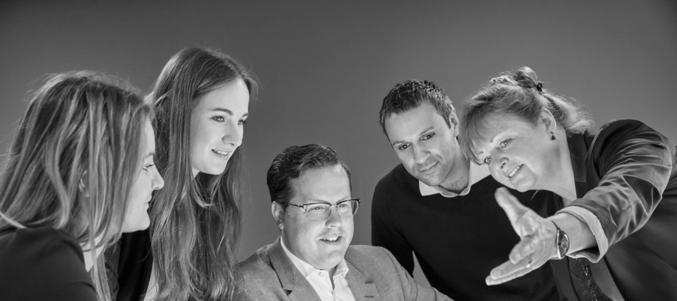
May I introduce myself
Helen Loomes FSLL
Business Development Director
International Projects
Akademie Presenter
Fellow of The Society of Light and Lighting
BSI and ISO TC

Slide 3
Human response to light
IS LIGHT A DRUG?

Slide 5
DYNAMIC LIGHT
Natural light changes in intensity, colour temperature and direction...

Slide 6
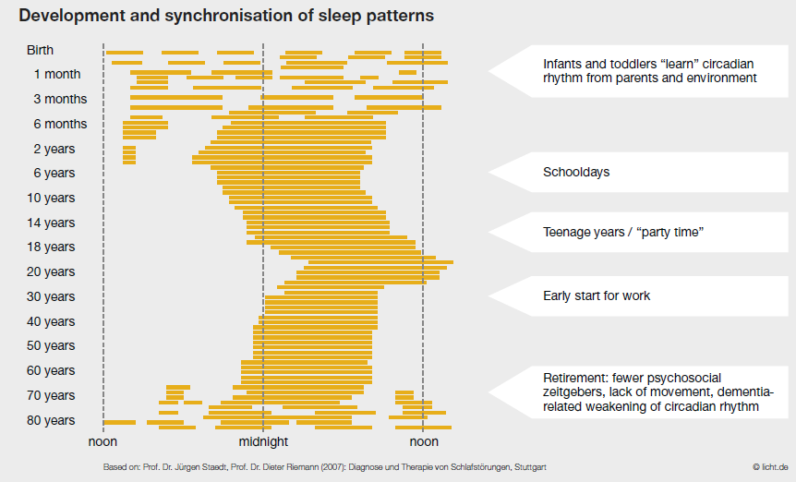
Development and synchronisation of sleeping behaviour

Slide 7
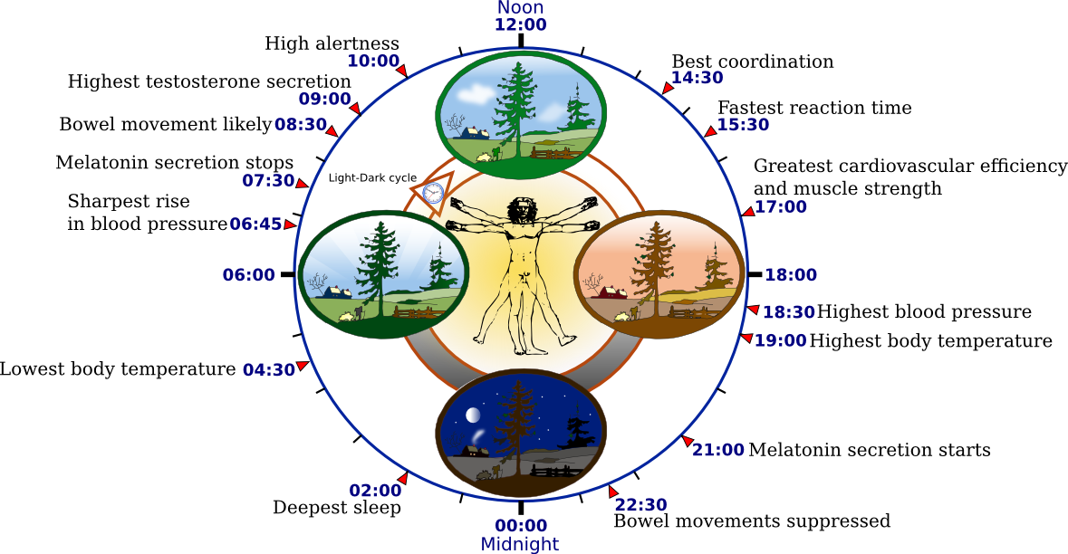
Tune into your biological rhythms

Slide 8
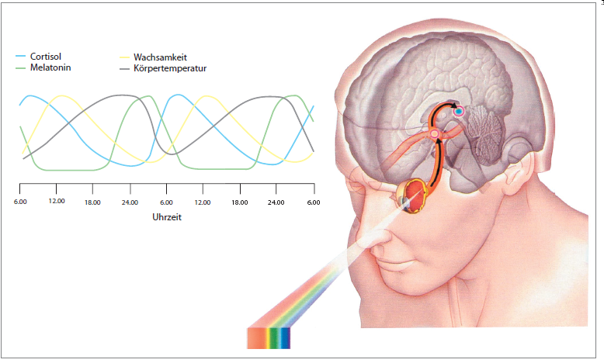
CYCLE OF DIFFERENT CIRCADIAN RHYTHMS
The biological clock is triggered daily via specific receptors in the retina
Notes:
8
Since 2002 scientists have found new photo biological receptors. These receptors aren‘t responsible for visual responses like the rods (Stäbchen) and cones (Zapfen Farbe). Their function is to set your internal biological clock and control your release of hormones. These hormones control your biological rhythm, for example so that you become tired at night.
In this diagram you can see that the sleeping hormone melatonin increases at 6 pm and decreases at 6 am.
Therefore the performance and attention curve decrease without the corresponding daylight.
Here you see that dynamic lighting can support the biological rhythm.
The biological rhythms of human beings can be modified by light, bluish light, around 450 nm especially, has the largest impact.
Saliva = Speichel = Messung Melatonin
Discovery of Melatonin in 1958.
Discovery of the biological clock in people in 1972.
Pineal gland = Epiphysis releases melatonin and serotonin (happy hormones).
Melatonin suppression = incidence of light in an eye curbs the release of melatonin
Increasing light levels signal the body to begin its active cycle. It responds by producing serotonin, adrenalin and cortisol. Hormone levels rise, along with temperature and metabolism and by mid-afternoon, the body has reached its peak metabolism. Two important hormones are cortisol that rises in the morning and make us feel more alert and melatonin that rises in the evening and make us feel more sleepy. Metabolism converts the fuel in the food we eat into the energy needed to power everything we do, from moving to thinking to growing.

Slide 9
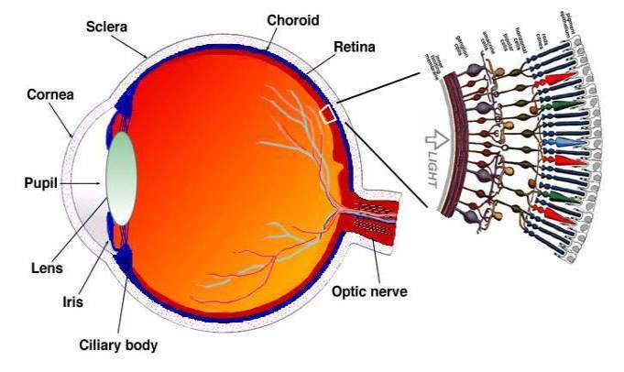
Cones for day/colour vision
Rods for night vision
Third receptors:
Intrinsically photosensitive retinal ganglion cells.
They respond to blue wavelengths of light at approx 460nm.
Notes:
First we have to understand how this works. Light enters via the lens into the eye and reaches the retina at the back of our eye-ball. When the light reaches the retina, it passes a layer of ganglion cells, bipolar cells and then the layer of where the cones and rods are. With the cones (red, blue, green) we can see colours, the rods are for low lux level vision (no colour recognition).
In 2002, “Hattar et al” described in the layer of ganglion cells, the 3rd receptors in addition to the known rods and cones.

Slide 10
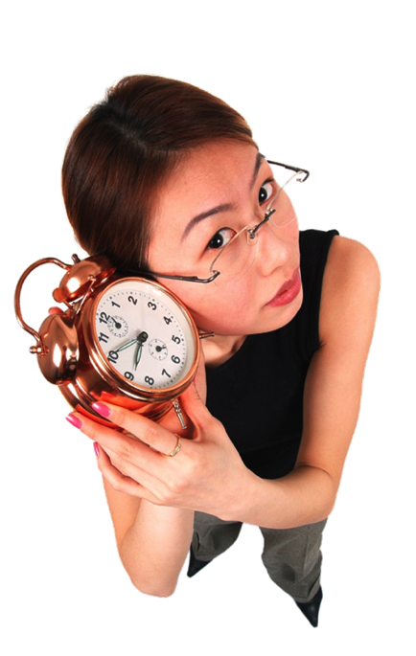
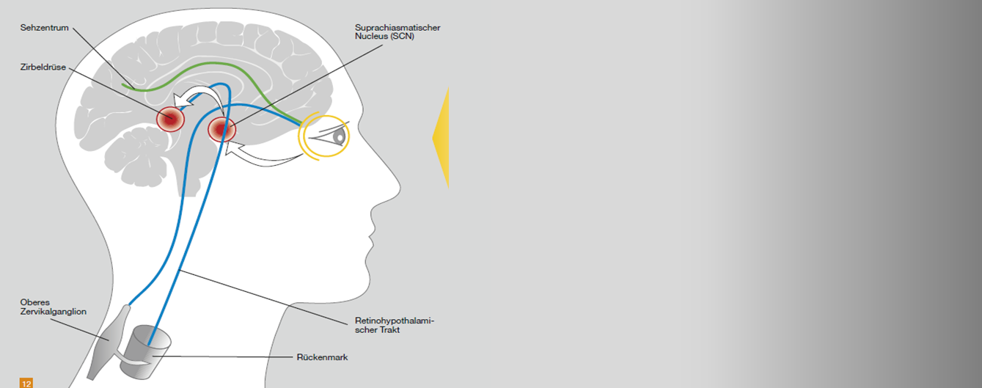
Visual Cortex
Suprachiassmatic Nucleus
Pineal
Gland
LIGHT
Superior
Cervical
Ganglia
Preganglionic Sympathetic Neurons
Notes:
Circadian Oscillator

Slide 11
DYNAMIC LIGHT
Natural light changes in intensity, colour temperature and direction...

Slide 12
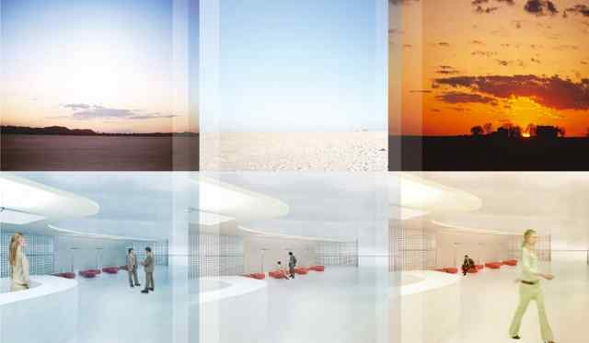
DYNAMIC LIGHT
… and so we should try to reproduce it with flexible artificial light
Notes:
Natural light changes over the day in
intensity,
colour temperature and
angle.

Slide 13
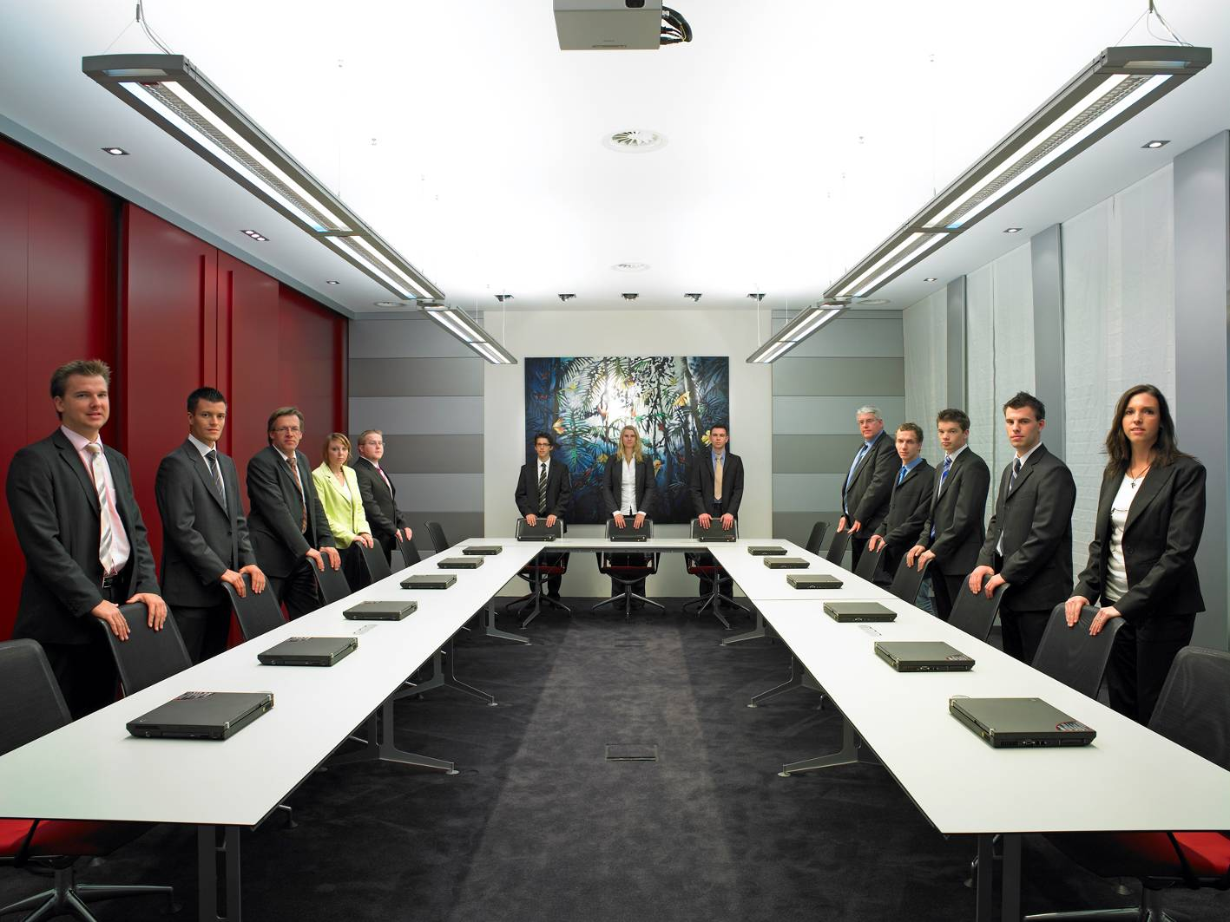
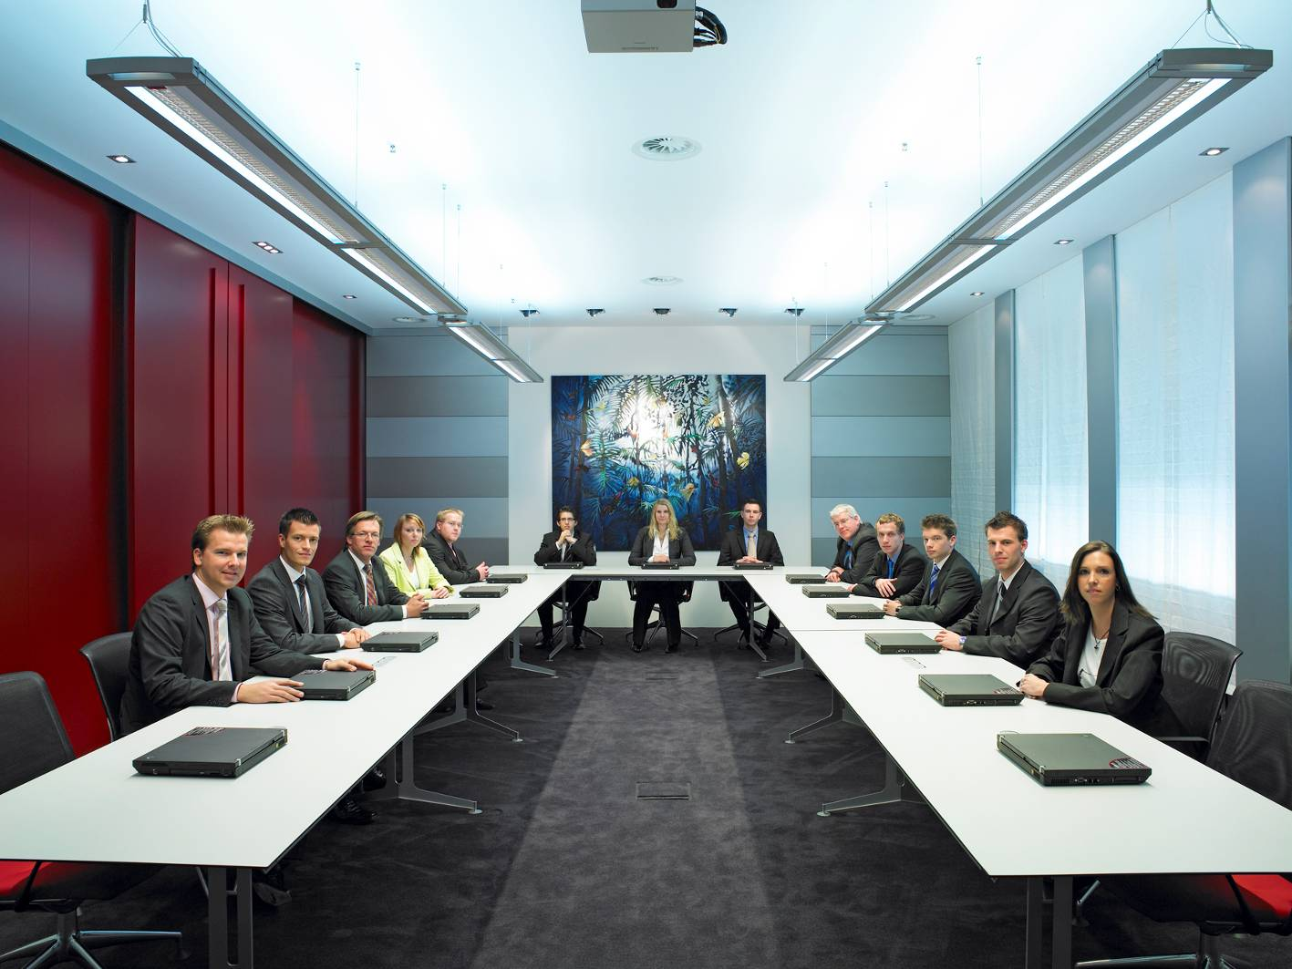
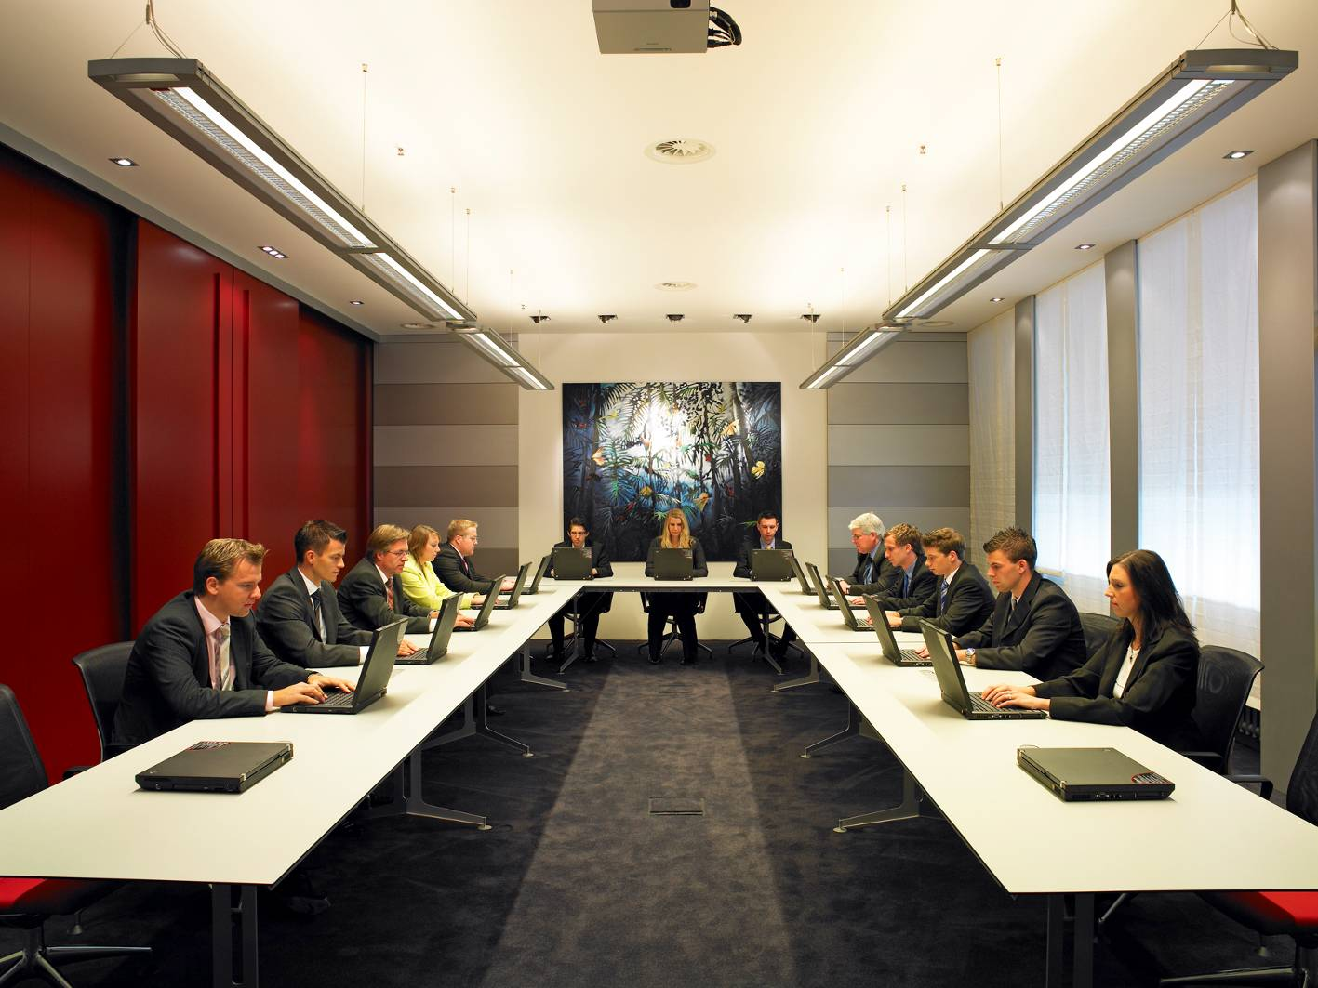
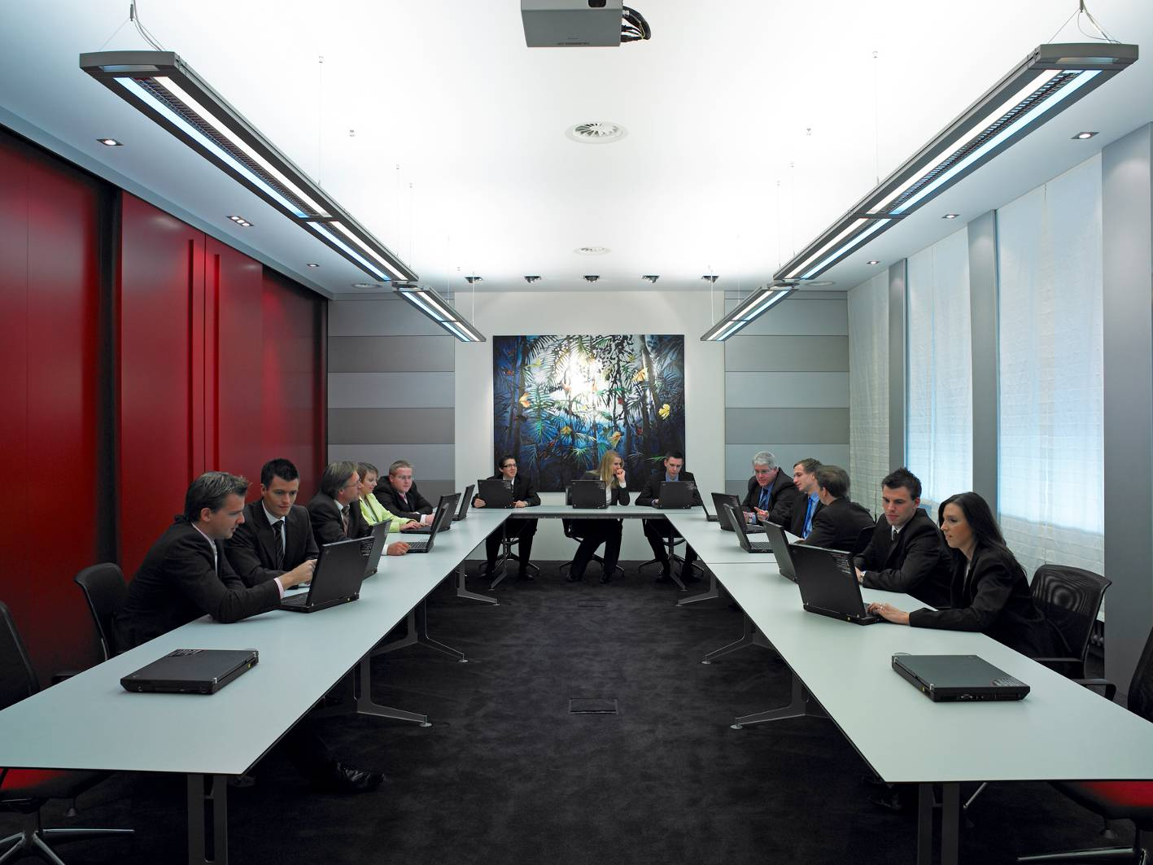
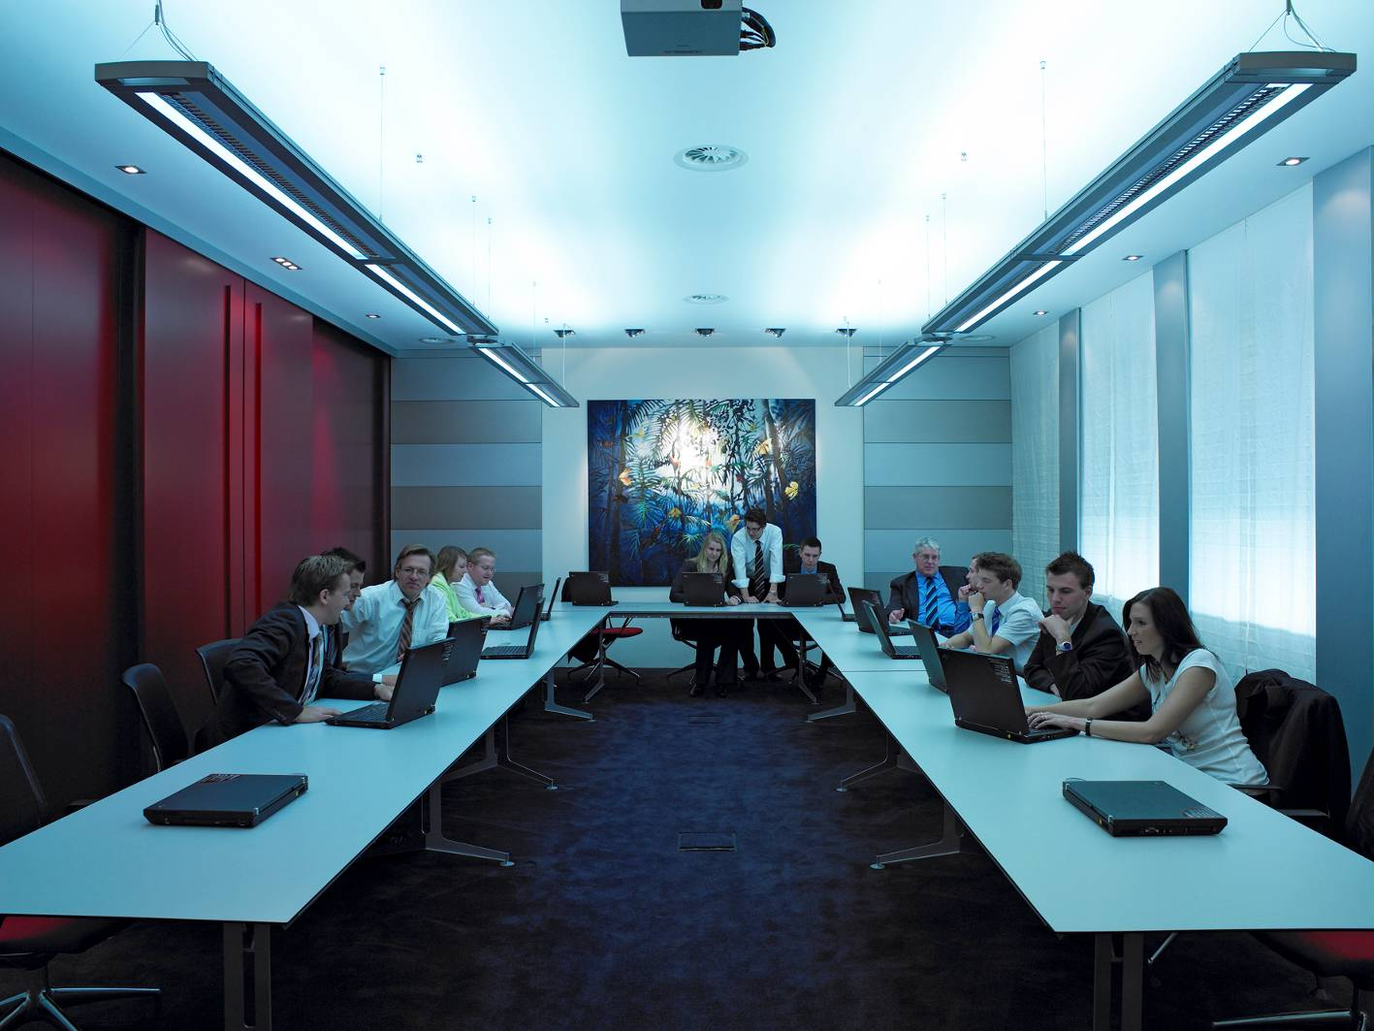
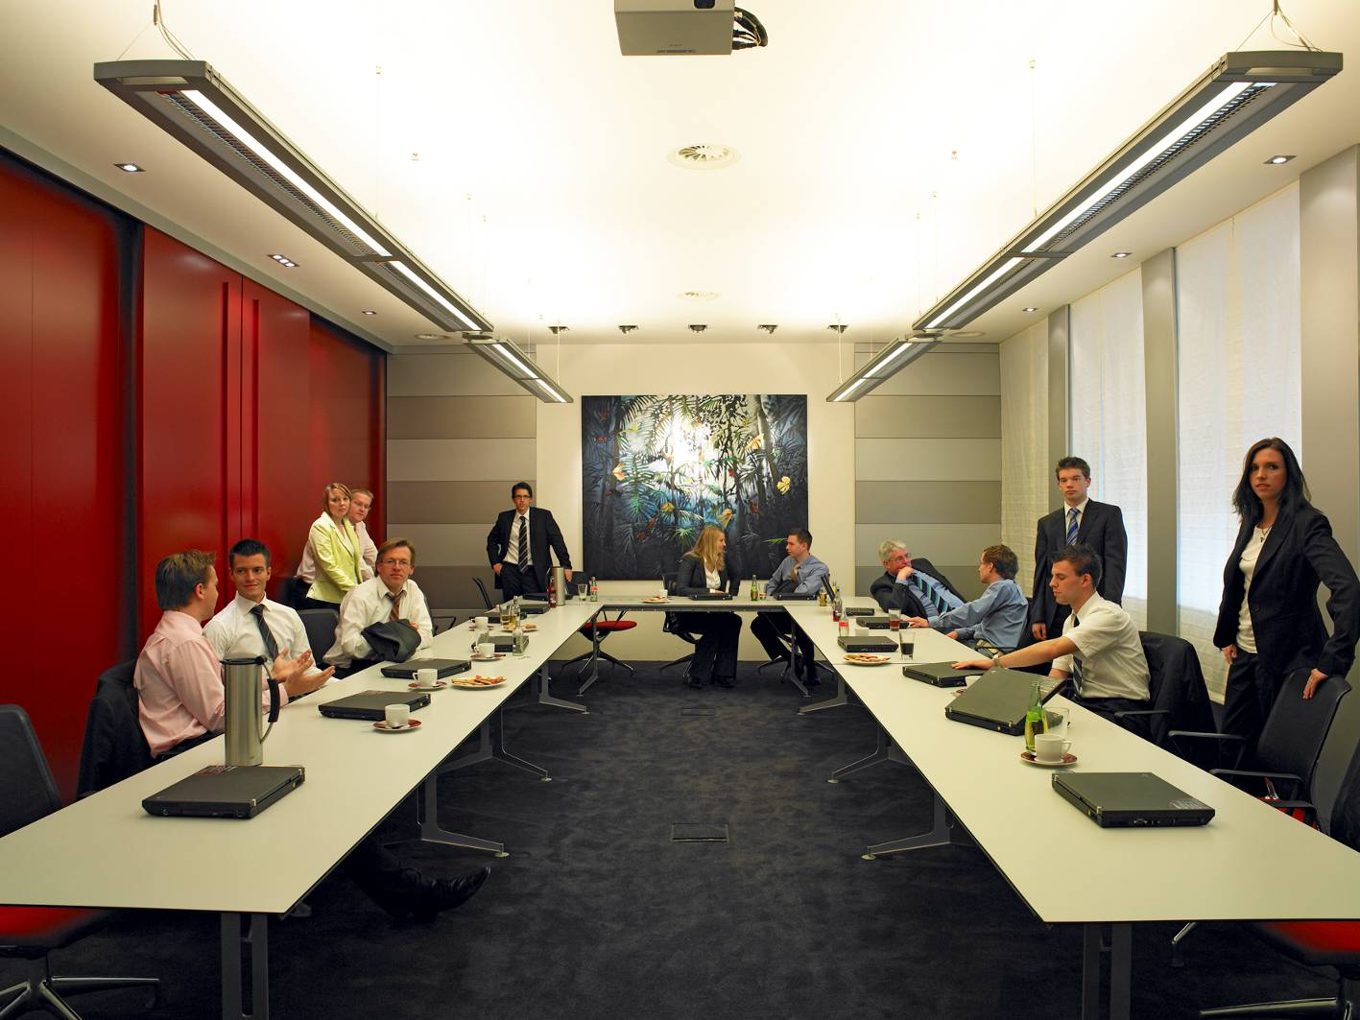
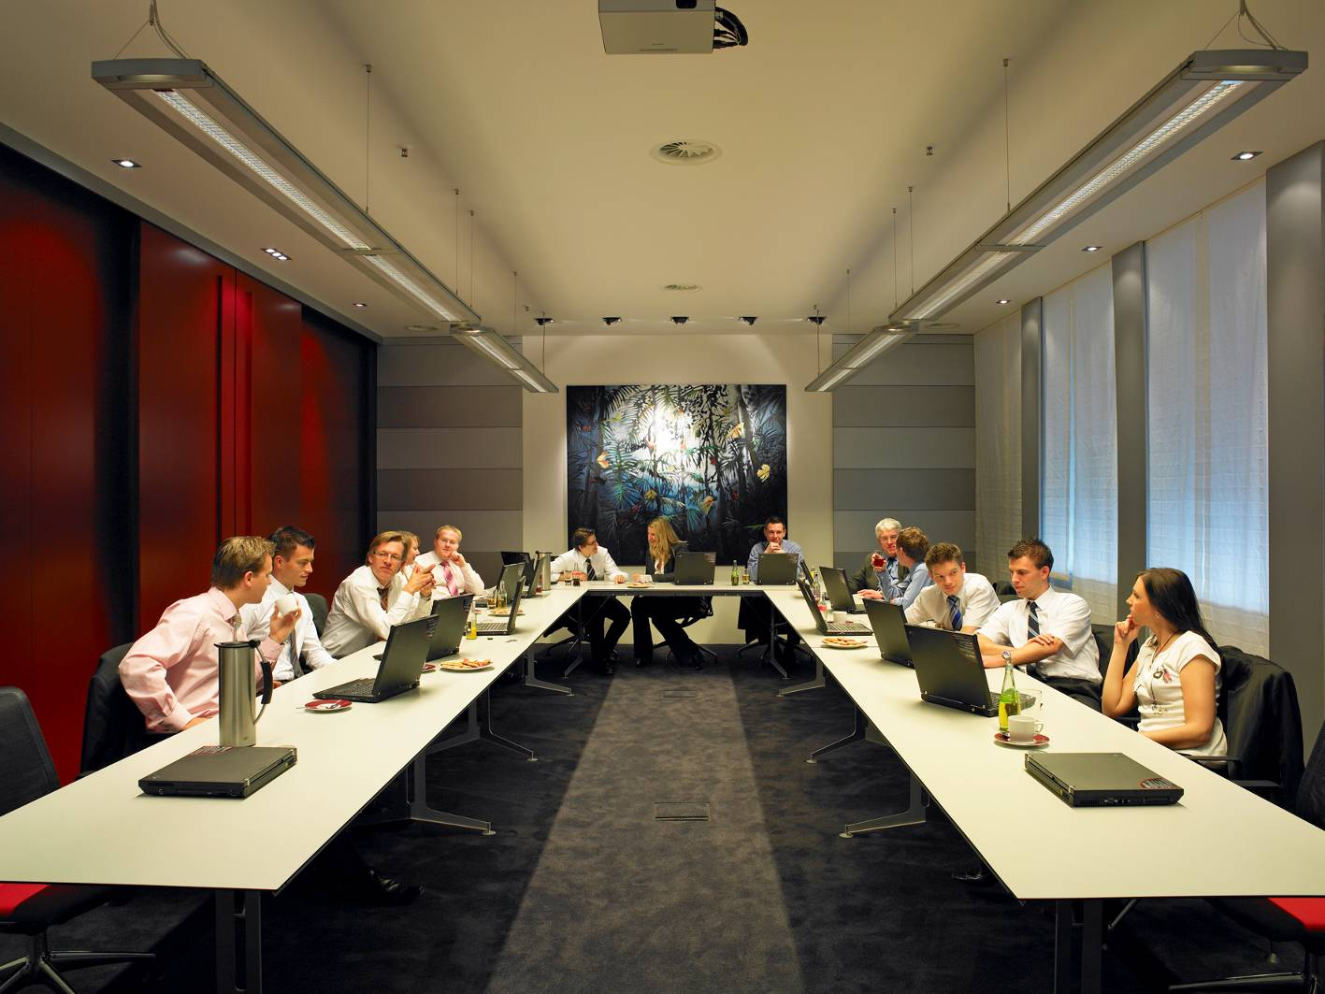
Dynamic light can affect concentration or well-being…
in a
meeting room
Notes:
Here you see a dynamic light control in one of our meeting rooms.
From the welcome at the morning (with activate light/ blue light)
Over a conference till lunch with normal light and a short activate time after lunch with blue light
To the end of the conference with discussions in the evening with warm light.

Slide 14
EDUCATION

Slide 15
JOINT RESEARCH IN HAMBURG SCHOOLS 2011-2012
TRILUX was involved in several research projects at schools in Hamburg, Dresden and Berlin.
For the research project in Hamburg, 39 schools were modified with dynamic light from TRILUX and Philips.
The modified schools had the opportunity to switch their lighting to suit the situation.
300 lux 4.000 K (traditional light),
1.000 lux 6.000 K (concentration),
650 lux 12.000 K (activate)
300 lux 2.700 K (calm).
Notes:
Cold colour temperature light can push you in the morning or after lunch to get a better performance.
But before you go to sleep, a warm colour temperature is preferable to aid beauty sleep.
The effects of dynamic light are not completely explored just the basic statements.
Trilux is involved in some research projects in grammar schools.
The schools have good experience with the dynamic light.

Slide 16
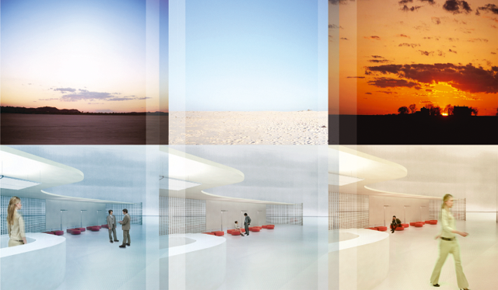
CASE STUDY: HAMBURG-EPPENDORF
The study comprised of 166 students and 18 teachers over the course of 1 year.
The students were between 7 and 16 years of age.
Conducted by the Hamburg UKE Clinical Centre for Child and Youth Psychosomatic Research.
Notes:
This is a study where different lighting scenes were available to teachers to use according to the activity.

Slide 17
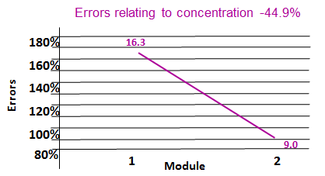
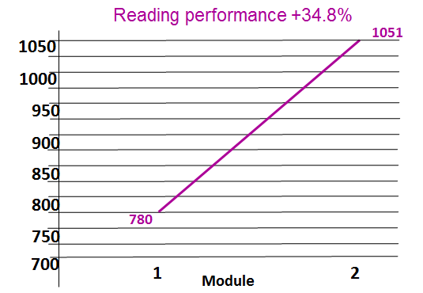
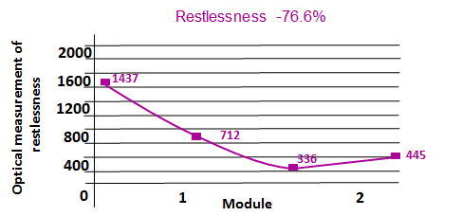
CASE STUDY: HAMBURG-EPPENDORF
Notes:
The reading speed rose by almost 35% when pupils were working under Dynamic Lighting Classroom System. On average, pupils read 1,051 words in a set time compared with 780 words in the baseline measurement under conventional lighting.

Slide 18
Health

Slide 20
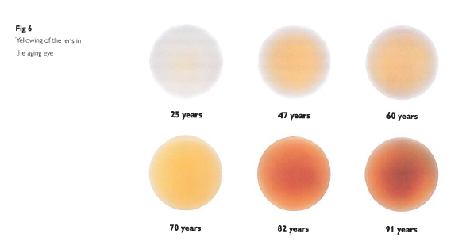
THE AGEING EYE
25 years
47 years
60 years
70 years
82 years
91 years
Notes:
As the eye ages so it yellows, this means older people see less light from the blue end of the spectrum than younger people.

Slide 21
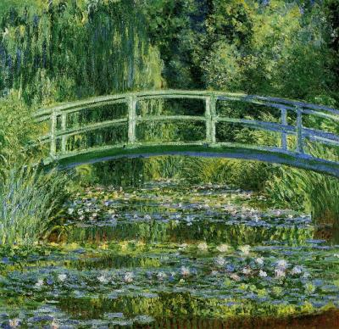
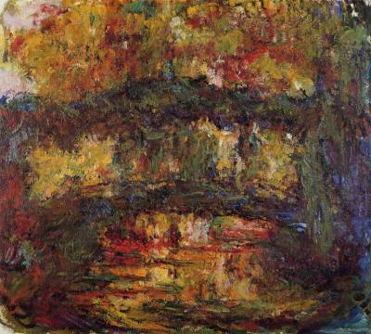
A darker, more hazy world
Older people experience
A reduction in vividness of the colours of images e.g. reds begin to look like pinks
A reduced ability to discriminate blues

Slide 22
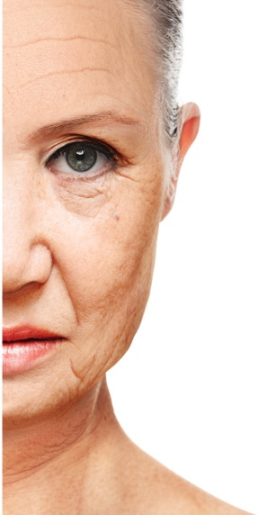
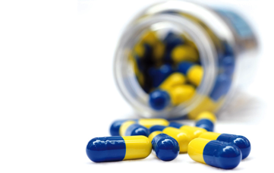
People with Dementia suffer from
frequent sleep disturbances
including night wandering and confusion
drugs can lead to further confusion and increase the risk of falls
Source: wikimedia

Slide 23
People with Dementia tend to be
Old
Easily confused, which leads to frustration
Liable to fall
People with dementia have 8.9 times as many falls.
Approximately half of all fallers who fracture their hips will never be functional walkers again.
20% will die within 6 months
In 2014 in England and Wales, 10 people died from the effects of fall
- every day!
Lighting can help promote independent living and maintain dignity

Slide 24
Architecture
Adapting the architecture to the patients requirements can increase their well-being
Provide orientation and security
straight corridors
handrails
Colour concept
Good quality lighting
clearly arranged rooms
Notes:
The whole package is needed.

Slide 25
DEMENTIA FRIENDLY LIGHTING
Primary elements
Use daylight wherever possible
Expose people to the 24-hour cycle of light and dark
Choose the right light source and high light levels, possibly up to twice normal levels
Consider surfaces: reflection, contrast and perception
Use sufficient ‘domestic’ style fittings
At 75 years a person requires 3.9 times the light that a 32 year old needs to elicit the same response

Slide 26
DEMENTIA FRIENDLY LIGHTING
Good darkness at night
Light is annoying and disturbs sleep
Promotes the production of Melatonin
Melatonin not only aids sleep but it is a very powerful anti-oxidant

Slide 27
research
Dementia Services Development Centre
Sterling University
Thanks to
Kristina Allison BA (Hons), MA, MSLL, MILP
Lighting Enterprises Consultancy & Associates Ltd.
Notes:
Best of breed demonstration ward and bedroom at Sterling. Uses Liventy, Sanesca, Inpera Ligra Plus, Acruro, Arkon and Ambiella night light.

Slide 34
THE KINGS FUND
The King's Fund is an English health charity that shapes healthcare policy and practice through research and analysis.

Slide 35
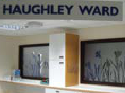
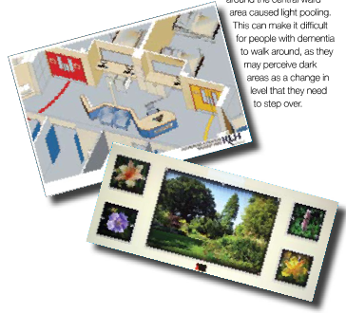
IPSWICH HOSPITAL
Ipswich Hospital was chosen to create a pioneering care environment in conjunction with the Kings Fund.

Slide 36
‘If we could only change three things, these would be:
Signposting using accent colours
Creating a central social space
Improving the lighting’
Senior nurse,
Dementia care and adult safeguarding

Slide 37
Maria-hilf hospital, brilon, germany
New lighting has been installed in all patient rooms and corridors of the geriatric department.
A light management system controls the light level and the colour temperature.

Slide 38
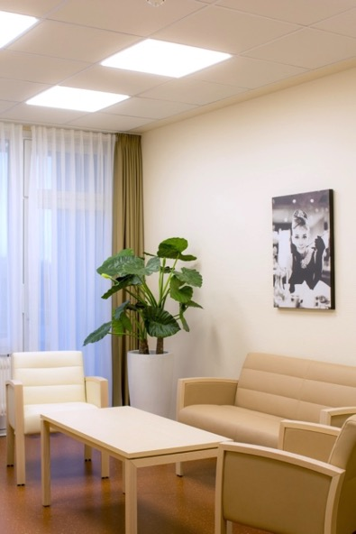
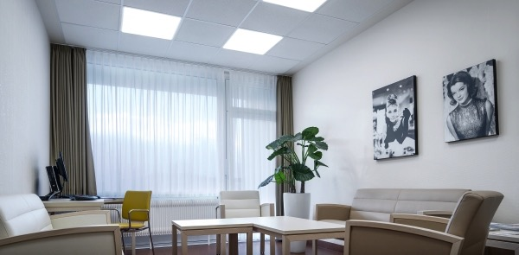
Illumination levels
Between 600 to 1500 lux during the day in patient rooms
300 lux on the floor and 600 lux at eye level in corridors
Notes:
All LED lighting is controlled via a central management system to give 600 lux at eye level and 300 lux at floor level in corridors and between 600 to 1,500 lux during the day in patient rooms.

Slide 39
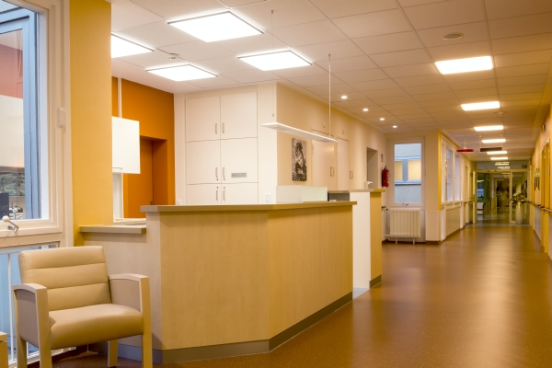
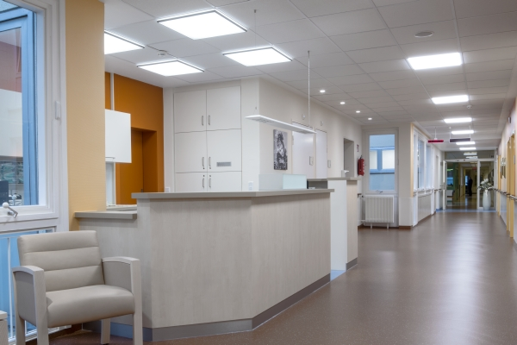
The entrance and corridors
Colour temperature varies between 3,000K and 6,500K

Slide 40
Maria-hilf hospital, brilon, germany

Slide 41
general impressions after the lighting renovation?
After the renovation, the activities of the geriatric patients have become calmer.
In detail, after a few days of acclimatisation they have a more relaxed demeanour compared to the day of admission and on other wards.
When asked why they felt calmer, some of the patients point directly to good lighting and a pleasant atmosphere.
Thomas Pape Director of Care Service

Slide 42
WHAT is the medical impression after the lighting renovation?
The generally positive reaction of geriatric patients has allowed the medical management to significantly lower support in the form of medication.
Thomas Pape Director of Care Service

Slide 43
How DO the staff benefit from the new lighting?
The therapeutic team is excited by the consistently positive reactions of their patients as well as its own positive experience of pleasant illumination.
Thomas Pape Director of Care Service

Slide 44
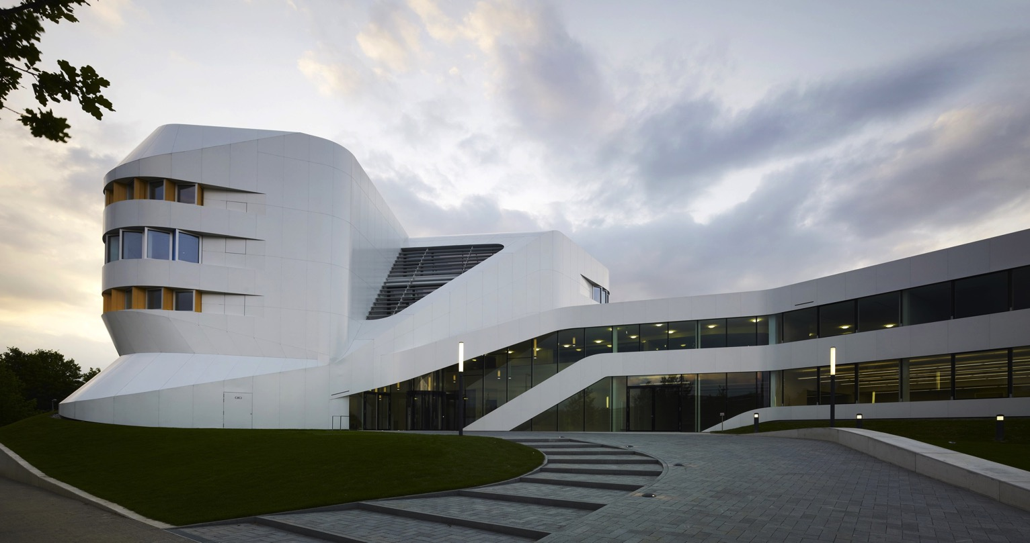
IAO Stuttgart, Fraunhofer Institute ZVE
Notes:
This is the Centre for Virtual Engineering for Fraunhofer Institute, which is Europe’s largest application-oriented research organisation.
Their research is geared entirely to people’s needs; health, communication, energy and the environment. TRILUX are now involved on a research programme with them.

Slide 45
Olive Research Project in conjunction with German Federal Ministry for Education and Research (BMBF)
Notes:
This collaborative research is being carried out by a specialist department in TRILUX, our think tank, ITZ, and with other partners under the acronym OLIVE aiming towards "optimised light systems for improvements in performance capability and health".
It is a three year programme to June 2017 with a budget of nearly 6million Euros and is overseen by the German Federal Ministry.
It is exploring the bio-medical factors which will then be developed upon to create solutions (light fittings and controls) that have freely selectable light spectra.

Slide 46
Olive Research Project in conjunction with German Federal Ministry for Education and Research (BMBF)
Notes:
The participants divide into academic and practical areas of expertise. Charite de Berlin and Intellux are developing the testing program; Franhofer are looking at the ergonomic requirements and automated control; TRILUX and VS are providing the hardware and also software that will make it more responsive to human interaction.

Slide 47
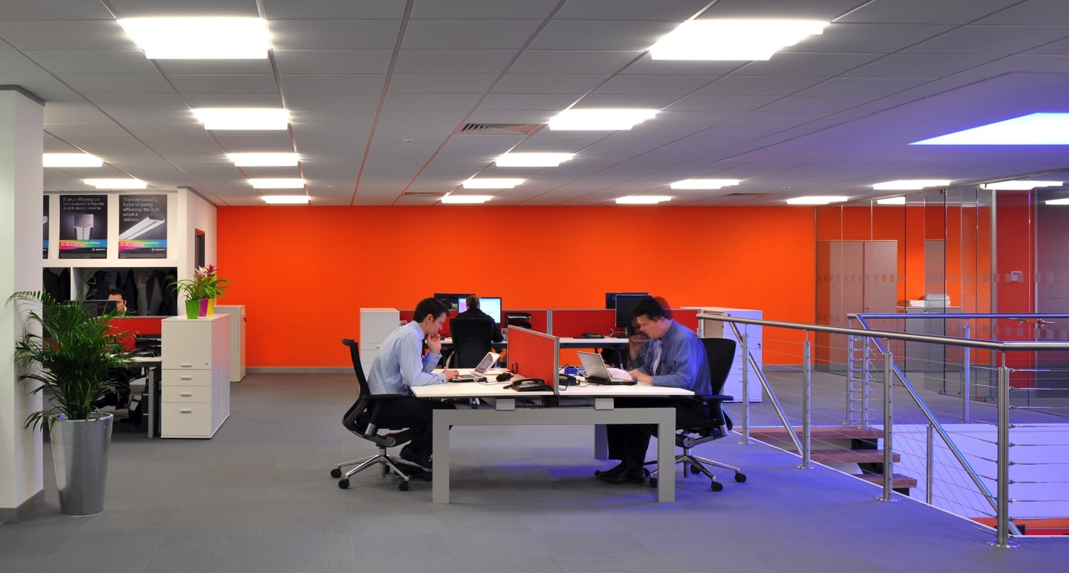
Our own research
Notes:
Closer to home, we have just started a small pilot study at our own offices in Chelmsford.
These luminaires have the capability to change from 2,700K to 6,000k and although there are some windows they are quite a distance away from the participants of the study.
One week will be spent under the warm setting of the luminaires for the duration of the working day, and another will be under the cool conditions. The final week will encompass a daylight simulating change in colour temperature and intensity.
This will then be repeated in February when we will have totally different daylight conditions.

Slide 48
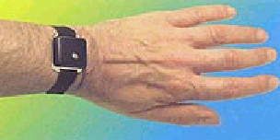
measurability
Actiwatches 24 hours per day
Sleep diaries
Mood/alertness VAS
KSS –Karolinska sleepiness scales
Notes:
My very helpful colleagues have agreed to wear Actiwatches for the full duration of the study. These measure light received and also detect movement.
They will also be completing sleep diaries and questionnaires on levels of alertness and comfort.

Slide 49
Professor debra j. skene
Chronobiology
Faculty of Health and Medical Sciences
University of Surrey, Guildford, UK
Notes:
This study is being moderated by Professor Debra Skene of Surrey University who has very kindly provided tried and tested questionnaires and is making sure we stick to all of the required protocols.

Slide 50
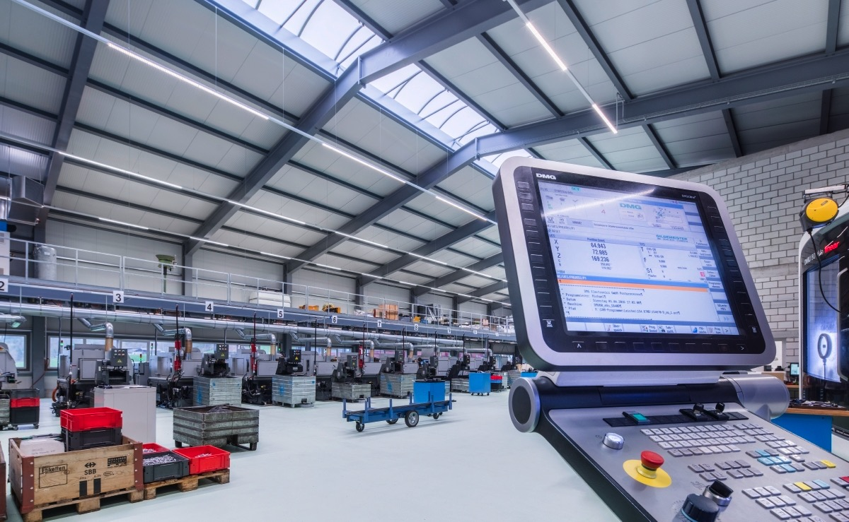
Our own research
Notes:
In Germany at our own factory we have just started recording baseline measurements for 6 months in an area where they work a 3 shift pattern.
The new lighting protocol will start in February and will be a further 6 month study.

Slide 51
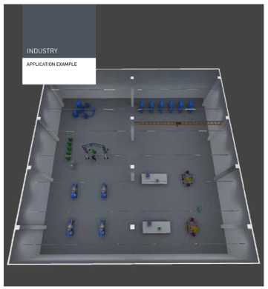
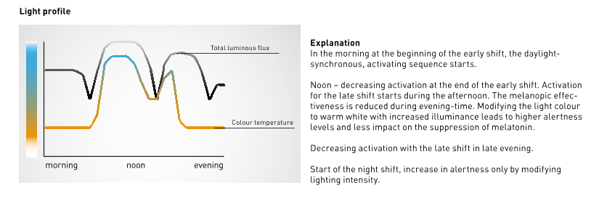
An example
Notes:
I think the light profile will be similar to this, but the final decision hasn’t been made yet. There are lots of discussions going on about increasing light levels but not the colour temperature to keep people alert at night but not entrain their circadian rhythms, this makes it suitable for shorter shift times or regularly rotating shift patterns.
6am – 2pm First shift Increase of alertness due to higher illuminance levels and increase of CT to support the circadian rhythm. Then there is a reduction of CT and illuminance to calm down before the finishing time.
2pm -10pm Second Shift Follows daylight synchronous CT until 6pm “sunset”. Illuminance levels stay higher to increase alertness but then lowers down towards the end of the shift.
10pm-6am Third shift Increase illuminance but with a warm CT to increase alertness without influencing the inner clock (melatonin levels).

Slide 52
Human centric Lighting conference royal institution, london. 22.2.2016
Professor Debra Skene, University of Surrey.
Professor Rob Lucas
Manchester University
Luke Price
Public Health England
CIE TN003 Report on the First International Workshop on Circadian and Neurophysiological Photometry, 2013
www.cie.co.at/index.php/Publications/Technical+Notes

Slide 53
Light affects how we feel

Slide 54
fresh – stimulating – light – neutral – cool

Slide 55
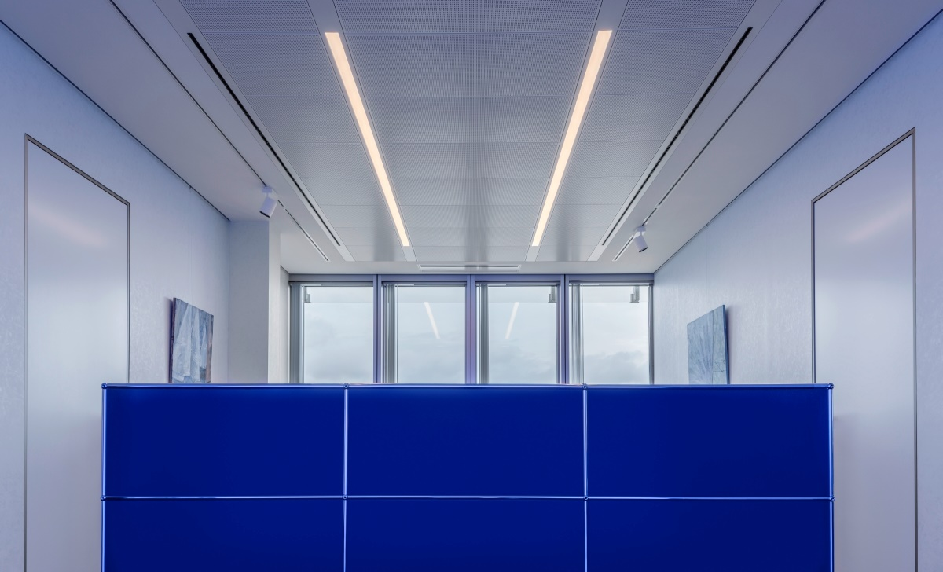
fresh – stimulating – light – neutral – cool

Slide 56
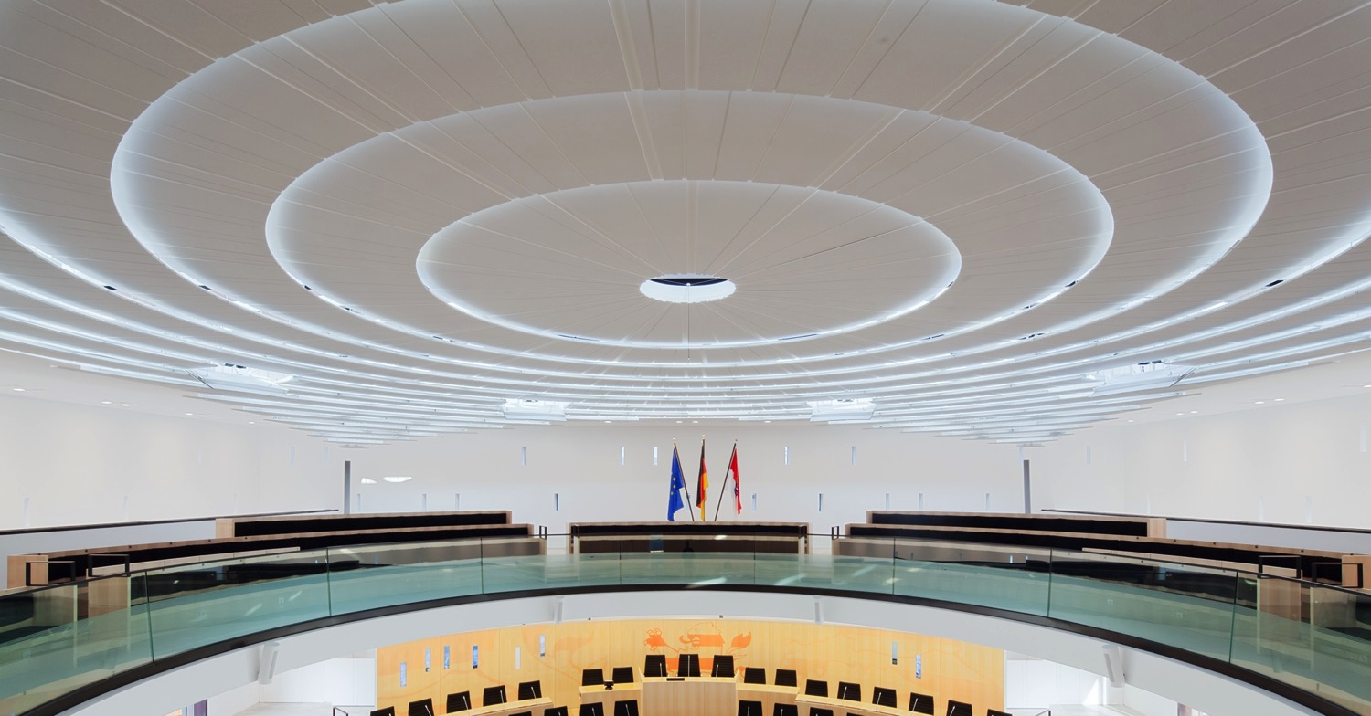
fresh – stimulating – light – neutral – cool

Slide 57
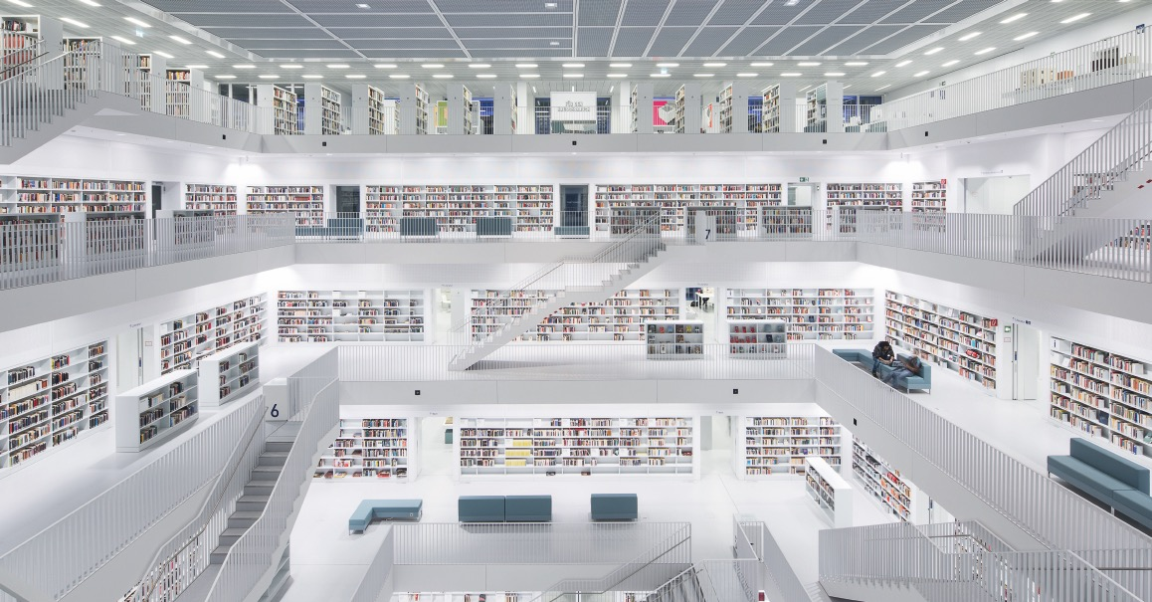
fresh – stimulating – light – neutral – cool

Slide 58
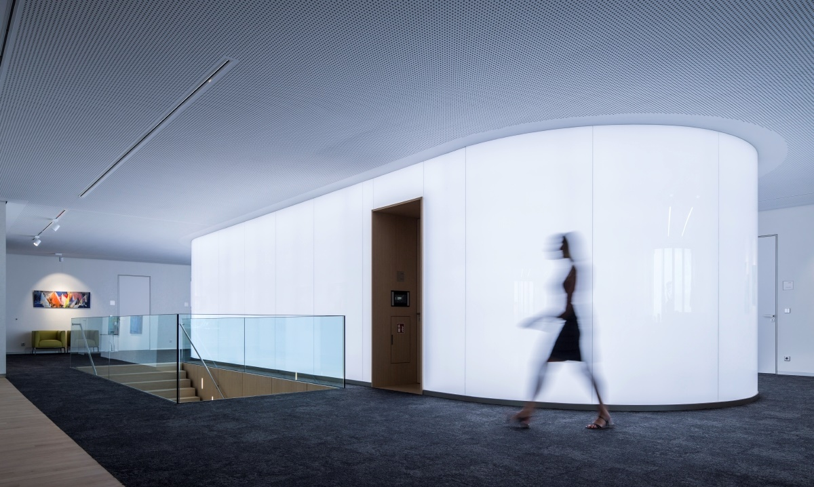
fresh – stimulating – light – neutral – cool

Slide 59
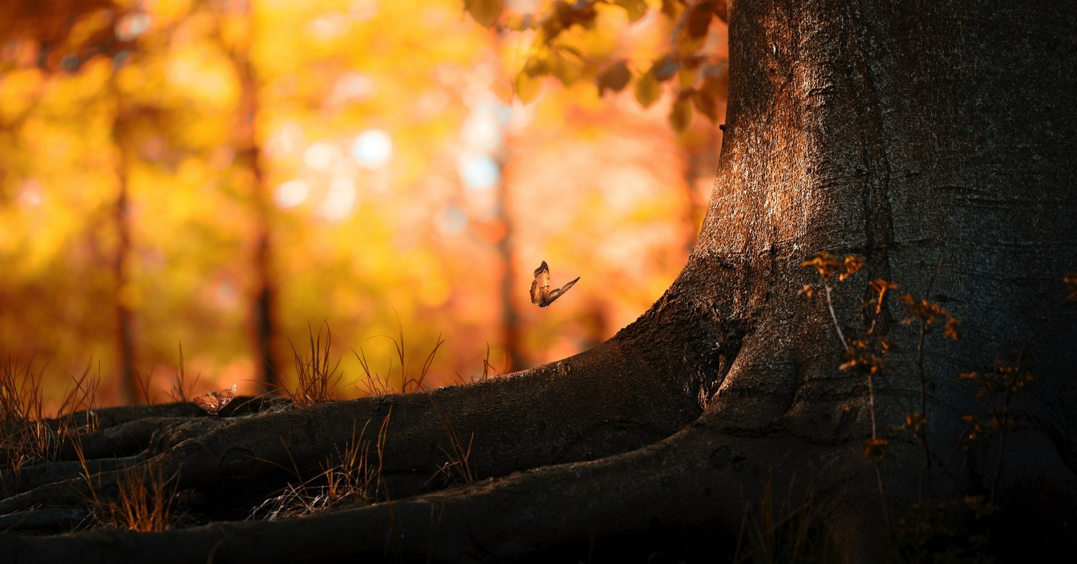
warm – relaxing – natural – comforting

Slide 60
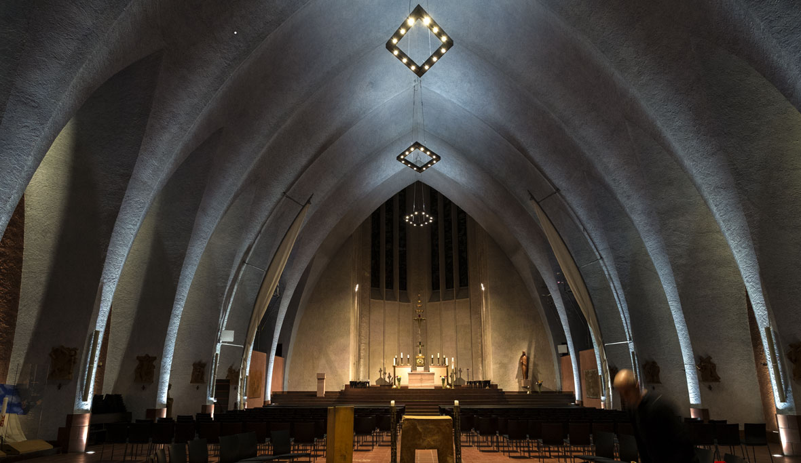
warm – relaxing– comforting

Slide 61
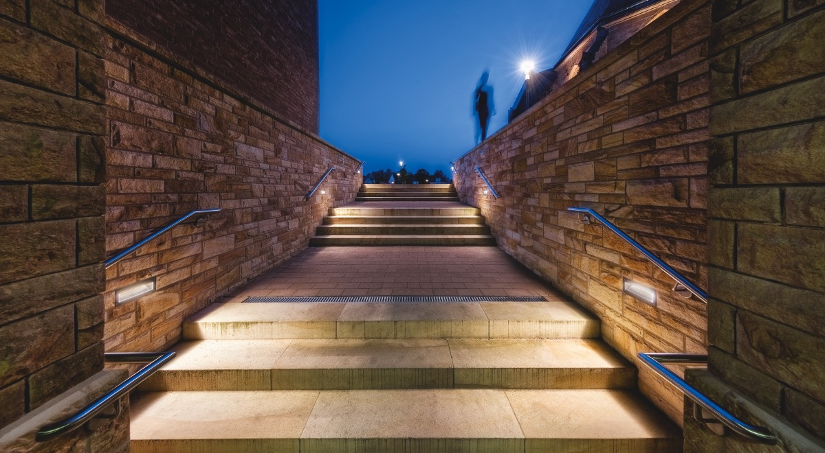
warm – relaxing–comforting

Slide 62
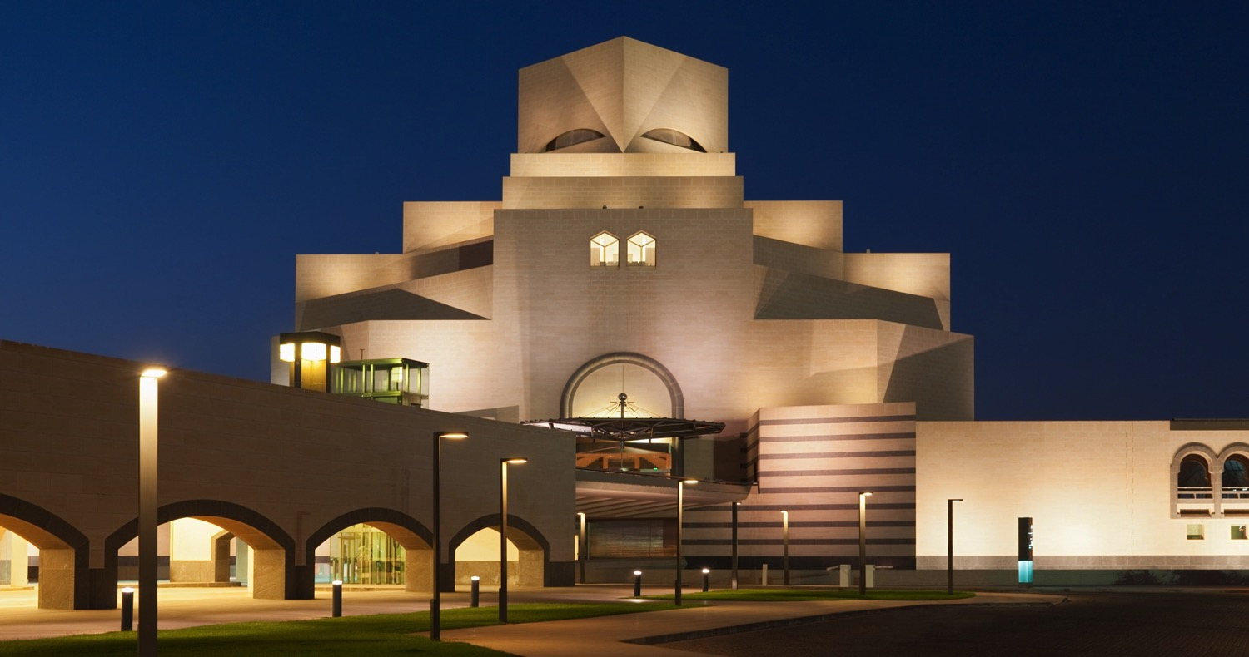
warm – relaxing–comforting

Slide 63
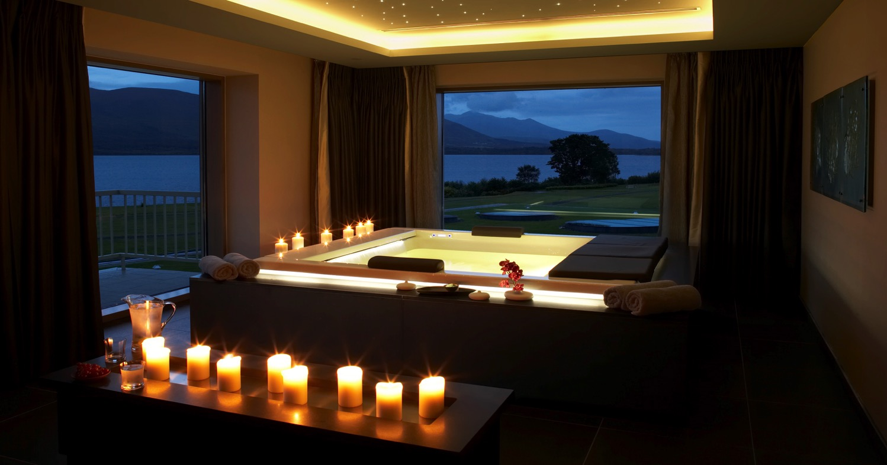
warm – relaxing – comforting

Slide 64
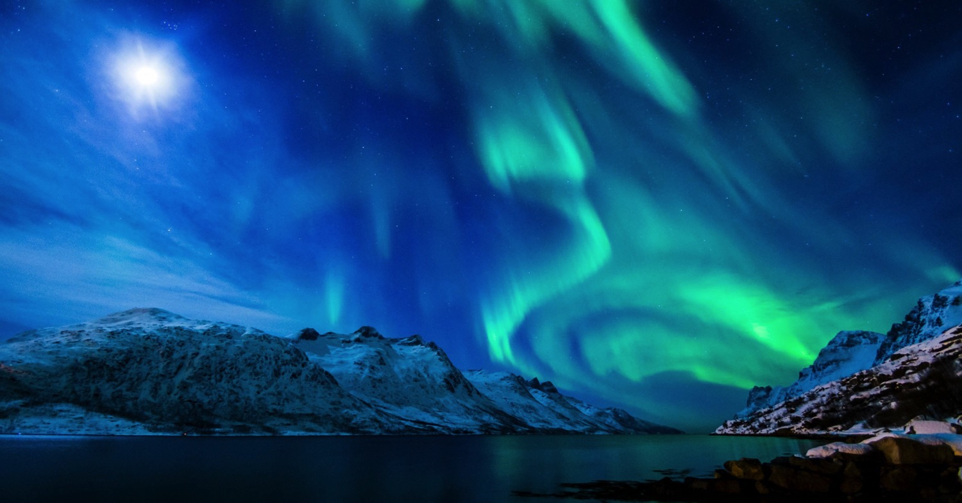
wow! – spectacular – euphoric – sublime – inspiring

Slide 65
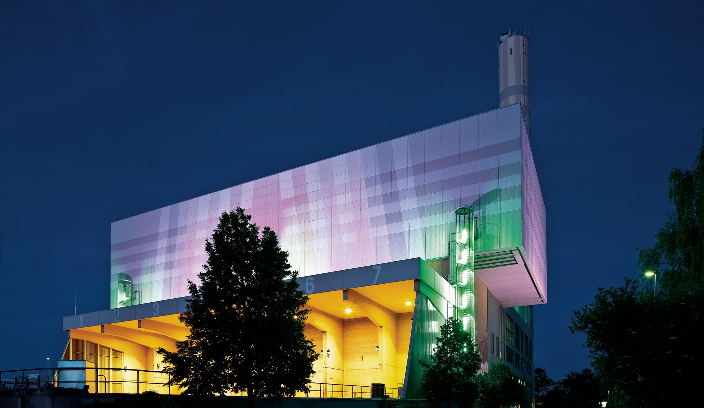
wow! – spectacular – euphoric – sublime – inspiring

Slide 66
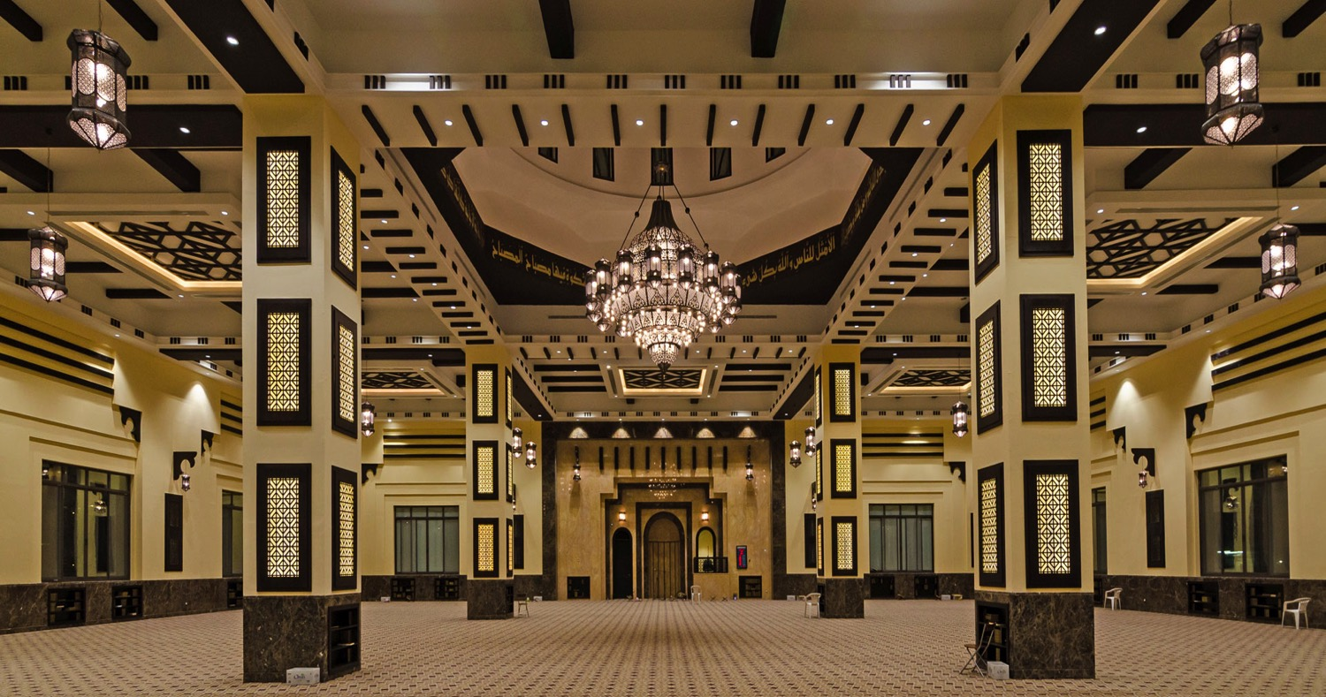
wow! – spectacular – euphoric – sublime – inspiring

Slide 67
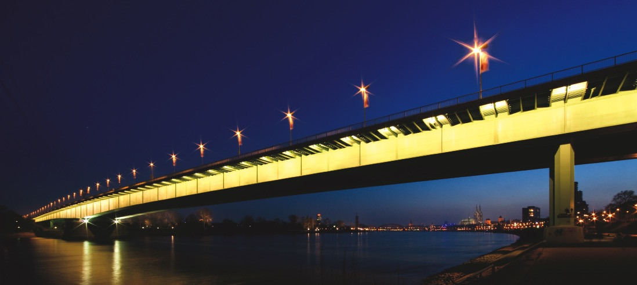
wow! – spectacular – euphoric – sublime – inspiring

Slide 68
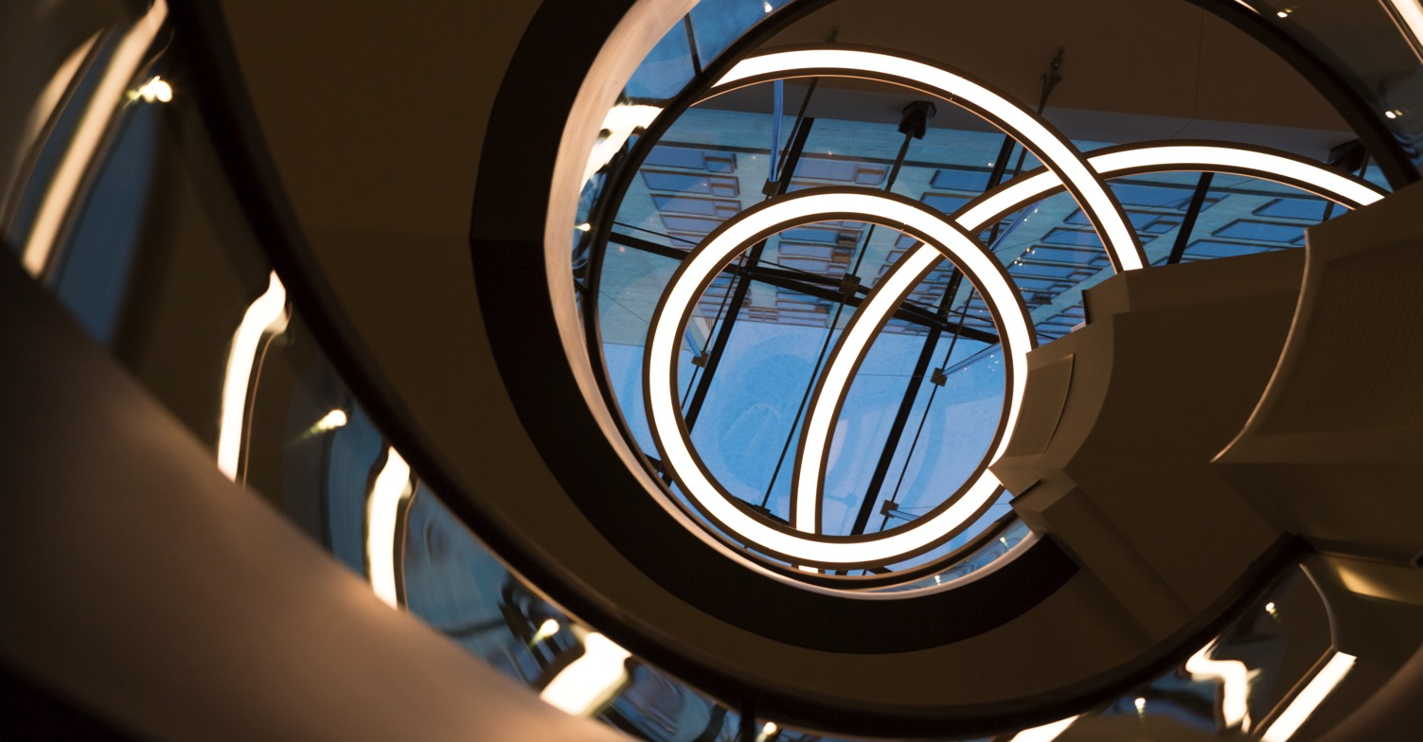
wow! – spectacular – euphoric – sublime – inspiring

Slide 69
wow! – spectacular – euphoric – sublime – inspiring

Slide 70
conclusions
There is still a lack of standardised recommendations for light use, however much research has shown that light in the workplace mitigates sleepiness, lifts the mood, and improves the mental status in general.
There are several possibilities for the use of light in the workplace, depending on the time schedules. Effective use of light may lead to an adaptation to the extended night work period and facilitate the subsequent re-adaptation to daytime life.
Much research is still needed but should also canvass the genetic predisposition of people i.e. larks and owls.

Slide 71
What is your definition of a drug?

