Slide 1
LAUNCHING Q1 | 2017
PLANNING AIDS

Slide 2
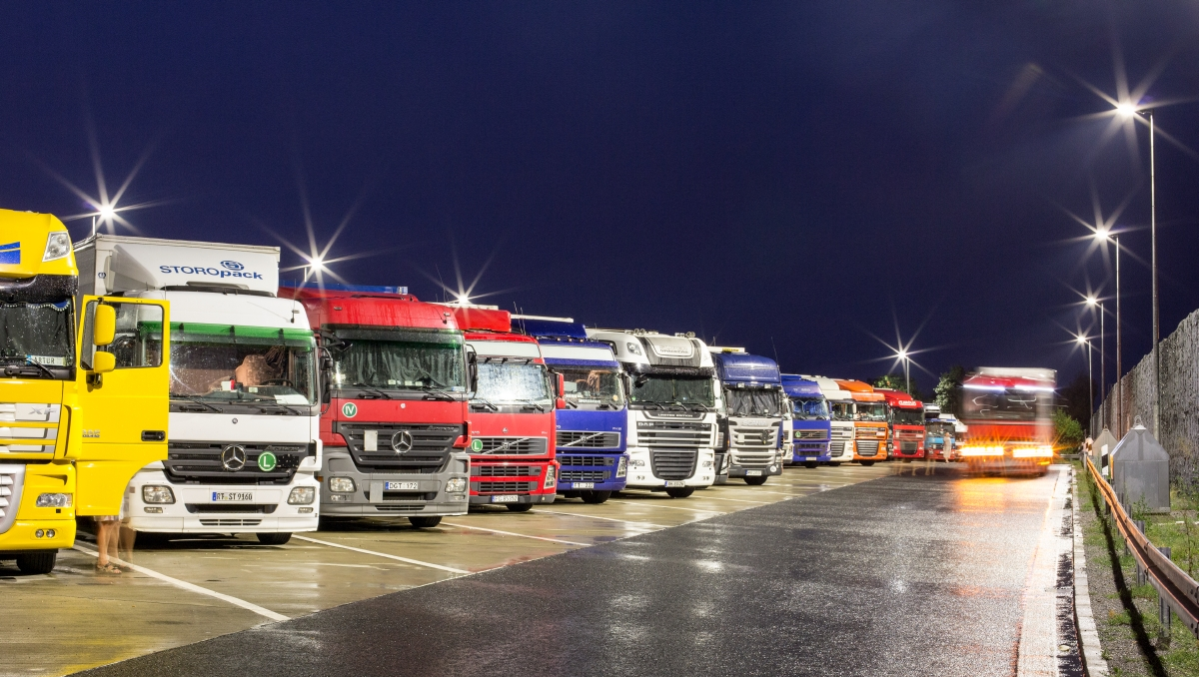
POST LUMINAIRES

Slide 3
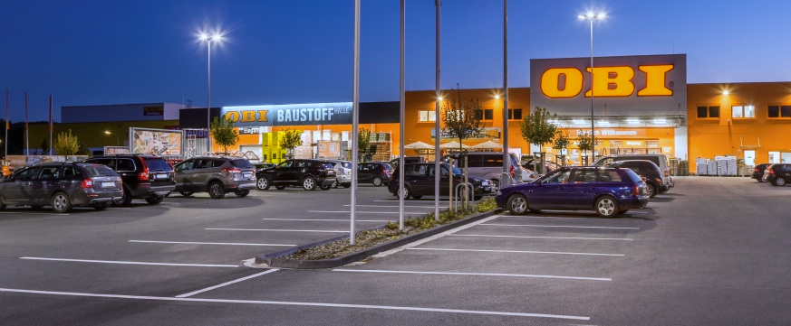
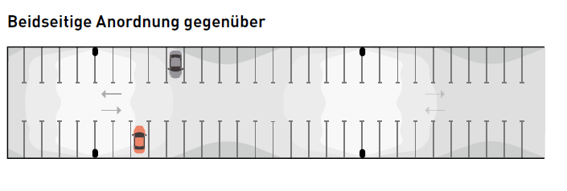
PARKING LOTS
LUMENA STAR 40
PLANNING AIDS
Parking lot width 16 m
Post height 6 m
Inclination angle 10°
Luminaire for 5 lux LnSTAR 40-AM2L/2200
Luminaire for 10 lux LnSTAR 40-AM2L/4200
Luminaire for 20 lux LnSTAR 40-AM2L/8200
Distance of start of parking lot to 1st luminaire 12.5 m
Distance of luminaires between each other 37.5 m

Slide 4
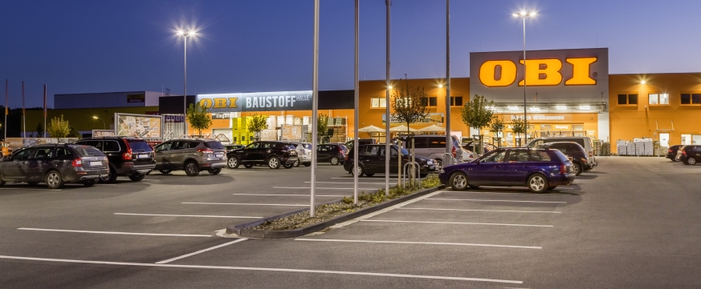
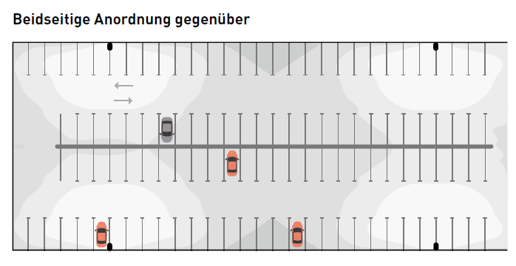
PARKING LOTS
LUMENA STAR 40 | LUMENA STAR 70
PLANNING AIDS
Parking lot width 16 m
Parking lot width 32 m
Post height 8 m
Inclination angle 10°
Luminaire for 5 lux LnSTAR 40-AM2L/5600
Luminaire for 10 lux LnSTAR 70-AM1R/11000
Luminaire for 20 lux LnSTAR 70-AM1R/22000
Distance of start of parking lot to 1st luminaire 15 m
Distance of luminaires between each other 50 m

Slide 5
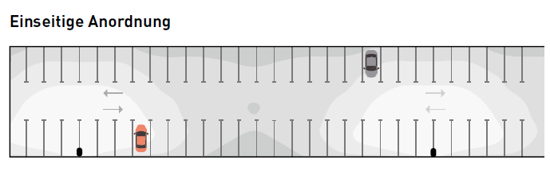
PARKING LOTS
LUMENA STAR 40
PLANNING AIDS
Parking lot width 16 m
Post height 8 m
Inclination angle 10°
Luminaire for 5 lux LnSTAR 40-AM2L/6200
Luminaire for 10 lux LnSTAR 70-AM1R/12000
Luminaire for 20 lux LnSTAR 70-AM1R/24000
Distance of start of parking lot to 1st luminaire 10 m
Distance of luminaires between each other 50 m

Slide 6
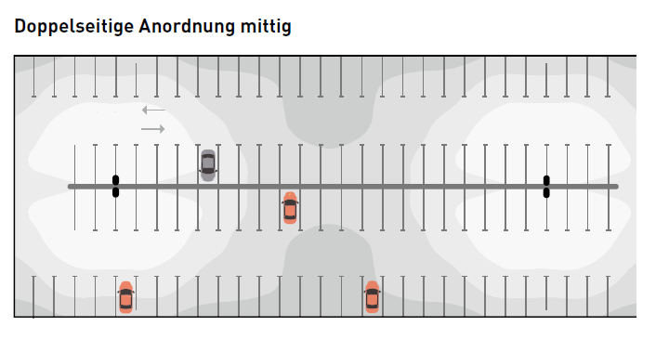
PARKING LOTS
LUMENA STAR 40 | LUMENA STAR 70
PLANNING AIDS
Parking lot width 32 m
Post height 8 m
Inclination angle 10°
Luminaire for 5 lux LnSTAR 40-AM2L/5600
Luminaire for 10 lux LnSTAR 70-AM1R/11000
Luminaire for 20 lux LnSTAR 70-AM1R/22000
Distance of start of parking lot to 1st luminaire 12.5 m
Distance of luminaires between each other 52.5 m

Slide 7
REFURBISHMENT EXAMPLE
OLD SYSTEM WITH 150W
Planning aids
 | OLD SYSTEM 150W | LnStar 40 10,000lm
Number of luminaires | 25 | 25
Control gear unit | CCG | ET
Connected load of luminaires | 175W | 70W
Luminaire luminous flux | 9,600lm | 10,000lm
Total connected load of lighting system | 4,375W | 1,750W
Yearly energy consumption | 17,500 kWh | 7,000 kWh
Nominal energy costs p.a. | 3,675 € | 1,470 €
Savings potential | 60%
Savings potential in kilowatt hours p.a. | 2,205 kWh
Cost savings p. a. | 463.05 €

Slide 8
REFURBISHMENT EXAMPLE
OLD SYSTEM WITH 250W
Planning aids
 | OLD SYSTEM 250W | LnStar 70 18,000lm
Number of luminaires | 25 | 25
Control gear unit | CCG | ET
Connected load of luminaires | 275W | 128W
Luminaire luminous flux | 17,920lm | 18,000lm
Total connected load of lighting system | 6,875W | 3,200W
Yearly energy consumption | 27,500 kWh | 12,800 kWh
Nominal energy costs p.a. | 5,775 € | 2,688 €
Savings potential | 53%
Savings potential in kilowatt hours p.a. | 3,087 kWh
Cost savings p. a. | 648.27 €

Slide 9
REFURBISHMENT EXAMPLE
OLD SYSTEM WITH 400W
Planning aids
 | OLD SYSTEM 400W | LnStar 70 32,000lm
Number of luminaires | 25 | 25
Control gear unit | CCG | ET
Connected load of luminaires | 440W | 259W
Luminaire luminous flux | 30,720lm | 32,000lm
Total connected load of lighting system | 11,000lm | 6,475lm
Yearly energy consumption | 44,000 kWh | 25,900 kWh
Nominal energy costs p.a. | 9,240 € | 5,439 €
Savings potential | 42%
Savings potential in kilowatt hours p.a. | 3,801 kWh
Cost savings p. a. | 798.21 €

Slide 10
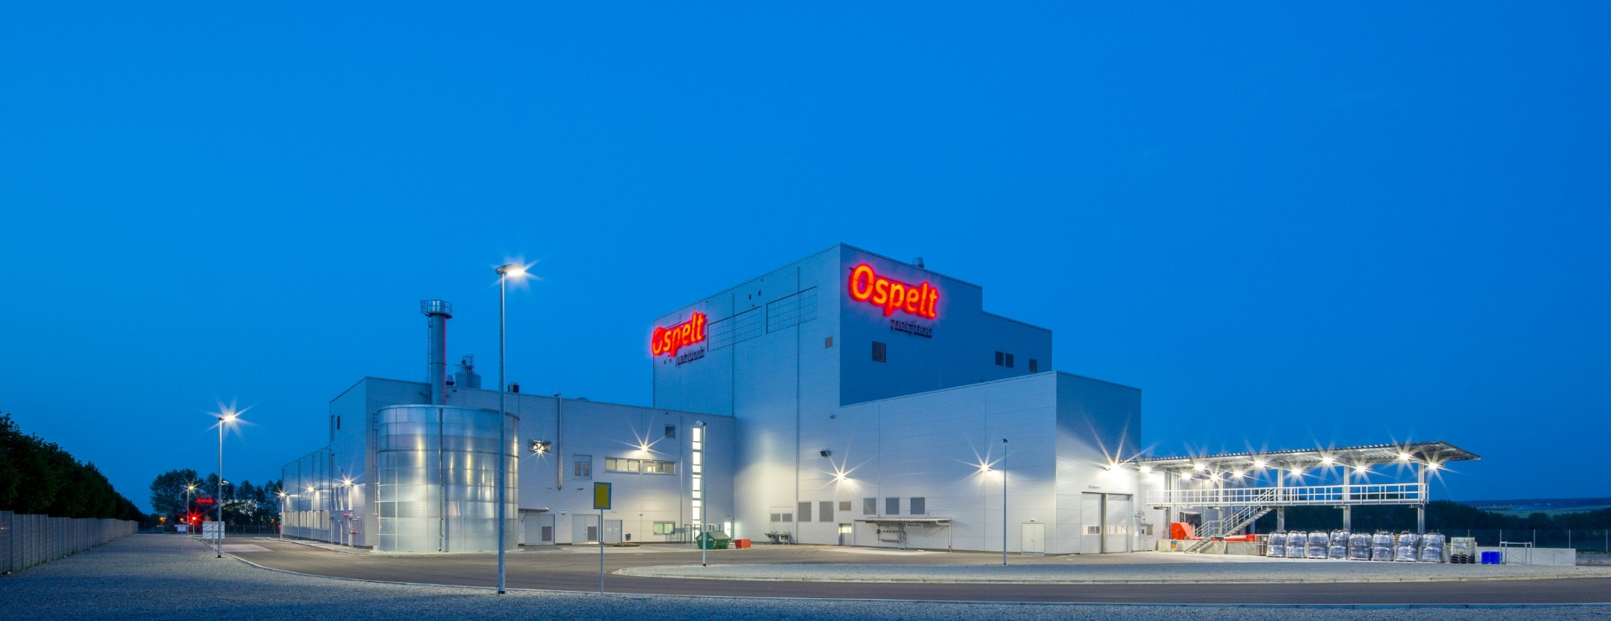
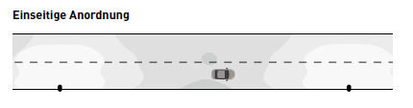
FACTORY ROADS
LUMENA STAR 40 | LUMENA STAR 70
PLANNING AIDS
Carriageway width 8 m
Post height 8 m
Luminaire arrangement on one side
Inclination angle 0°
Luminaire for 10 Lux LIQ 70-AB2L/6200-740
Luminaire for 20 Lux LIQ 90-AB2L/13500-740
Luminaire spacing 40 m
Light point overhang 0 m

Slide 11

CONVENTIONAL AND LED IN COMPARISON
WHICH LED LUMINOUS FLUX DO I NEED AND WHICH LUMINAIRE CAN I TAKE
PLANNING AIDS
1 x 50 W HME 1200 lm LnStar 40-AM2L/1200-740
2 x 50 W HME 2400 lm LnStar 40-AM2L/2400-740
1 x 80 W HME 2400 lm LnStar 40-AM2L/2400-740
2 x 80 W HME 5100 lm LnStar 40-AM2L/5100-740
1 x 125 W HME 4200 lm LnStar 40-AM2L/4200-740
2 x 125 W HME 8200 lm LnStar 40-AM2L/8200-740
1 x 250 W HME 8200 lm LnStar 40-AM2L/8200-740
2 x 250 W HME 16500 lm LnStar 70-AM1R/16500-740
1 x 400 W HME 13500 lm LnStar 70-AM1R/13500-740
1 x 50 W HST 2600 lm LnStar 40-AM2L/2600-740
2 x 50 W HST 5600 lm LnStar 40-AM2L/5600-740
1 x 70 W HST 4200 lm LnStar 40-AM2L/4200-740
2 x 70 W HST 8200 lm LnStar 40-AM2L/8200-740
1 x 100 W HST 6800 lm LnStar 40-AM2L/6800-740
2 x 100 W HST 13500 lm LnStar 70-AM1R/13500-740
1 x 150 W HST 11000 lm LnStar 70-AM1R/11000-740
2 x 150 W HST 22000 lm LnStar 70-AM1R/22000-740

Slide 12
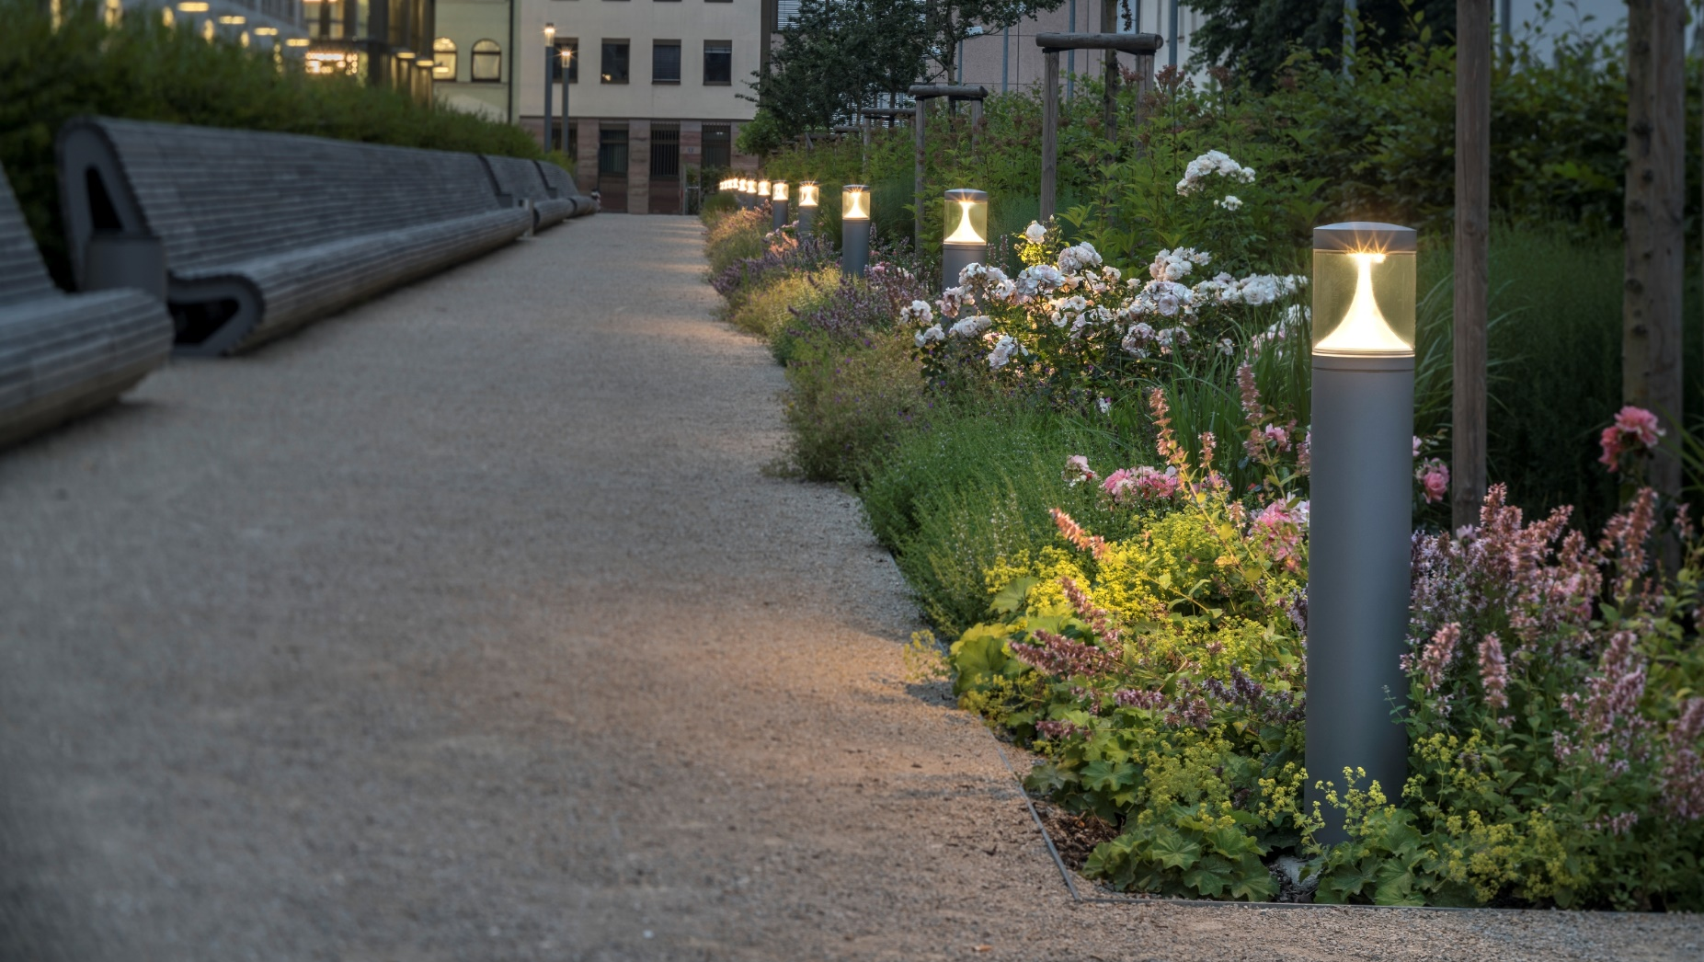
BOLLARD LUMINAIRES & LIGHT COLUMNS

Slide 13
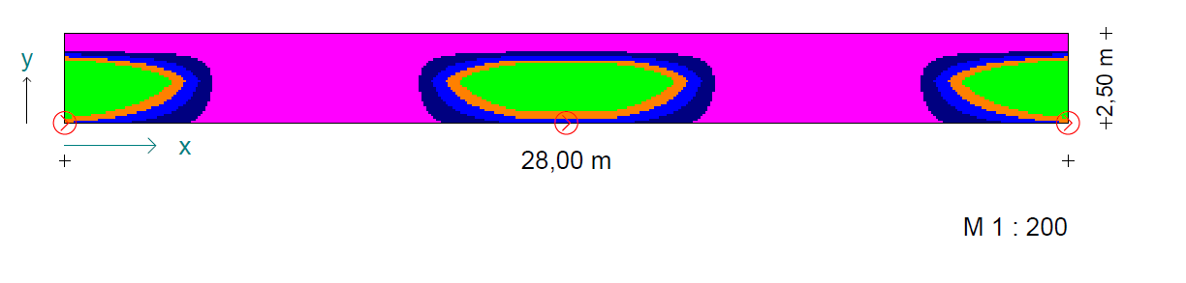
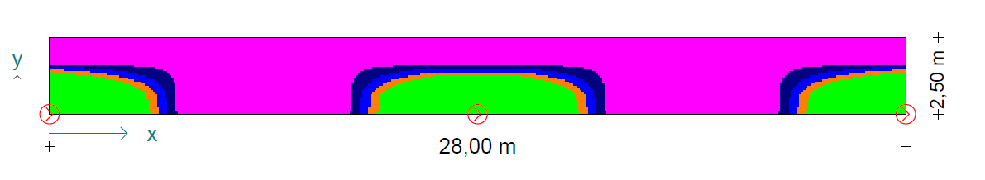
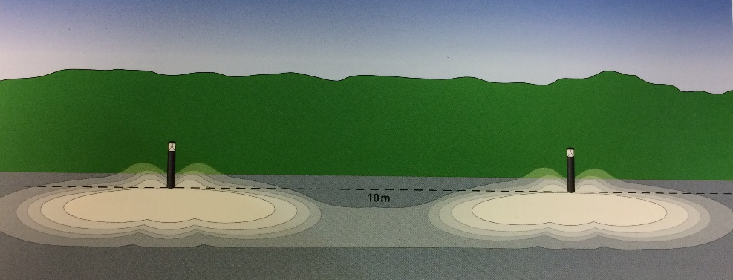
BOLLARD LUMINAIRES
PLANNING AIDS
LENS: AB14L
LENS: AB2L

Slide 14
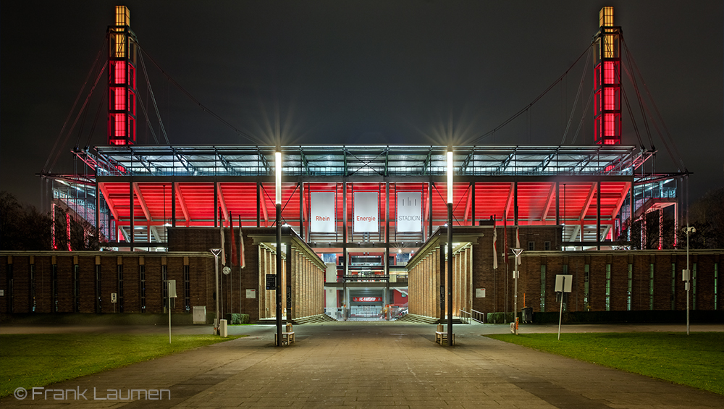
FLOODLIGHTING

Slide 15
Basics of floodlighting
PLANNING AIDS
Type of floodlighting
Accenting
Planar floodlighting
Combination
From itself
Building in the space
Far effect
Near effect
Visual axes
Visible through 360°
Building surface
- Shiny/matt
Transparency
Colour
Architecture
- Modern
Functional
Historical
Ambient lighting
Bright
Dark
Disruptive influences
Overall impression
Environment
e.g. observatories
Disruptive influences
Motorways
Unintended advertising media
Installation
Vandalism
Existing light points
Heritage protection
Post/building/substrate
Light colour
Warm white
Cool white
Coloured

Slide 16
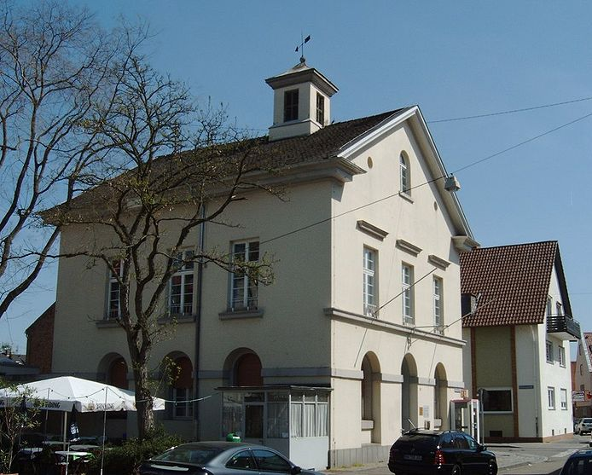
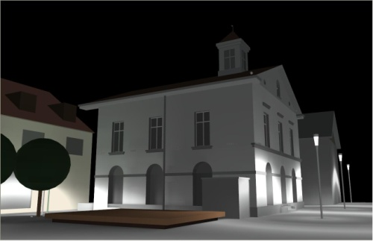
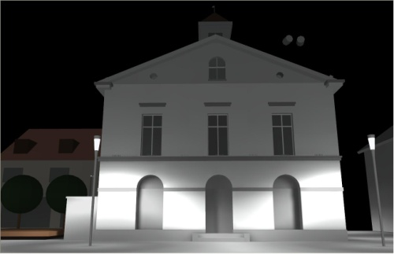
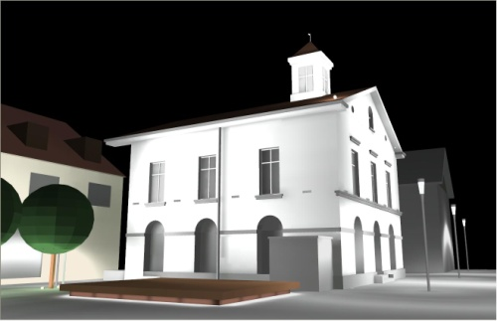
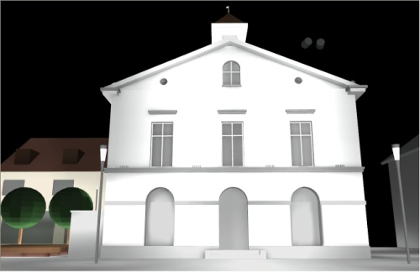
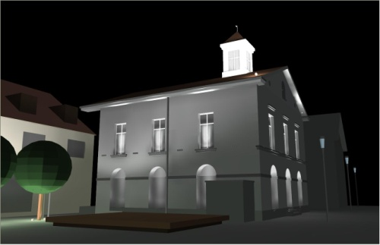
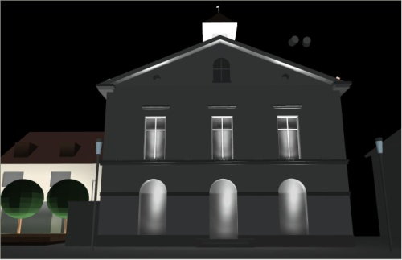
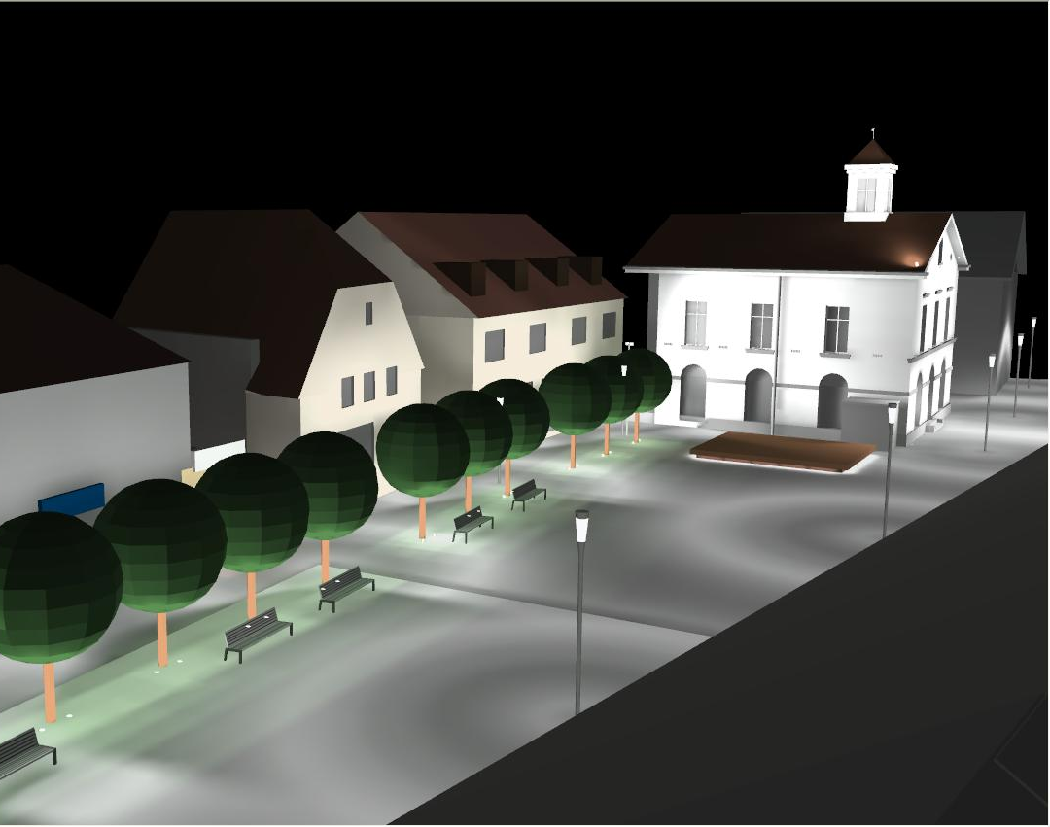
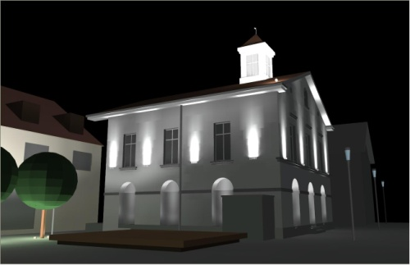
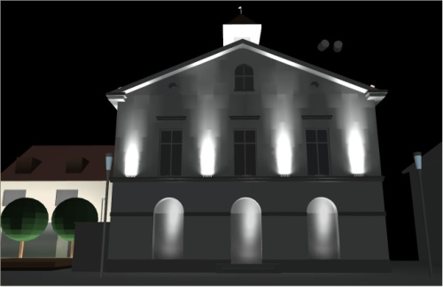
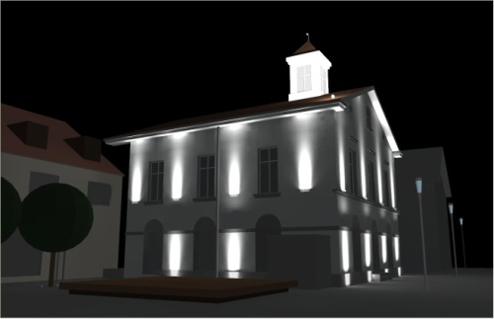
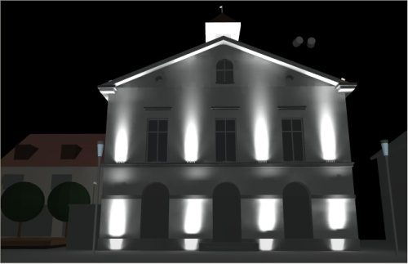
Light in urban spaces
PLANNING AIDS
Town hall concept, Mannheim

Slide 17
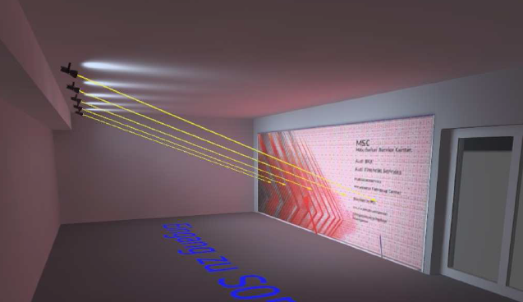
FACIELLA
PLANNING AIDS
Distance of luminaires to wall: 4.30m
5 x Faciella 08 wide distribution or alternatively
3 x Faciella 15 wide distribution
Advertising panel: 6m x 2.5m

Slide 18
Fundamentals of floodlighting –
Surfaces
PLANNING AIDS
Planar lighting – "flat illumination"
Not much structure
High distance effect
High uniformity
The further away the luminaire is from the building, the better is the uniformity
Glare in indoor areas
Ideal for uninhabited advertising areas

Slide 19
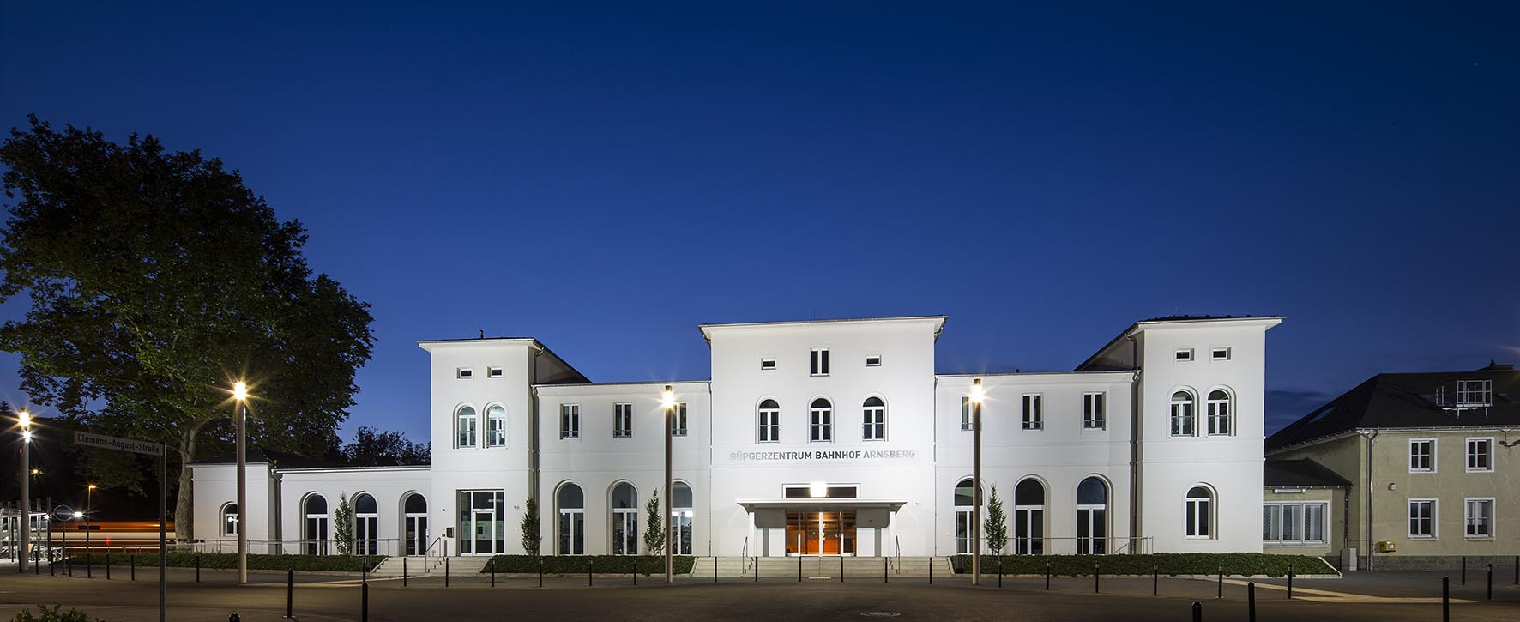
Railway station, ARNSBERG
PLANNING AIDS

Slide 20
Fundamentals of floodlighting –
Accents
PLANNING AIDS
From close-up
Emphasising of details, e.g. clocks, figures and ledges
Distance effect possible
Usually upper building sections
Faciella 20 narrow distribution
AT THE BUILDING
Wall structures become visible and gain depth
Very 3-dimensional
Very theatrical, a "Halloween" impact
Smooth facade without applied objects.
More for medium and far effect
8521 COB version: Reference value 12m

Slide 21
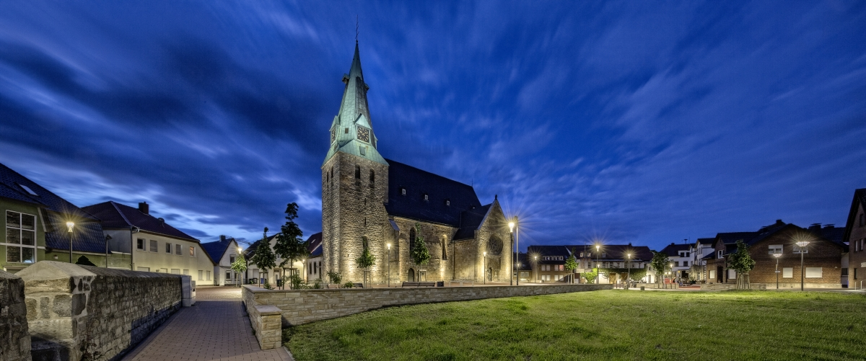
WESTERKAPPELN CHURCH SQUARE
PLANNING AIDS

Slide 22
Fundamentals of floodlighting –
Combination
PLANNING AIDS
Accenting via ground-recessing
Wide-area floodlighting as moderate general light
Optimal for all visual areas (near, central and distance effect)

Slide 23
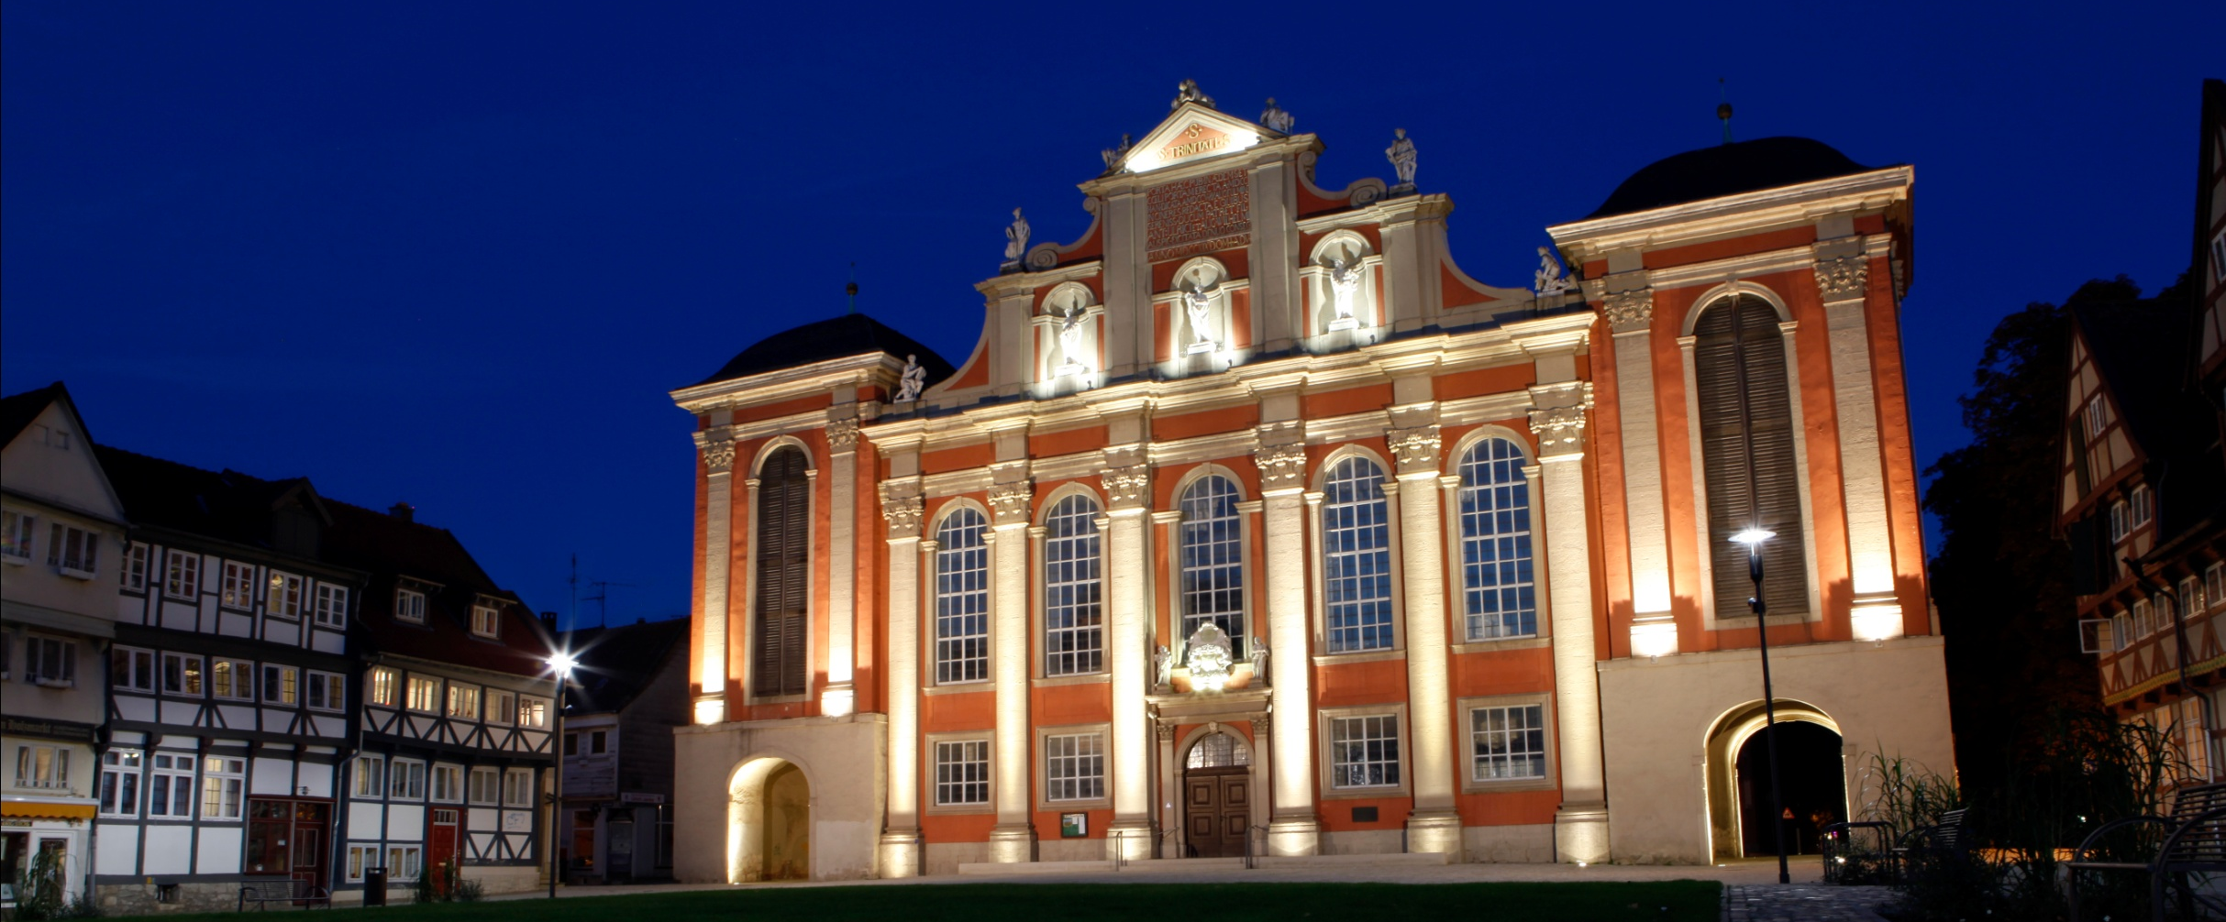
WOLFENBÜTTEL TRINITATISKIRCHE
PLANNING AIDS

Slide 24
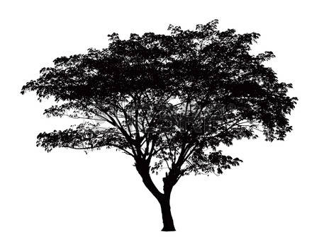
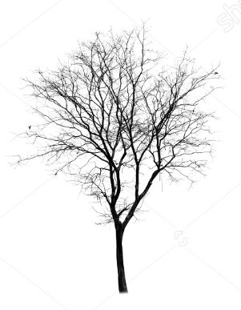
Fundamentals of floodlighting –
Light and nature
PLANNING AIDS
Observe the main direction of view
Large trees: 3x luminaires 120°
Small trees: 1x luminaire in front
Many identical trees: on the side, or at least identical for all
Observe the main direction of view
High, straight trees e.g. poplars:
RE 2400lm
Wide overreaching trees e.g. oak/beech RM 2400lm
City trees/ornamental trees/shrubs with 1x RM 1000lm
120°

Slide 25
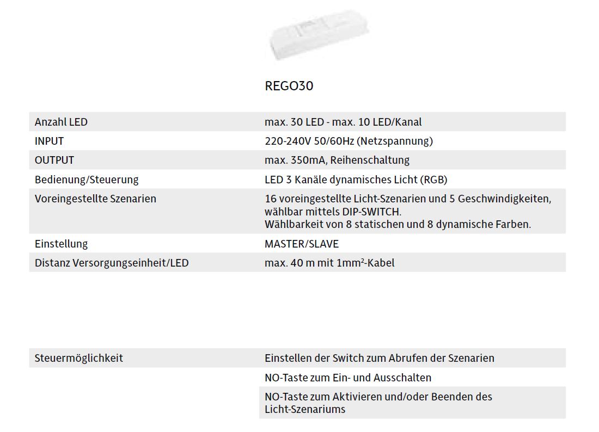
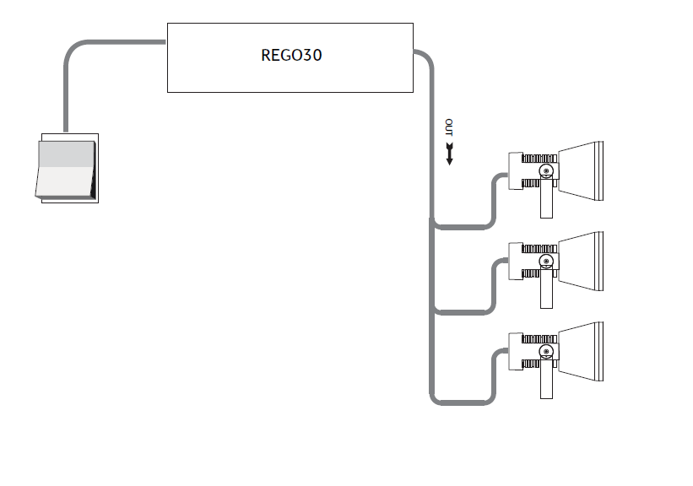
RGB
PRODUCT LAUNCHING Q1|2017

Slide 26
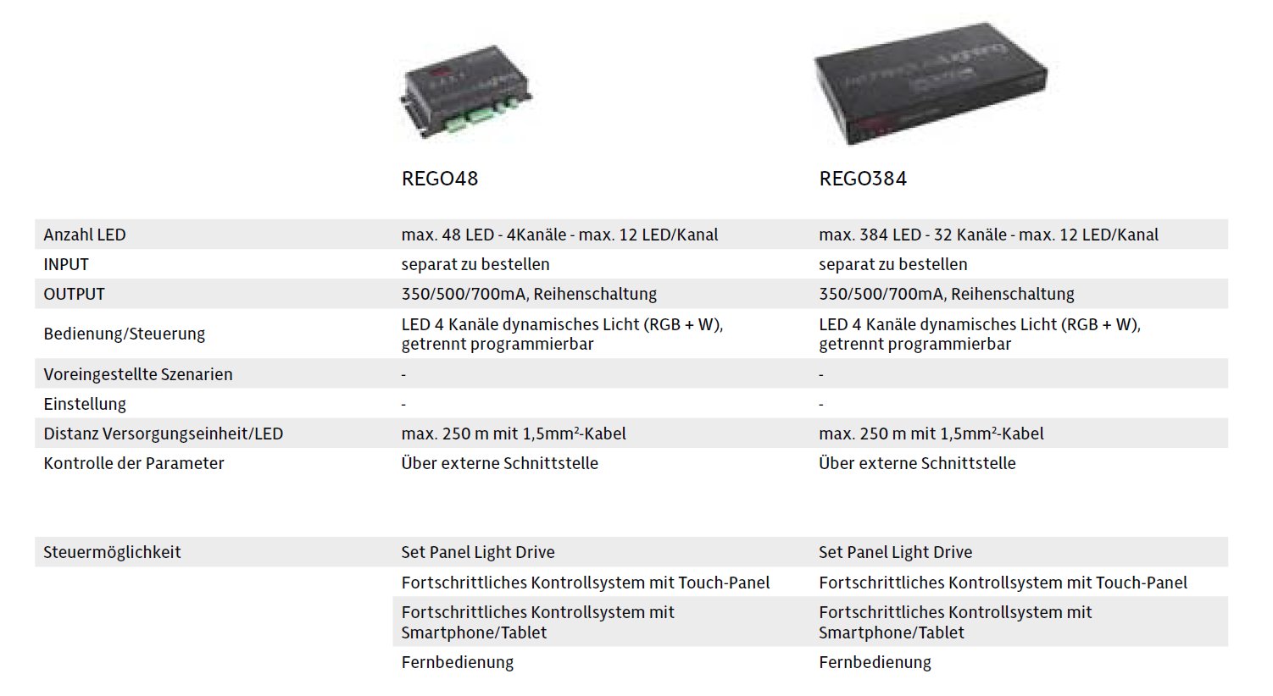
RGB
PRODUCT LAUNCHING Q1|2017

Slide 27
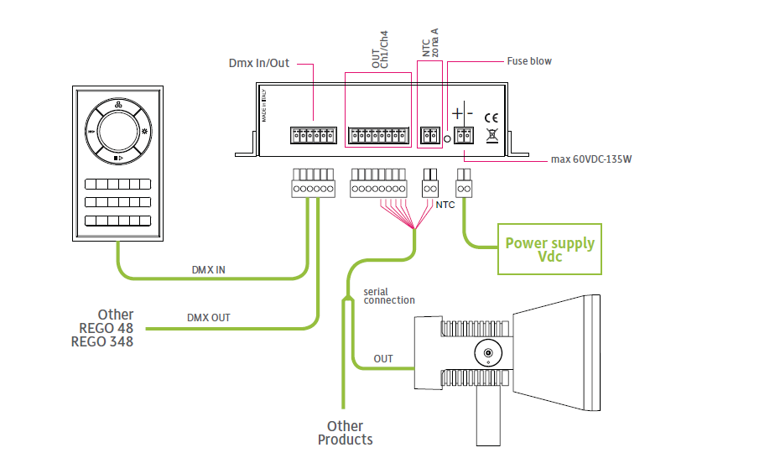
RGB
PRODUCT LAUNCHING Q1|2017

Slide 28
LAUNCHING Q1 | 2017
MANY THANKS!

Slide 29
LAUNCHING Q1 | 2017
FAQ

Slide 30
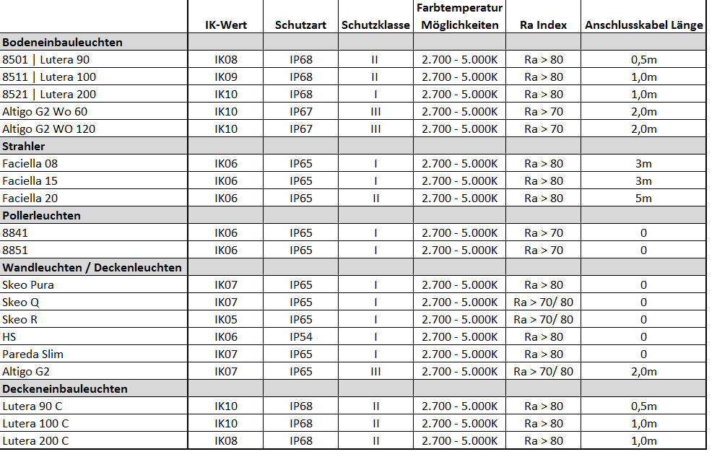
Information about the series
Planning aids

Slide 31
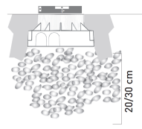
FAQ
LUTERA GROUND-RECESSED LUMINAIRES
FAQ / GUIDE
Which accessories must be ordered mandatorily for the ground-recessed luminaires?
Ordering the mounting housing and stainless steel cover plate (round or square) is obligatory.
What is the difference between the normal mounting housing (ET) and the expanded mounting housing (ETE)
The normal mounting housing is simply an extended piece of tube and does not make installation easier. The expanded mounting housing on the other hand is more convenient when cabling and wiring the luminaires.
Why do I definitely need a drainage?
This makes sure that the water collecting below the luminaire
can flow away reasonably. A drainage of 20-30cm is recommended.
How warm does the glass become with full load of the LEDs?
The LED variants dissipate a maximum of 37° to the surface of the glass.
How do the luminaires behave with chemical influences?
The luminaire must not come into contact with aggressive substances, chemicals, cleaning agents and/or fertilisers.

Slide 32
FAQ
LUTERA GROUND-RECESSED LUMINAIRES
FAQ / GUIDE
With what weight can I drive over the luminaires?
8501 – Lutera 90: 2,000kg | 8511 – Lutera 100: 3,000kg | 8521 – Lutera 200: 2,000kg
What is the difference between the lenses and the COB module with the Lutera 200 (8521)?
With the Lutera 200 (8521) you can choose between a version with 9 LEDs (max. 1,650lm) and a version with a high-output LED COB module (max. 2,900lm)
Are the luminaires DALI-compatible?
With the Lutera 200 (8521) it is possible to custom-produce the luminaires also with DALI.
Can I equip the luminaires with RGB control as well?
Yes, all sizes of the Lutera are also available with RGB control. The RGB system is DMX-based and mandatorily requires accessory components.

Slide 33
FAQ
LUTERA GROUND-RECESSED LUMINAIRES
FAQ / GUIDE
Are the luminaires also available in colour versions?
Yes, the luminaires are also available with coloured LEDs in red, blue, green and amber.
Are the luminaires available from stock?
High-seller types in all three construction sizes are available from stock.
Which beam angle does the Lutera have?
Narrow distribution: 10°
Medium wide distribution: 30°
Wide distribution: 50°
How long are the cables to the Lutera?
8501: 0.5m
8511: 1.0m
8521: 1.0m

Slide 34
FAQ
ALTIGO G2 GROUND-RECESSED LUMINAIRES
FAQ / GUIDE
Which load pressures can the luminaires take?
The luminaire resists a load of 500kg. This means the luminaire cannot be rolled over by cars and other similarly large vehicles.
What is the difference between a transparent cover and a frosted cover?
Light comfort is better with the frosted cover. Observers do not see the single LEDs and therefore the appearance of the luminaire is more attractive.
Which lengths does the ground-recessed version of the Altigo G2 have?
The ground-recessed version is available in lengths 600mm and 1,200mm.
What is the mandatory accessory with the luminaire?
The ground mounting enclosure must be ordered for the ground-recessed version.

Slide 35
FAQ
8841 BOLLARD LUMINAIRES
FAQ / GUIDE
Which sizes are the bollard luminaires available in?
The bollard luminaire comes in two sizes. One has approx. 60cm and the other has approx. 1.0m.
Is 850lm the maximum luminous flux?
No, the bollard can also be produced with significantly higher luminous flux on request.
What is the major advantage of the MLTIQ technology with the bollard?
As standard, the AB2L lens is assembled to enable maximum possible spacing between the bollard luminaires. The AB14L lens is more suitable for depth illumination.

Slide 36
FAQ
FACIELLA SPOTLIGHT
FAQ / GUIDE
Which sizes are the Faciella luminaires available in?
The Faciella spotlight is available in three construction sizes to provide the most cost-efficient solution for the customer.
Are DALI versions possible?
DALI versions are possible with the Faciella 15 and Faciella 20.
Which accessories are available for the Faciella?
The following accessories are available for Faciella spotlights: Post straps, post connections, ground stakes, cylindrical shield, ribbed glass and a frosted panel.
Are there coloured versions of the spotlight and is RGB possible?
Yes, coloured versions are available as standard – red, blue, green and amber. RGB components must be mandatorily ordered (DMX-based RGB system)

Slide 37
FAQ
FACIELLA SPOTLIGHT
FAQ / GUIDE
Which beam angle does the Lutera have?
Narrow distribution: 10°
Medium wide distribution: 30°
Wide distribution: 50°
What is the cable length with the spotlights?
Faciella 08: 3m
Faciella 15: 3m
Faciella 20: 5m

Slide 38
FAQ
SKEO PURA WALL AND CEILING SURFACE-MOUNTED LUMINAIRES
FAQ / GUIDE
What is the major competitive advantage of the Skeo Pura?
Homogeneous illumination of the complete area and the flat dimensions of the luminaire with a depth of just 40 mm.
Are DALI versions possible?
Yes, Skeo Pura 40 is DALI-compatible.
Can I use the luminaires indoors?
Yes, the luminaires can also be used for indoor applications to especially provide entrance areas with a recognisable family philosophy. (the same luminaires outdoors as indoors)
Is the luminaire suitable for DC voltage, can can it therefore be connected to a central battery?
Yes, all Skeo Pura versions are DC-voltage compatible, so can be connected to a central battery.

Slide 39
FAQ
SKEO Q WALL AND CEILING SURFACE-MOUNTED LUMINAIRES
FAQ / GUIDE
What do the abbreviations GT and GS mean in the reference?
GT: glass transparent | GS: frosted glass
Which lighting technology combinations are available with the wall luminaires?
direct distribution: narrow and wide distribution
Direct/indirect distribution: narrow – narrow (Skeo Q-W1), narrow – wide (Skeo Q-W1) wide – wide (both sizes)
Can I use the luminaires indoors?
Yes, the luminaires can be used indoors.
Is the luminaire suitable for DC voltage, can can it therefore be connected to a central battery?
Yes, a large part of the range is DC-voltage compatible, so can be connected to a central battery. Please see the luminaire datasheet for the specific types in this regard.
Are DALI versions possible?
Construction size 2 of the wall and ceiling luminaire are DALI on request.

Slide 40
FAQ
SKEO R WALL AND CEILING SURFACE-MOUNTED LUMINAIRES
FAQ / GUIDE
What do the abbreviations GT and GS mean in the reference?
GT: glass transparent | GS: frosted glass
Which lighting technology combinations are available with the wall luminaires?
With both the large and small luminaire it is possible to select direct wide distribution and direct/indirect wide distribution.
Can I use the luminaires indoors?
Yes, the luminaires can be used indoors.
Is the luminaire suitable for DC voltage, can can it therefore be connected to a central battery?
Yes, a large part of the range is DC-voltage compatible, so can be connected to a central battery. Please see the luminaire datasheet for the specific types in this regard.
Are DALI versions possible?
Construction size 2 of the wall and ceiling luminaire are DALI on request.

Slide 41
FAQ
ALTIGO G2 WALL SURFACE-MOUNTED LUMINAIRES
FAQ / GUIDE
Which sizes are available with the wall surface-mounted luminaires?
The wall surface-mounted luminaires are available in sizes 100mm, 300mm, 600mm, 900mm and 1,200mm.
Is the control gear unit external?
Yes, the control gear unit is always external and must be ordered in addition to the luminaire.
Is through-wiring possible?
No, through-wiring is not possible because of lack of space in the luminaire.

Slide 42
FAQ
LUTERA C CEILING-RECESSED LUMINAIRES
FAQ / GUIDE
Which sizes are available with the ceiling-recessed luminaires?
Three construction sizes are available with the ceiling recessed version.
Is the control gear unit external?
No, the control gear unit is always in or on the luminaire and therefore must not be additionally ordered.
Which ceilings are suitable for installing the luminaires?
Luminaires must be recessed in cut / plasterboard apertures in suspended ceilings.
Are DALI versions possible?
DALI versions are possible on request with the Lutera 200 C.
Are accessories available for the ceiling-recessed luminaires?
No.

Slide 43
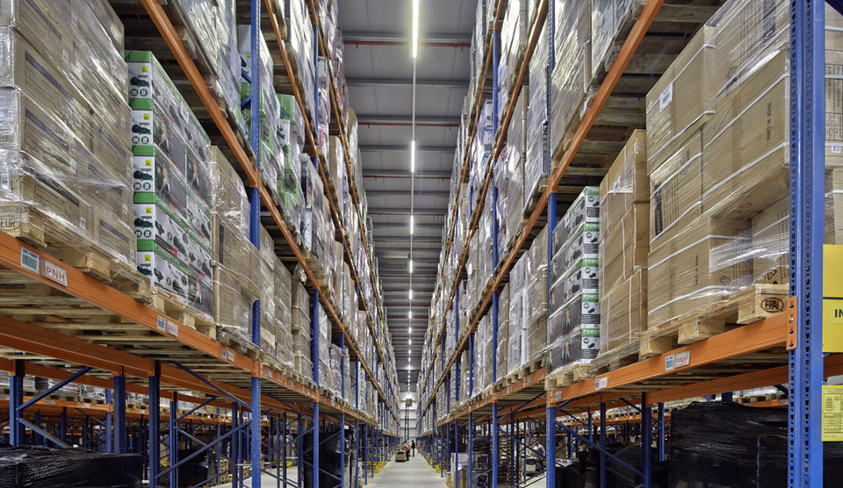
FAQ
Delivery times
FAQ / GUIDE
Defined high-seller types are in stock

Slide 44
FAQ
SERIES:
FACIELLA, LUTERA, LUTERA C, SKEO Q, SKEO R, ALTIGO G2
FAQ / GUIDE
01
02
03
04
For protection from oxidation and corrosion, the above-specified series are produced from alloys with low copper content and are given three-step surface treatment:
1. IRIDITE pre-preparation
2. Epoxy powder primer
3. Polyester powder coating
01 black textured (Akzo Nobel 8118669 - similar to RAL 9005)
02 white textured (Akzo Nobel 8158870 - similar to RAL 9016)
06 grey textured (Akzo Nobel 8129595 - similar to RAL 9006)
08 anthracite textured (Akzo Nobel 8026052 - 900 Sablé)
no surplus price

Slide 45
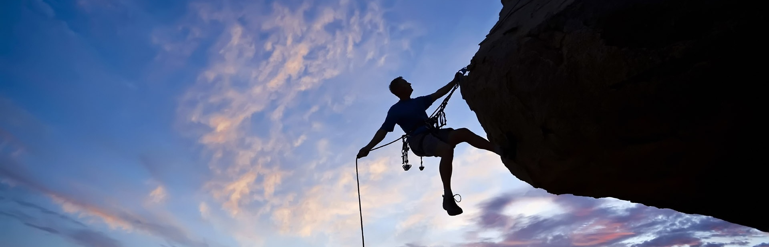
SKEO PURA – FLAT SQUARES FOR ATTRACTIVE FACADE LIGHTING
THE CHALLENGE
SKEO PURA – FLAT SQUARES FOR ATTRACTIVE FACADE LIGHTING
When illuminating exterior surfaces, it's often a matter of "the more stable the better". The challenge lies in the fact that the required high levels of resistance usually leads to tough, functional luminaires but often neglects the design aspects. After all, tough outdoor lighting should also have an attractive appearance – even if the light has been switched off.
LAUNCHING PRESENTATIONS ON THE SHAREPOINT

Slide 46
PARKING LOTS
LUMENA STAR 40
PLANNING AIDS
Parking lot width 16 m
Post height 6 m
Inclination angle 10°
Luminaire for 5 lux LnSTAR 40-AM2L/2200
Luminaire for 10 lux LnSTAR 40-AM2L/4200
Luminaire for 20 lux LnSTAR 40-AM2L/8200
Distance of start of parking lot to 1st luminaire12.5 m
Distance of luminaires between each other 37.5 m
FAQs, COMPETITIVE COMPARISONS, PLANNING AIDS ON THE SHAREPOINT

Slide 47
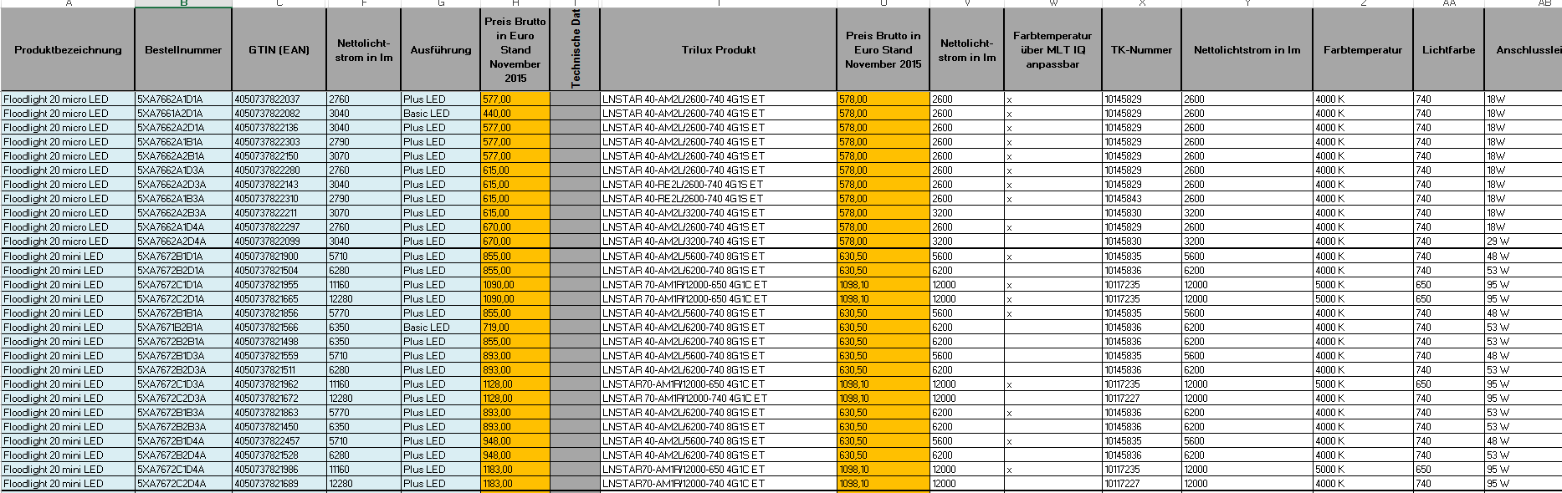
COMPARISON OF COMPETITION
PLANNING AIDS

Slide 48
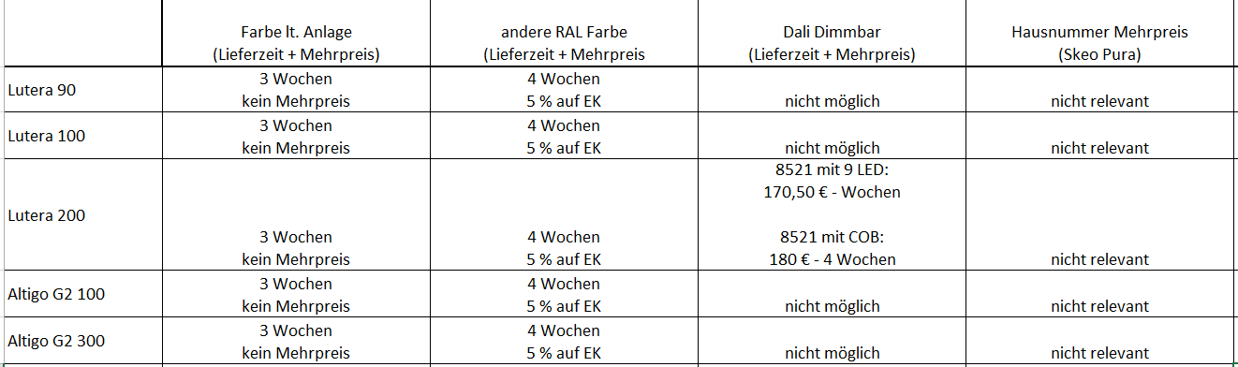
SPECIAL PRODUCTIONS
PLANNING AIDS
OVERVIEW ON THE SHAREPOINT

Slide 49
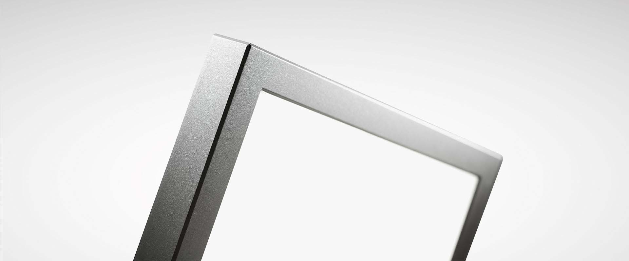
SKEO PURA – FLAT SQUARES FOR ATTRACTIVE FACADE LIGHTING
WALL AND CEILING LUMINAIRE
SKEO PURA – FLAT SQUARES FOR ATTRACTIVE FACADE LIGHTING
DISPATCH OF SALES SAMPLES IN WEEK 11

Slide 50
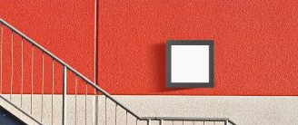
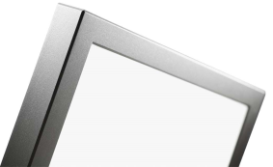
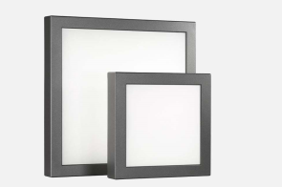
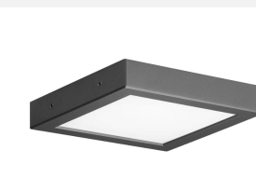
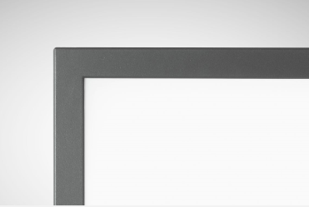
SKEO PURA
FLAT SQUARES FOR ATTRACTIVE FACADE LIGHTING
SKEO PURA – FLAT SQUARES FOR ATTRACTIVE FACADE LIGHTING
Luminaire luminous flux | 500lm – 1,650lm
Connected load/efficiency | 10W – 25W | max. 75 lm/W
Service life | L80 B10 50;000 h
Colour temperature | 3000K, 4000K
Electrical version | ET
Impact resistance | IK07
Protection rating | safety class | IP65 / safety class II
Light distribution | asymmetric wide distribution
Additional information
DATASHEETS IN SALES FORCE: WEEK 11
FOR OUTDOOR APPLICATIONS
TWO CONSTRUCTION SIZES
WALL/CEILING LUMINAIRE
DELIVERABLE

Slide 51
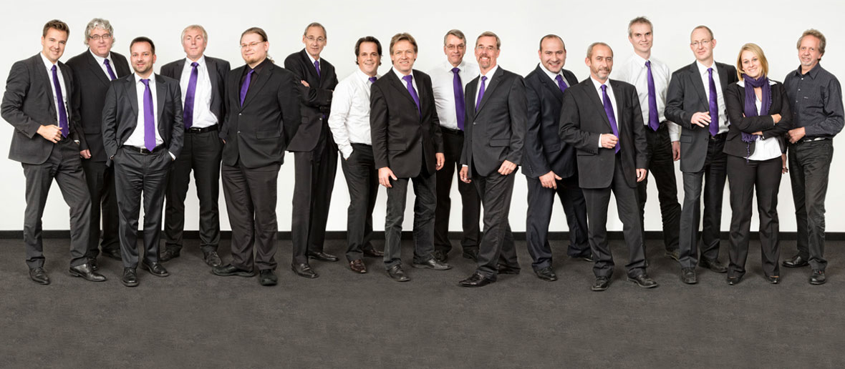
KNOWLEDGE TEST
AKADEMIE
E-LEARNING WITH KNOWLEDGE TEST: WEEK 13

