Slide 1
Outdoor luminaires
CROSS-SELLING
LAUNCHING TOUR Q1 2017
KC NUREMBERG | KC MUNICH | KC STUTTGART

Slide 2
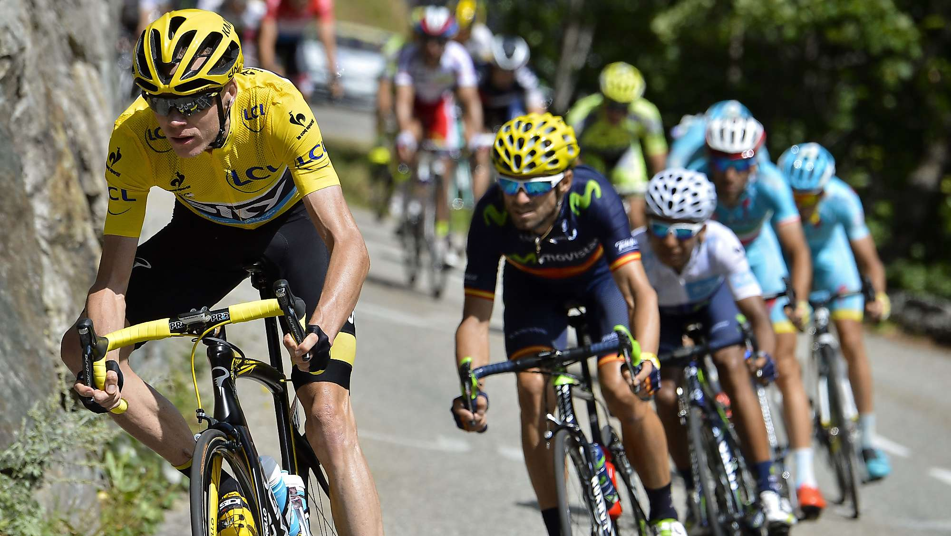
TARGET
STRATEGY – LIGHT AROUND THE BUILDING
IN 2020 EVERY 10th TURNOVER EURO IS AN OUTDOOR LUMINAIRE EURO

Slide 3
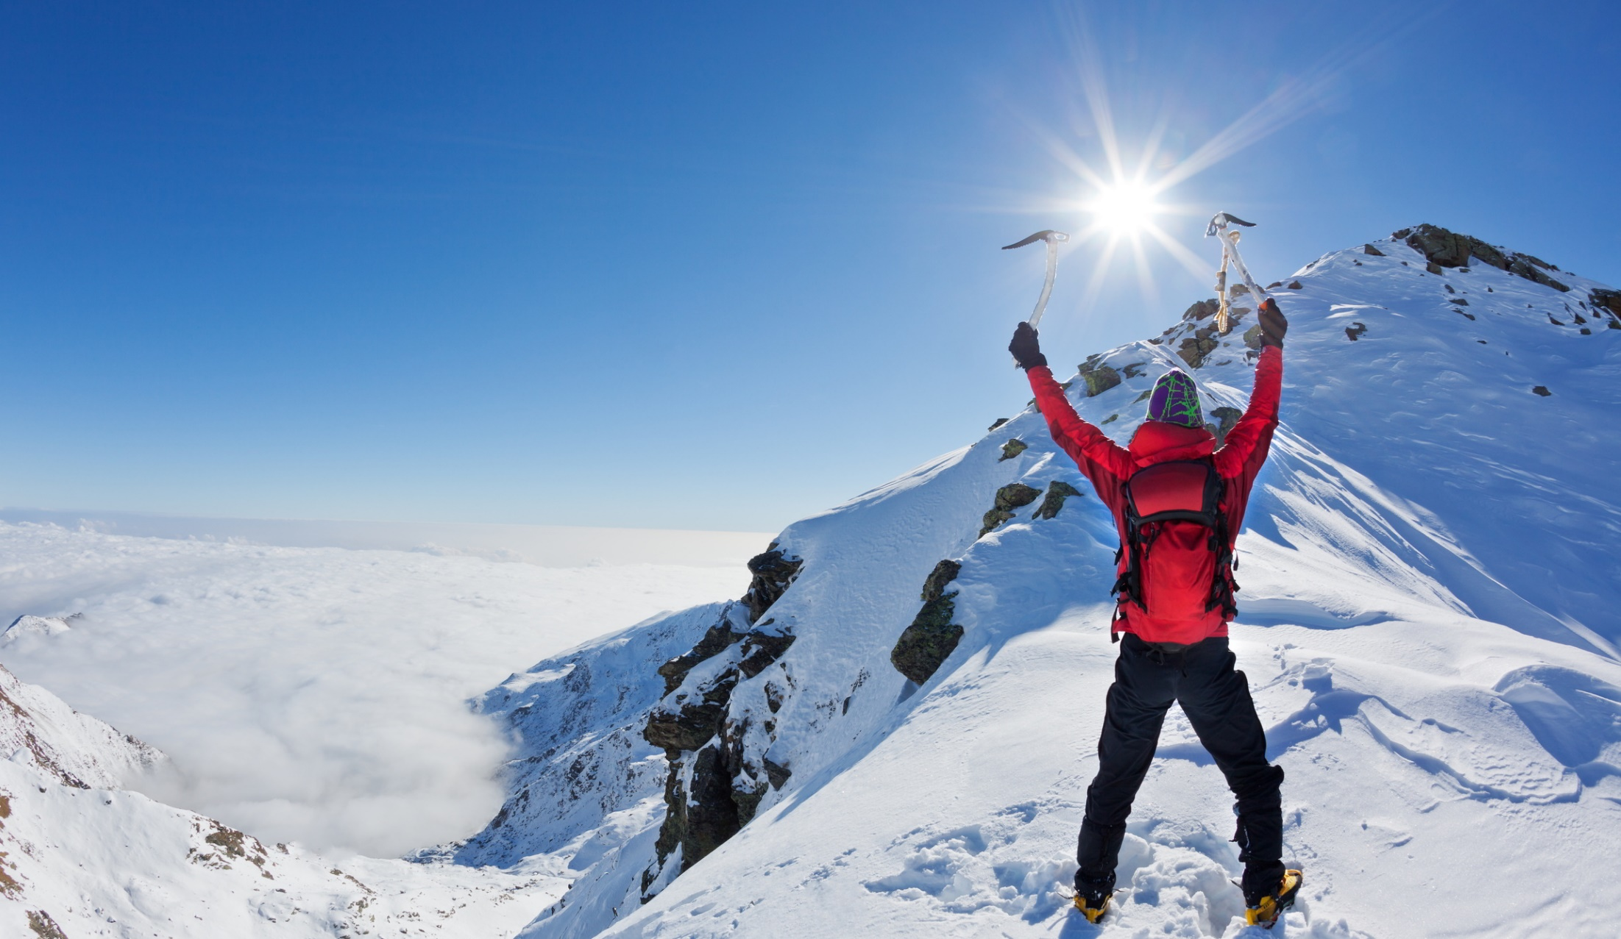
HOW CAN WE ACHIEVE THIS TARGET?

Slide 4
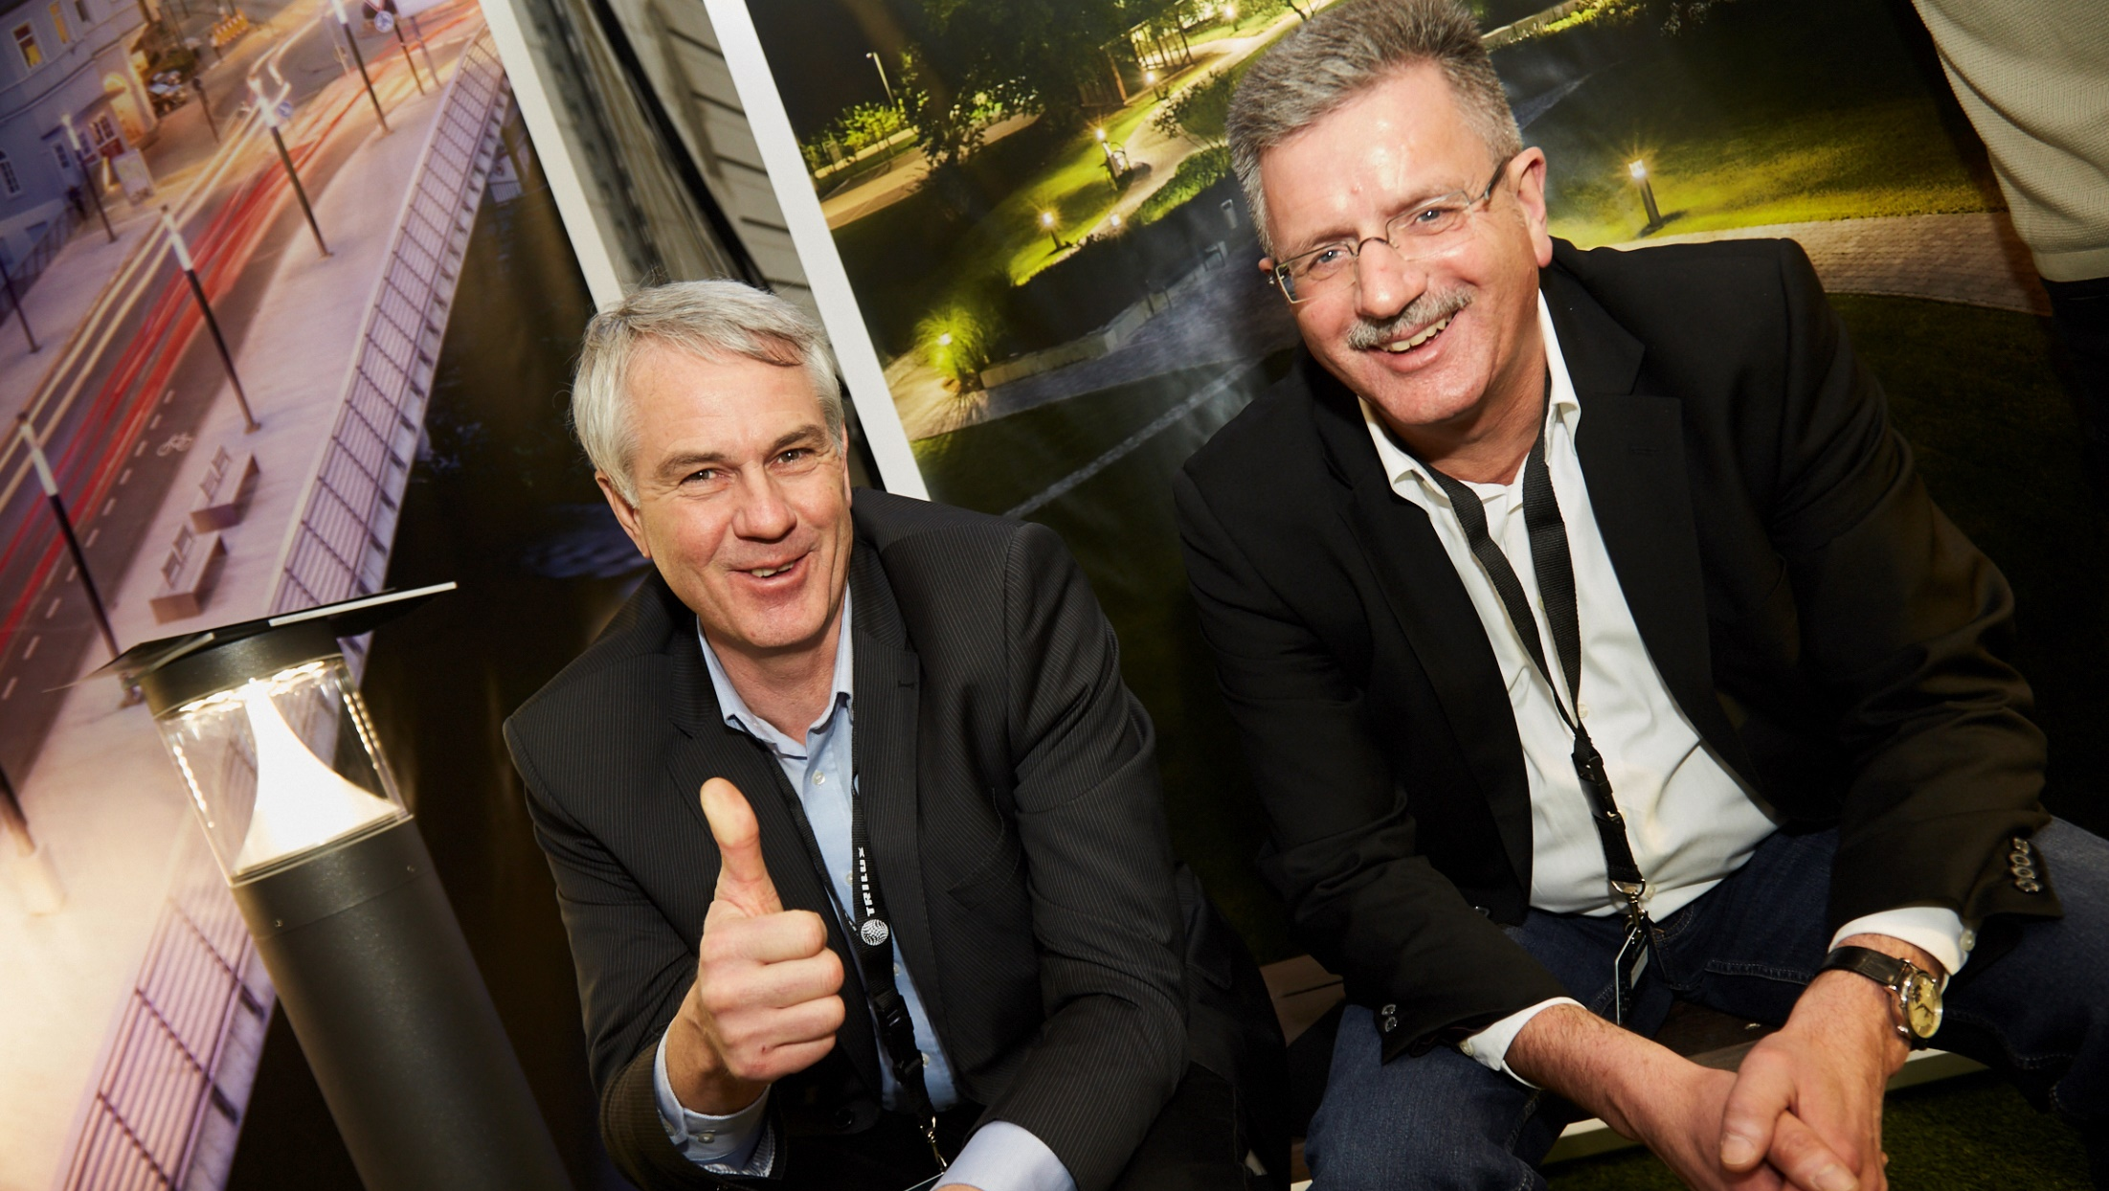
CROSS-SELLING

Slide 5

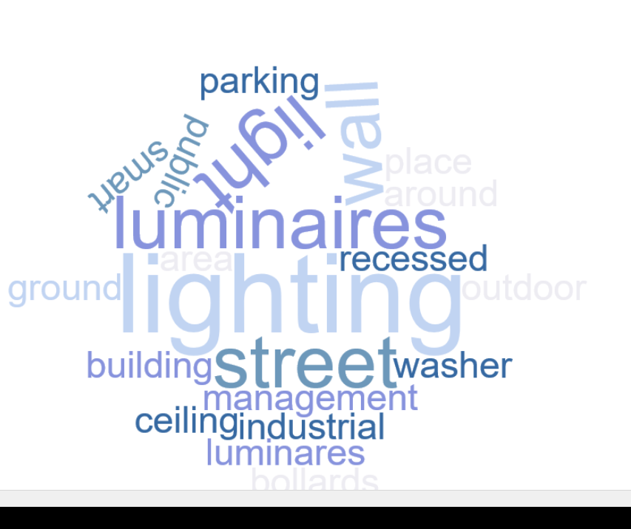
DEFINITION
WHAT DO WE UNDERSTAND BY CROSS-SELLING & LIGHTING NEAR BUILDINGS
PRODUCT LAUNCHING Q1 | 2017

Slide 6
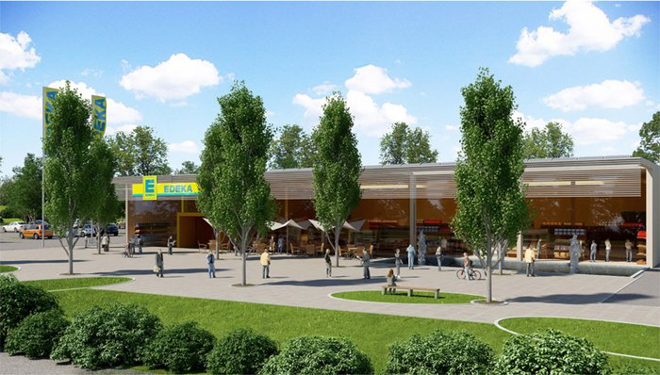
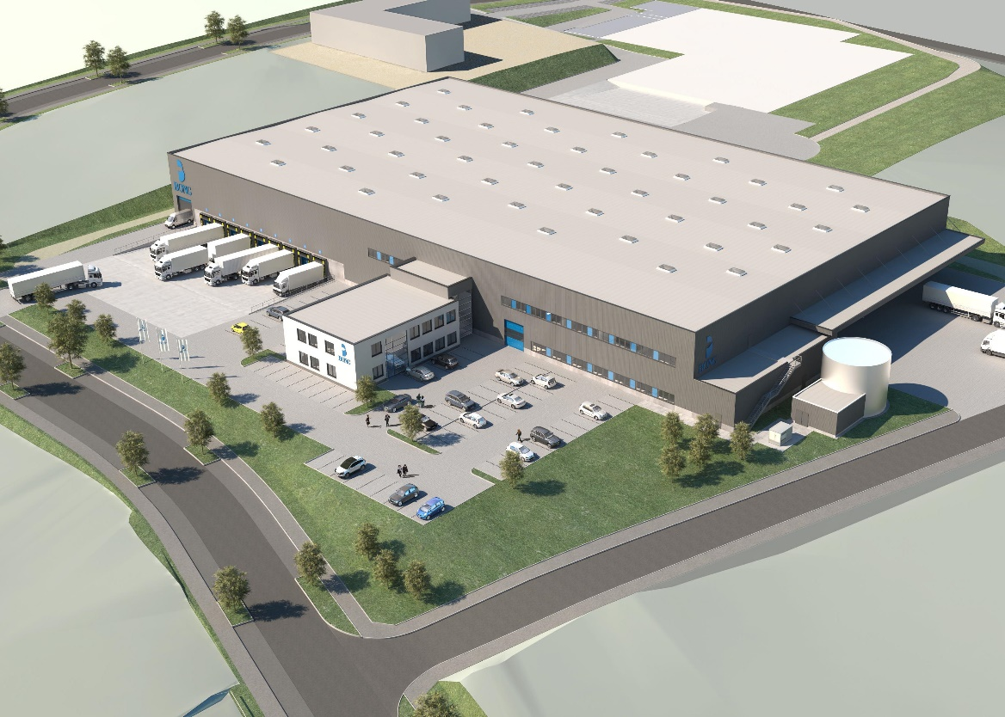

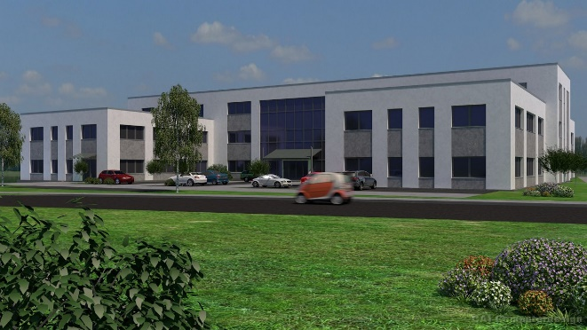


WE FIND AN OUTDOOR AREA IN EVERY APPLICATION
PRODUCT LAUNCHING Q1 | 2017

Slide 7

OUTDOOR AREAS WITH THE EXAMPLE OF AN INDUSTRIAL COMPLEX
PRODUCT LAUNCHING Q1 | 2017
OUTDOOR WORKPLACES
FACADE
LIGHTING
BUILDING LIGHTING
PARKING LOTS
PRESTIGIOUS
ENTRANCE AREA
PATHS
FACTORY ROADS

Slide 8
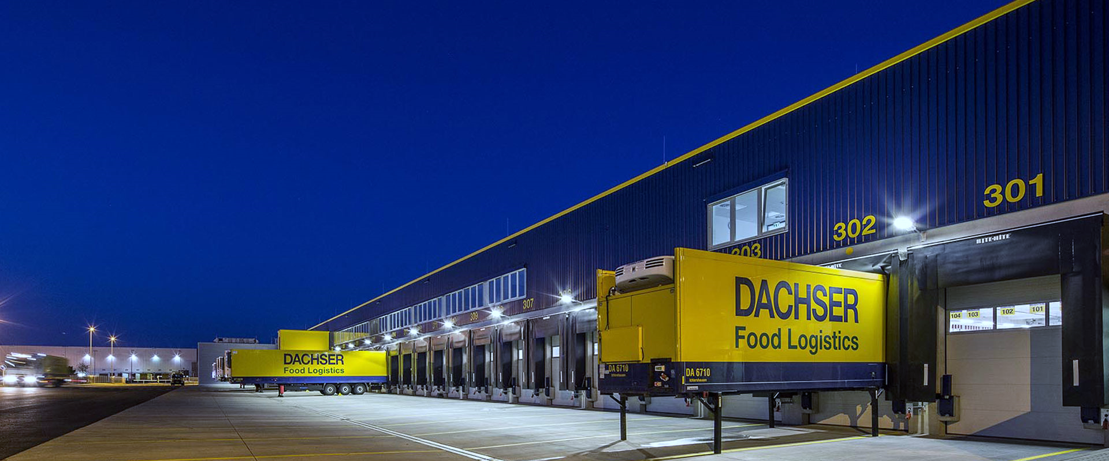
TURNOVER DEVELOPMENT CROSS-SELLING & TURNOVER DISTRIBUTION
PRODUCT LAUNCHING Q1 | 2017

Slide 9

YES WE CAN
CAN WE DO CROSS-SELLING?

Slide 10
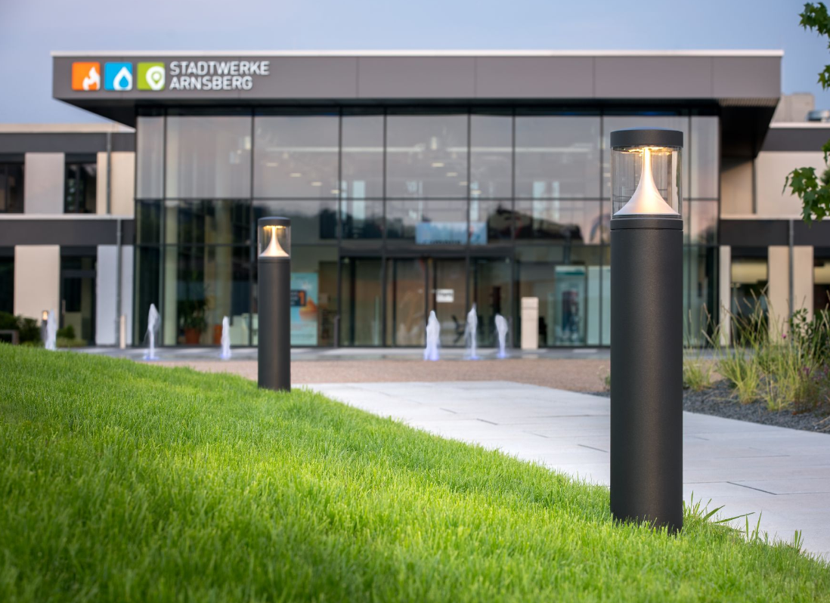
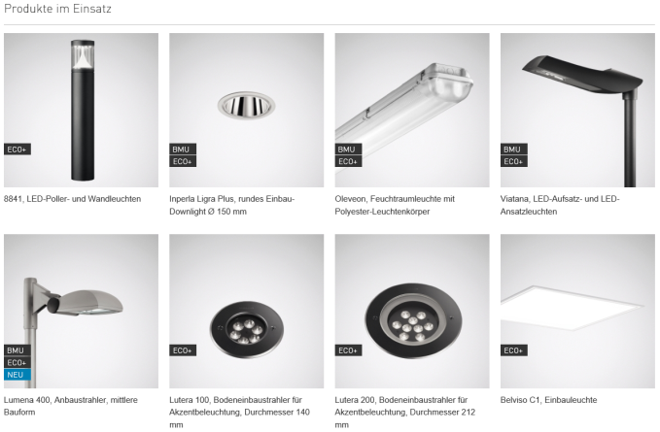
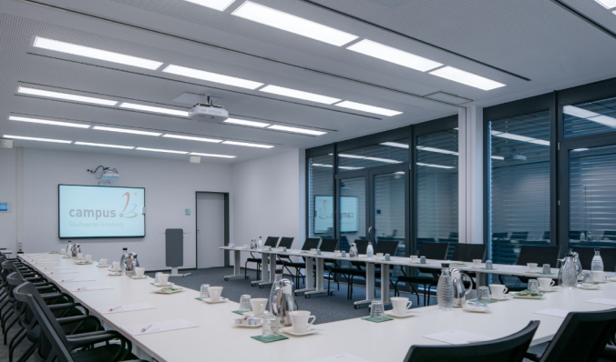
REFERENCES | CAMPUS
PRODUCT LAUNCHING Q1 | 2017

Slide 11
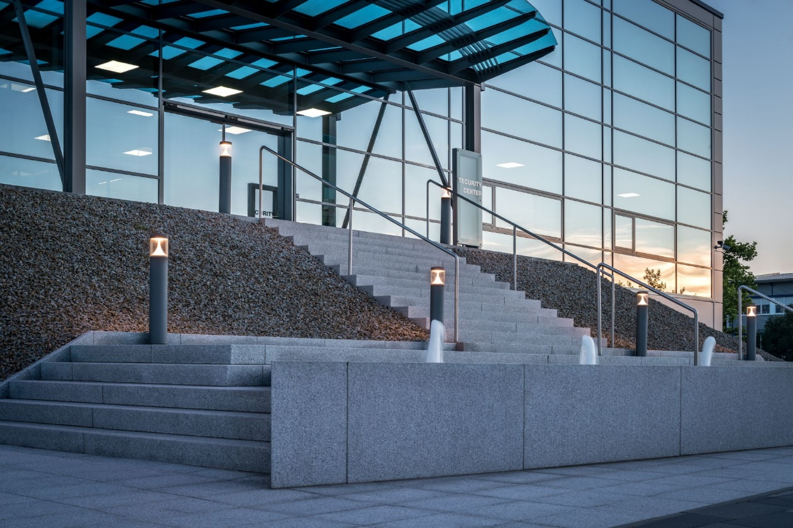
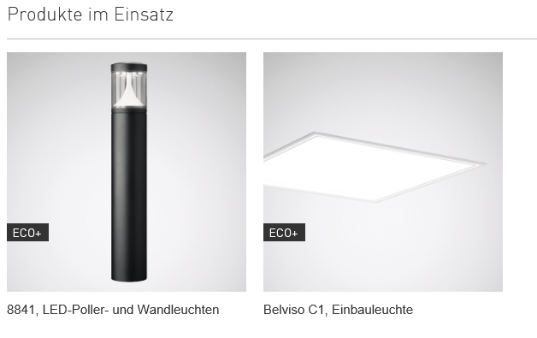
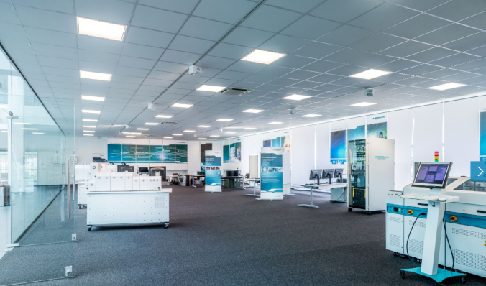
REFERENCES | MÜHLBAUER AG
PRODUCT LAUNCHING Q1 | 2017

Slide 12
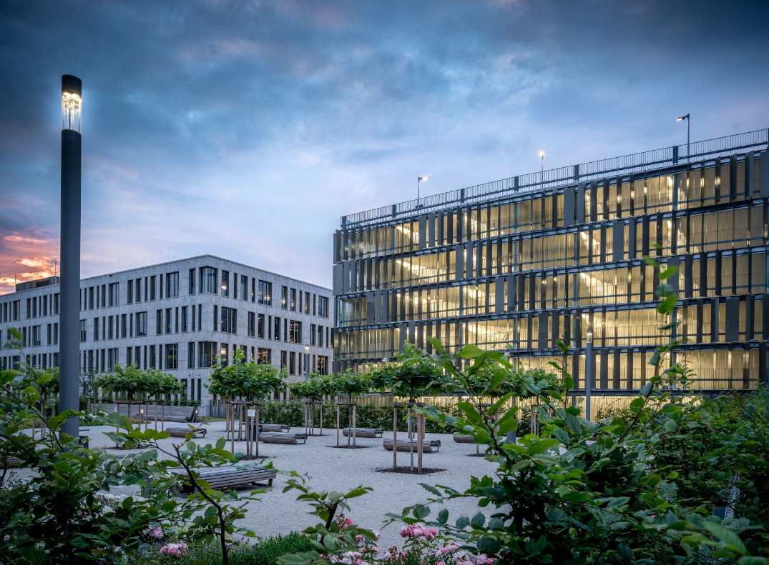
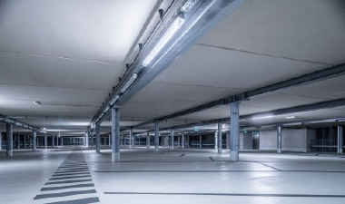
REFERENCES | DATEV CAMPUS NUREMBERG
PRODUCT LAUNCHING Q1 | 2017
TRILUX SERIES
8841
ConStela
Lumena 40
504..
Aragon
Offset S

Slide 13

CAN WE INSPIRE OUR CUSTOMERS?

Slide 14
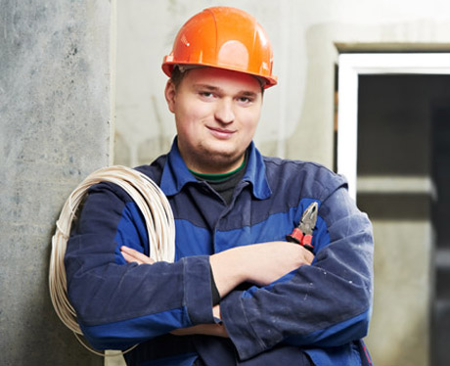



TARGET GROUPS
PRODUCT LAUNCHING Q1 | 2017
ELECTRICAL CONTRACTORS
LIGHTING DESIGNERS
END CUSTOMERS

Slide 15
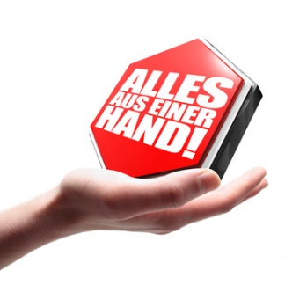

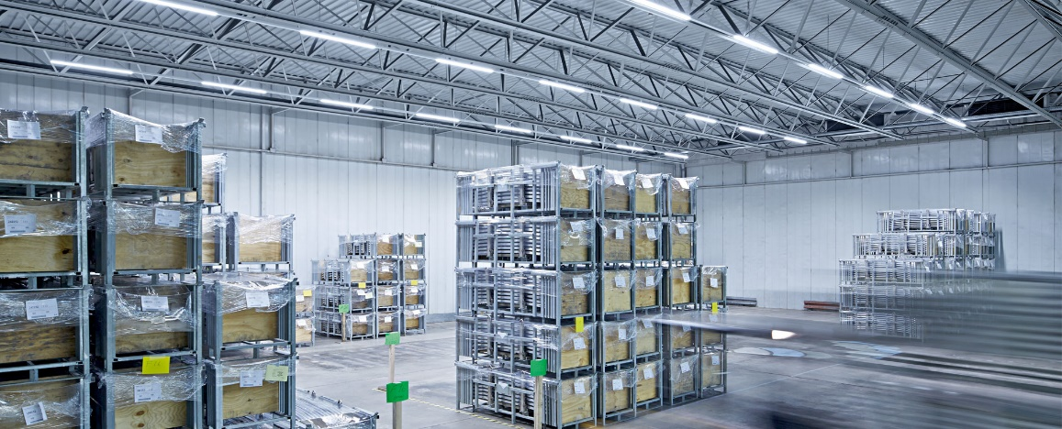
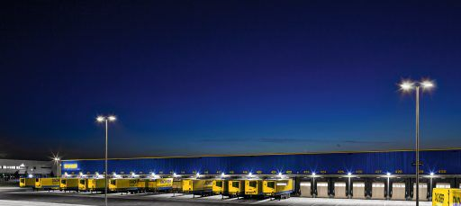
OUR FEATURE: ALL FROM A SINGLE SOURCE
PRODUCT LAUNCHING Q1 | 2017

Slide 16
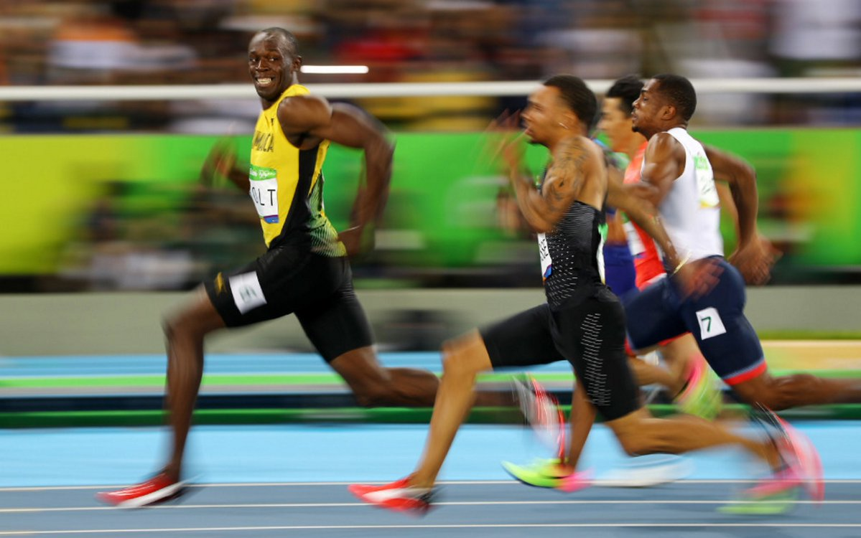
CAN WE PERSIST IN THE MARKET?

Slide 17











OVERVIEW OF COMPETITORS
PRODUCT LAUNCHING Q1 | 2017
All large competitors are partly or completely in the market for light near buildings.
With the combination of indoor and outdoor luminaires there are only a few competitors with large product ranges, meaning that it is not possible for all competitors to be active in the market as complete solution providers in project business.
→ Chance for TRILUX to expand the outdoor luminaire portfolio for strengthening the cross-selling philosophy in the TRILUX Group and present the company as a full-solution provider in project business

Slide 18

CAN WE INSPIRE WITH OUR PRODUCTS?

Slide 19
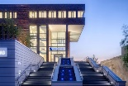
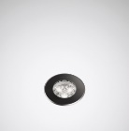
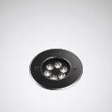
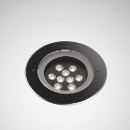
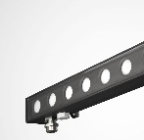
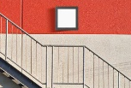
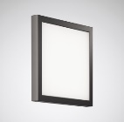
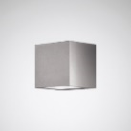
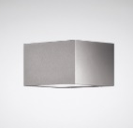
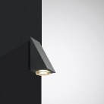
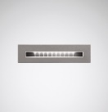
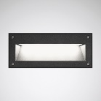
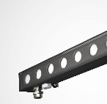
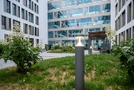
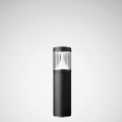
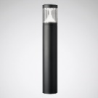
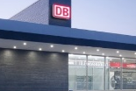
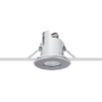
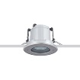
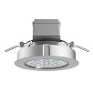
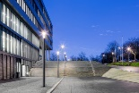
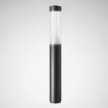
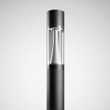
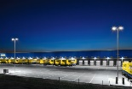
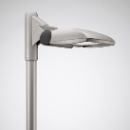
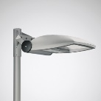
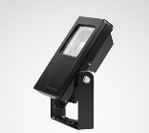
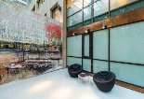
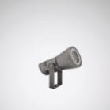







PORTFOLIO DEFINITION OF CROSS-SELLING
PRODUCT LAUNCHING Q1 | 2017
GROUND RECESSED LUMINAIRES
WALL AND CEILING LUMINAIRES
8501
8511
8521
ALTIGO G2
SKEO PURA
SKEO Q
SKEO R
HS
PAREDA SLIM
PAREDA
ALTIGO G2
BOLLARD LUMINAIRES
CEILING-RECESSED LUMINAIRES
8841K
8841
LUTERA 90 C
LUTERA 100 C
LUTERA 200 C
LIGHT COLUMNS
PROJECTORS
8841LS
CS20
CS23
LnStar 40
LnStar 70
COMBIAL
SPOTLIGHTS
POST LUMINAIRES
FACIELLA 08
FACIELLA 15
FACIELLA 20
LUMEGA IQ
CUVIA
VIACON
ONTRIA

Slide 20















TRILUX APPLICATIONS
PRODUCT LAUNCHING Q1 | 2017
GROUND RECESSING
SPOTLIGHTS
BOLLARDS
WALL
LUMINAIRES
CEILING
LUMINAIRES
WALL
WASHERS
WORKPLACES
OUTDOORS
CAR PARK
FACTORY
ROADS
INDUSTRY
OFFICE
SHOP & RETAIL
KEY ACCOUNT
ARCHITECTURAL

Slide 21



















Portfolio TODAY
PRODUCT SEGMENTS
PRODUCT LAUNCHING Q1 | 2017
GROUND-RECESSED
SPOTLIGHTS
OUTDOOR WORKPLACES
BOLLARDS
WALL LUMINAIRES
PARKING LOTS | DISTRIBUTION
CEILING LUMINAIRE
LIGHT COLUMNS
FACTORY ROADS

Slide 22
















Portfolio FROM 01.04.
PRODUCT SEGMENTS
PRODUCT LAUNCHING Q1 | 2017
GROUND-RECESSED
SPOTLIGHTS
OUTDOOR WORKPLACES
BOLLARDS
WALL LUMINAIRES
PARKING LOTS | DISTRIBUTION
CEILING LUMINAIRE
LIGHT COLUMNS
FACTORY ROADS

Slide 23



Slide 24

GROUPING CLASSIFICATION | HANDS ON TRAINING
GROUP 1 (Fabio Granata)
Mr Arne Perlitz
Mr Armin Kaufmann
Mrs Katrin Kochanek
Mr Stefan Fett
Mr Jochen Deuschle
Mr Dieter Mrmann
Mrs Michaela Pranjic
Mr Dieter Dannhorn
Mr Patrick Zeise
Mr Thomas Ey
Mrs Karin Meister
Mr Norbert Sedlmeir
Mr Andreas Drasch
Mr Roland Gerold
Mr Manfred Hurtig
Mr Jörg Wiederhold
GROUP 2 (Wolfgang Nückel)
Mr Joachim Straub
Mr Jörg Rebelato
Mr Daniel Reitz
Mr Arvid Spektor
Mr Steffen Klügel
Mr Rainer Haag
Mr Mirko Bertram
Mr Dieter Bogner
Mrs Gabriela Walk
Mr Günter Fertl
Mr Stephan Bauer
Mrs Tajana Kolutac
Mr Heiko Standop
Mrs Astrid Herbert
Mr Thomas Kring
Mr Dietmar Ank

Slide 25

GROUND RECESSED LUMINAIRES

Slide 26










LUTERA
THE COMPLETE RANGE FOR PERFECT PRESENTATIONS
PRODUCT LAUNCHING Q1|2017
Luminaire luminous flux | 500lm – 2,900lm
Connected load/efficiency | 5W – 26W / up to 112lm/W
Service life | L80 50,000 h
Colour temperature | 3000K, 4000K, blue, red, green, amber, RGB
Electrical version | ET, Dali (on request for 8521)
Roll-over capacity | 8501 & 8521: 2,000kg | 8511: 3,000kg
Protection rating | safety class | IP68 / safety class I
Impact resistance | IK10
Tiltable LED PCB | 8501: no | 8511: to 10° | 8521 to 15°
Additional information
MOUNTING HOUSINGS
COVER PLATES
3 CONSTRUCTION SIZES
WATER-TIGHT

Slide 27

FAQ
LUTERA GROUND RECESSED LUMINAIRES
FAQ / GUIDE
Which accessories must be ordered mandatorily for the ground-recessed luminaires?
Ordering the mounting housing and stainless steel cover plate (round or square) is obligatory.
What is the difference between the normal mounting housing (ET) and the expanded mounting housing (ETE)?
The normal mounting housing is simply an extended piece of tube and does not make installation easier. The expanded mounting housing on the other hand is more convenient when cabling and wiring the luminaires.
Why do I definitely need a drainage?
This makes sure that the water collecting below the luminaire
can flow away reasonably. A drainage of 20-30cm is recommended.
How warm does the glass become with full load of the LEDs?
The LED variants dissipate a maximum of 37°C to the surface of the glass.
How do the luminaires behave with chemical influences?
The luminaire must not come into contact with aggressive substances, chemicals, cleaning agents and/or fertilisers.

Slide 28
FAQ
LUTERA GROUND-RECESSED LUMINAIRES
FAQ / GUIDE
With what weight can I drive over the luminaires?
8501 – Lutera 90: 2,000kg | 8511 – Lutera 100: 3,000kg | 8521 – Lutera 200: 2,000kg
What is the difference between the lenses and the COB module with the Lutera 200 (8521)?
With the Lutera 200 (8521) you can choose between a version with 9 LEDs (max. 1,650lm) and a version with a high-output LED COB module (max. 2,900lm)
Are the luminaires DALI-compatible?
With the Lutera 200 (8521) it is possible to custom-produce the luminaires also with DALI.
Can I equip the luminaires with RGB control as well?
Yes, all sizes of the Lutera are also available with RGB control. The RGB system is DMX-based and mandatorily requires accessory components.

Slide 29
FAQ
LUTERA GROUND-RECESSED LUMINAIRES
FAQ / GUIDE
Are the luminaires also available in colour versions?
Yes, the luminaires are also available with coloured LEDs in red, blue, green and amber.
Are the luminaires available from stock?
High-seller types in all three construction sizes are available from stock.
Which beam angle does the Lutera have?
Narrow distribution: 10°
Medium wide distribution: 30°
Wide distribution: 50°
How long are the cables to the Lutera?
8501: 0.5m
8511: 1.0m
8521: 1.0m

Slide 30
COMPETITIVE SITUATION
GROUND-RECESSED LUMINAIRES | TRILUX LUTERA VS BEGA 77 96.
PRODUCT LAUNCHING Q1|2017
Criteria | Comments on strengths and weaknesses | worse |  |  | same |  |  | better
 |  | 1 | 2 | 3 | 4 | 5 | 6 | 7 | 8 | 9
Construction sizes | TX: 8501 | 8511 | 8521 vs BEGA: 77 961 | 77 964
Luminaire luminous flux range | TX: 500lm – 2.900lm | Bega 960lm – 1.800lm
Efficiency | TX: up to 112 lm/W | Bega up to 83lm/W
Protection rating | both IP68
Safety class | both safety class I
Impact resistance | both IK10
Tightness | TX: sealed cable gland | BEGA: Aqua Stop System
Offer price | reference Lutera 100 | TX P0:220 € vs BEGA: 470 €

Slide 31
COMPETITION SITUATION
REFERENCE TYPE: LUTERA 100
PRODUCT LAUNCHING Q1|2017
 |  | EVALUATION FACTORS
 |  | Dimensions |  | Luminaire luminous flux |  | Efficiency |  | Protection rating |  | Roll-over capacity |  | Tiltable LED PCB
COMPETITORS | TRILUX | 152mm 80mm |  | 1,000lm |  | 112lm/W |  | IP68 |  | 3,000kg | IK10 |  | yes
 | Bega 77 961 | 205mm 130mm |  | 1,000lm |  | 83lm/W |  | IP68 |  | 3,000kg | IK10 |  | yes
 | Philips | 150mm 78mm |  | 720lm |  | 48lm/W |  | IP68 |  | 500kg | IK10 |  | no
 | RZB | 190mm 250mm |  | 650lm |  | 54lm/W |  | IP68 |  | | IK08 |  | yes
 | iGuzzini Light-UP | 312mm 124mm |  | 770lm |  | 54lm/W |  | IP68 |  | 3,500kg | IK10 |  | yes

Slide 32





ALTIGO G2
THE COMPLETE RANGE FOR PERFECT PRESENTATIONS
PRODUCT LAUNCHING Q1|2017
Luminaire luminous flux | 500lm – 4,000lm
Connected load/efficiency | 11W – 36W/ up to 111lm/W
Service life | L80 50,000 h
Colour temperature | 3000K, 4000K
Electrical version | ET, DALI (on request) RGB
Load bearing capacity | 500kg
Protection rating | safety class | IP65 / safety class II
Light distribution | Rotationally symmetric Asymmetric
Additional information
LOAD BEARING CAPACITY: 500kg
LIGHT COMFORT
2 CONSTRUCTION SIZES
DELIVERY CAPABILITY 04/2017

Slide 33
FAQ
ALTIGO G2 GROUND-RECESSED LUMINAIRES
FAQ / GUIDE
Which load pressures can the luminaires take?
The luminaire resists a load of 500kg. This means the luminaire cannot be rolled over by cars and other similarly large vehicles.
What is the difference between a transparent cover and a frosted cover?
Light comfort is better with the frosted cover. Observers do not see the single LEDs and therefore the appearance of the luminaire is more attractive.
Which lengths does the ground-recessed version of the Altigo G2 have?
The ground-recessed version is available in lengths 600mm and 1,200mm.
What is the mandatory accessory with the luminaire?
The ground mounting enclosure must be ordered for the ground-recessed version.

Slide 34

BOLLARD LUMINAIRES & LIGHT COLUMNS

Slide 35







8841 | 8841 LIGHT COLUMN
SPECIFICALLY HIGH PERFORMANCE
PRODUCT LAUNCHING Q1|2017
Luminaire luminous flux | 8841: 700lm | 850lm 8841LS: to 3,500lm
Connected load/efficiency | 8841: 10W 8841LS: to 41W | 85 – 100 lm/W
Service life | L80 100,000 h
Colour temperature | 3000K, 4000K
Electrical version | ET, DALI (on request)
Protection rating | safety class | IP65 / safety class II
Light distribution | asymmetric wide distribution rotationally symmetric wide distribution MLTIQ
Additional information
FAMILY PHILOSOPHY
SUCCESS STORY
EXTREME SPACING
MLT IQ

Slide 36


Slide 37
FAQ
8841 BOLLARD LUMINAIRES
FAQ / GUIDE
Which sizes are the bollard luminaires available in?
The bollard luminaire comes in two sizes. One has approx. 60cm and the other has approx. 1.0m.
Is 850lm the maximum luminous flux?
No, the bollard can also be produced with significantly higher luminous flux on request.
What is the major advantage of the MLTIQ technology with the bollard?
As standard, the AB2L lens is assembled to enable maximum possible spacing between the bollard luminaires. The AB14L lens is more suitable for depth illumination.

Slide 38
COMPETITIVE SITUATION
BOLLARD LUMINAIRES | TRILUX 8841 VS BEGA 99 856
PRODUCT LAUNCHING Q1|2017
Criteria | Comments on strengths and weaknesses | worse |  |  | same |  |  | better
 |  | 1 | 2 | 3 | 4 | 5 | 6 | 7 | 8 | 9
Luminaire luminous flux | TX: 850lm | BEGA: 1,700lm
Connected load | TX: 10W | BEGA: 29W
Efficiency | TX: up to 85lm/W | BEGA: 61 lm/W
Protection rating | both IP65
Spacing | TX: to 12m | BEGA: to 9m

Slide 39





CONSTELA
SPECIFICALLY HIGH PERFORMANCE
PRODUCT LAUNCHING Q1|2017
Luminaire luminous flux | 1,650lm – 5,600lm
Connected load/efficiency | 16W to 49W / up to 117 lm/W
Service life | L80 100,000 h
Colour temperature | 3000K, 4000K
Electrical version | ET, (LR, LRA, DALI on request)
Diameter | 200mm & 230mm
Protection rating | safety class | IP65 / safety class II
Light distribution | asymmetric wide distribution rotationally symmetric wide distribution; MLT IQ
Additional information
MODULAR SYSTEM
VARIOUS DESIGNS
SPOTLIGHT MODULES
CUSTOMER REQUESTS

Slide 40

SPOTLIGHTS

Slide 41





FACIELLA
ONE SPOTLIGHT. THREE MODULES: ALL POSSIBILITIES.
PRODUCT LAUNCHING Q1|2017
Luminaire luminous flux | 500lm – 4,200lm
Connected load/efficiency | 7W – 43W / up to 102lm/W
Service life | L80 50,000 h
Colour temperature | 3000K, 4000K, blue, red, green, amber, RGB
Electrical version | ET, DALI (on request Faciella 15 & 20)
Protection rating | safety class | IP65 / safety class II
Light distribution | rotationally symmetric narrow rotationally symmetric medium wide rotationally symmetric wide
Additional information
POST CONNECTIONS
DIVERSE ACCESSORIES
3 CONSTRUCTION SIZES
HIGH LUMEN OUTPUT

Slide 42
FAQ
FACIELLA SPOTLIGHT
FAQ / GUIDE
Which sizes are the Faciella luminaires available in?
The Faciella spotlight is available in three construction sizes to provide the most cost-efficient solution for the customer.
Are DALI versions possible?
DALI versions are possible with the Faciella 15 and Faciella 20.
Which accessories are available for the Faciella?
The following accessories are available for Faciella spotlights: Post straps, post connections, ground stakes, cylindrical shield, ribbed glass and a frosted panel.
Are there coloured versions of the spotlight and is RGB possible?
Yes, coloured versions are available as standard – red, blue, green and amber. RGB components must be mandatorily ordered (DMX-based RGB system).

Slide 43
FAQ
FACIELLA SPOTLIGHT
FAQ / GUIDE
Which beam angle does the Lutera have?
Narrow distribution: 10°
Medium wide distribution: 30°
Wide distribution: 50°
What is the cable length with the spotlights?
Faciella 08: 3m
Faciella 15: 3m
Faciella 20: 5m

Slide 44
COMPETITIVE SITUATION
SPOTLIGHTS | TRILUX FACIELLA VS BEGA 77
PRODUCT LAUNCHING Q1|2017
Criteria | Comments on strengths and weaknesses | worse |  |  | same |  |  | better
 |  | 1 | 2 | 3 | 4 | 5 | 6 | 7 | 8 | 9
Construction sizes | TX: 3 vs BEGA: 4
Luminaire luminous flux range | TX: 500lm – 4,200xlm | Bega 700lm – 5,300lm
Efficiency | TX: up to 102 lm/W | Bega up to 76lm/W
Protection rating | both IP65
Safety class | TX: SC II | BEGA: SC I
Offer price | Faciella 08 180 € vs 77 683 285 €
 | Faciella 15 293 € vs 77 703 346€
 | Faciella 20 550€ vs 77 651 510 €
BEGA: 77 683 | 77 703 | 77 651 | 77 651

Slide 45


RGB
PRODUCT LAUNCHING Q1|2017

Slide 46

RGB
PRODUCT LAUNCHING Q1|2017

Slide 47

RGB
PRODUCT LAUNCHING Q1|2017

Slide 48
COMPETITION SITUATION
REFERENCE TYPE: FACIELLA 15 | 9 LED
PRODUCT LAUNCHING Q1|2017
 |  | EVALUATION FACTORS
 |  | Luminaire luminous flux |  | Efficiency |  | Protection rating | Safety class |  | IK value |  | Alignment
COMPETITORS | TRILUX | 2,000lm |  | 95 lm/W |  | IP65 / I |  | IK06 |  | flexible on-site
 | Bega 77 703 | 1,100lm |  | 77 lm/W |  | IP65 / I |  | IK06 |  | 120° alignable
 | Philips | 2,525 lm |  | 48 lm/W |  | IP65 / I |  | IK06 |  | 180° alignable
 | iGuzzini ipro | 1,900lm |  | 100 lm/W |  | IP66 | II |  | IK07 |  | 40° alignable
 | ERCO | 1,857lm |  | 92 lm/W |  | IP65 / I |  | no information |  | 90° alignable

Slide 49

WALL LUMINAIRES & CEILING SURFACE-MOUNTED LUMINAIRES

Slide 50





SKEO PURA
FLAT SQUARES FOR ATTRACTIVE FACADE LIGHTING
PRODUCT LAUNCHING Q1|2017
Luminaire luminous flux | 500lm – 1,650lm
Connected load/efficiency | 10W – 25W | max. 70 lm/W
Service life | L80 50,000 h
Colour temperature | 3000K, 4000K
Electrical version | ET, DALI (Skeo Pura 40 on request)
Impact resistance | IK07
Protection rating | safety class | IP65 / I
Light distribution | rotationally symmetric wide distribution
Additional information
FLEXIBILITY OF DESIGN
TWO CONSTRUCTION SIZES
WALL/CEILING LUMINAIRE
DELIVERABLE

Slide 51
FAQ
SKEO PURA WALL AND CEILING SURFACE-MOUNTED LUMINAIRES
FAQ / GUIDE
What is the major competitive advantage of the Skeo Pura?
Homogeneous illumination of the complete area and the flat dimensions of the luminaire with a depth of just 40 mm.
Are DALI versions possible?
Yes, Skeo Pura 40 is DALI-compatible.
Can I use the luminaires indoors?
Yes, the luminaires can also be used for indoor applications to especially provide entrance areas with a recognisable family philosophy. (the same luminaires outdoors as indoors)
Is the luminaire suitable for DC voltage, can it therefore be connected to a central battery?
Yes, all Skeo Pura versions are DC-voltage compatible, so can be connected to a central battery.

Slide 52
COMPETITIVE SITUATION
WALL SURFACE-MOUNTED LUMINAIRES | TRILUX SKEO PURA VS BEGA 33 234
PRODUCT LAUNCHING Q1|2017
Criteria | Comments on strengths and weaknesses | worse |  |  | same |  |  | better
 |  | 1 | 2 | 3 | 4 | 5 | 6 | 7 | 8 | 9
Construction sizes | TX: 2 construction sizes | BEGA: 3 construction sizes
Luminaire luminous flux range | TX: 500lm – 1650lm | BEGA: 500lm – 1,800lm
Efficiency | TX: up to 75 lm/W | Bega up to 64lm/W
Protection rating | both IP65
Safety class | both safety class I
Impact resistance | TX: IK07 | BEGA: IK06
Luminaire depth | TX: 40mm | BEGA: 80mm
Offer price | Skeo Pura 26 203€ vs 33 232 215 €
 | Skeo Pura 40 310€ vs 33 234 390 €
BEGA: 33 232 | 33 233 | 33 234

Slide 53
COMPETITION SITUATION
REFERENCE TYPE: SKEO PURA 40
TRILUX
 |  | EVALUATION FACTORS (1) very good – (10) very bad
 |  | Luminaire luminous flux |  | Efficiency |  | Depth |  | IK | Weight |  | LED power supply unit
COMPETITORS | TRILUX | 1,650lm |  | 75 lm/W |  | 40mm |  | IK07 |  | 220-240V 0/50-60Hz
 | Bega 33 234 | 1,850lm |  | 65lm/W |  | 90mm |  | IK06 |  | 220-240V 0/50-60Hz
 | RZB Evo Square | 620lm |  | 34 lm/W |  | 64mm |  | IK06 |  | 220 - 240 V/ 50 Hz
 | Simes ZEN | 1,173lm |  | 53 lm/W |  | 75mm |  | IK06 |  | 230V 0/50-60Hz

Slide 54





SKEO Q
FILIGREE RECESSED LUMINAIRE FOR LARGE LIGHT ACCENTS
PRODUCT LAUNCHING Q1|2017
Luminaire luminous flux | 20lm – 3,200lm
Connected load/efficiency | 4W to 28W / up to 107 lm/W
Service life | L80 50,000 h
Colour temperature | 3000K, 4000K
Electrical version | ET
DC voltage compatibility | yes
Protection rating | safety class | IP65 / I
Light distribution | asymmetric wide distribution rotationally symmetric wide distribution
Additional information
2 CONSTRUCTION SIZES
FLEXIBLE USES
SIMPLE INSTALLATION
DELIVERABLE

Slide 55





SKEO Q – A CUBE SETS ACCENTS
PHOTOMETRIC OPTIONS
PRODUCT LAUNCHING Q1|2017
Lighting technology:
AMxR
Lighting technology:
RBxR
Lighting technology:
AMxR-AMxR
Lighting technology:
RBxR-RBxR
Lighting technology:
AMxR-RBxR

Slide 56
FAQ
SKEO Q WALL AND CEILING SURFACE-MOUNTED LUMINAIRES
FAQ / GUIDE
What do the abbreviations GT and GS mean in the reference?
GT: glass transparent | GS: frosted glass
Which lighting technology combinations are available with the wall luminaires?
direct distribution: narrow and wide distribution
Direct/indirect distribution: narrow – narrow (Skeo Q-W1), narrow – wide (Skeo Q-W1) wide – wide (both sizes)
Can I use the luminaires indoors?
Yes, the luminaires can be used indoors.
Is the luminaire suitable for DC voltage, can can it therefore be connected to a central battery?
Yes, a large part of the range is DC-voltage compatible, so can be connected to a central battery. Please see the luminaire datasheet for the specific types in this regard.
Are DALI versions possible?
Construction size 2 of the wall and ceiling luminaire are DALI on request.

Slide 57
COMPETITIVE SITUATION
WALL SURFACE-MOUNTED LUMINAIRES | TRILUX SKEO Q VS BEGA 24 37.
PRODUCT LAUNCHING Q1|2017
Criteria | Comments on strengths and weaknesses | worse |  |  | same |  |  | better
 |  | 1 | 2 | 3 | 4 | 5 | 6 | 7 | 8 | 9
Construction sizes | Two construction sizes
Luminaire luminous flux range | TX: 20lm – 3,200lm | Bega 400lm – 800lm
Efficiency | TX: up to 107 lm/W | Bega up to 41lm/W
Protection rating | TX: IP65 | BEGA: IP64
Safety class | both safety class I
Impact resistance | both IK07
Offer price | direct: SKEO Q W1 136€ vs BEGA 24 370 151 €
 | direct/indirect: SKEO Q W1 143 € vs BEGA 24371 180€
BEGA 24 370 | 24 371

Slide 58




SKEO R
FILIGREE RECESSED LUMINAIRE FOR LARGE LIGHT ACCENTS
PRODUCT LAUNCHING Q1|2017
Luminaire luminous flux | 20lm – 3,000lm
Connected load/efficiency | 4W to 28W / up to 107 lm/W
Service life | L80 B10 50,000 h
Colour temperature | 3000K, 4000K
Electrical version | ET
DC voltage compatibility | yes
Protection rating | safety class | IP65 / I
Light distribution | asymmetric wide distribution rotationally symmetric wide distribution
Additional information
2 CONSTRUCTION SIZES
FLEXIBLE USES
WALL & CEILING SURFACE-MOUNTING
DELIVERY CAPABILITY 04/2017

Slide 59
FAQ
SKEO R WALL AND CEILING SURFACE-MOUNTED LUMINAIRES
FAQ / GUIDE
What do the abbreviations GT and GS mean in the reference?
GT: glass transparent | GS: frosted glass
Which lighting technology combinations are available with the wall luminaires?
With both the large and small luminaire it is possible to select direct wide distribution and direct/indirect wide distribution.
Can I use the luminaires indoors?
Yes, the luminaires can be used indoors.
Is the luminaire suitable for DC voltage, can can it therefore be connected to a central battery?
Yes, a large part of the range is DC-voltage compatible, so can be connected to a central battery. Please see the luminaire datasheet for the specific types in this regard.
Are DALI versions possible?
Construction size 2 of the wall and ceiling luminaire are DALI on request.

Slide 60





HS
DECORATIVE WALL LUMINAIRE WITH TRIANGULAR CHARACTER
PRODUCT LAUNCHING Q1|2017
Luminaire luminous flux | 300lm
Connected load/efficiency | 4W / 75lm/W
Service life | L80 50,000 h
Colour temperature | 3000K, 4000K
Electrical version | ET
Protection rating | safety class | IP54 | safety class I
Light distribution | rotationally symmetric medium wide
Additional information
NEW LED VERSION
BOLLARD LUMINAIRE
WALL LUMINAIRE
DELIVERABLE

Slide 61





ALTIGO G2
FILIGREE RECESSED LUMINAIRE FOR LARGE LIGHT ACCENTS
PRODUCT LAUNCHING Q1|2017
Luminaire luminous flux | 300lm – 4,000lm
Connected load/efficiency | 3W – 36W / up to 111 lm/W
Service life | L80 50,000 h
Construction sizes | 100mm | 300mm | 600mm | 900mm | 1200mm
Colour temperature | 3000K, 4000K
Electrical version | ET, DALI & RGB (on request)
Protection rating | safety class | IP65 / safety class II
Light distribution | asymmetric rotationally symmetric
Additional information
5 CONSTRUCTION SIZES
WALL SURFACE-MOUNTED LUMINAIRE
RECESSED CEILING LUMINAIRE
DELIVERABLE 04/2017

Slide 62
FAQ
ALTIGO G2 WALL SURFACE-MOUNTED LUMINAIRES
FAQ / GUIDE
Which sizes are available with the wall surface-mounted luminaires?
The wall surface-mounted luminaires are available in sizes 100mm, 300mm, 600mm, 900mm and 1,200mm.
Is the control gear unit external?
Yes, the control gear unit is always external and must be ordered in addition to the luminaire.
Is through-wiring possible?
No, through-wiring is not possible because of lack of space in the luminaire.

Slide 63





PAREDA
FILIGREE RECESSED LUMINAIRE FOR LARGE LIGHT ACCENTS
PRODUCT LAUNCHING Q1|2017
Luminaire luminous flux | 30lm | 110lm
Connected load/efficiency | 3W | 6W
Service life | L80 50,000 h
Colour temperature | 3000K, 4000K
Electrical version | ET
Impact resistance | IK09
Protection rating | safety class | IP65 / I
Light distribution | asymmetric medium wide
Additional information
HIGH PRODUCT QUALITY
2 CONSTRUCTION SIZES
FLUSH & RAISED
DELIVERABLE 04/2017

Slide 64





PAREDA SLIM
FILIGREE RECESSED LUMINAIRE FOR LARGE LIGHT ACCENTS
PRODUCT LAUNCHING Q1|2017
Luminaire luminous flux | 110lm
Connected load/efficiency | 5W / up to 22 lm/W
Service life | L80 B10 50,000 h
Colour temperature | 3000K, 4000K
Electrical version | ET
Impact resistance | recess depth | IK07 | 72mm
Protection rating | safety class | IP65 / I
Light distribution | asymmetric medium wide
Additional information
HIGH PRODUCT QUALITY
LOW RECESS DEPTH
SIMPLE INSTALLATION
DELIVERABLE 04/2017

Slide 65

CEILING-RECESSED LUMINAIRES

Slide 66





LUTERA C
FILIGREE RECESSED LUMINAIRE FOR LARGE LIGHT ACCENTS
PRODUCT LAUNCHING Q1|2017
Luminaire luminous flux | 100 lm – 2,000 lm
Connected load/efficiency | 3W – 23W / up to 100 lm/W
Service life | L80 50,000 h
Colour temperature | 3000K, 4000K
Electrical version | ET, DALI & RGB (on request)
Protection rating | safety class | IP65 / I
Light distribution | asymmetric rotationally symmetric
Additional information
3 CONSTRUCTION SIZES
TRANSPARENT GLASS
LIGHT COMFORT
DELIVERABLE 04/2017

Slide 67
FAQ
LUTERA C CEILING-RECESSED LUMINAIRES
FAQ / GUIDE
Which sizes are available with the ceiling-recessed luminaires?
Three construction sizes are available with the ceiling recessed version.
Is the control gear unit external?
No, the control gear unit is always in or on the luminaire and therefore must not be additionally ordered.
Which ceilings are suitable for installing the luminaires?
Luminaires must be recessed in cut / plasterboard apertures in suspended ceilings.
Are DALI versions possible?
DALI versions are possible on request with the Lutera 200 C.
Are accessories available for the ceiling-recessed luminaires?
Frosted glass for improving the light comfort.

Slide 68
COMPETITIVE SITUATION
GROUND-RECESSED LUMINAIRES | TRILUX LUTERA C VS BEGA 66 7
PRODUCT LAUNCHING Q1|2017
Criteria | Comments on strengths and weaknesses | worse |  |  | same |  |  | better
 |  | 1 | 2 | 3 | 4 | 5 | 6 | 7 | 8 | 9
Construction sizes | TX 3 | BEGA 5
Luminaire luminous flux range | TX: 350lm – 2,000lm | BEGA: 100lm – 1,500lm
Efficiency | TX: up to 100lm/W | BEGA: up to 60lm/W
Protection rating | TX: IP68 / IP65 | BEGA: IP65
Safety class | both safety class I
Impact resistance | TX: IK07 / IK08 | BEGA: IK07
Offer price | TX LUTERA 90C 160€ vs BEGA 66 709: 170€
 | TX LUTERA 100C 223€ vs BEGA 255€
 | TX LUTERA 200C 300€ vs BEGA 337€

Slide 69
ALTIGO G2
FILIGREE RECESSED LUMINAIRE FOR LARGE LIGHT ACCENTS
PRODUCT LAUNCHING Q1|2017
Luminaire luminous flux | 300lm – 4,000lm
Connected load/efficiency | 3W – 36W / up to 111 lm/W
Service life | L80 50,000 h
Construction sizes | 100mm | 300mm | 600mm | 900mm | 1200mm
Colour temperature | 3000K, 4000K
Electrical version | ET, DALI & RGB (on request)
Protection rating | safety class | IP65 / safety class II
Light distribution | asymmetric rotationally symmetric
Additional information
5 CONSTRUCTION SIZES
WALL SURFACE-MOUNTED LUMINAIRE
RECESSED CEILING LUMINAIRE
DELIVERABLE 04/2017

Slide 70

SPOTS & PROJECTORS

Slide 71
PORTFOLIO – PROJECTORS
PRODUCT LAUNCHING Q1|2017
2017
2017
PERF.
PERF.
ESTADIA
526 €
LUMENA STAR 70
525 €
ESTADIA
526 €
LUMENA STAR 70
540 €
CORE
LUMENA 600
365 €
CORE
LUMENA STAR 40
330 €
LUMENA STAR 40
330 €
LUMENA 400
150 €
COMBIAL
77 €
ENTRY
ENTRY
COMBIAL
80 €
conventional
LED
OUT
conventional
LED
OUT
Launching of Combial LED in the ENTRY sector
OUTPHASING of conventionally lamped luminaires.
Slender portfolio in the project sector

Slide 72




COMBIAL LED
PRODUCT LAUNCHING Q1|2017
Luminaire luminous flux | 3,500lm – 12,000lm
Connected load/efficiency | 35W – 120W | max. 100lm/W
Service life | L80 50,000h
Colour temperature | 3000K, 4000K
Electrical version | ET
Construction sizes | 3
Protection rating | safety class | IP65 / I
Light distribution | symmetric wide distribution
Additional information
ENTRY SEGMENT
CLEAR DIFFERENTIATION
3 CONSTRUCTION SIZES
DELIVERABLE 04/2017

Slide 73





LUMENA STAR 40
PRODUCT LAUNCHING Q1|2017
Luminaire luminous flux | up to 10,000lm
Connected load/efficiency | 16W – 70W | max. 143lm/W
Service life | 100,000h
Colour temperature | 3000K, 4000K
Electrical version | ET, LR, LRA, DALI (on request)
Protection rating | safety class | IP65 / I
Light distribution | asymmetric medium wide rotationally symmetric medium wide, MLT IQ
Additional information
ALLROUNDER
DIVERSE ACCESSORIES
MLT IQ
DELIVERABLE 04/2017

Slide 74
COMPETITIVE SITUATION
PROJECTORS | TRILUX LUMENA STAR 70 VS SITECO FLOODLIGHT 20 MINI
STRATEGY TO 2020 | LIGHT NEAR TO BUILDINGS
Criteria | Comments on strengths and weaknesses | worse |  |  | same |  |  | better
 |  | 1 | 2 | 3 | 4 | 5 | 6 | 7 | 8 | 9
Luminaire luminous flux | LnStar 40: 2,200lm – 10,000lm | FL: 6,000lm – 12,000lm
Efficiency | TX: 6,800lm 142lm/W| Siteco: 6,600lm 118 lm/W
Protection rating | both IP66
Safety class | II
Lighting technology | TX: MLTIQ – SITECO: Standard
Gross list price: | LNStar 40 630 € vs Siteco: 855 €

Slide 75


DIGRESSION
POWER REDUCTION
PRODUCT LAUNCHING Q1|2017

Slide 76


LUMENA STAR 70
PRODUCT LAUNCHING Q1|2017
Luminaire luminous flux | 8,200lm – 32,000lm
Connected load/efficiency | 69W – 269W | max. 146lm/W
Service life | 60,000h
Colour temperature | 3000K, 4000K
Electrical version | ET, LR, LRA, DALI (on request)
Protection rating | safety class | IP65 | safety class I
Light distribution | asymmetric medium wide
Additional information
400W REPLACEMENT
INDIRECT LED SYSTEM
LOW IMPRESSION OF GLARE
DELIVERABLE

Slide 77
COMPETITIVE SITUATION
PROJECTORS | TRILUX LUMENA STAR 70 VS SITECO FLOODLIGHT 20 MIDI
PRODUCT LAUNCHING Q1|2017
Criteria | Comments on strengths and weaknesses | worse |  |  | same |  |  | better
 |  | 1 | 2 | 3 | 4 | 5 | 6 | 7 | 8 | 9
Luminaire luminous flux | LnStar 70: 8,200lm – 32,000lm| FL: 18,000lm – 28,000lm
Efficiency | TX: 26,000lm 133lm/W| Siteco: 6,600lm 113 lm/W
Protection rating | both IP66
Lighting technology | TX: indirect LED system – SITECO: standard
Gross list price: | LNStar 70 1370€ vs Siteco: 1240€

Slide 78
TRILUX PORTFOLIO
COMPARISON OF PROJECTORS
PRODUCT LAUNCHING Q1|2017
 | LNSTAR 70 | LNSTAR 40 | COMBIAL
Construction sizes | 70 | 40 | 20/30/40
Luminaire luminous flux | 8,200lm - 32,000lm | 2,200lm - 10,000lm | 3,500lm – 12,000lm
Efficiency | to 146 lm/W | to 143 lm/W | 100 lm/W
net/net price: | 540 € | 330 € | 99 €
2017
PERF.
ESTADIA
526 €
LUMENA STAR 70
540 €
CORE
LUMENA STAR 40
330 €
ENTRY
COMBIAL
99 €
conventional
LED
OUT

Slide 79

POST LUMINAIRES

Slide 80




VIACON
AN INTELLIGENT LUMINAIRE WITH INTEGRATED FUTURE SAFETY
PRODUCT LAUNCHING Q1|2017
Luminaire luminous flux | 800lm – 8,200lm
Connected load/efficiency | 8W – 63W / up to 140lm/W
Service life | L80 100,000 h
Colour temperature | 3000K, 4000K
Electrical version | LR, LRA, ETDD
Protection rating | safety class | IP66 | II
Light distribution | Standard: asymmetric wide distribution (AB2L | AB5L) + MLT IQ
Additional information
Bracket-mounted /post-top luminaire
MLT IQ
FAMILY
DELIVERY CAPACITY: 04/2017

Slide 81







LUMEGA IQ 50
FLEXIBLE OUTDOOR LIGHTING WITH INTELLIGENCE
PRODUCT LAUNCHING Q1|2017
Luminaire luminous flux | 800lm – 5,600lm
Connected load/efficiency | 8W to 53W / up to 120 lm/W
Service life | L80 100,000 h
Colour temperature | 3000K, 4000K
Electrical version | LR, LRA, switchable, optional LMS
Protection rating | safety class | impact resistance | IP66 | II | IK 08
Light distribution | asymmetric wide distribution
 | symmetric wide distribution (paths and cycle paths)
Additional information
MLT IQ
THE PATENT FOR SIMPLICITY
SIMPLE OPERATION
DELIVERY CAPACITY: 01/2017

Slide 82





CUVIA
ROAD LIGHTING SIMPLY CONSIDERED FOR THE FUTURE
PRODUCT LAUNCHING Q1|2017
Luminaire luminous flux | Cuvia 40:1,000 – 3,200lm / Cuvia 60:3,500 – 7,500lm
Connected load/efficiency | Cuvia 40: 10 – 30W / to 110 lm/W Cuvia 60: 25 – 59W / to 140 lm/W
Service life | L80 100,000 h
Colour temperature | 4000K , optional 3000K
Electrical version | LR, LRA, switchable
Protection rating | safety class | impact resistance | IP66 | II | IK 09
Light distribution | asymmetric wide (Cuvia 40/60) / symmetric wide (Cuvia 40) + MLT IQ
Additional information
Cuvia 40
Cuvia 60
MLT IQ
INSTALLATION
FAMILY
/ DELIVERABLE

Slide 83








ONTRIA
TECHNICAL OUTDOOR LUMINAIRE
PRODUCT LAUNCHING Q1|2017
Luminaire luminous flux (lm) | 3600 / 6200 / 9100 / 12000 15000 / 20000 / 24000
Efficiency | > 100 lm/W
Service life | L80 50,000 h
Colour temperature | 4000K
Electrical version | switchable / LR (in progress)
Safety class | Safety class I
Protection rating | impact resistance | IP66 | IK 08
Light distribution | asymmetric wide distribution
Additional information
No SOF!
FEATURES
MOUNTING / INSTALLATION
FAMILY /
DELIVERY CAPACITY: 12/2016

Slide 84
ONTRIA
TECHNICAL OUTDOOR LUMINAIRE
PRODUCT LAUNCHING Q1|2017
Additional information
Luminaire housing of die-cast aluminium.
Colour similar to DB 703
Ontria I without cooling ribs
Ontria II and Ontria III with cooling ribs
Long-life sealing system.
Automatic locking mechanism
- prevents unintentional closing of the luminaire
Power disconnection when luminaire is opened
Pressure equalisation
Light distribution.
Asymmetric wide distribution
Cluster with high-performance LEDs
Computer-optimised lenses
Cover of hardened glass
Control gear compartment
Control gear unit
Overvoltage protection
Electrical connection
Tool-free luminaire opening
Fixing point for separate post fixing

Slide 85

ONTRIA
TECHNICAL OUTDOOR LUMINAIRE
PRODUCT LAUNCHING Q1|2017
Additional information
Post mounting
Installation as post-top or bracket-mounted luminaire
Settable inclination angle (0°/5°/10°/15°)
For post-spigot Ø 42/60/76mm, fixings are available as accessories
Electrical connection
To 3-pole connection terminal
With M20 cable gland as strain relief
Power disconnection when luminaire is opened
Alignment made simple
With level tube for convenient horizontal alignment
Modular kit
Luminaire
Post mounting
Must be ordered separately

Slide 86
POST LUMINAIRES
POSITIONING / COMPARISON
PRODUCT LAUNCHING Q1|2017
Performance
 | Lumega IQ | Cuvia | Viacon | Ontria
Construction sizes | 50 / 70 / 90 | 40 / 60 | 80 / 110 | I / II / III
Safety class / protection rating | II / IP66 | II / IP66 | II / IP66 | I / IP66
Luminaire luminous flux | 800 – 22000 lm | 1000 – 7500 lm | 800 – 8200 lm | 3600 – 24000 lm
LR / LRA | x / x | x / x | x / x | Step 2 / -
LMS | x | - | x | -
Mounting comfort | ++ | + | + | o
Performance | ++ | + | + | o
Lumega IQ
Core
Cuvia
Viacon
Entry
Ontria

Slide 87
POST LUMINAIRES
POSITIONING / GROSS PRICE COMPARISON
PRODUCT LAUNCHING Q1|2017
Performance
 | Lumega IQ | Cuvia | Viacon | Ontria* * incl. post fixing
Construction size 1 | 660€ - 750€ | 502€ - 540€ | 490€ - 510€ | 400€ - 430€
Construction size 2 | 852€ - 1092€ | 785€ | 720€ - 750€ | 520€ - 535€
Construction size 3 | 1,323€ - 1,530€ | - | - | 670€ - 800€
Examples
3200 lm | 690€ | 540€ | 510€ | 400€ (3600 lm)
9100 lm | 1,037€ | - | - | 520€
20000 lm | 1,530€ | - | - | 760€
Lumega IQ
Core
Cuvia
Viacon
Entry
Ontria

