Slide 1
BICULT LED
DIE LICHT-REVOLUTION AUF DEM SCHREIBTISCH
INVEGO LED
THE FILIGREE WALL LUMINAIRE FOR INDOORS AND OUTDOORS

Slide 2
Light in outdoor areas around buildings must do much more than just provide reliable orientation. The design should blend harmoniously into the surroundings – and ideally also harmonise with the luminaires in the interior.

Slide 3
A real all-rounder: Invego LED is available in a square, round or rectangular design and in various sizes – and can be installed either as a recessed or surface-mounted luminaire. A special feature is the successful combination of light effect and design. The high-quality light and good light distribution guarantee reliable orientation. At the same time the discreet, attractive design cuts an excellent figure not only in outside areas but indoors as well.

Slide 5
Lighting design flexibility – everything's possible
Invego LED is optionally available as a square, round or rectangular version in several sizes. Invego LED is also flexible when it comes to the mounting method: it can be installed as a recessed or surface-mounted wall luminaire. The luminous flux and light colour can be precisely modified to the local conditions. This makes the product range a versatile all-rounder for outdoor applications around buildings.

Slide 6
Technically optimised – excellent quality of light
One strength of Invego LED: its quality of light. The directional asymmetric light is glare-free thanks to the grooved illumination surface and thus enables quick and reliable orientation. The high colour rendering index ensures natural colours and high visual comfort.

Slide 7
Flat surface-mounting instead of fussy recessing Thanks to its particularly flat design, Invego LED is also discreet when surface-mounted. It thus offers an attractive alternative to the much more complex installation as a recessed luminaire.

Slide 8
Holistic – light, design and architecture in harmony
The light of Invego LED ensures well-illuminated and atmospheric outdoor areas and enables safe, reliable orientation. At the same time the luminaire enhances the outdoor areas – e.g. buildings, walls and staircases – with its eye-catching design. It also looks attractive in indoor areas such as staircases and stairwells. Ideal conditions then for holistic lighting concepts across building boundaries.

Slide 9
As quick as a flash – for simple refurbishments
Invego LED can be installed as a recessed or surface-mounted luminaire regardless of size and construction design. The surface-mounted luminaire is particularly suited to refurbishment projects and indoor applications thanks to its simple installation.

Slide 10
The wall material doesn't matter – the robust housing
Concrete is welcome: Invego LED has a robust housing that allows the luminaire not only to be installed in classic masonry but also to be installed into concrete.

Slide 11
The control gear unit – from integrated to separated
For particularly simple installation, the control gear unit was integrated into the luminaire with the two larger versions of Invego LED. The small variants can be connected together to an external control gear unit – this ensures fast installation and saves unnecessary costs.

Slide 12
Outstanding light – for all areas around buildings
Sizes, shapes and lighting technology can be customised to individual applications. The intelligent light control via a grooved illumination surface ensures a high level of visual comfort. The result: customised light for reliable orientation.

Slide 13
Attractive – the simply beauty for outdoors
Looks more than good: classic shapes, an elegant anthracite colour and the range-typical grooved illumination surface give the Invego range its unmistakable design. Matching the simple but high-quality design style, the luminaire has no visible screws in the front area.

Slide 14
Unobtrusive – a flat design with a strong appearance
The recessed luminaires nestle discreetly and flush against the wall. The surface-mounted luminaires also stay elegantly in the background due to their especially flat design. The motto: elegant discretion.

Slide 15
Robust – low maintenance, high reliability
Due to its high protection rating (IP65), Invego LED is also protected against water jets from any angle – and thanks to IK08 it performs reliably even if it gets knocked or hit.

Slide 16
Holistic – design across building boundaries
The Invego range of luminaires can be used both indoors and outdoors to achieve holistic lighting concepts with a uniform design that transcend building boundaries.

Slide 17
Attractively illuminated outdoor areas are becoming increasingly important in industry. With its high quality of light and design, the Invego LED family meets all normative and design requirements. And thanks to its wide spectrum of variants with four designs, it blends harmoniously into any architectural environment.

Slide 18
Whether in the entrance area or on the way from the car park to the shop – the Invego LED luminaire family enhances the entire area around the building with its high quality of light and design quality. And thanks to its wide range of variants (four designs and two mounting methods) it harmonises perfectly with the surrounding architecture.

Slide 19
Paths, stairs, stairways: Invego LED enhances areas around buildings with its high quality of light and design quality. Thanks to its wealth of variants (four designs and two mounting methods), the wall luminaire blends perfectly into any environment – and even looks good in corresponding indoor areas.

Slide 20
The new worlds of work begin outside: with the Invego LED luminaire family, areas around buildings with stairs, paths and walls can be attractively illuminated. The luminaire scores points with its high design quality and quality of light, and also thanks to the wide range of variants with four designs and two types of mounting.

Slide 21
Innen und außen in Harmonie! Die Invego LED wertet den gebäudenahen Bereich mit ihrer hohen Licht- und Designqualität auf. Mit vier Bauformen und zwei Montagearten ist die Leuchtenfamilie extrem anpassungsfähig und macht sogar in assoziierten Innenbereichen eine gute Figur. Ideal für ein ganzheitliches Design über Gebäudegrenzen hinweg.

Slide 22
The Invego LED wall luminaire is available in four construction designs and can be optionally mounted as a recessed or surface-mounted luminaire. The high quality materials, excellent workmanship and further intelligent details such as the robust 2-in-1 housing simplify the mounting process.

Slide 23
Lighting and architecture in harmony: With four different designs, Invego LED adapts perfectly to any environment – and enhances areas around the building with its high quality of light and design. Thanks to its high-quality workmanship it also durably withstands wind, weather, knocks and impacts.

Slide 24
tbd

Slide 25
INVEGO The filigree wall luminaire for indoors and outdoors
Four classic designs Adaptable: Invego LED is available in four different designs – round, square and rectangular in portrait and landscape format – as well as in different sizes.
Flexible mounting as a recessed or surface-mounted luminaire With its intelligent housing concept, Invego LED can be mounted either as a recessed or surface-mounted luminaire. This offers high design flexibility.
A holistic all-rounder
With its wide range of variants, Invego LED is not only suitable for almost all outdoor areas – its attractive design also makes it a suitable candidate for indoor areas such as stairwells. Ideal for holistic lighting concepts.
Discreet elegance Typical for Invego LED are the simple design language and its timeless elegance. The grooved illumination surface sets attractive light accents and provides the design that is so typical of the product range.
A slender surface-mounted solution for minimum effort Thanks to its especially slim design, Invego LED also fits discreetly to the wall as a surface-mounted luminaire. The installation complexity is reduced to a minimum – particularly attractive for restorations and retroactive mounting.

Slide 26
TECHNICAL DATA
Lumen packages | 150 up to 420 lm
Service life | 50.000h L80 25 °C
Colour temperature | 3.000 K / 4.000 K
Light distribution | asymmetric medium wide (AM)
Electrical version | 240V ET 24V

Slide 27
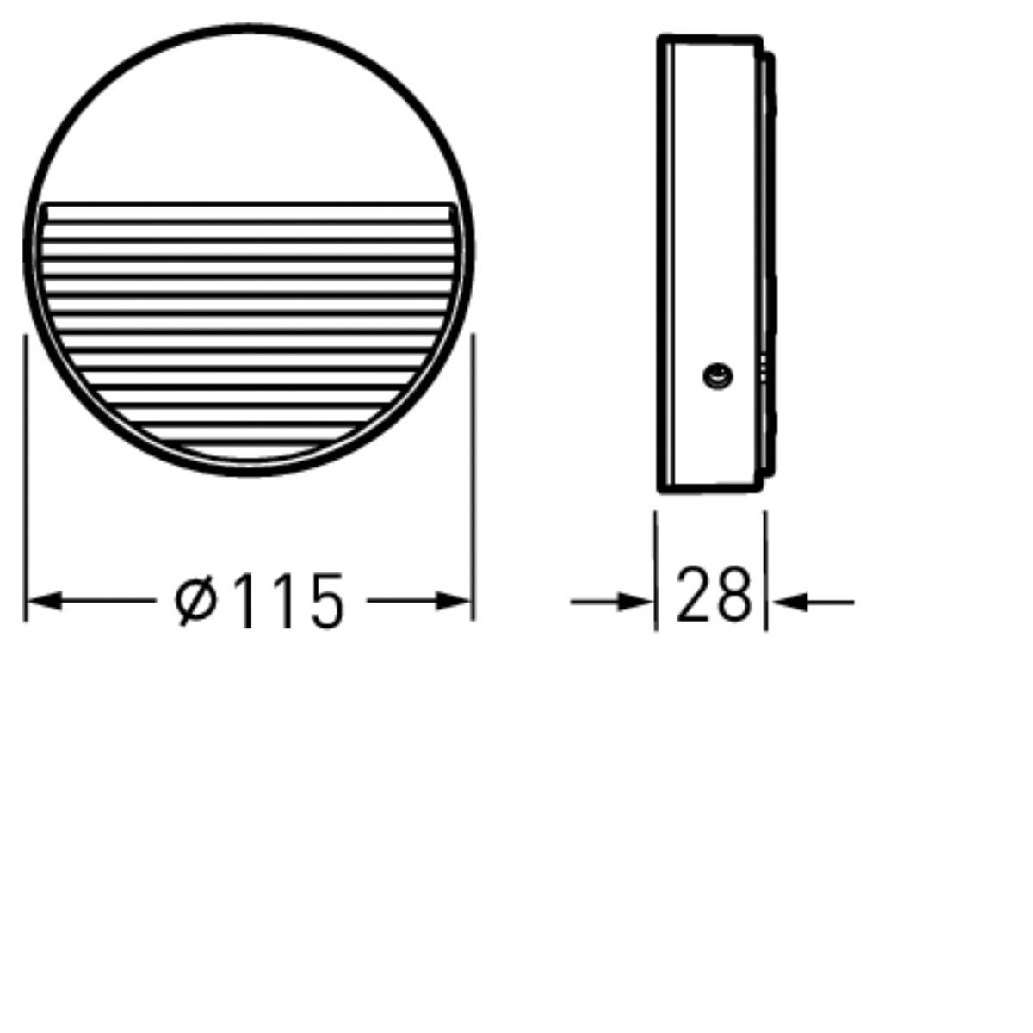
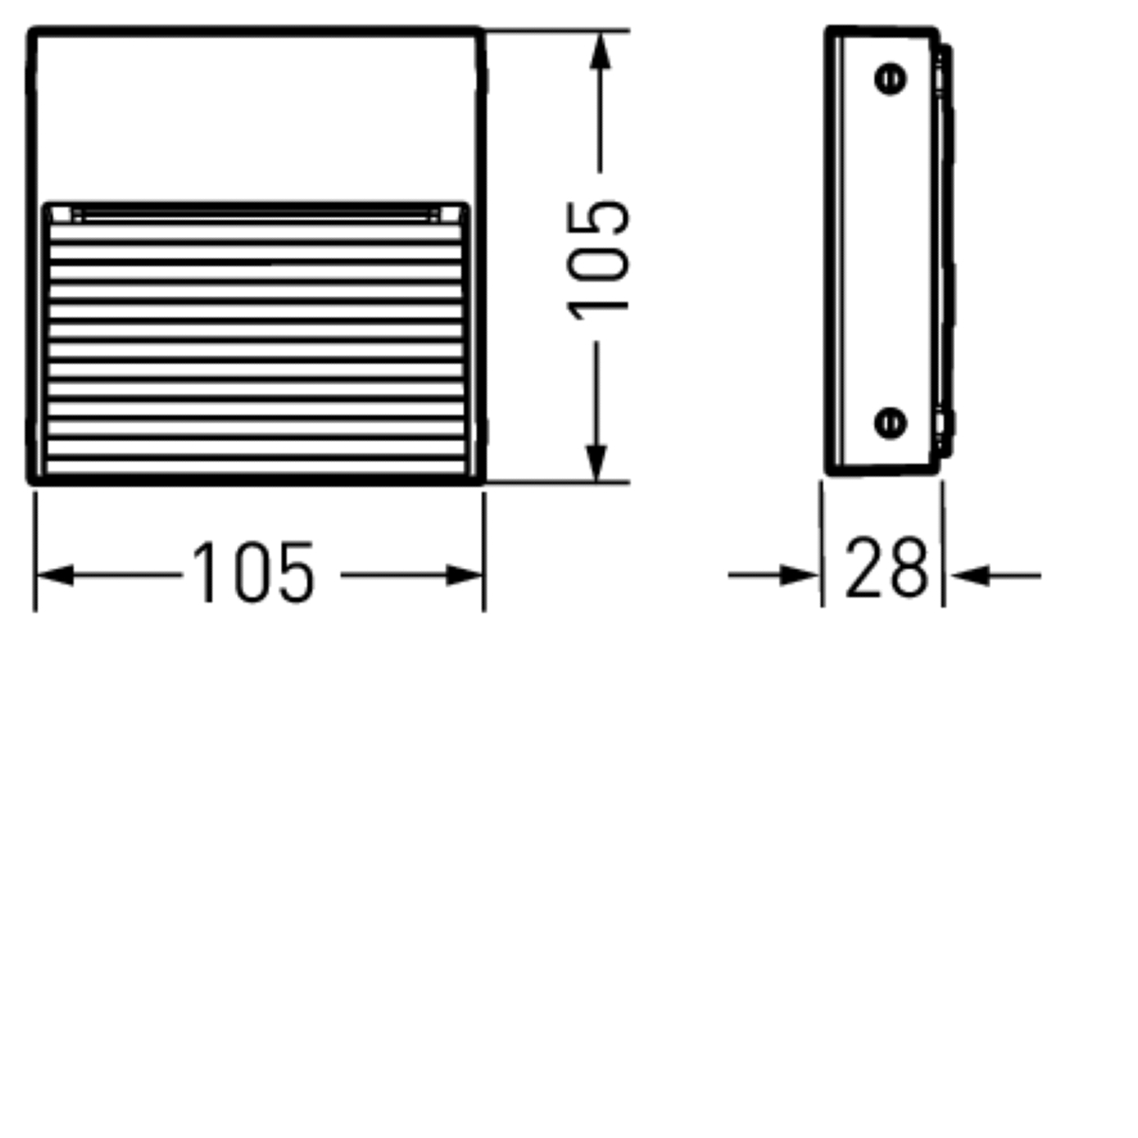
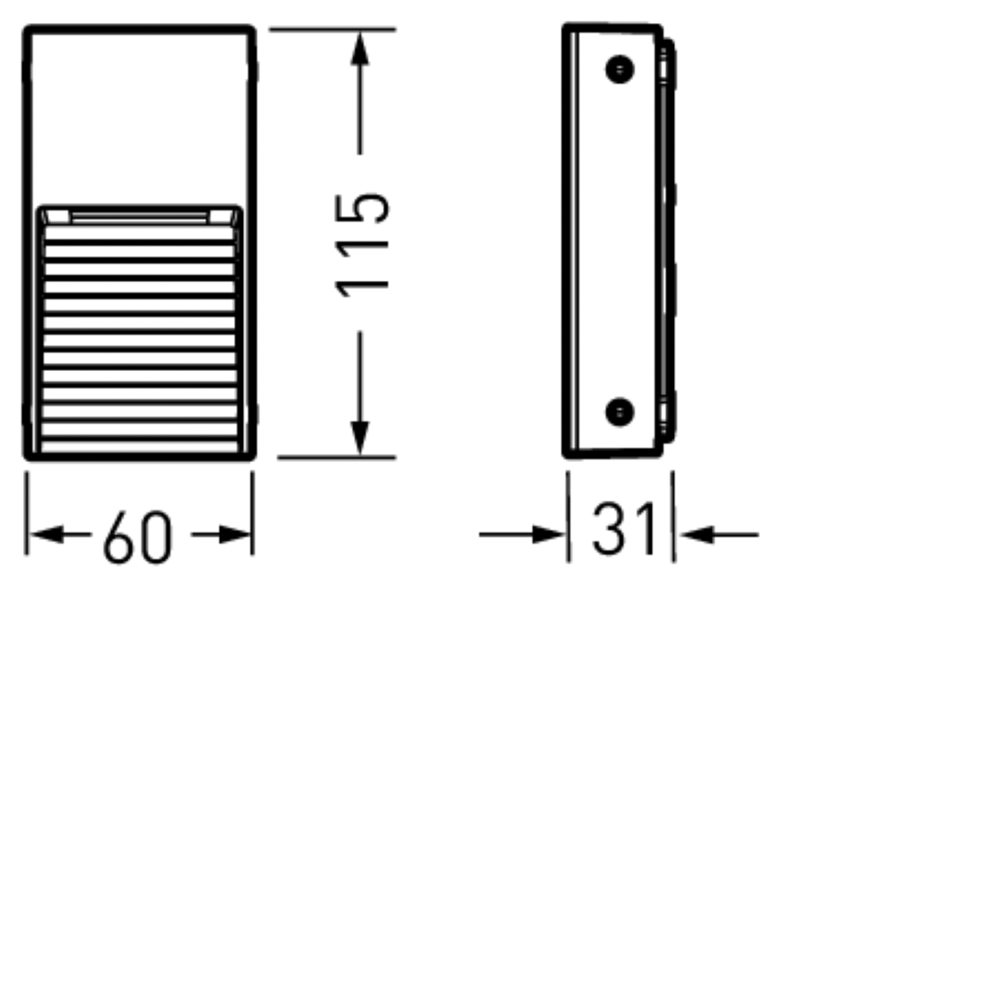
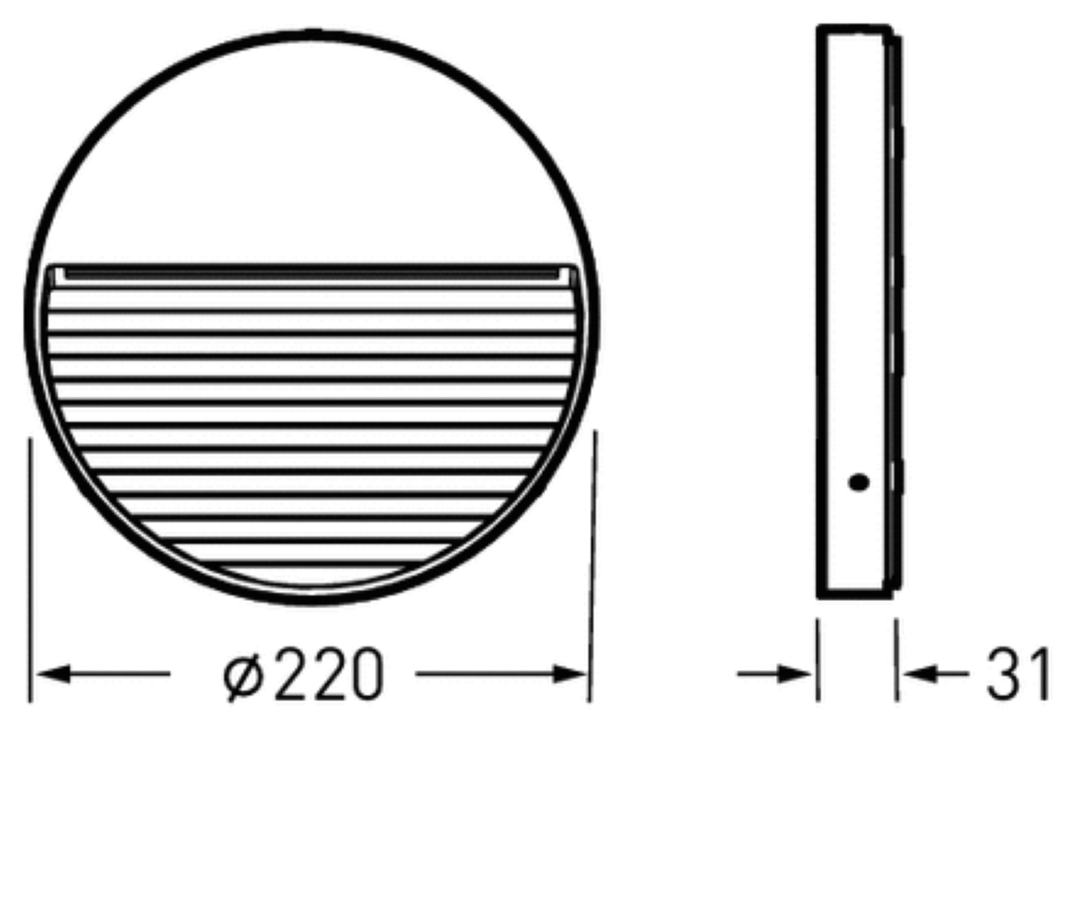
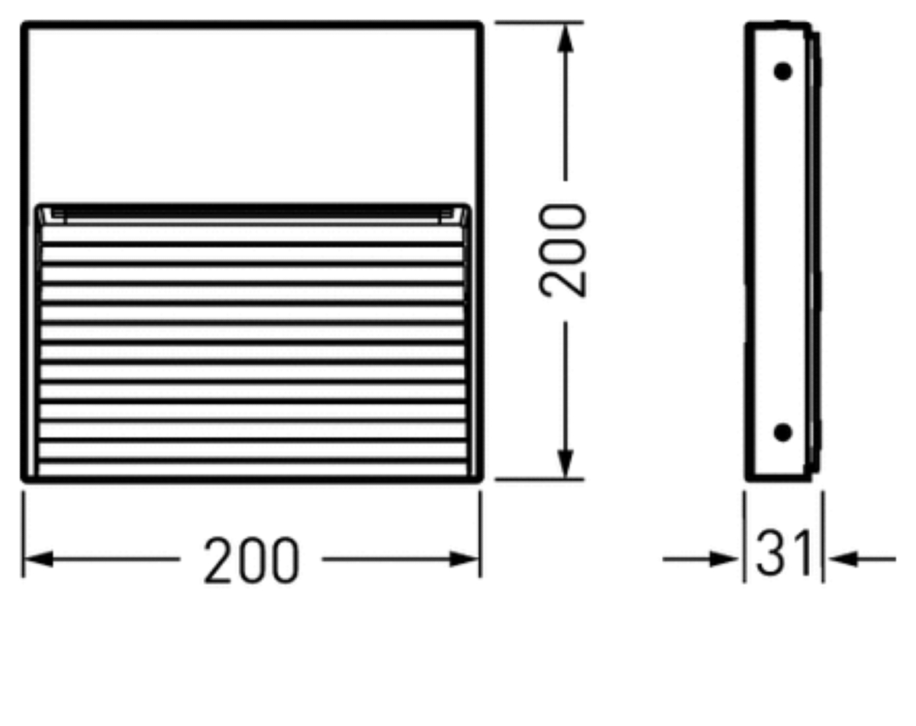
TECHNICAL DATA
Zubehör | · optional: separat installation housing for recessing · for 24V luminaires: external drivers in IP20 (Indoor) or IP66 (Outdoor)
Features | · luminaire family with 6 sizes and shapes · glare-free light distribution · CRI > 90

