Slide 1
LIGHT COLUMN SYSTEM CONSTELA 19 SMARTER. STRONGER. More Attractive. www.trilux.com

Slide 2
THE CHALLENGE
AESTHETICS AND DESIGN
High aesthetic requirements in terms of light column design
FUTURE
Future-safety for Smart City applications and future-oriented companies
LIGHT
clean illumination of representative squares and entrance areas, as well as high quality of light and reduction of glare

Slide 3
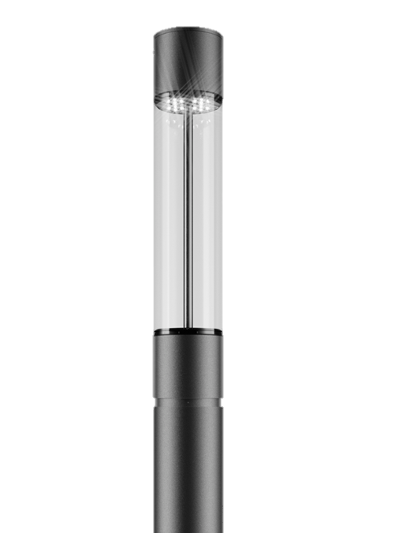
MODULAR LIGHT COLUMN SYSTEM
SMARTER. STRONGER. NICER
LIGHT COLUMN
The new TRILUX light column scores points with a unique design and offers many intelligent additional modules that can contribute to Smart City but also support the digitalisation process in industry and retail. It can be used in any area and in any harsh outdoor environment.
CONSTELA
INDIVIDUALITY
DIGITALISATION
FUTURE

Slide 4
PERFECT PROPORTIONS AND DESIGN JOINT
SMARTER. STRONGER. NICER
APPEARANCE
Not only the sizes and proportions of the standpipe, luminaire head and functional modules have been perfectly matched. The individual elements are clearly delineated from each other by a specially developed design joint without visible screws at the transitions. This makes the functionality of the column "readable" and contributes to the uniquely high aesthetic appeal.
DESIGN
CLEAR LENGTH CONCEPT
DESIGN ELEMENT
NO VISIBLE SCREWS

Slide 5
USABLE IN ANY ENVIRONMENT
SMARTER. STRONGER. NICER.
ENVIRONMENT
None is as strong as this: Thanks to its robust construction, the ConStela IQ 19 proves itself even under the toughest conditions. It is approved for use up to the highest wind zone 4 on terrain category 1 - and thus defies wind and weather on beach promenades as well as in exposed locations in the mountains.
WIND ZONE 4
WIND ZONE 4
CATEGORY 1
UP TO 6 MODULS

Slide 6
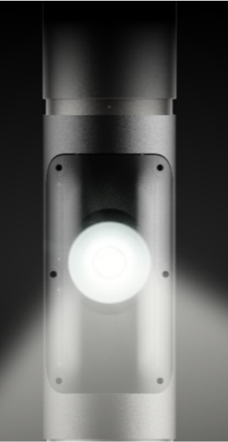
SPOTLIGHTS AND ACCENTUATION INCLUDED
SMARTER. STRONGER. NICER.
ACCENTS
The ConStela IQ 19 not only ensures perfectly illuminated paths and squares - narrow-beam and wide-beam spotlight modules allow e.g. historical buildings or monuments to be perfectly staged from the light column. Particularly clever: the spotlight modules can be rotated freely through 360°.
SPOTLIGHT
STAGING
ACCENTUATION
LIGHT DISTRIBUTIONS

Slide 7
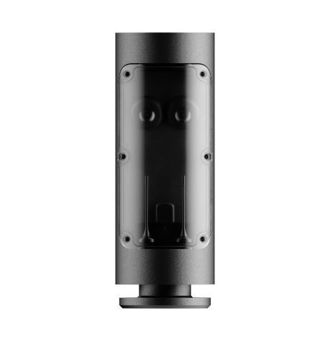
ADDITIONAL INTELLIGENT MODULS
SMARTER. STRONGER. NICER.
INTELLIGENCE
The ConStela IQ 19 can be quickly and easily equipped with IoT function modules via standardised interfaces using plug and play. This opens the way to a wide range of IoT applications beyond the lighting network.
SMART MODULE
WLAN
CAMERA
LOUDSPEAKER

Slide 8
DIFFERENT POSSIBILITIES FOR LIGHTING
asymmetrical &
facade design
rotational symmetrical
asymmetrical

Slide 9
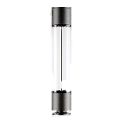
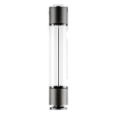
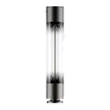
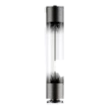
LUMINAIRE
HEAD
luminaire
head
BETWEEN
ELEMENTS
STAND- PIPES
SMART MODULES
LOUD-
SPEAKER
MODULE
SPOTLIGHT
MODULE
WLAN
MODULE
CAMERA
MODULE
BETWEEN
ELEMENTS
between
elements
standpipes
STANDPIPE
3M EARTH UNIT
STANDPIPE
3M FLANGE PLATE
STANDPIPE
4M EARTH UNIT
STANDROHR
4M FLANSCHPLATTE
STANDPIPE
4M FLANGE PLATE

Slide 10
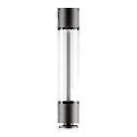
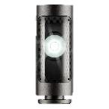
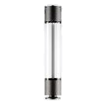
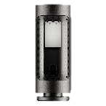
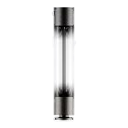
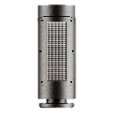
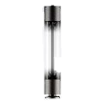
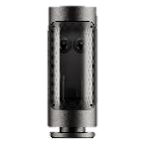
OVERVIEW OF THE COMPONENTS
luminaire head, clear, 1m,
e.g.: TOC: 7545051 CS 19 100-AB2L/5100-730 4G1S ETDD
Spotlight Module, 0,5m
e.g.: TOC: 7742851 CS 19 S-MOD RB21R/4200-740 1G1 ETDD
optionally rotationally symmetrical or asymmetrical, from 2,700K to 4,000K, from 2,200lm to max. 5,100lm
choice of rotationally symmetrical narrow beam or wide beam, with 3,000K or 4,000K, from 2,200lm to 4,200lm
luminaire head, clear, 1m, SLR,
e.g.: TOC: 7546640 CS 19 100-AB2L-SLR1/5100-730 4G1S ET
WLAN-Module, 0,5m
TOC 7727200 Smart Module CS 19 500 WLAN
optionally rotationally symmetrical or asymmetrical, from 2,700K to 4,000K, from 2,200lm to max. 5,100lm, with Zhaga interface
500 users can log on to the WLAN at the same time.
luminaire head, with gradient printing, 1m
e.g.: TOC: 7545751 CS 19 C 100-RB6L/1800-740 2G1S ETDD
Loudspeaker Module, 0,5m
TOC 7727400 Smart Module CS 19 500 Loudspeaker
optionally rotationally symmetrical or asymmetrical, from 2,700K to 4,000K, from 2,200lm to max. 5,100lm
Loudspeakers for music and announcements
luminaire head, with gradient printing, 1m, SLR, e.g.: TOC: CS 19 C 100-RB6L.SLR/1800-740 2G1S ETDD
Camera Module, 0,5m
TOC: 7727300 Smart Module CS 19 500 Camera
optionally rotationally symmetrical or asymmetrical, from 2,700K to 4,000K, from 2,200lm to max. 4,200lm, with Zhaga interface
Camera module to increase security in critical areas, as well as traffic counting and people counting.

Slide 11
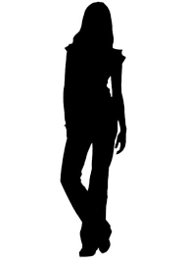
PERFECT PORPORTIONS
7m
max. 6 modules + luminaire head
4m
3m

Slide 12
TECHNICAL FEATURES | CS19
Luminaire luminous flux
up to 5,100 lm
Height
up to 7 m
Service life
100,000 h / CLO
Switching types
LR, LRA, ETDD, SLR
Light distribution options
asymmetric
rotationally symmetric
MLT
Diameter
193.7 mm
Designed for
wind zone 4, terrain category 1
Material
steel supporting column

Slide 13
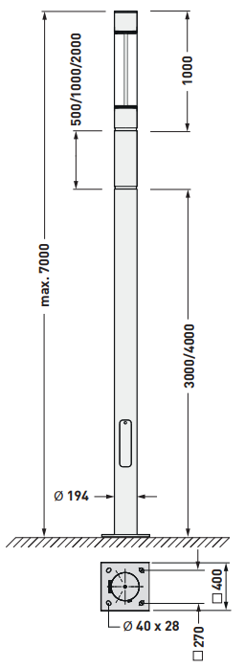
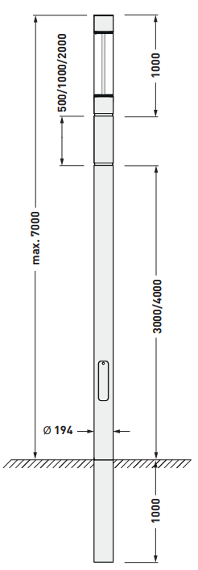
DIMENSIONAL DRAWINGS
Flange plate
Underground support

Slide 14
CONSTELA – 5 REASONS FOR CS19
1
UNIQUE DESIGN
Highly aesthetic workmanship, no visible screws in the module transitions
5
REASONS
FOR
CS 19
2
CS19 IS MORE THAN JUST LIGHT
Spotlight, WiFi, camera, loudspeaker modules as standard
3
INDIVIDUAL CONFIGURATION
Numerous configuration options with up to 6 modules in one light column
4
INSTALLATION FLEXIBILITY
Installation aid and the possibility to rotate the modules 360° during installation
5
RAPID AVAILABILITY
Rapid availability of standard versions thanks to a sophisticated logistics concept

Slide 15
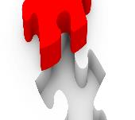
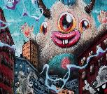
FURTHER FEATURES
OPERATION IN THE ROUGHEST ENVIRONMENTS
INDIVIDUAL POSSIBILITIES
Be it by the sea or atop a mountain – even with a light point height of 7 m, ConStela CS19 can be used in wind zone 4 and terrain category 1.
A selection of different RAL tones enables an individual colour design for the light column, facilitating city colours or company CI adaptation.
HIGHEST COMPONENT QUALITY
CUSTOMISED SOLUTIONS
In terms of the components used, we rely on the highest quality, just as with the selection of our suppliers for the smart components.
TRILUX has always stood for realising individual solutions in cooperation with customers.
4
5
MADE IN GERMANY
ANTI-GRAFFITI PAINT
Germany as a production location guarantees high quality.
Special paint finishes such as anti-graffiti paint or seawater-resistant paint facilitate use even under adverse external conditions.
6

Slide 16
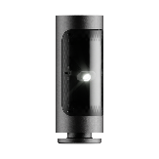
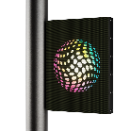
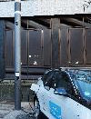
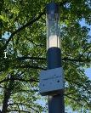
ADDITIONAL MODULES POSSIBLE
GOBO Spotlight
Project lettering or logos from the stele onto the floor or façade
External monitor
Corporate films or information can be played on the monitor. Information on historical buildings can be shown in the city marketing area.
Charging station for e-mobility
Implementation of a wallbox at the light column for charging electronic vehicles. A charging power of 11kw can be provided from the CS19.
Environmental sensors
Permanent measurement of nitrogen dioxide (NO2), particulate matter (PM2.5 and PM10) and ozone (O3) as well as additional environmental parameters such as temperature, air pressure and humidity (further pollutants on request)

Slide 17
THANK YOU FOR YOUR ATTENTION! www.trilux.com

Slide 18
BACK UP

Slide 19
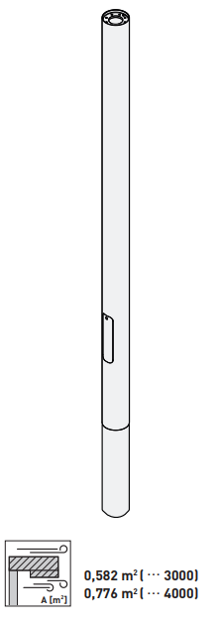
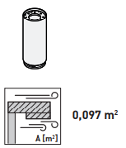
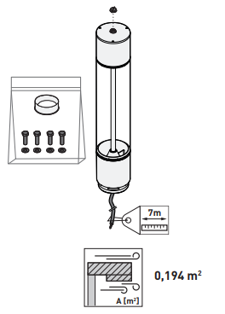
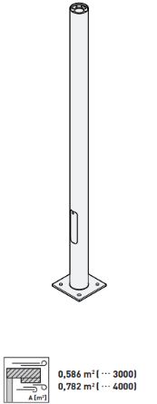
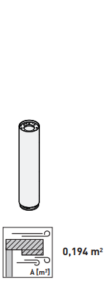
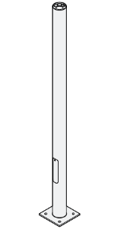
OVERVIEW OF COMPONENTS
SUPPORTING COLUMNS
INTERMEDIATE ELEMENTS
LUMINAIRE HEAD

Slide 20
MODULAR LIGHT COLUMN SYSTEM
SMARTER. STRONGER. NICER.
.
CAMERA
The use of the camera is for security purposes, people counting also enables an analysis of the flow of people. Further options: The system can detect free parking spaces – and direct visitors right to the closest available parking space.
SMART MODULE
PEOPLE COUNTING
TRAFFIC COUNTING
SAFETY

Slide 21
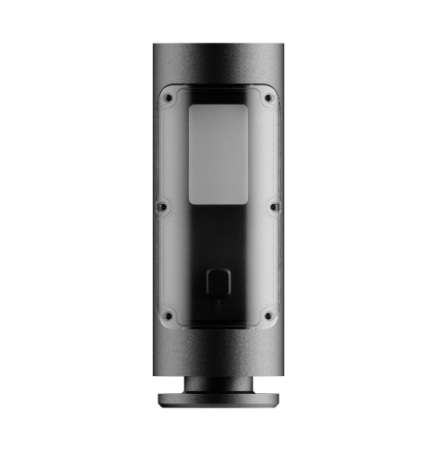
MODULAR LIGHT COLUMN SYSTEM
SMARTER. STRONGER. NICER.
FREE WIFI
500 users can simultaneously dial into the WLAN generated by the light column. This increases the time spent in public places or creates outdoor working places.
SMART MODULE
500 USERS AT ONCE
OUTDOOR WORKING PLACES
CONNECTIVITY & NETWORKING

Slide 22
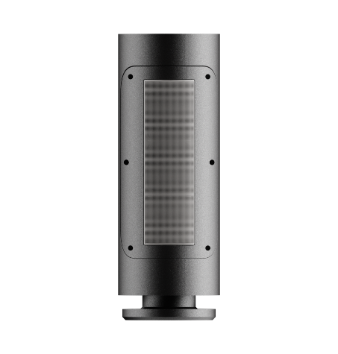
MODULAR LIGHT COLUMN SYSTEM
SMARTER. STRONGER. NICER.
LOUDSPEAKER
A loudspeaker can be used to increase the time spent in public places or to announce information.
SMART MODULE
PEOPLE COUNTING
TRAFFIC COUNTING
SAFETY

Slide 23
BACK UP SUSTAINABILITY AND ENVIRONMENTAL PROTECTION

Slide 24
Further Information:
Topics - Sustainability - TRILUX - Company - TRILUX Simplify Your Light

