Slide 1
BICULT LED
DIE LICHT-REVOLUTION AUF DEM SCHREIBTISCH
BICULT LED
A LIGHT REVOLUTION AT THE DESK

Slide 2
The world of working is changing: rigid structures are becoming flexible, tasks more complex and the well-being of employees more important – home offices are also increasingly becoming alternatives. This demands not only flexible and comfortable office equipment but also modern lighting concepts that combine excellent light with flexibility and individual setting options.

Slide 3
The new TRILUX Bicult LED is revolutionising office lighting. It is the first desktop luminaire to combine direct and indirect light output. While the glare-free indirect lighting directed upwards illuminates the complete office, the direct component creates perfect light at the desk. Users can also set their personal lighting preferences individually on the luminaire or via an app. This enables light compliant with standards and a level of flexibility unknown until now.

Slide 6
The light revolution for both desk and room
With the innovative Bicult LED, TRILUX has developed a unique desktop luminaire that optimally illuminates both workstations and the complete room. Thanks to the high, glare-free indirect component, supplementary ceiling luminaires or standing luminaires are not required for standard-compliant illumination of the workplace. This means that no further horizon needs to be integrated into the room, achieving a uniquely clear and uniform ceiling appearance.

Slide 7
Planning general lighting – and keeping all options open
The Bicult LED enables new building constructions and core refurbishments to be especially simply and attractively planned, because only one form of general lighting is needed in such projects. Bicult LED as a desktop luminaire is part of the furniture and ensures standard-compliant lighting perfectly matched to the room use.

Slide 8
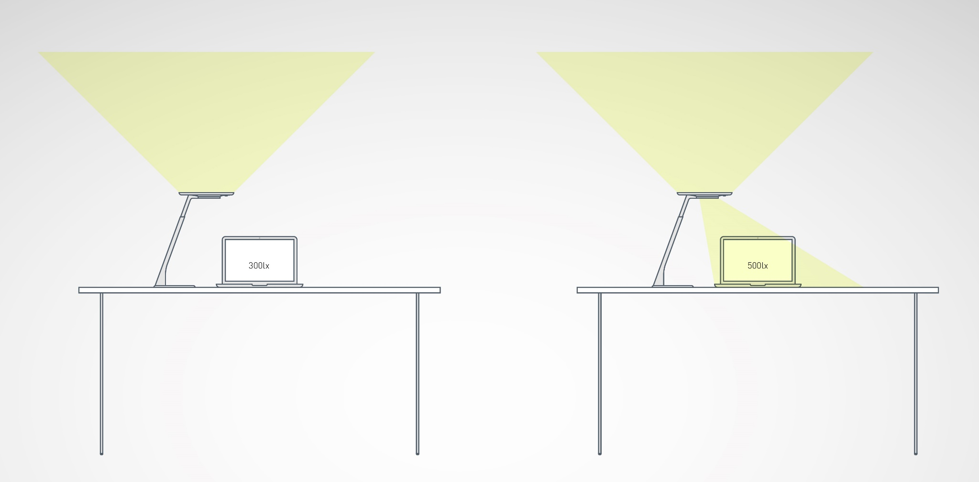

Slide 9
Consummate quality of light
The elevated indirect light component of the desktop luminaire also illuminates the room with luminous flux of 5,000 lm – without causing glare for any standing employees. This is ensured by a special "triple glare control system (TGCS)" consisting of a combination of three optical systems and a special light control and light mix. Individual light settings are also possible in the open space without negatively affecting the complete room itself.
.

Slide 10
Flexible lighting for flexible work
The desktop luminaire is simply connected via a standard power socket and can be used in any location. If the floor plan or use of the room changes, the lighting does not need to be re-planned or reinstalled with high effort – the luminaires are simply moved to a new location. This saves time and costs.

Slide 11
Cleverly networked and smart
In larger rooms with several workstations, the individual Bicult LED luminaires (SMART Connect version) can be simply interconnected and combined to form groups. A sensor in the luminaire detects the presence of occupants and the indirect light component of all grouped luminaires is automatically matched accordingly, ensuring an optimum general lighting level throughout the room at all times. If desired, the indirect light component can also be integrated via DALI into the building management system. The direct component remains individually settable by the user at any time.

Slide 12
Commissioning as simple as child's play
Bicult LED is installed as quick as a flash without complex mounting. It only needs to be positioned on the desk and inserted into the socket. All luminaires are preconfigured and can be immediately put into operation – as a result perfect visual conditions are created in home offices without any effort. If desired, various operating parameters such as the light colour can be simply modified via an app.

Slide 13
Light as individual as people
Bicult LED focuses on the user by offering them numerous possibilities to set their personal lighting preferences. E.g., the direct light output can be targeted to the desired place on the desk simply by rotating the focus ring. The intensity of the direct and indirect light components and light colour is flexibly controlled via push-button on the luminaire or via an app with the SMART versions.
Perfectly matched light at any workstation
The SMART Single and Connect versions of Bicult LED enable personal light profiles to be created via an app which can then be called up at any Bicult LED desktop luminaire. If the workstation is changed this means the individual light settings do not need to be reconfigured every time. These can be simply activated via a smartphone or tablet.

Slide 14
Human Centric Lighting at your own desk
A circadian curve is saved in all Bicult LED versions for adapting the light colour automatically to daylight. This is simply switched on or off by pressing a button. As a consequence, the desktop luminaire generates activating or relaxing light according to needs and the time of day.
Standard-compliant desk lighting also for home offices
Employers have the obligation to ensure optimum work conditions with the same standards as in offices for their home office employees – the right lighting is also included here, along with ergonomic office furniture and suitable hardware. With Bicult LED, home offices become professional workplaces – with optimum visual conditions.

Slide 15
Perfect light thanks to a height-adjustable luminaire head
The light unit of Bicult LED can be height-adjusted. As a result the luminaire can be optimally matched to different people working at the desk and glare is completely excluded.
Simple charging of smartphones and tablets
The luminaire base has a USB port for directly charging mobile end devices such as smartphones and tablets on the luminaire.

Slide 16
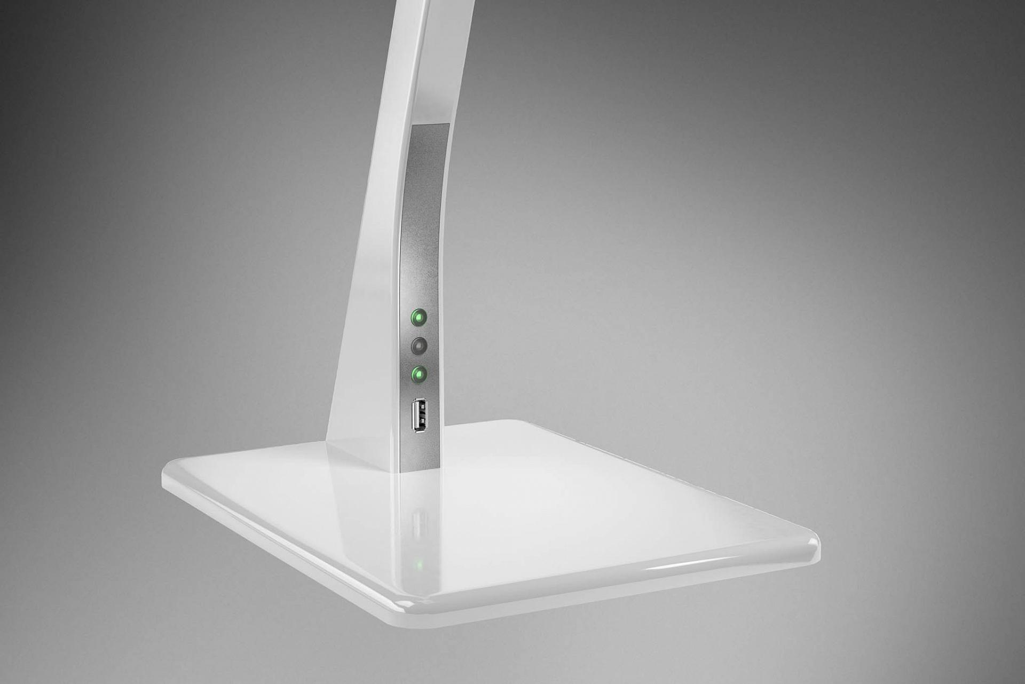
Simple charging of smartphones and tablets
A USB port enables mobile devices such as smartphones and tablets to be charged directly on the luminaire. With the variants with inductive charging function, smartphones can be charged by simply placing them on the luminaire base.
Standard: USB-Port

Slide 17
For more space on the desk
Bicult LED is also the perfect solution with smaller desks. The versions with table clamp are simply attached to the edge of the desk top. The light can be ideally aligned via an additional joint on the base of the luminaire.

Slide 18
BICULT APP

Slide 19
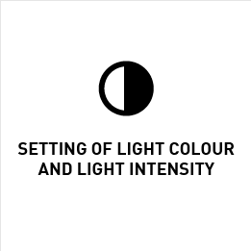
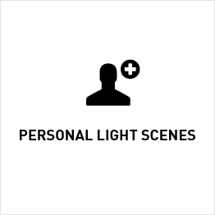
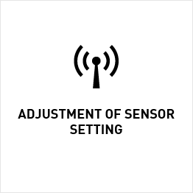
AN OVERVIEW OF FEATURES
The light colour and light intensity can be adjusted via app according to your personal preferences and needs.
You can use the app to define personal light scenes and call them up any time and anywhere.
You can configure the stored HCL curve according to your individual requirements.
All basic settings are stored in the app, but you can make personal modifications yourself.

Slide 20
INDIVIDUAL LIGHT SCENES SAVE AND EDIT
Save your individual light scenes to the app and take them with you.
When you're absent does a colleague use your workstation, or do you work at different places?
You always have your personal light in your pocket thanks to your smartphone.

Slide 21
SUPPORT YOUR BIORHYTHM Human Centric Lighting (HCL)
Light colour and light intensity are automatically adjusted according to the incident daylight.
The changeover from summer to winter time and your location are automatically taken into account.
The Bicult app lets you decide how the light best supports you.
Activate HCL mode with or without daylight-dependent control or switch it off completely.

Slide 22
One desktop luminaire for any application: the glare-free indirect light component of Bicult LED generates pleasant general lighting, and standard-compliant illumination of the workstation with the direct component. The light can be individually set by the user via an app or push-button.

Slide 23
The Bicult LED desktop luminaire creates attractive light complying with standards not only on desks but throughout the room. No supplementary ceiling luminaires or standing luminaires are needed because of the combination of indirect and direct light components. This provides new design flexibility.

Slide 24
Rigidly installed ceiling lighting limits flexible room use. Everything is possible on the other hand with Bicult LED. The desktop luminaire with its combination of direct and indirect light components ensures perfectly illuminated rooms and optimum light at the workstation – wherever it is positioned.

Slide 25
Everything with a single desktop luminaire: the indirect light component of Bicult LED ensures perfectly illuminated rooms and the direct component achieves optimum visual conditions on the desk. The light can be flexibly controlled and also precisely adapted to individual needs with personal light profiles.

Slide 26
TECHNICAL DATA
Luminaire luminous flux | direct (500 lm) and indirect (5,000 lm) light emission
Energy efficiency | > 100 lm/W
Service life | 50.000h L80 25 °C
Light colour | 2.700 K up to 6.500 K
Version | KOMFORT, SMART Single, SMART Connect
Colour | White, silver, chrome
Switch | three buttons on the luminaire, SMART versions additionally via app and smart device, separate adjustment of direct and indirect components
Sensor | integrated daylight and presence sensor (SMART versions only)
Further Features | SMART Connect luminaires with the possibility of networking with each other, USB port on the base, indirect light with high glare control thanks to the special Triple Glare Control System (TGCS)

