Slide 1
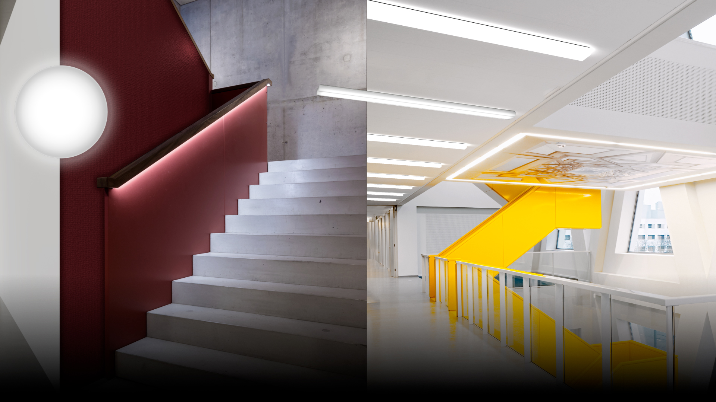
OLISQ
GEOMETRIC LIGHT WITHOUT LIMITS

Slide 2
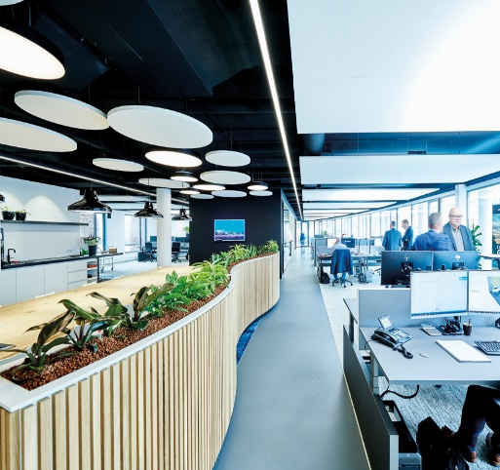
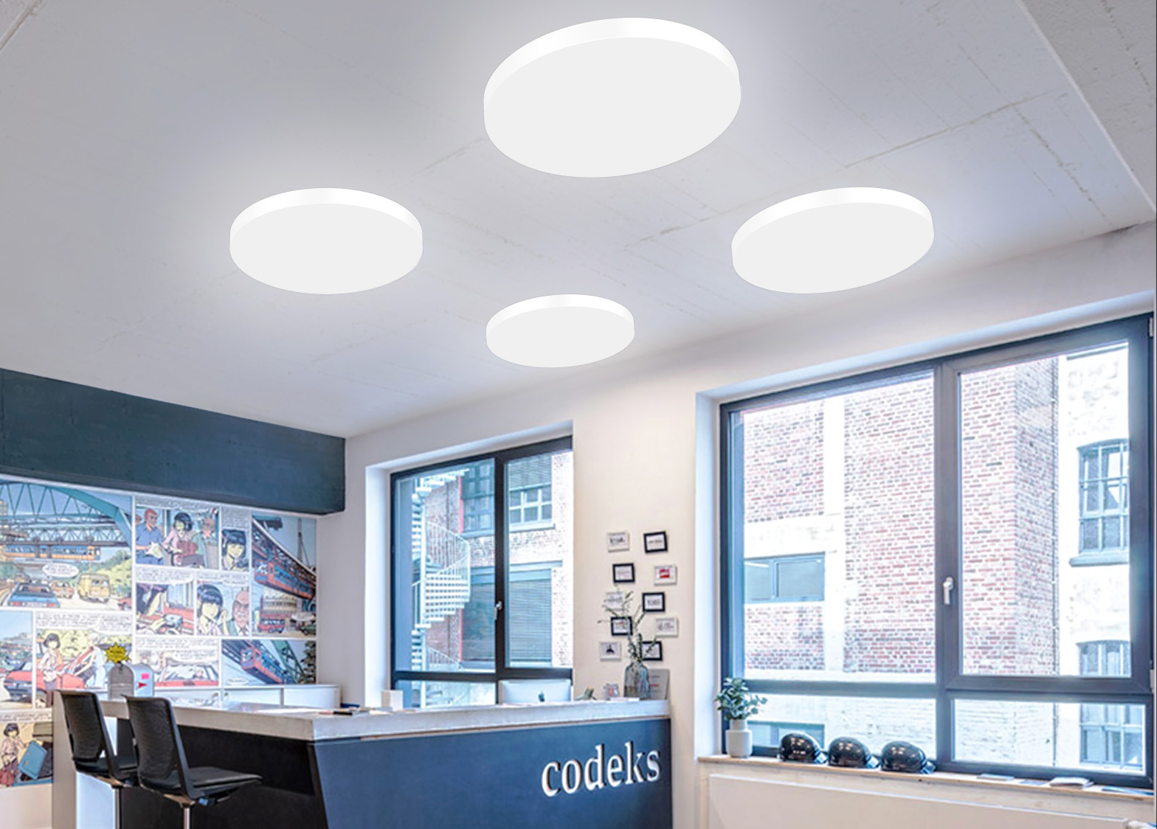
Plan entrance, recreation and movement zones throughout a building with little effort and at the same time illuminate them attractively – individually, architecturally and in accordance with standards throughout the building
Subsidies for movement zones and transit zones often remain unused despite large savings potentials
Growing refurbishment pressure throughout the building due to rising energy costs and Single Lighting Regulation requirements
Increased demands on sustainability, due to the Ecodesign Directive, building certificates, etc.

Slide 3
Luminaire range with unique flexibility in terms of shape, size, mounting method and protection rating, with a purist design
Best values for efficiency and service life for subsidy support and building certification
Easy upgrade without painting or new drilling points due to 1:1 refurbishment of many existing luminaire systems
High quality components and good maintenance capability, e.g. replacement of the light engine

Slide 4
Three shapes, one design, all functionalities
The modular luminaire family combines maximum versatility with a uniformly attractive design. Available in three shapes - round, square, linear - and in nine sizes, the range-typical minimalist geometric design and high-quality feel of OLISQ ensure a unified appearance and performance, visually, in terms of lighting technology and functionally. This enables uniquely attractive architectural design with light and luminaires.
A new era for walls and ceilings
Where simple hemispherical "kneecap" luminaires were used in the past, OLISQ now provides excellent, uniform light and an attractive ambience with its new but universal light distributions. A wide range of mounting methods, sizes and accessories for wall and ceiling illumination offer every freedom for tailor-made solutions optimised for the specific application. Subsequent modifications are also quick and easy to implement, e.g. colour individualisation or functional upgrades.

Slide 5
Quick mounting and simple refurbishment
Clever features enable lightning-fast installation using a click system, as well as efficient and clean 1:1 refurbishment of many existing solutions by using existing drilling and feed points. In addition, all components are arranged in the box in mounting sequence, which speeds up installation and prevents damage and soiling. Service and maintenance is also user-friendly and sustainable: the luminaire is made of high quality components, can be easily disassembled and the LED module can be replaced without tools.
One series for all movement and meeting zones
Thanks to the modular approach, OLISQ can be used to equip all typical movement and meeting zones in buildings with a single series. There is a choice of three shapes in various sizes, two luminous fluxes per size, two light colours and an Active variant, two protection ratings (IP40 for standard cases and IP54 for e.g. sanitary and shower rooms), two diffuser materials (PC and PMMA) and two impact strengths (IK03 and IK08).

Slide 6
Our green deal – sustainability at all levels
Not only the long service life of L90 50,000 h and the extremely high efficiency of up to 143 lm/W make OLISQ an investment in the future. The luminaire is already optimised for minimal material use during production and is particularly sustainable in operation thanks to good service and maintenance, for example with replaceable light engine and replaceable diffusers. At the end of the product life cycle, easy dismantling creates the best conditions for efficient recycling. Thus, OLISQ not only complies with the Ecodesign Directive and funding conditions, but also provides users with a sustainably cost-efficient solution.

Slide 7
Three shapes with all functions
All three shapes offer the same photometric options. The result is high design flexibility in finding the right solution for the individual project.
An eye-catcher due to different mounting methods
By varying the mounting options (surface-mounted, semi-recessed or suspended), attractive "eye-catchers" are created in the look and feel of the overall solution with the same effort in terms of lighting design.
Design elements – RAL according to choice
Accessories and decorative attachments enable precisely matched light and rooms. Decorative rings are available in any desired RAL colour according to the specifications of the customer.

Slide 8
Impact resistance
Even the basic version is ideally equipped for use in hallways and stairwells with IK03. If the going gets tougher, all variants are also available with IK08 as standard.
Multilumen
With the multilumen version, luminous flux can be varied via a switch in the luminaire or via app. This is ideal for subsequently and flexibly adapting the luminaire to changing conditions.
Wireless networking – smartness included
Optionally, the luminaires can be wirelessly networked with LiveLink SwarmSens and offer functions such as HCL or "running light". Emergency light variants and other sensor variants are also possible.

Slide 9
Economical and durable
The high efficiency of up to 143 lm/W guarantees permanently low energy consumption, while the long service life of up to 50,000 hours (L90) keeps overall operating and maintenance costs low.
Sustainability from start to finish
It is not only high efficiency and long service life that make OLISQ a role model in terms of environmental friendliness. From "Made in Germany" with short delivery routes, minimal emissions and post-production recycling to easy service/maintenance and optimised packaging concepts for waste reduction – OLISQ sets new sustainability standards at all levels.

Slide 10
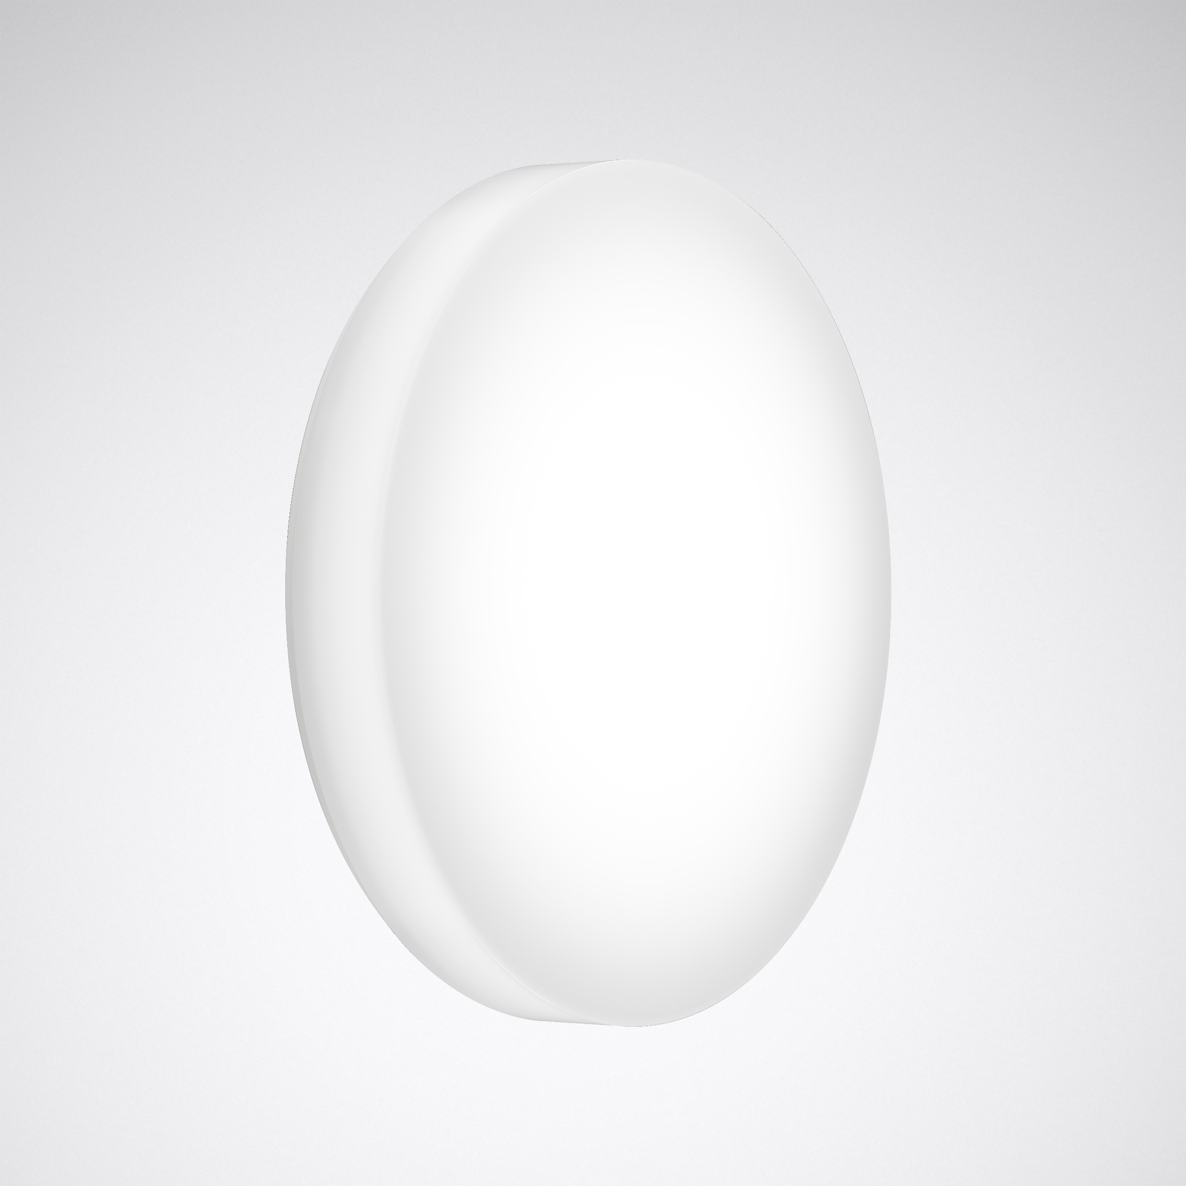
Quality of light and design – the purist range for aesthetes
The purist, filigree design of the luminaire family harmonises with a wide range of architecture and enhances it with excellent light and a minimalist design. In particular, a combination of the various shapes, mounting types, colours and features such as wall or ceiling illumination creates new, perfectly illuminated attractive spaces without sacrificing functionality. Range-typical elements such as the finely structured, high quality diffuser look and feel, the flatness and the precise geometric edges make the luminaires an eye-catcher even in switched off state.

Slide 11
Education
Away from learning factories to living spaces! The robust luminaires even cope with rough everyday school life and bring excellent light into educational facilities with HCL (optional). A variety of colours and shapes as well as colour design options allow zoning for better orientation, and the wide range of variants also enables use in sanitary and shower areas.

Slide 12
Health
Provides orientation: larger buildings can be attractively zoned thanks to enormous flexibility in shapes, mounting methods and colours. Variants with vandalism protection (optional) and IK08, for example for psychiatric areas, HCL for patient rooms as well as emergency light luminaires and sensor luminaires allow building-wide use. The range-typical design creates a harmonious and uniform look throughout, even in canopied outdoor areas.

Slide 13
Office
Corridors, stairwells, entrance and lounge areas – the wide range of variants guarantees attractive light for all areas beyond the VDU workstation and allows the building to be harmoniously zoned. Suspended luminaires are particularly suitable for prestigious areas such as foyers, while solutions with a higher protection rating are ideal for canopied outdoor areas and social areas. Especially individual: the luminaires become part of the corporate CI as variants in the corporate colour (optional).

Slide 14
Industry
Can also be tough: with protection ratings IP40 or IP54 and IK03 or IK08 impact strength, the luminaire proves itself in challenging environments, including canopied outdoor areas, and as a standard version with D marking also in production locations exposed to fire hazards. The attractive design – also available in corporate CI colours on request – and excellent light bring more quality and good looks to stairwells and corridors. Emergency light and sensor variants ensure maximum safety.

Slide 15
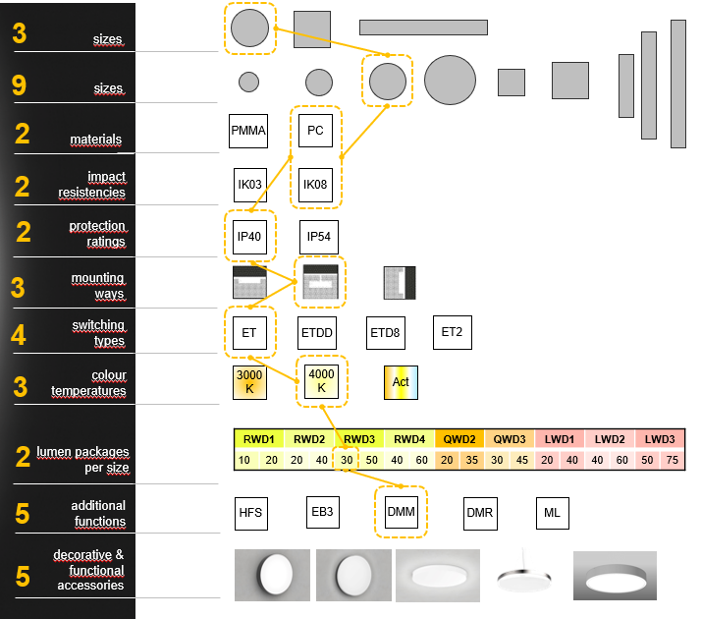
Implement everything with one system
Whether prestigious or functional areas: The enormous range of variants enables the illumination of all ancillary and transit areas of a building with just a single luminaire range. Well thought-out selection options simplify the planning process. Particularly simple: 1:1 refurbishment of the most common existing luminaires.

Slide 16
N O
Drilling
Dirt
Paint
It's that fast
All designs are installed according to the same principle – and help mounting with clever features such as the click system. For lightning-fast 1:1 refurbishments, the drilling and feed points of many classic TRILUX solutions (e.g. 740.N, Deca and 3331) can be used. This enables quick and clean modernisation without re-drilling or repainting.

Slide 17
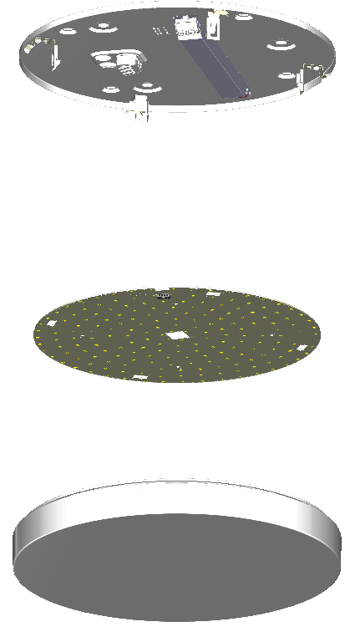
Efficient and maintenance-friendly
With an extremely high efficiency of up to 143 lm/W and a long maintenance-free service life (L90, 50,000 h), the range is particularly attractive from an economical point of view. Any maintenance work is done quickly thanks to the simple servicing with a circuit board replaceable without tools and the availability of various spare parts.

