Slide 1
opendo

Slide 2
Opendo
Opendo
Licht auf Leistungskurs
Licht auf Leistungskurs

Slide 3
Tight cost framework with high demands on quality and efficiency
Efficient replacement of obsolete conventional luminaire systems
Specific structural and photometric requirements
New tasks, such as monitoring air quality

Slide 4
Customised solutions for all areas in schools and offices
High-quality planar light across the entire width of the luminaire
Refurbishment and maintenance-friendly design
Turnkey solutions with integrated functional modules, e.g. CO₂ sensors

Slide 5
Quality of light and design have a particular influence on the working atmosphere in the office. Opendo is impressive in both areas – with customised planar light and an unmistakably modern design.
Sensor systems
Light management
Integrated emergency light
Anything is possible!

Slide 6
The educational sector places the highest demands on lighting technology and quality, sometimes with complex structural conditions on site. Perfectly adjusted: Thanks to customised light distributions – such as asymmetric blackboard lighting – Opendo meets all the requirements for future-proof and sustainable school lighting.

Slide 7
Schools and offices place high standard requirements on lighting, for instance UGR19 and BAP suitability for VDU work or asymmetric blackboard lighting. Customised solutions for education and offices make it possible to cover all requirements with one single luminaire. This simplifies planning and facilitates integrated solutions in a uniform design.

Slide 8
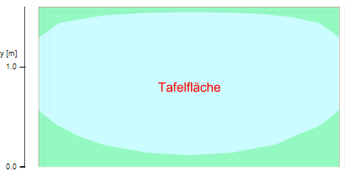
Black board surface
Customised solutions for schools and offices
Flexible optics package with application-specific light distributions such as asymmetric blackboard light.
One design for all areas
Straightforward, modern design that blends harmoniously into any environment and facilitates holistic solutions across applications.
Illuminance [lx]
Average illuminance
Minimum illuminance
Maximum illuminance
Uniformity Uo
Non-uniformity Ud

Slide 10
Emergency light system with integrated battery
All inclusive: Opendo is available with emergency light function and integrated battery.
Custom-fit installation options
Installation options as suspended or surface-mounted luminaire, as individual luminaire or continuous line.

Slide 11
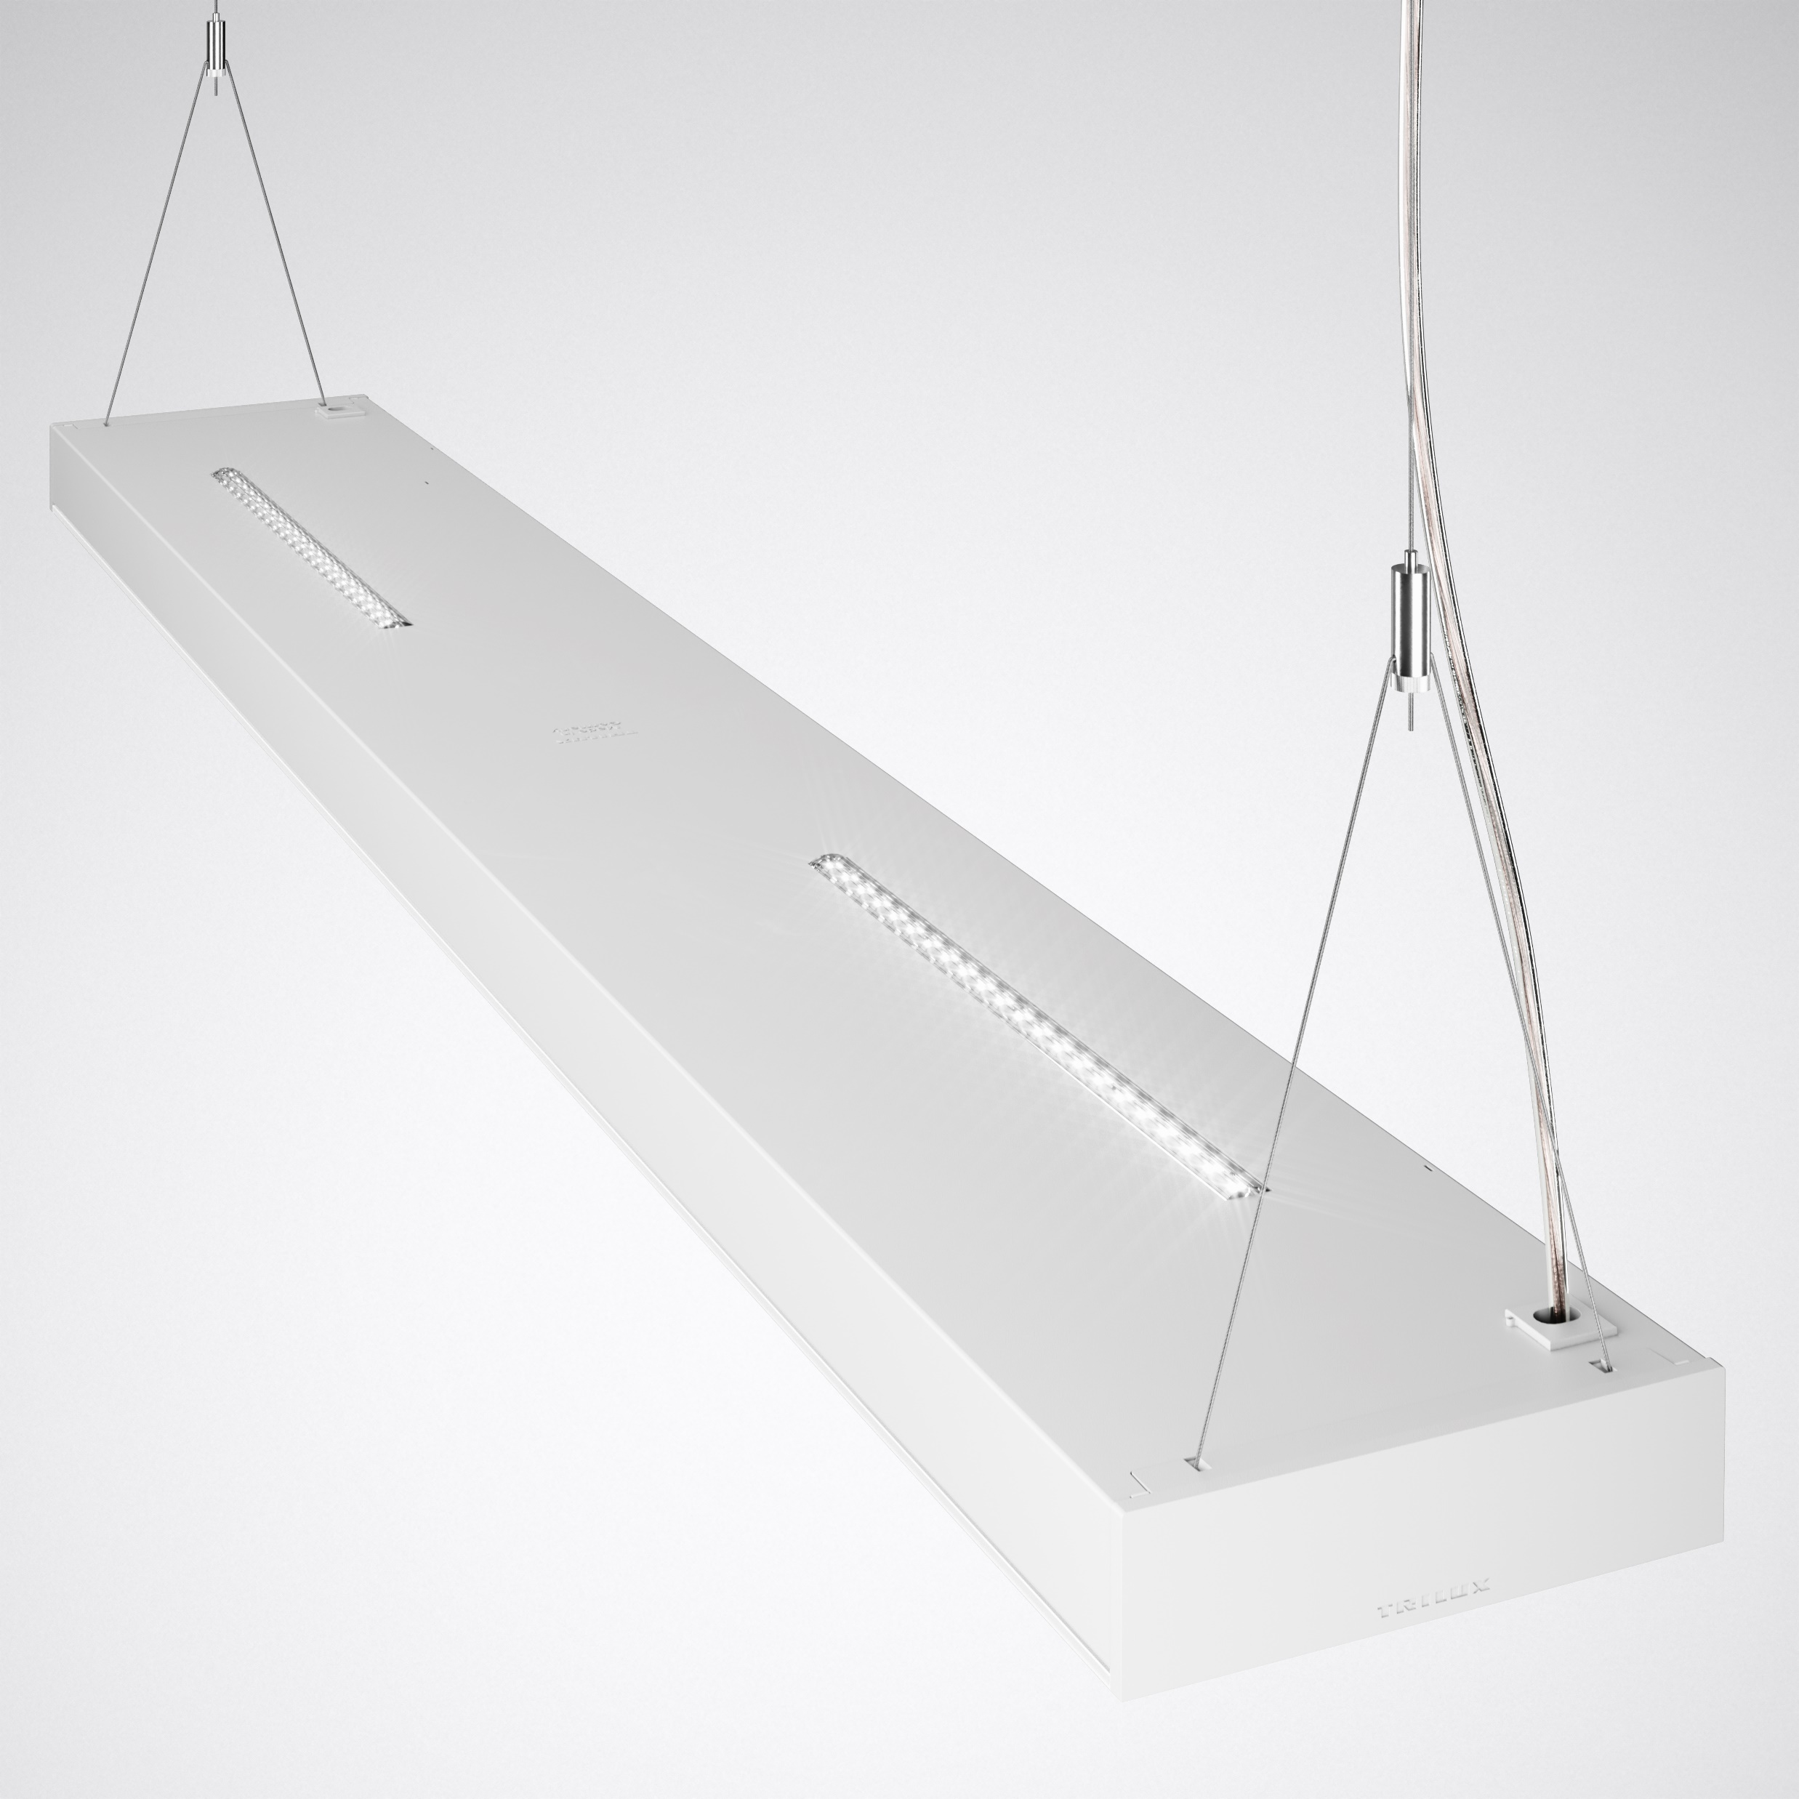
INSTALLATION
In case of the pendant luminaire, the feed is located on the side of the rope suspension.
In case of the surface-mounted luminaire, the feed is located both centrally and laterally at the drill points.

Slide 12
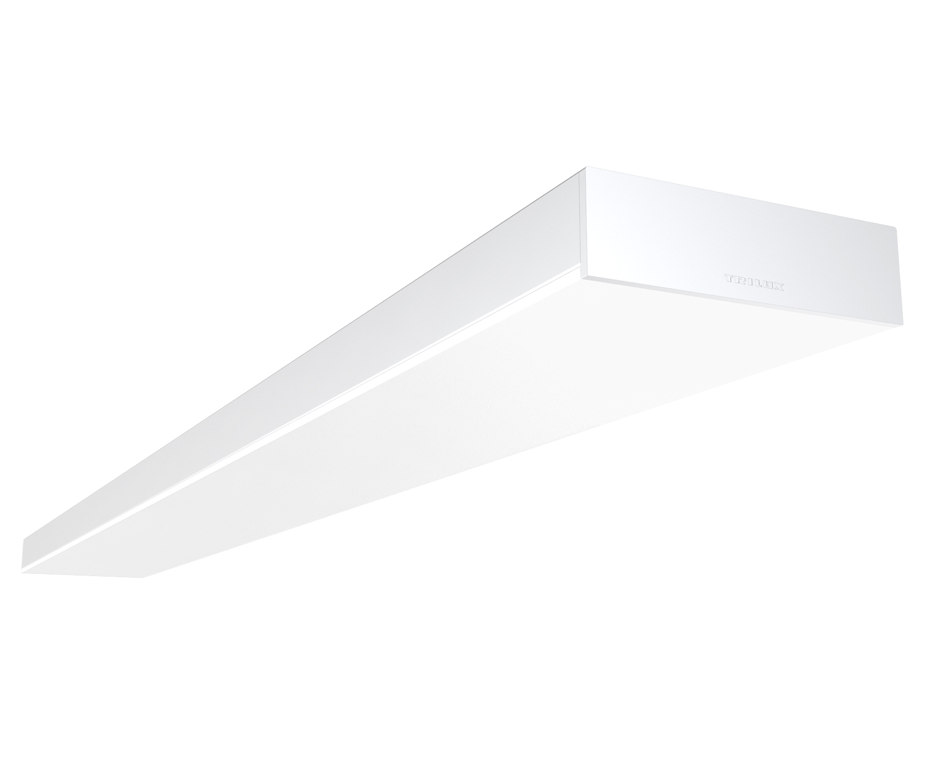
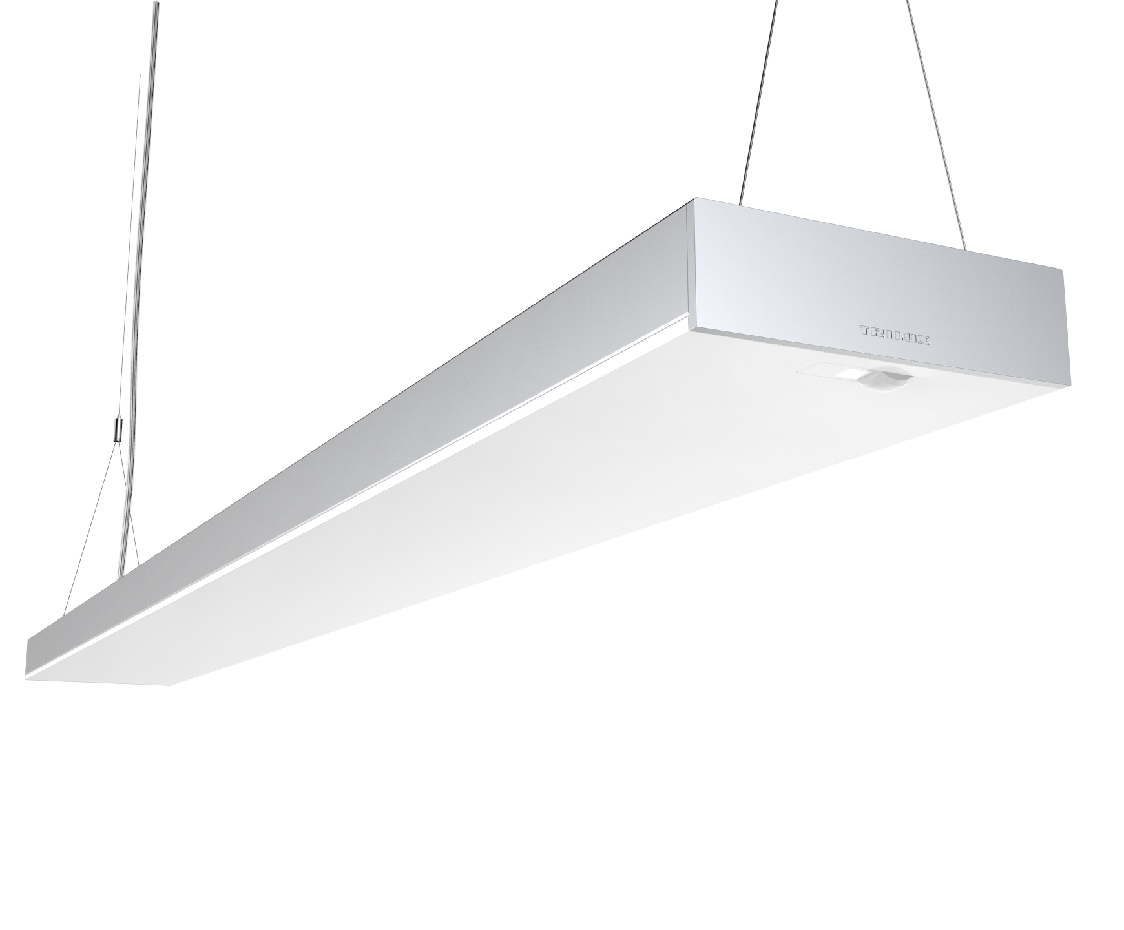
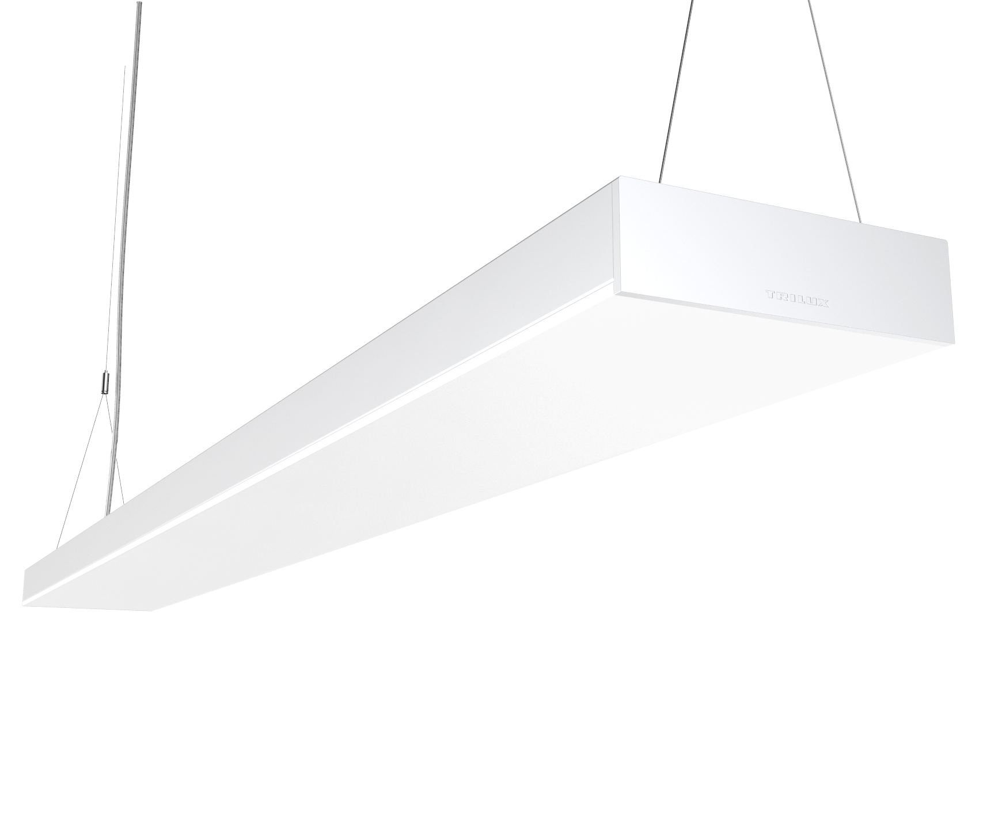
Modern schools and offices require lighting solutions that take into account not only business and functional requirements but also aesthetic needs. This is why we developed Opendo. It scores points equally with its light quality and its design. Its light emission surface over the entire width of the luminaire and the lateral light edge are unique features. Thanks to custom-fit photometrics for every application area, Opendo can be used to realise holistic solutions from a single cast.

Slide 13
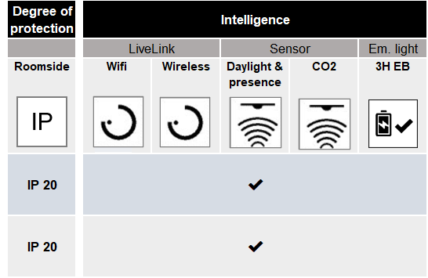
VARIANTS

Slide 14
High material quality, sophisticated installation features and a clever refurbishment concept make installation particularly simple. Continuous lines require only a single infeed thanks to optional through-wiring. This makes installation particularly effortless.

Slide 15
High-quality materials and simple structure
Sheet steel body and installer friendly design make installation easy and efficient.
Continuous line with through-wiring
Rapid continuous line installation thanks to through-wiring with only one infeed.

Slide 16
Networking and light management
Simple networking, option via radio (wireless) if no DALI control lines are available.

Slide 17
PORTFOLIO SYSTEMATICS
0
Available light modules
Available head pieces
and leads
Available connectors and through wiring
Light module blank
in white or silver
Head piece blank
in white or silver
Continuous line connector
in white or silver
Light module with daylight and presence sensor in white or silver
1000 mm in 3pole / 5pole / 7pole
2000 mm in 3pole / 5pole / 7pole
Through wiring in
1200 mm in 3pole / 5pole / 7pole
1500 mm in 3pole / 5pole / 7pole
Light module with CO2 sensor
in white or silver
Light module with EB 3H emergency light battery in white or silver
Available rope suspension
Available ceiling boxes
Triangle rope suspension in 2000 mm
blank in white or silver
with LiveLink
in white or silver

Slide 18
High efficiency, low operating costs and excellent quality of light are just some of Opendo’s strengths. The luminaire can be flexibly equipped with sensors, in particular a CO₂ sensor for measuring air quality. Especially sustainable: The control gear can be replaced without effort in the event of maintenance.

Slide 19
Revisable control gear
Simple replacement of the control gear unit for simple maintenance and improved sustainability.
HCL – dynamic sunlight quality
Human Centric Lighting strengthens the biorhythm and increases well-being.

Slide 20
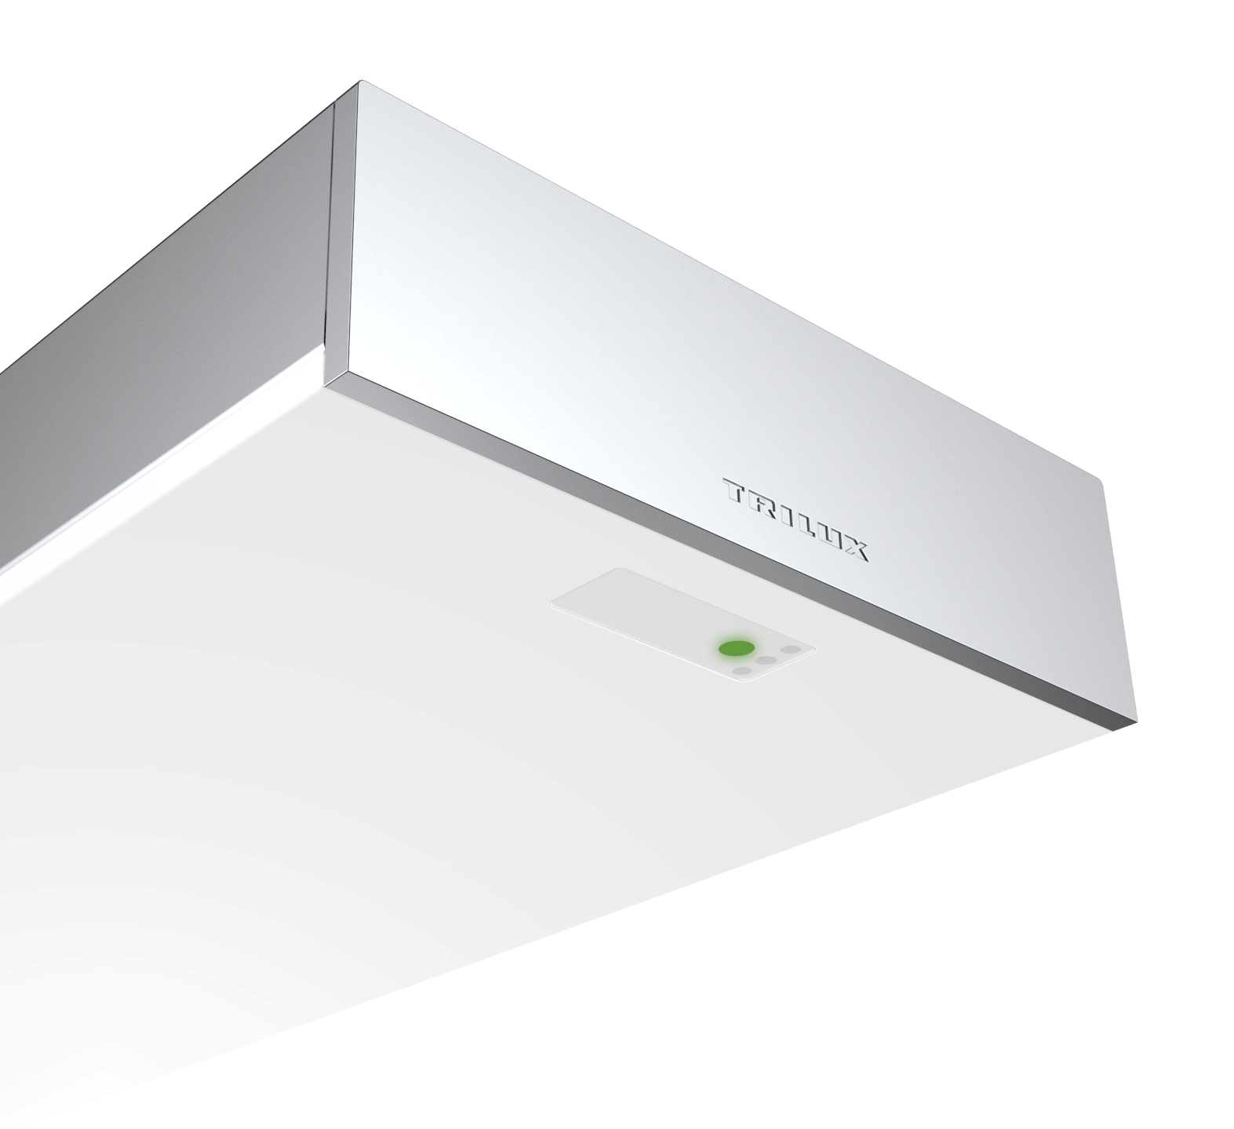
CO₂ sensors and IoT components
“Turnkey” versions with integrated IoT components, e.g. CO₂ sensor systems for measuring air quality.
Control via classic sensors
Modules with integrated daylight and presence sensors increase efficiency.

Slide 21
FUNDING OBJECT
Publication of municipal guidelines with details of the BMU funding program: 01.01.2020 (supplement)
Application window: Project applications can be submitted all year round since 01.01.2020
Promotion of interior lighting: 25% (35%) promotion for reduction of CO2 emissions by 50% with control and regulation technology
It is worth to be quick: Applications submitted in the period from August 1, 2020 to December 31, 2021 will be subsidized by a further ten percentage points.
Energy consumption – Numerous national and regional aid programmes support the long overdue LED lighting refurbishment in schools, for instance the BMU funding measures. Opendo meets all the energy efficiency and sustainability requirements associated with funding.

