Slide 1
OLEVEON FIT LED
Simply planned. Flexibly refurbished. Fit for the future..

Slide 2
Whether for parking garages, distribution halls, production areas or canopied outdoor areas – weather-proof luminaires are often used according to the principle of "the most important thing is standard-compliant and functional". This however neglects the enormous potential offered by modern damp-proof lighting in terms of quality of light, energy efficiency, spatial effect and connectivity.

Slide 3
Oleveon Fit LED raises the lighting quality in damp rooms to a new level. Innovative 3-D prismatic technology provides uniform, glare-free light and state-of-the-art LED technology minimises energy consumption. Upgrading is child's play: Oleveon Fit LED was designed for quick and simple refurbishments, and thanks to its wide range of versions and integration of light management and sensors can be optimally adapted to the specific framework conditions.

Slide 5
Wide range of versions for custom light
With its high flexibility and adaptability, Oleveon Fit LED is the complete solution from a single source in the weather-proof luminaire segment. Thanks to application-specific optics, lumen packages and diffuser materials, even the standard solution adapts perfectly to the various applications. Individual customer specifications can be implemented via custom productions. Oleveon Fit LED can be intelligently controlled via light management systems such as LiveLink and various sensor technology modules.

Slide 6
Oleveon Fit LED in its various optical versions aims primarily at efficiency or light effect. The efficiency-optimised version with innovative TRILUX 3-D prismatic technology can save up to 15 % in light points compared to the standard market solutions.
A variant of Oleveon Fit LED further optimised with a diffuser emits especially pleasant and uniform light – an advantage with low room heights, e.g. in parking garages or above assembly workstations.
In Prüfung

Slide 7
Reliable lighting level
The optionally available CLO technology (Constant Light Output) guarantees uniform luminous flux over the complete service life. This ensures consistently high lighting quality and also reduces the energy consumption of the luminaires by up to 10 % compared to a classically switchable solution.

Slide 11
Great for refurbishments
Refurbishments were never as easy: thanks to the intelligently designed housing concept with an elongated mounting slot and a high number of infeed possibilities, existing drill holes and cables can be used almost independently of the model and manufacturer with one-to-one replacements. A further highlight is clipless catch technology: clips are no longer needed for mounting the diffuser, so that losable parts and small parts to be installed beforehand are a thing of the past. That cuts mounting times by up to 10 %. Further connection options such as the Wieland rapid connection system possible as special solutions.

Slide 12
Flexibly adaptable on location
With its especially flexible luminaire concept, Oleveon Fit LED can also be simply and quickly adapted to the specific framework conditions on location. With special variants for example, the luminous flux levels can be flexibly adjusted via the multilumen option. The luminaire to be opened enables simple adaptation of the luminaire to the specific room or individual mounting position. Product returns and new lighting designs are also avoided if the real conditions on-site differ from the planning.

Slide 13
A wireless solution for quick installation
If the site has no DALI control lines, Oleveon Fit LED can also be networked via wireless radio connection and then integrated into the LiveLink light management system. This enables the benefits of LED technology to be implemented application-specifically with regard to efficiency and controllability and without complex changes to the building construction, such as DALI lines needing to be routed.

Slide 14
It pays: consistently low operating and maintenance overheads
Oleveon Fit LED offers an excellent price-performance ratio. Thanks to high energy efficiency of up to 145 lm/W and a service life of L80 50,000 h, operating costs are significantly cut compared to conventional solutions, meaning that the initial investment is quickly paid back. The level of energy consumption can be further reduced by combining with sensors that are either integrated directly in the luminaires or via LiveLink.

Slide 15
Perfect visibility: 3-D prismatic technology for high quality of light
Oleveon Fit LED features a unique quality of light. The reason for this is its innovative TRILUX 3-D prismatic technology: this minimises glare and achieves especially uniform, pleasant distribution of light.
Colour temperature: 6,500 K to support productivity
As of now, the 6,500 K light colour is part of the standard repertoire of Oleveon Fit LED. The reason for this is that light with a high blue component is able to improve the ability to concentrate during the day. This enables error rates and accident rates to be cut and productivity to be increased.

Slide 16
Monitoring with LiveLink: keeping an eye on the lighting anytime and from anywhere
Using the intelligent LiveLink kit, operators can keep an eye on all lighting-relevant operating data – in real time. This enables proactive measures to be taken for optimising energy consumption and maintenance intervals. This minimises expensive failure times and via energy savings improves the CO₂ balance. For operators this is a significant plus in terms of reliability and flexibility.

Slide 17
Control with LiveLink: designing, using and adapting light scenes
The LiveLink Use Cases enable the operating parameters of all luminaires in a room to be individually configured and saved together. Via the Use Cases, specific application-dependent light scenes can be called via push-button or smart device such as special lighting conditions for assembly sequences or computer work. If the work sequences change or room utilisation changes, the Use Cases can be flexibly reprogrammed with just a few inputs – making sure that optimum visual conditions are once again immediately available.
Decades of experience: maximum reliability and problem-free operation
TRILUX has invested its decades of expertise in the area of weather-proof lighting into the development of Oleveon Fit LED, and offers a lighting solution with high quality materials and components.

Slide 18
EFFICIENCY CALCULATION
CALCULATION EXAMPLE – cool storage room
Luminaire | new system competition Zumtobel Scuba | new system TRILUX Oleveon Fit B 6000
System performance per luminaire | 45,5 W | 43 W
Number of luminaire per object | 105 | 88
System performance in total | 4.778 W | 4.224 W
Energy consumption p.a. | 20.926 kWh/a | 16.844 kWh/a
Energy costs Ø p. a. | 1.760 £/a | 1.417 £/a
Energy savings potential p.a. | - | 20 %
Safed kilowatt hours p.a. | - | 4.082 kWh/a
Energy cost savings Ø p.a. | - | 790 £/a
EnergY COSTS SAVING
790 £/a
EnergY
SAVING
20%
4.082 kWh/a
Energy price: 0,10 £/kWh
Annual operation time: 8.750 h

Slide 19
EFFICIENCY CALCULATION
CALCULATION EXAMPLE – cool storage room
Luminaire | old system T8 batten with protective tube | new system TRILUX Oleveon Fit 6000 L
System performance per luminaire | 66 W | 52 W
Number of luminaire per object | 32 | 32
System performance in total | 2.112 W | 1.677 W
Energy consumption p.a. | 5.808 kWh/a | 2.306 kWh/a
Energy costs Ø p. a. | 711 £/a | 283 £/a
Energy savings potential p.a. | - | 60 %
Safed kilowatt hours p.a. | - | 3.502 kWh/a
Energy cost savings Ø p.a. | - | 986 £/a
EnergY COSTS SAVING
428 £/a
EnergY
SAVING
60 %
3.502 kWh/a
Energy price: 0,10 £/kWh
Annual operation time: 2.750 h

Slide 21
Excellent quality of light and low operating costs – damp-proof lighting reaches a new level with Oleveon Fit LED. The luminaire with a wide range of variants can be precisely modified to the specific application, and is already fit for the future thanks to optional connectivity features.

Slide 22
Always a step ahead, also in the future, thanks to high flexibility: Oleveon Fit LED scores points not only in terms of quality of light, efficiency and its range of versions – the innovative connectivity features open up new possibilities for damp rooms.

Slide 23
Always a step ahead, also in the future, thanks to high flexibility: Oleveon Fit LED scores points not only in terms of quality of light, efficiency and its range of versions – the innovative connectivity features open up new possibilities for damp rooms.

Slide 24
This is how simple mounting can be: clever details such as the elongated mounting slot, a variety of electrical feed options and flexible lumen setting on location make Oleveon Fit LED the ideal 1:1 refurbishment product. Clipless catch technology also saves on installation time by up to 10 %.

Slide 25
Oleveon Fit LED represents customised, high quality light and low energy costs. Its many connectivity features make it already fit for the future and raise damp-proof lighting to a new, intelligent level.

Slide 26
TECHNICAL DATA
Energy efficiency | Up to 145 lm/W
Service life | L80 50.000 h tq 25° C, ta -20° to +35°C
Luminuous flux | 2.300 lm, 4.000 lm, 6.000 lm, 8.000 lm und als Multilumen-Lösung
Switching type | …ET… Electronic ballast, switchable. …ETDD…Electronic ballast, digitally dimmable (DALI).
Optical systems | …B…Symmetric wide light intensity distribution. …L…Lambertian light intensity distribution.
Protection class | IP 66
Sizes | 1.200 mm und 1.500 mm
Colour temperature | 4.000 K, 6.500 K
Accessories | PC/PMMA Abdeckungen erhältlich
Optional equipment | Constant Light Output-Technologie (CLO)
Emergency light | 3h
Further features | Integrated sensor solutions with presence detection, daylight-dependent lighting control and intelligent light management system (e.g. LiveLink); MOR (monitoring-ready); LiveLink versions for radio use among other applications

Slide 27
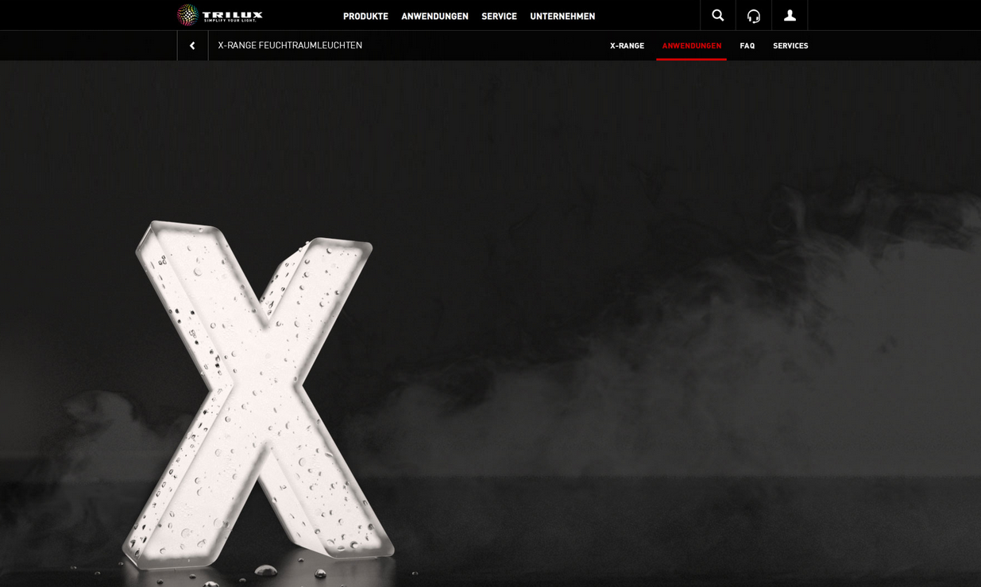
For helpful tools, services and more information on our X-Range extremely robust weatherproof luminaires, please visit
https://www.trilux.com/uk/products/x-range-weatherproof-luminaires/applications/

