Slide 1
E-Line NEXT
Everything remains.
Except better. www.trilux.com

Slide 2
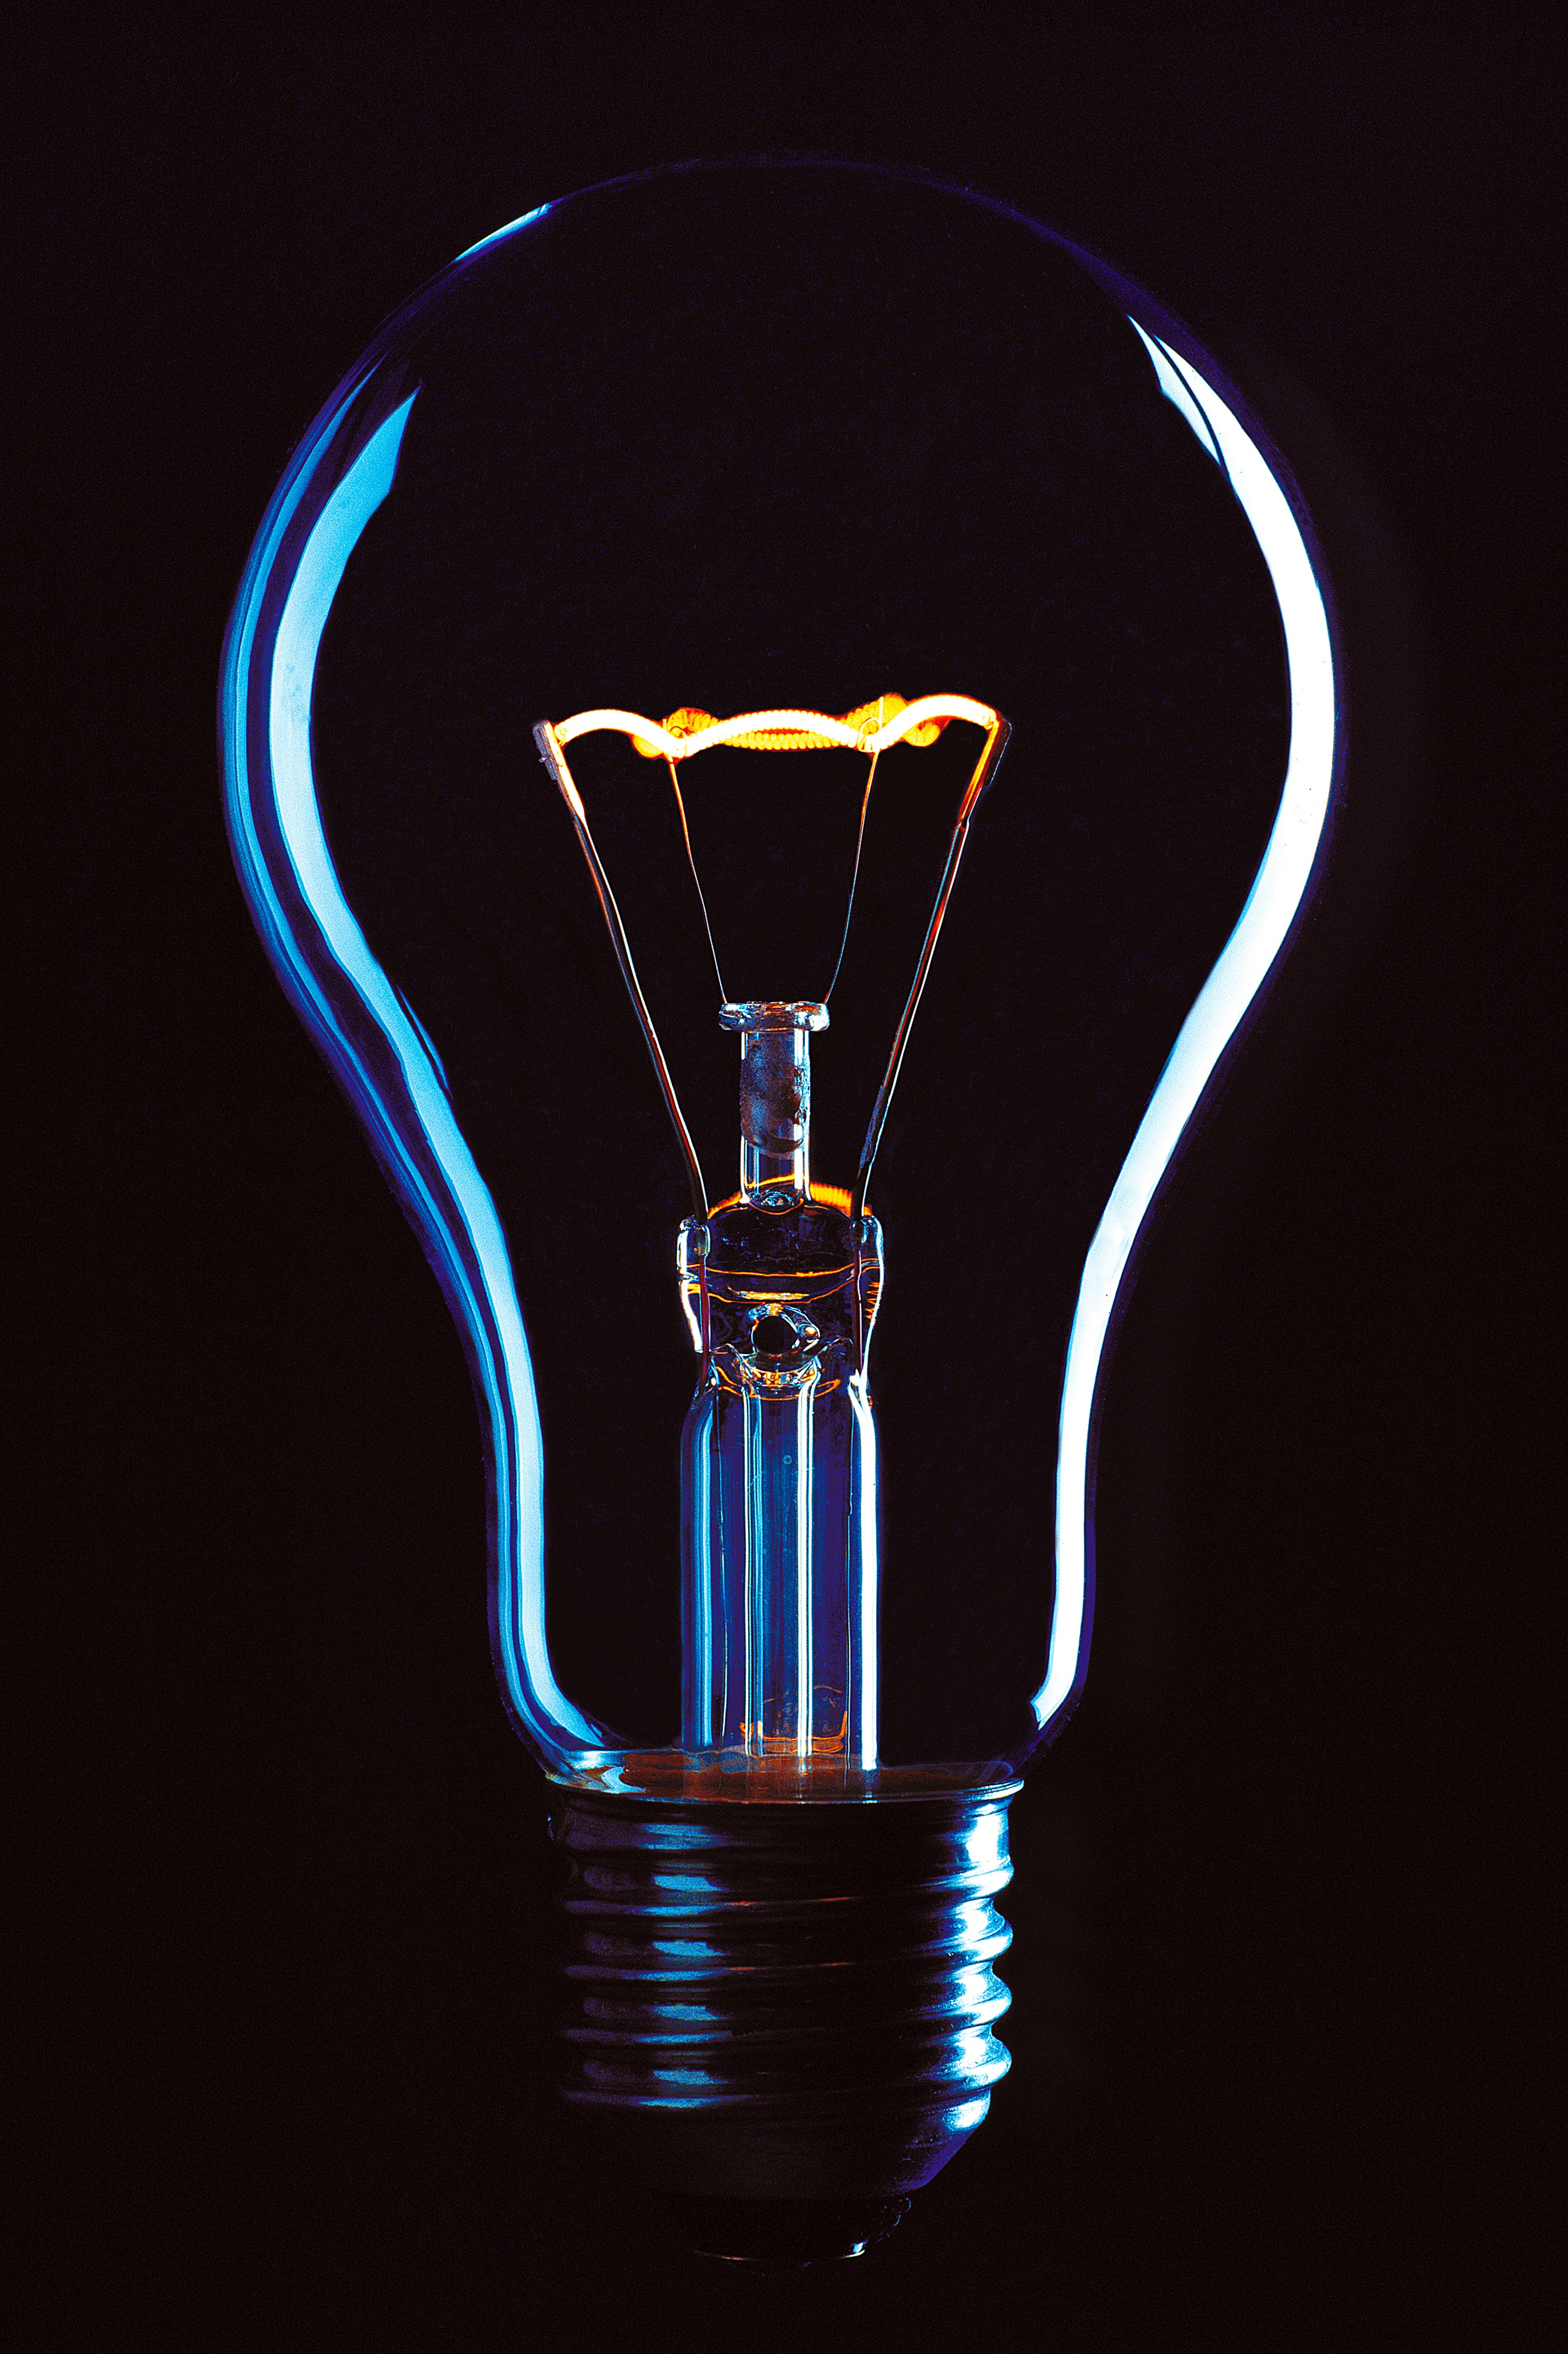
The challenge
LED continuous line systems have enormous potential, e.g. in industry, shop & retail, office and education. However, most systems are too inflexible. The result is compromises in terms of quality of light, energy efficiency, design, controllability and future safety. This is a challenge for lighting designers and architects, a risk for operators and a nuisance for users.

Slide 3
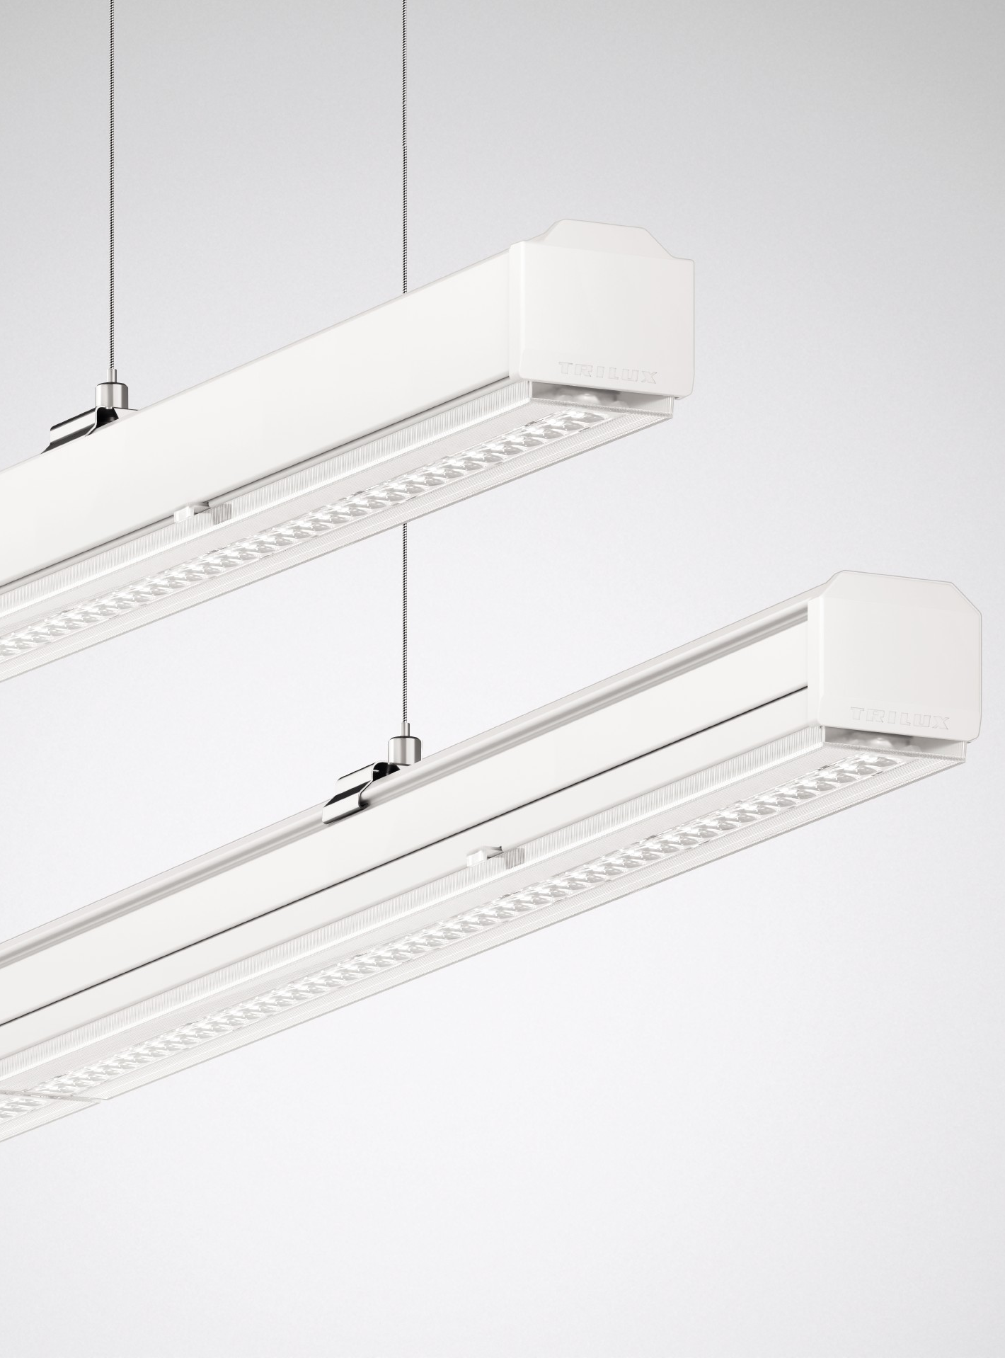
The solution
TRILUX has used 25 years of experience with continuous lines and radically upgraded the E-Line LED. With innovative technological possibilities for the market requirements of today and tomorrow. The result: E-Line Next LED. The modular system is uniquely versatile in its optics, lumen packages and lengths and covers two performance levels with one system. Pioneering in quality of light and energy efficiency (up to 190 lm/W), E-Line Next LED is the ideal solution for continuous line projects across all applications.

Slide 4
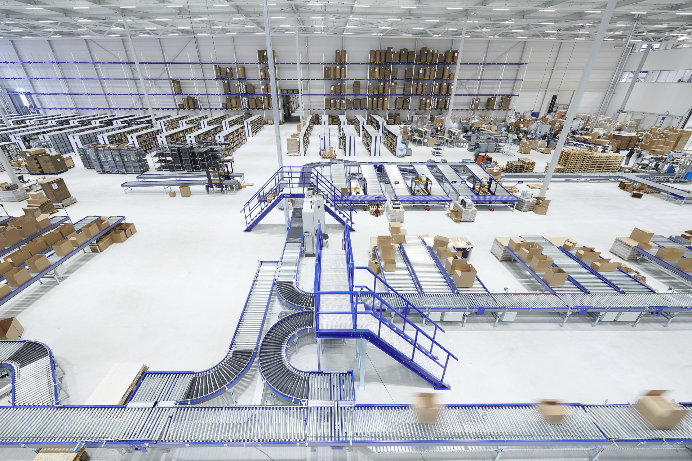
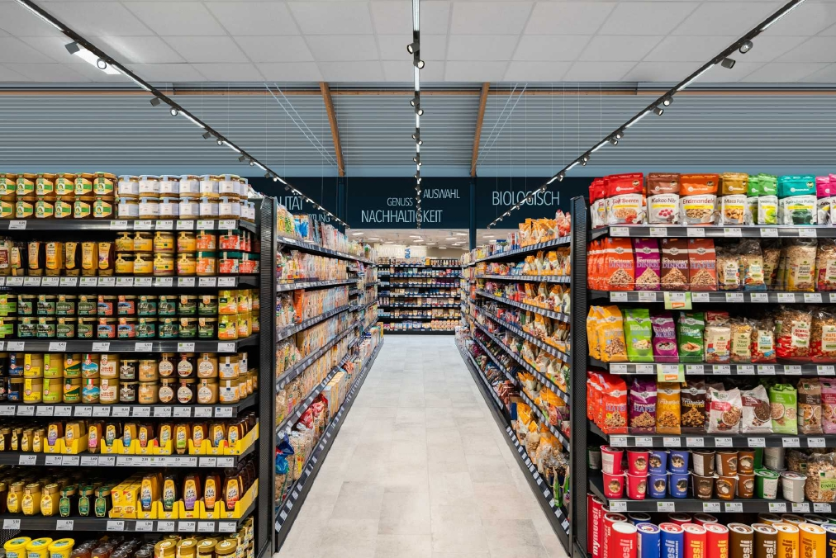
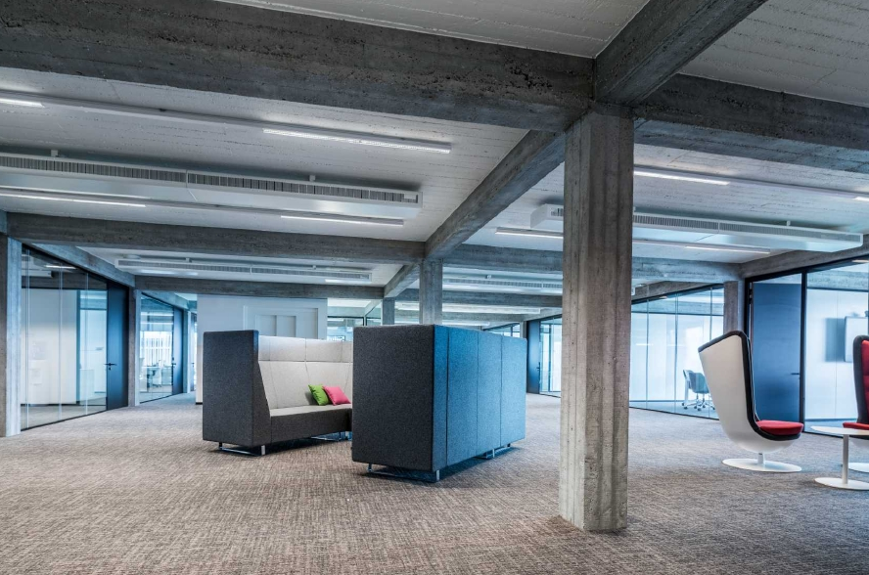
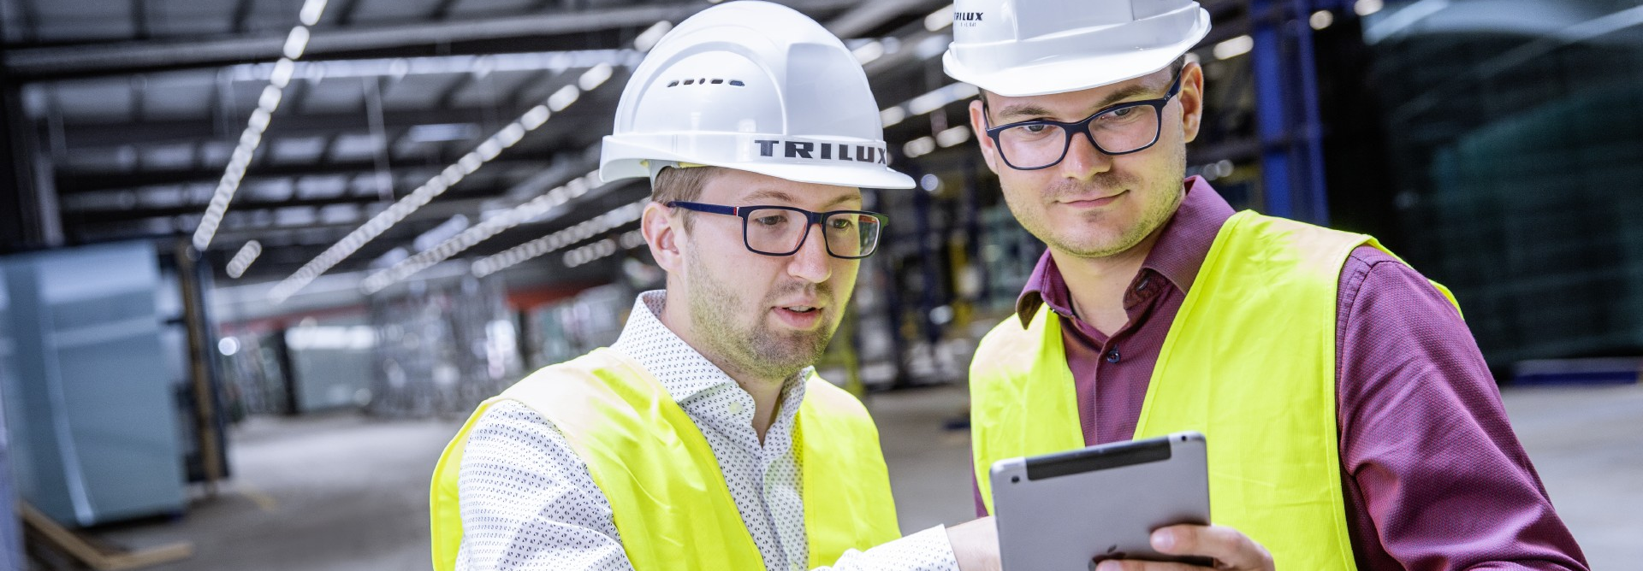
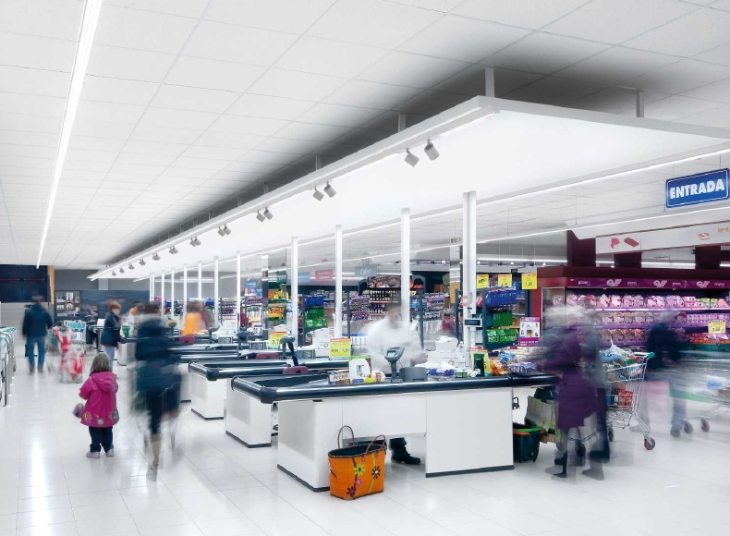
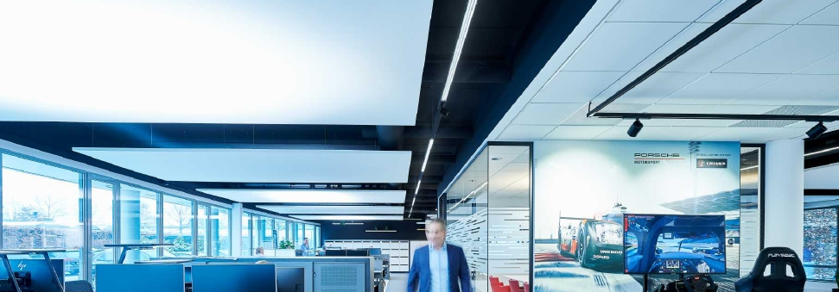
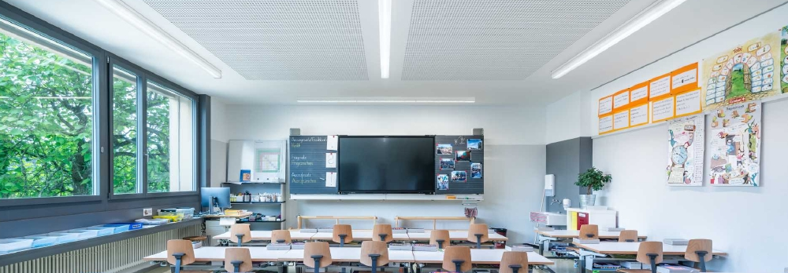

Slide 5
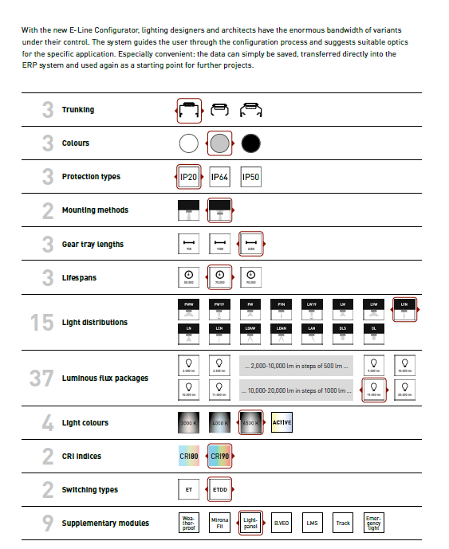
Advantages with lighting design
All tenders with a single system – E-Line Next LED
Finally a system that is ready for anything. The modular system offers a uniquely wide selection of optics, lumen packages, module lengths, protection ratings, colour rendering indices and much more. Most components can be freely combined so that all conceivable tender specifications can be met.

Slide 6
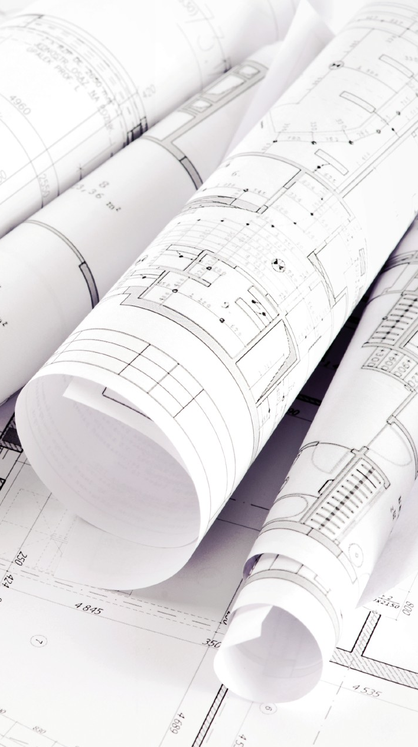
Advantages with lighting design
Made-to-measure from infinite possibilities – thanks to the E-Line Configurator
In total, E-Line Next LED offers around 250,000 different combination options. Too many? Not at all! With the new E-Line Configurator, lighting designers and architects have the enormous bandwidth of variants under their control.

Slide 7
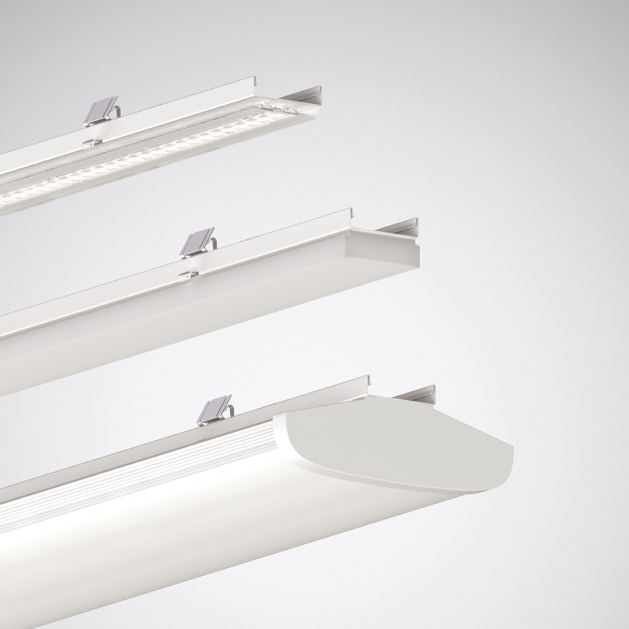
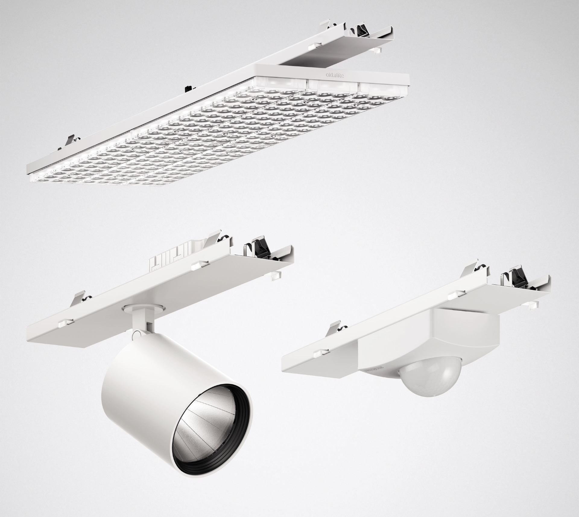
Advantages with lighting design
From planar and shelf lighting to accentuation – perfect light with custom optics
E-Line Next LED is available with 15 different optics and spotlights. This means it always achieves optimum visual comfort in any application and at any mounting height, and at the same time offers complete flexibility for accenting and emotional light. The portfolio includes, for example, glare-controlled solutions for computer workstations, systems with a high colour rendering index, special optics for the logistics sector and double asymmetric optics for ideally illuminated aisles in the retail sector.

Slide 8
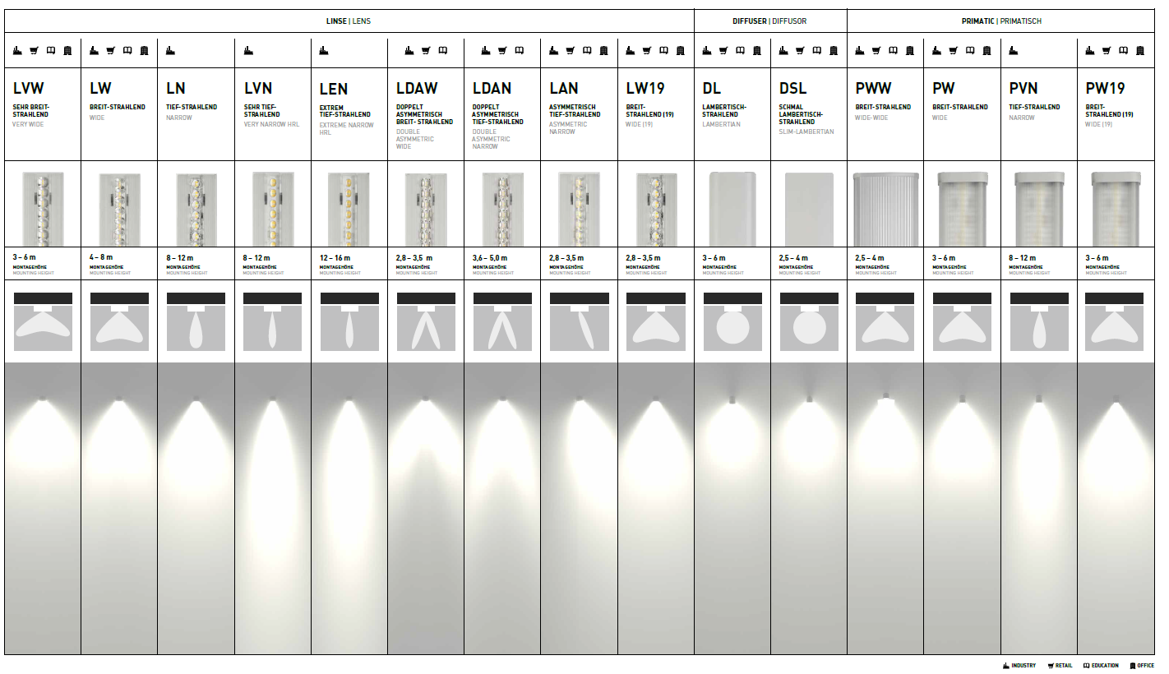
Advantages with lighting design

Slide 9
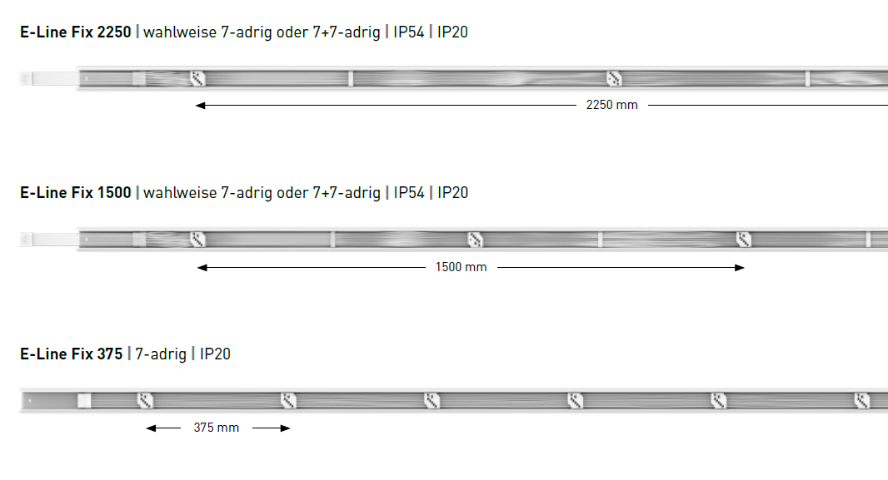
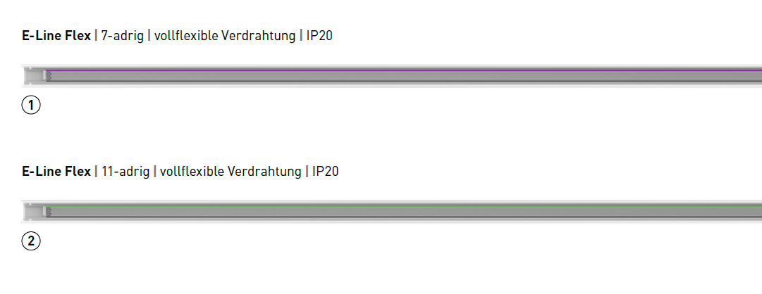
Advantages with lighting design
Flex or Fix – from cost-efficient to maximum flexibility
In terms of trunking, two different systems are available. The Flex system has continuous wiring and thus enables the modules to be freely positioned in the trunking – ideal for maximum flexibility The Fix system on the other hand has fixed female connectors – at spacing of either 368,75 mm, 1.475 mm or 2.212,5 mm. Perfect for cost-sensitive projects.
2212,5 mm
1475 mm
IP64
IP64
368,75 mm

Slide 10
Advantages with lighting design
2.000 lm
500 lm
2.500 lm
3.000 lm
3.500 lm
4.000 lm
4.500 lm
5.000 lm
High light output: luminous flux packages from 2,000 to 20,000 lumens
E-Line Next LED comes as standard with luminous flux packages of between 2,000 and 20,000 lumens. This means that warehouses with high mounting heights can be illuminated just as effortlessly and efficiently as offices, supermarkets and educational facilities.
Perfect light and maximum efficiency: the ideal lumen package
Precise selection of the luminous flux guarantees maximum visual comfort and efficiency. This is the reason why the luminous flux packages of E-Line Next LED can be selected from 2,000 to 10,000 lumens in steps of 500. Between 10,000 and 20,000 lumens, the luminous flux packages can be configured in steps of 1,000 lumens.
5.500 lm
6.000 lm
6.500 lm
7.000 lm
7.500 lm
8.000 lm
8.500 lm
9.000 lm
9.500 lm
10.000 lm
1.000 lm
11.000 lm
12.000 lm
13.000 lm
14.000 lm
15.000 lm
16.000 lm
17.000 lm
18.000 lm
19.000 lm
20.000 lm

Slide 11

Advantages with lighting design
Changes in the project or a new budget? No problem at all.
Everything's planned and ready – but suddenly the requirements in a project change, for example due to a new cost framework or the wish to include Human Centric Lighting (HCL). In such cases the lighting designers and architects have to adapt the lighting design. Those specifying E-Line Next LED have a clear advantage though, because all system components are compatible and can be flexibly modified to the new framework conditions. For example, if costs have to be saved, it is sufficient to modify the service life requirement (>50,000 h or >70,000 h) via the configurator without the light distribution being affected. You suddenly want it to be HCL after all? Just replace the gear tray with the corresponding Active variant. Done. In this way, two price points and (almost) all customer needs can be covered with one system. That's flexibility that makes a real difference in practice.

Slide 12
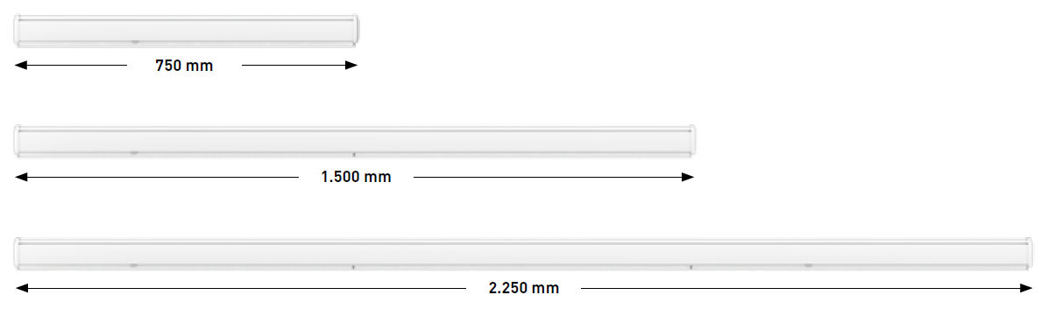
Advantages with lighting design
Three module lengths. And one target. To optimally illuminate all rooms.
Three different module lengths make E-Line Next LED especially adaptable. The classic 1,500 mm-length gear tray is ideal for renovating old E-Line systems. In some applications, for example supermarkets, perfectly illuminated merchandise aisles and shelves play an important role. Until now, lighting designers had to compromise with aisle lengths that could not be exactly divided by 1,475 mm. This is the reason why TRILUX now offers a 737,5 mm-length gear tray – ideal for "filling gaps" and optimisation in the shop area. There's also a 2.212,5 mm-length luminaire insert for particularly cost-efficient buildings.
2.250,5 mm
1,475 mm
737,5 mm

Slide 13
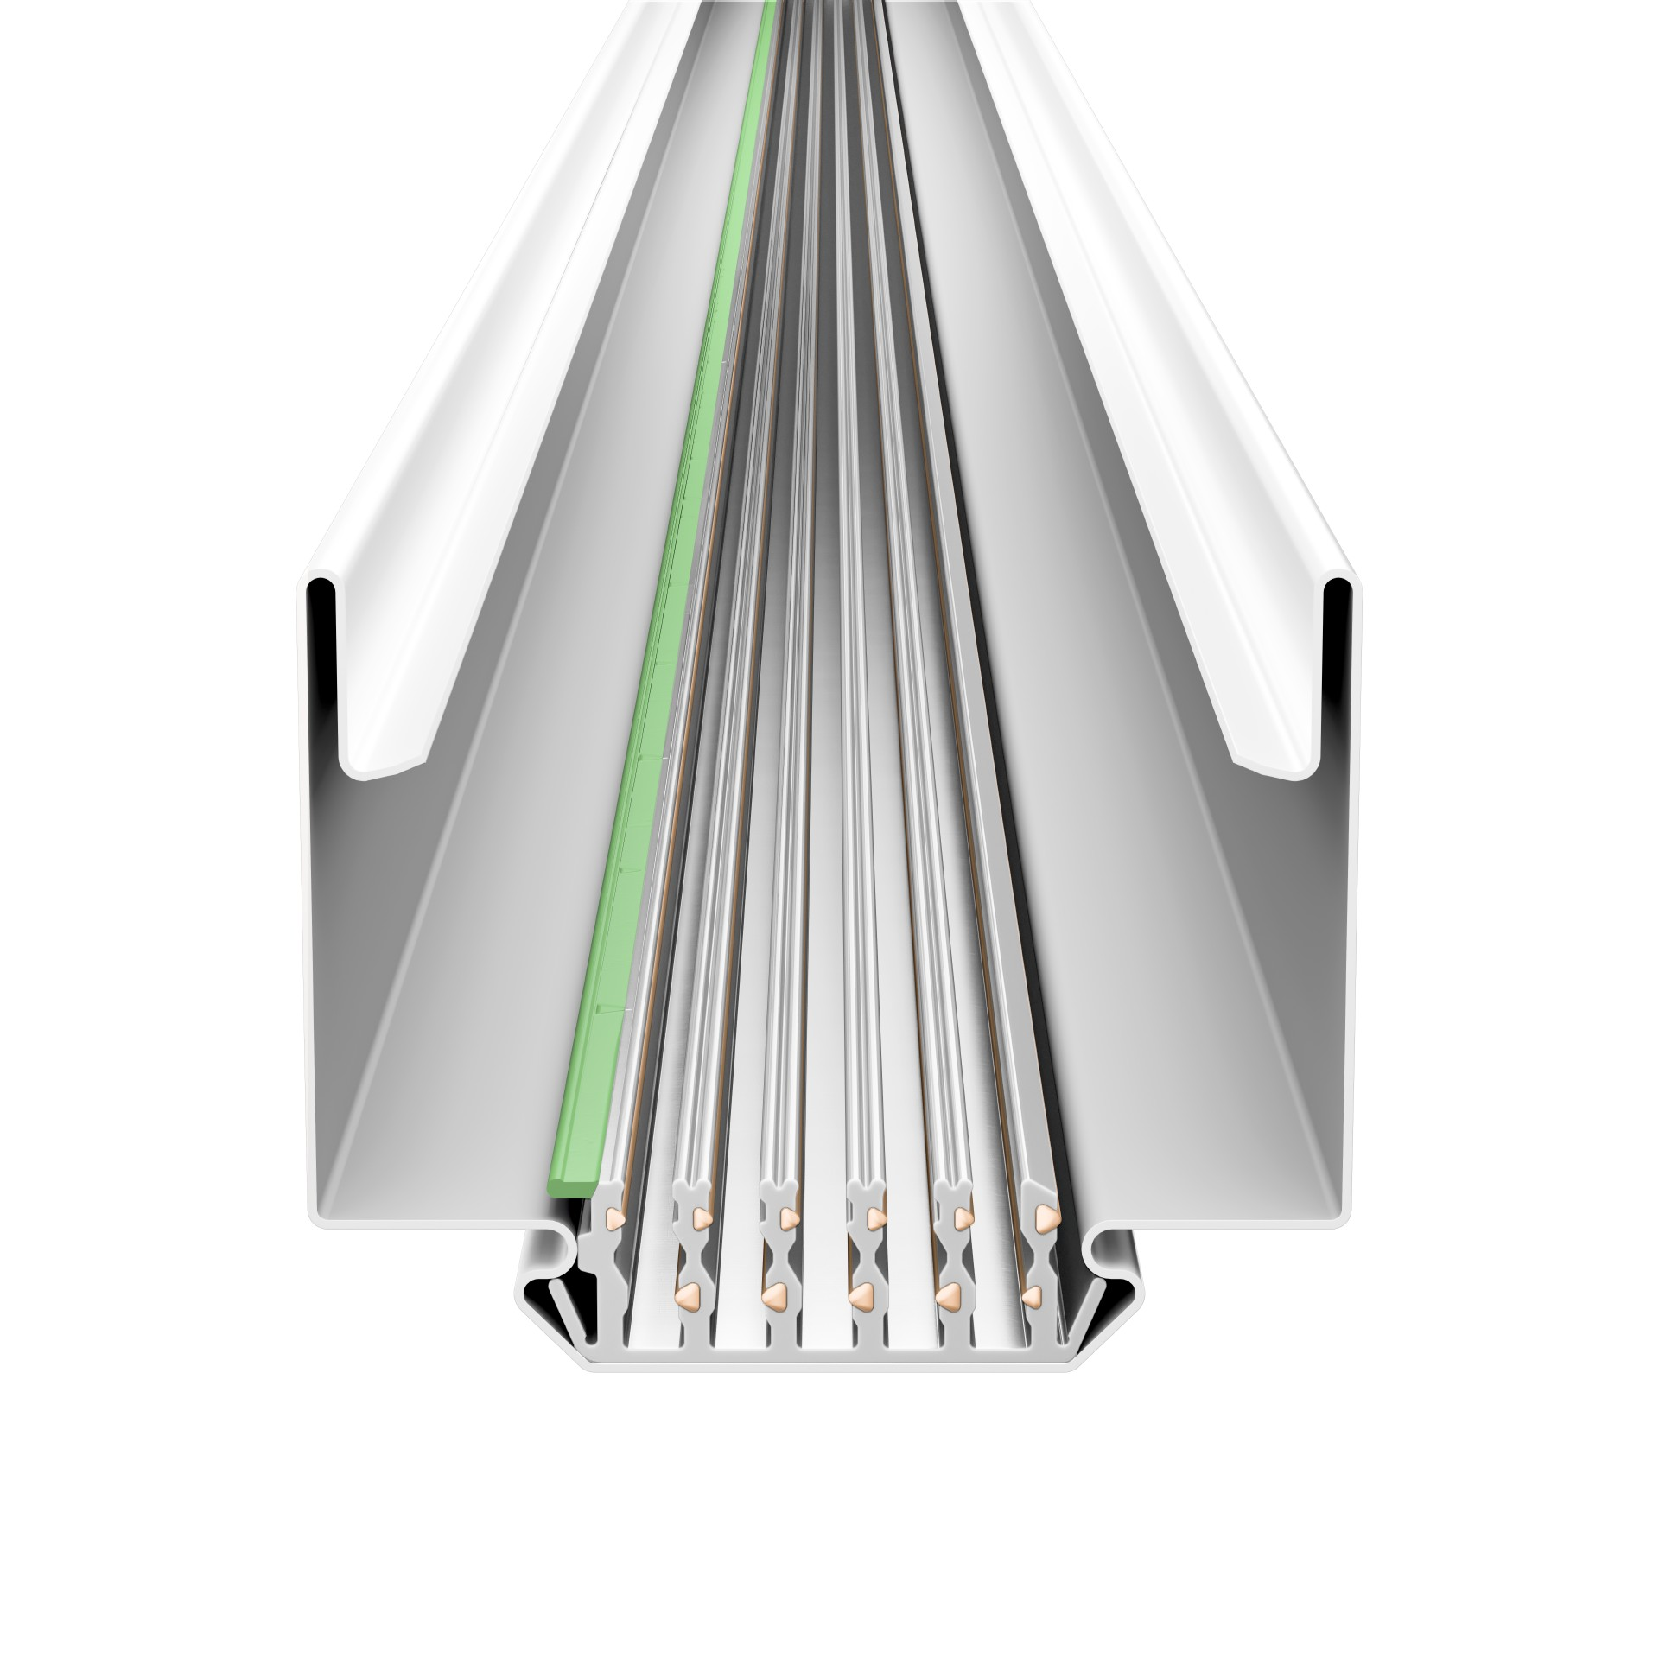
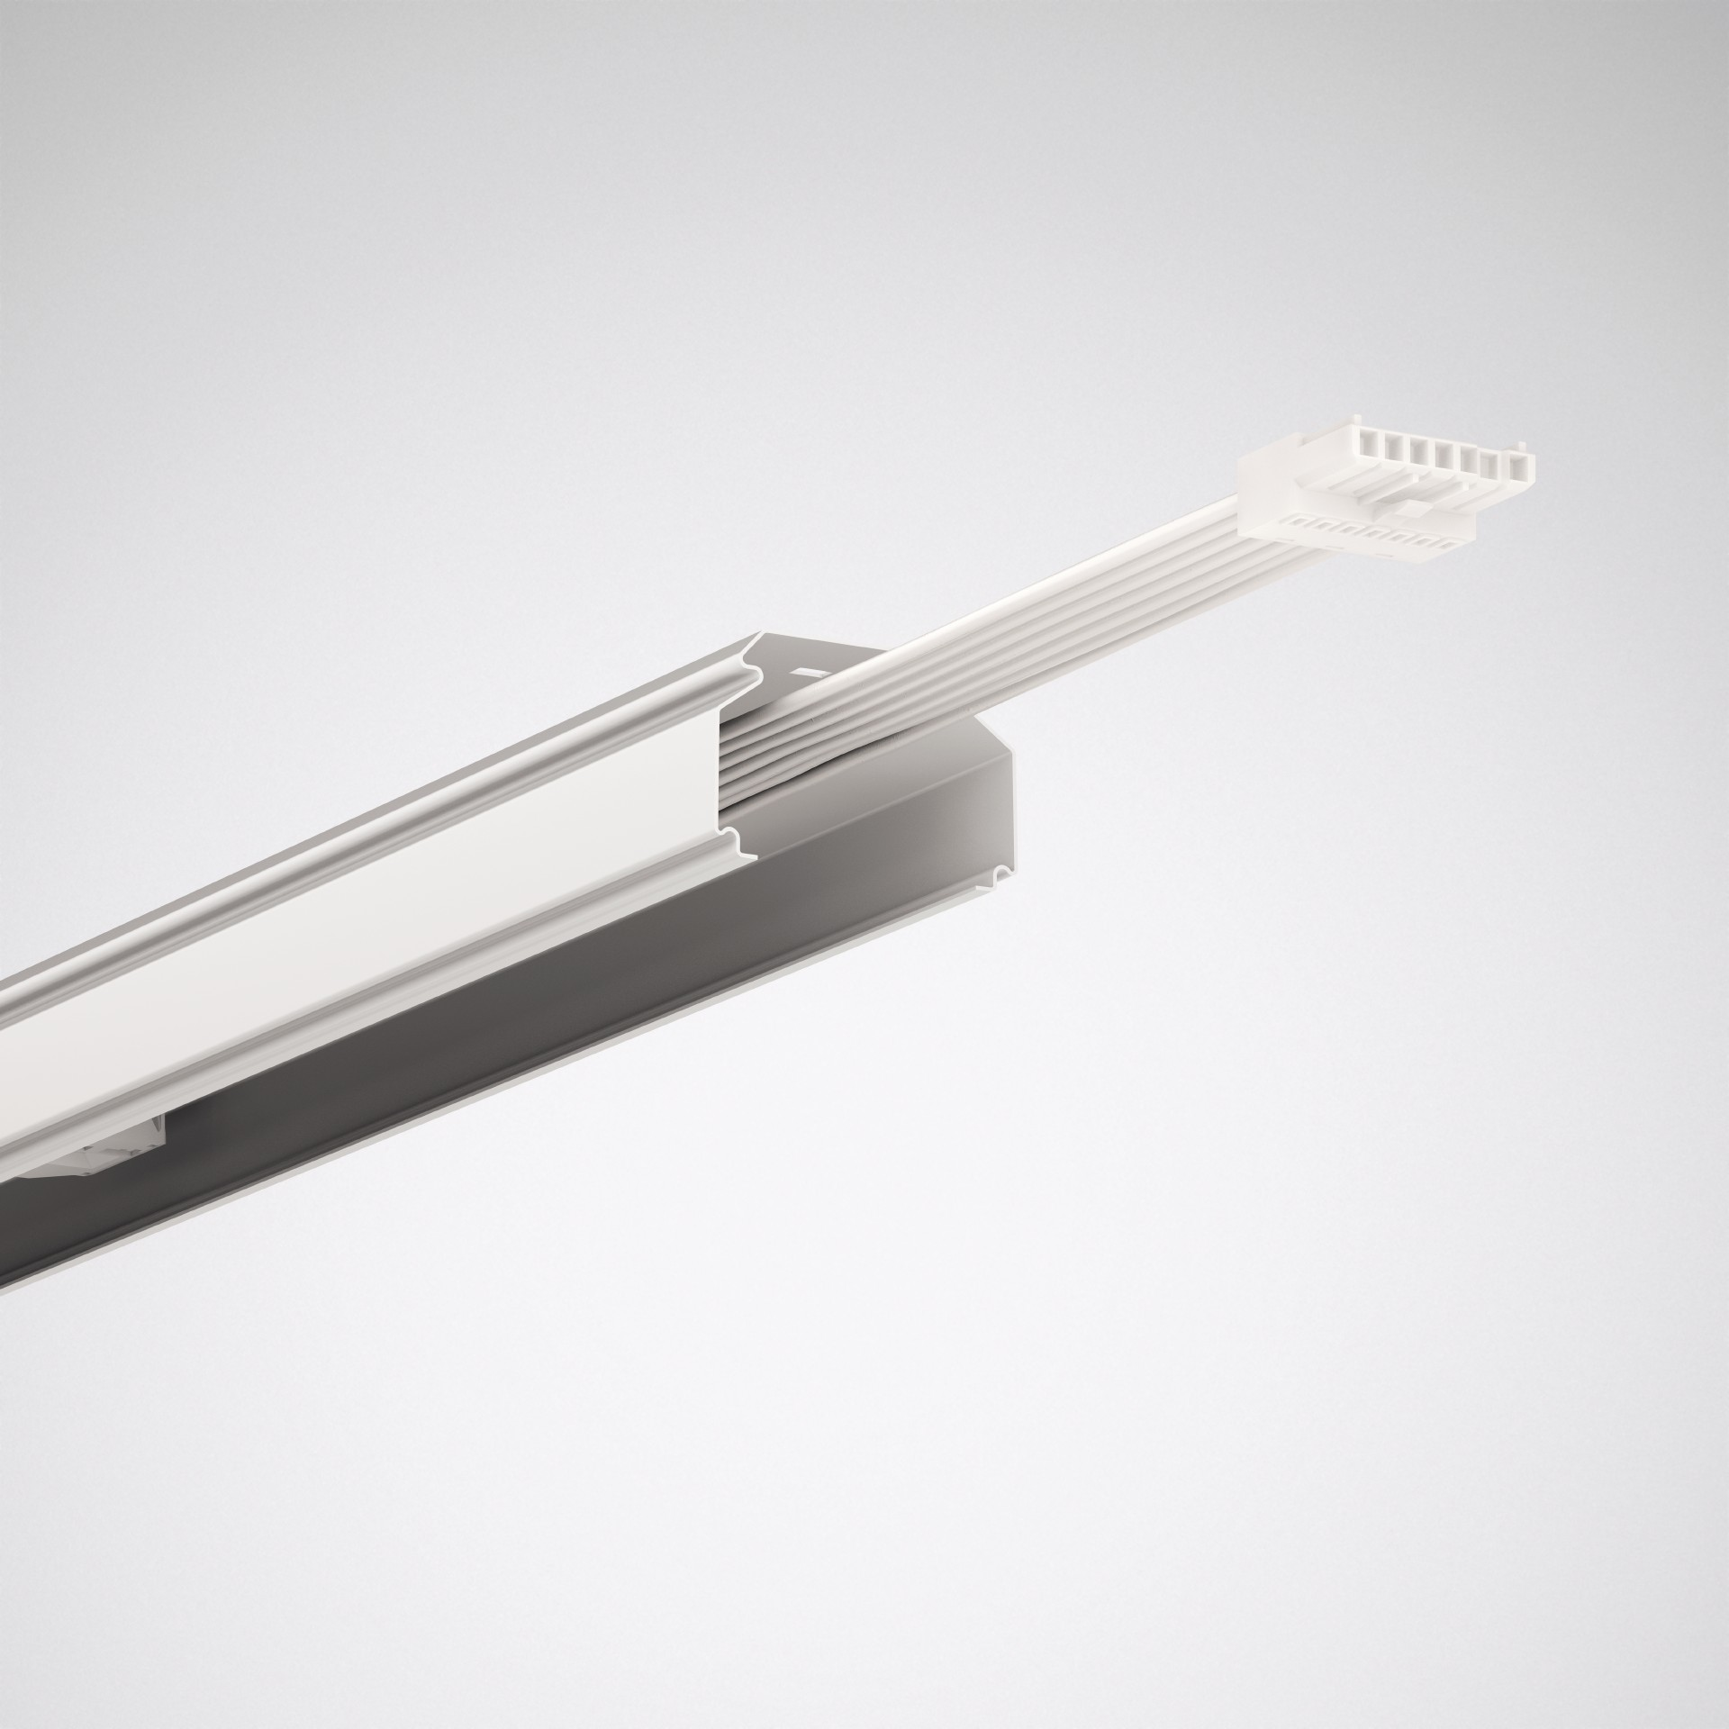
Advantages with lighting design
All aboard: current conductors for additional loads
With E-Line Next LED, additive technologies and consumers such as emergency lighting circuits or sensors can be integrated into the system. Beacons can also be integrated effortlessly in the future. The Flex version of the E-Line Next LED has an 11-core current conductor, the Fix version has 14 (7+7) cores. The additional consumers make it possible to use the lighting infrastructure for further tasks to increase e.g. comfort and security.

Slide 14
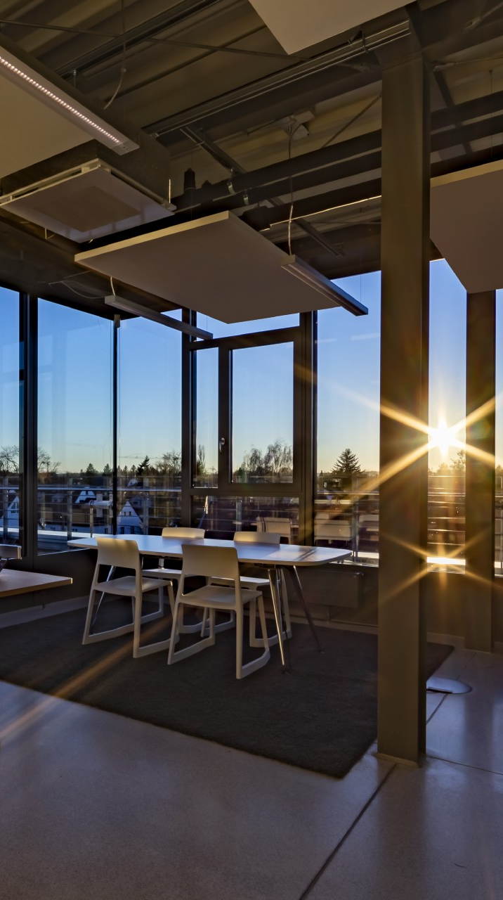
Advantages with lighting design
Human Centric Lighting throughout – like daylight in a building
All E-Line Next LED variants are available as HCL-enabled Active solutions. This means that HCL can be used for the first time across applications. The HCL luminaires change their spectral composition over the course of the day like natural sunlight and thus bring "daylight into the interior of the building". In this way the body receives important impulses that support the biological rhythm and can improve well-being.

Slide 15
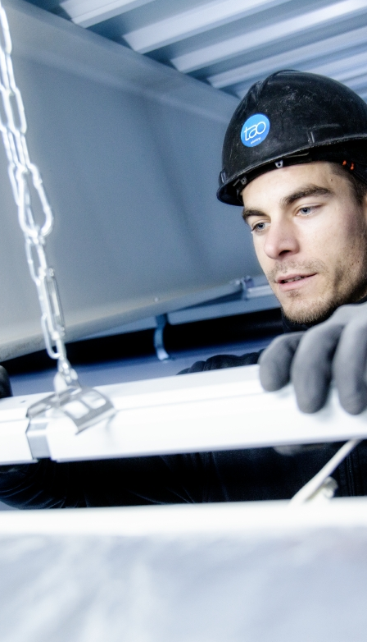
Advantages with installation
Quick, clean and simple – intuitive and simple mounting
Typical for E-Line Next LED is fast, simple and intuitive installation. After the trunking has been attached, the gear trays are simply latched into place without tools via spring catches. A special feature of E-Line Next LED: the spring catch snaps into place after mounting and provides acoustic and visual feedback that it is correctly inserted.

Slide 16
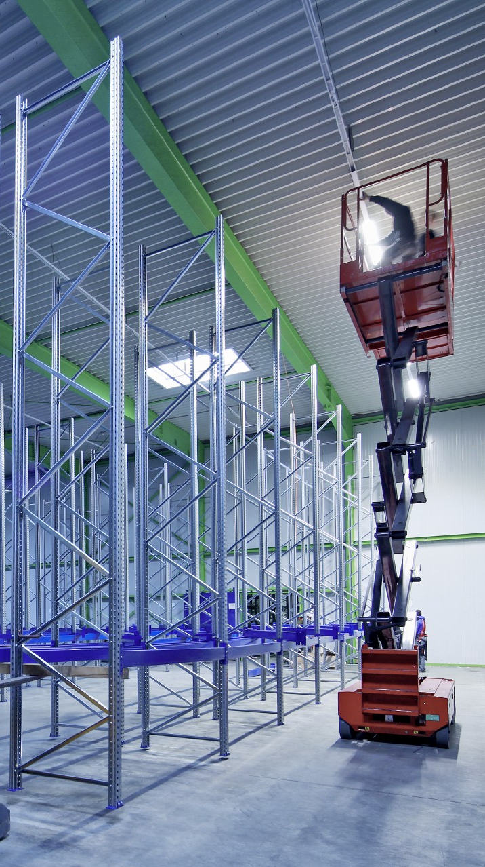
Advantages with installation
One drilling point every four metres – definitely a benefit
E-Line Next LED Flex has a new trunking geometry and a new type of coupling. This enables suspension distances of 4 metres and saves much time and costs during installation.

Slide 17
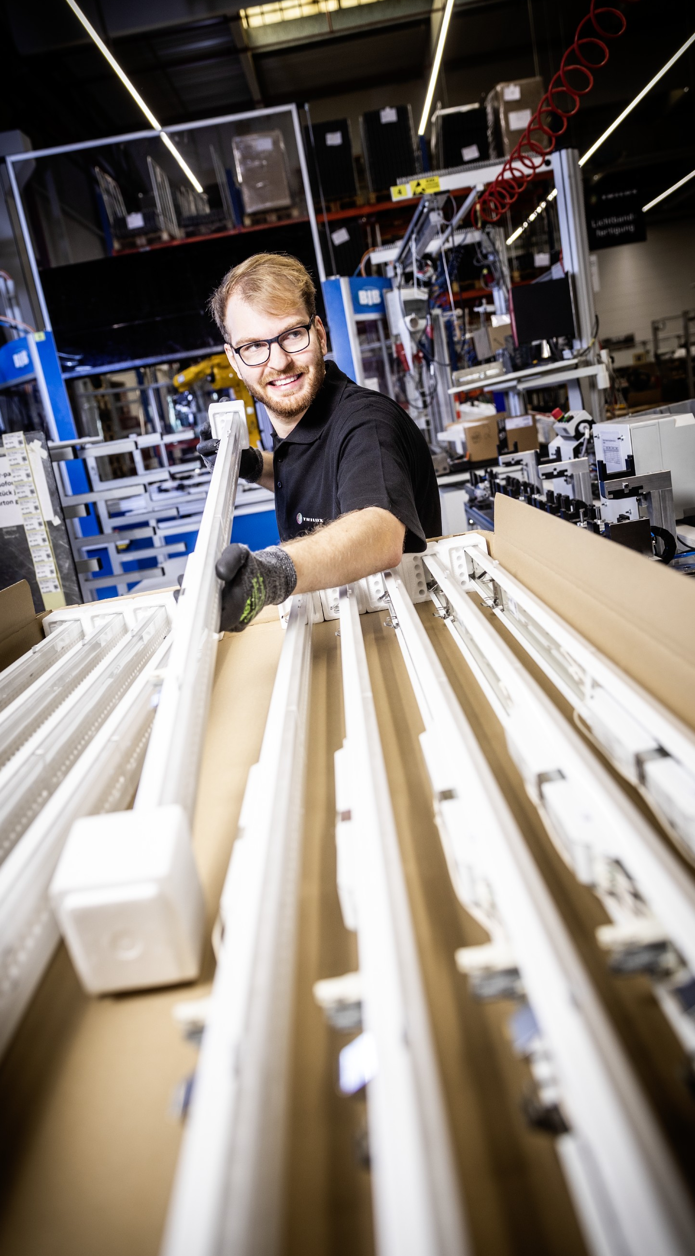
Advantages with installation
Optimised packaging sizes – less effort, less waste, lower costs
To date, E-Line has been delivered in packs of 1 or 4. However, unpacking and disposing of waste costs time and burdens the environment. For this reason, customers now have the option of having their E-Line Next LED supply delivered to the construction site in tailor-made, large containers instead of in many single packs. That saves up to 15% in time and also protects the environment.

Slide 18
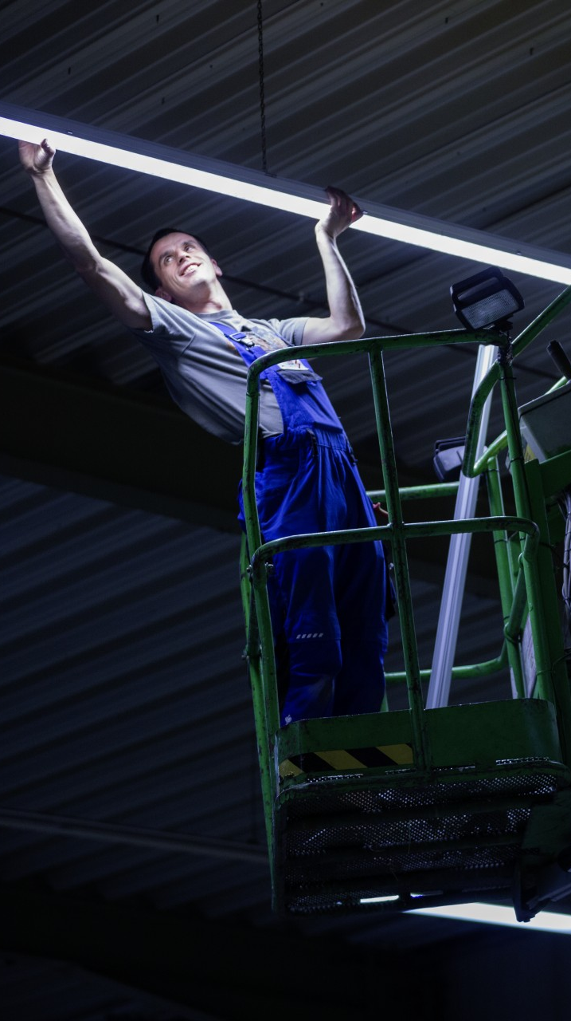
Advantages with installation
Refurbished in a flash – quick upgrades for obsolete systems
The new E-Line Next LED Fix gear trays with their taps also fit old E-Line trunking units, regardless of whether they are LED versions or existing T5/T8 systems. A renovation is therefore done quickly, easily and with minimal effort.

Slide 19
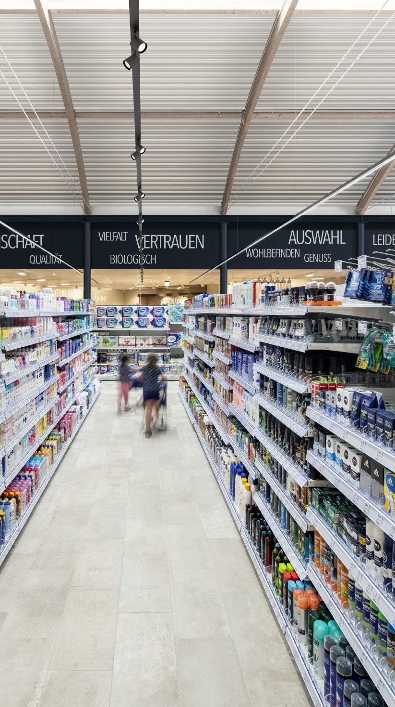
Advantages in operation
Highest quality of light – a visible difference
With its versatility in terms of optics and lumen packages as well as high glare control, E-Line Next LED provides customised light everywhere. With a colour rendering index of Ra>90 in the standard portfolio, especially natural colour rendering is guaranteed. The result – very good quality of light and maximum visual comfort. A real advantage, especially when details are involved, for example in quality control in the automotive industry or merchandise display in shop & retail.

Slide 20
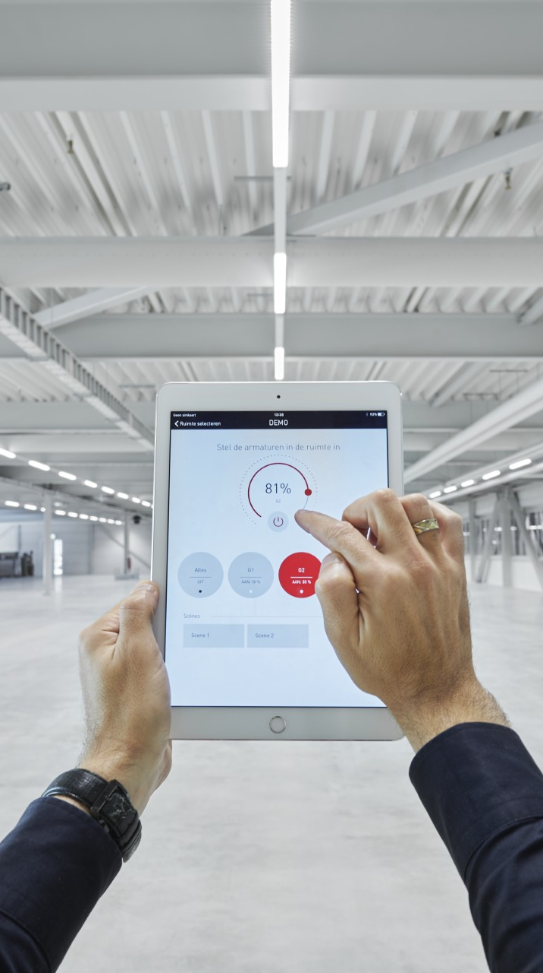
Advantages in operation
Check! Low operating costs, quick paybacks
Thanks to its uniquely high energy efficiency of up to 190 lm/W, E-Line Next LED is particularly economical in operation. At the same time, the system scores with a service life of 70,000 h (L80, up to tq 50°C). The result: low operating costs and quick payback periods.

Slide 21
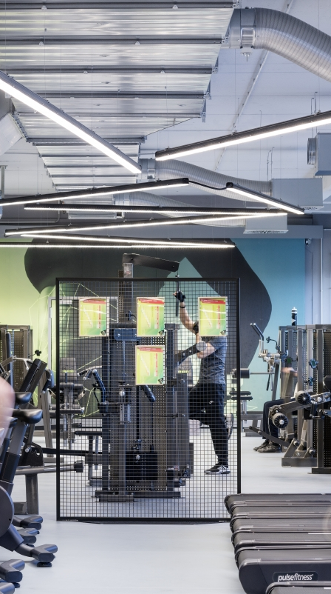
Advantages in operation
Click and go. Minimal downtime during refurbishment
Whether it's a T5, T8 or LED system: converting an existing E-Line to the new E-Line Next LED Fix is done in just 44 seconds. Only the gear trays are exchanged. The existing trunking units can still be used. This minimises expensive downtimes when refurbishing during running operation.

Slide 22
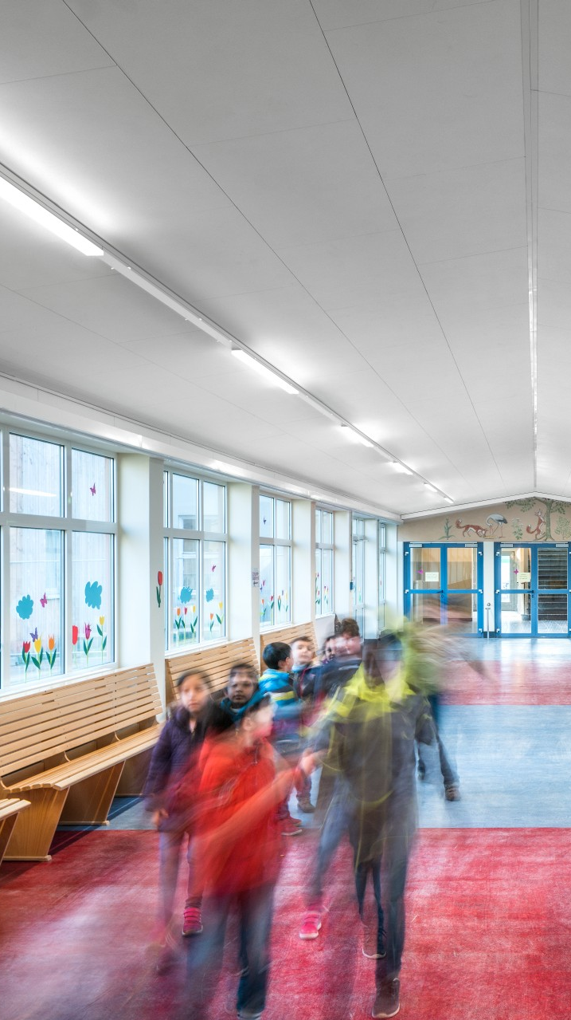
Advantages in operation
Snap springs can be removed – a good idea for sure
Theft and mischief prevented: the snap springs can be removed after installation so that the luminaire cannot be opened by unauthorised persons after installation (for example in schools and educational establishments).

Slide 23
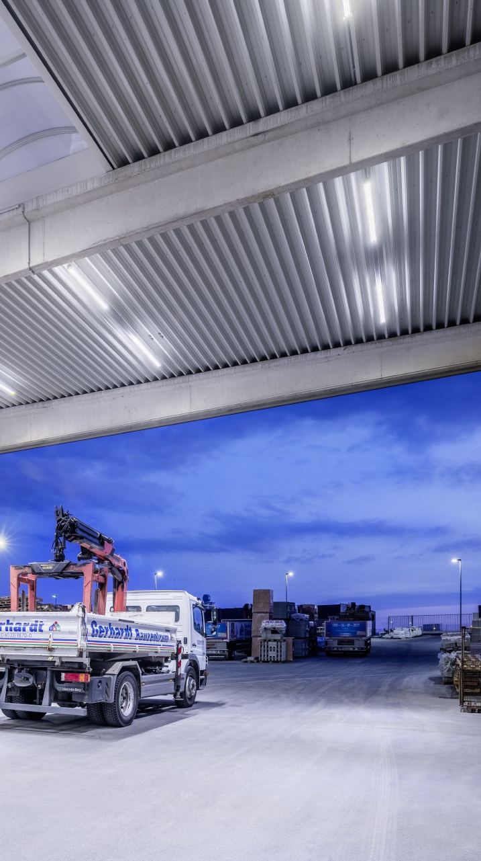
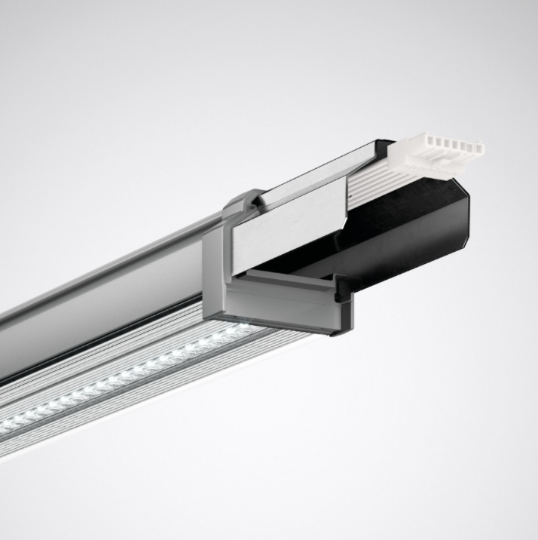
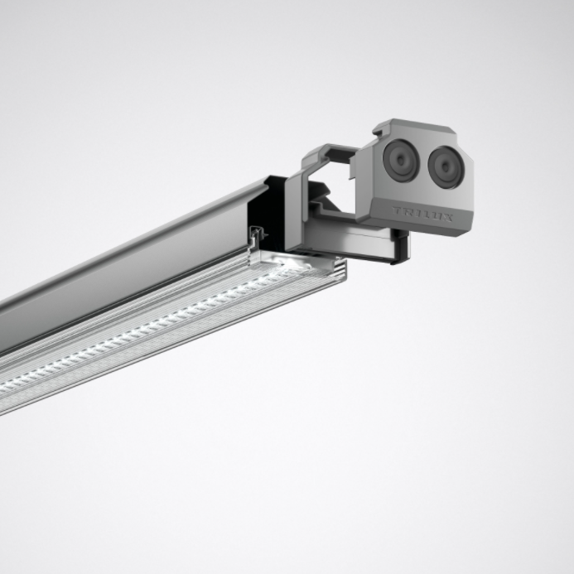
Advantages in operation
For tough cases – also as an IP64 variant
Simply unstoppable: as an IP64 variant the E-Line Next LED shows its robust side, ideal for areas with high safety requirements or harsh conditions, such as cold stores, canopied outdoor areas, industrial production facilities, technical rooms or teaching kitchens in the education sector.
Combined with all lens optics and various sensor and emergency lighting variants, the IP64 variant can be used in a variety of applications.

Slide 24
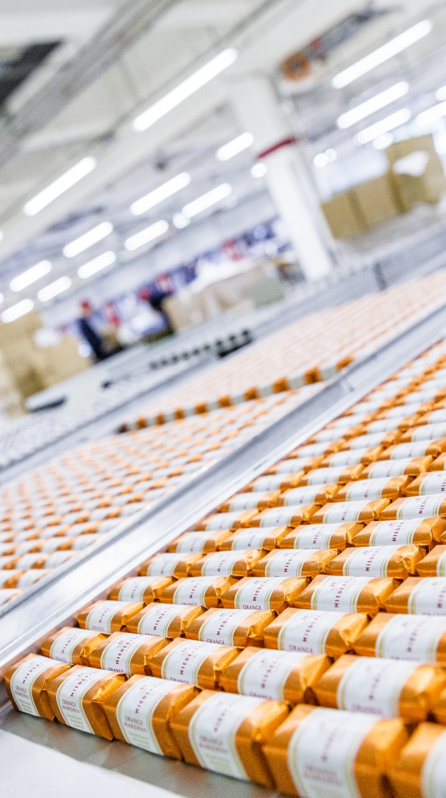
Advantages in operation
Clean – all variants are HACCP-compliant
High hygiene standards must be maintained in the food industry and canteen kitchens. E-Line Next LED is ideal for this. The special design prevents dust deposits so that all variants – whether IP20 or IP64 – are HACCP-compliant and suitable for use in hygiene-sensitive environments.

Slide 25
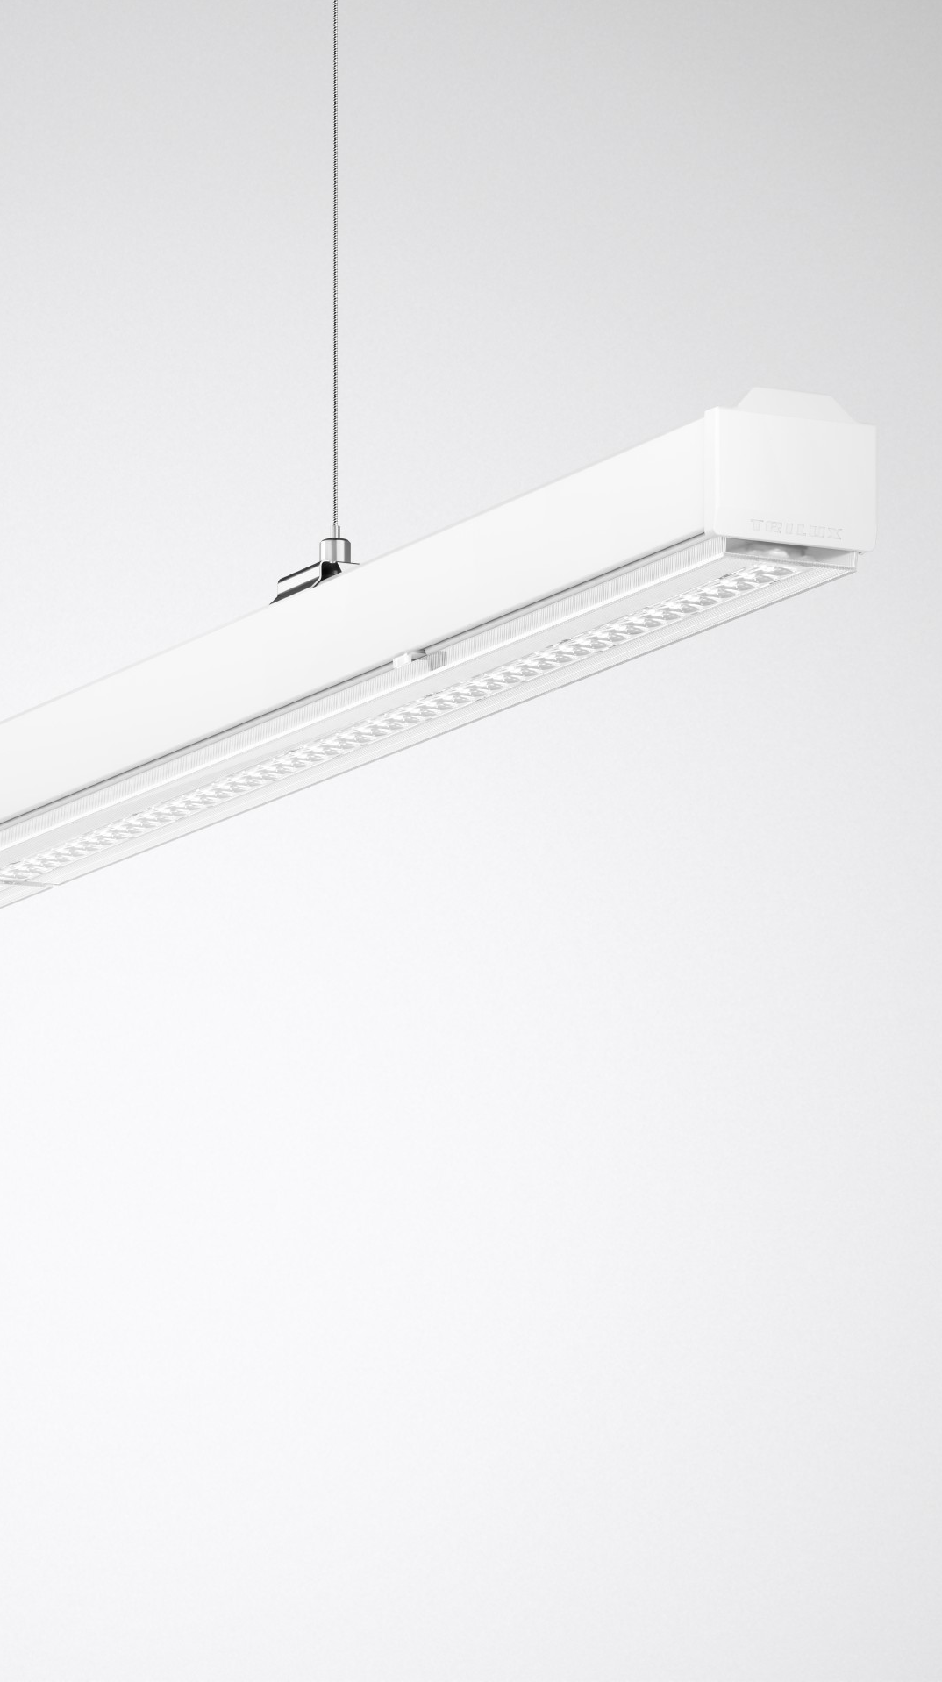
Advantages in operation
An attractive design down to the last detail
Looks more than good: due to the attractive design of the optic and trunking and the high-quality workmanship, E-Line Next LED also looks good in prestigious surroundings. Thanks to the new fastening system, no screw points are visible on the optic. The snap springs can also be easily removed after mounting. This way, not even the smallest detail disturbs the high-quality, minimalist design.

Slide 26
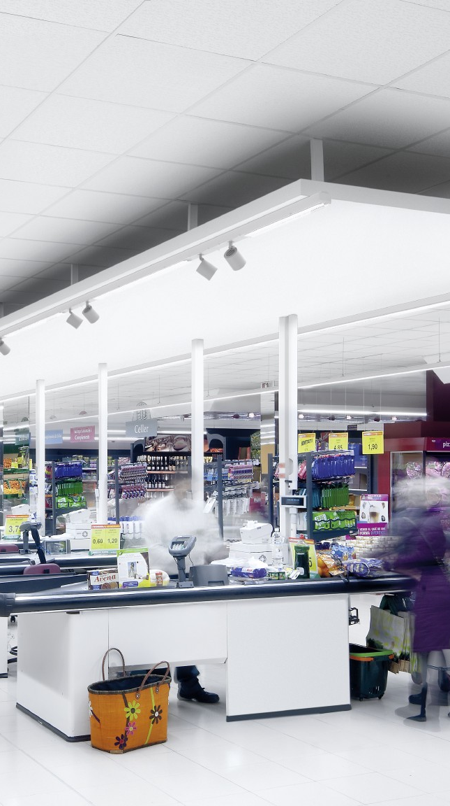
Advantages in operation
Future-proof – keeping all options open
E-Line Next LED offers maximum future security. New applications can be implemented with little effort simply by exchanging the modules. The power supply required for this is already available. 11 cores with the Flex version, and 14 cores with the Fix version. As a result, the system can be used to collect and analyse movement data for proximity marketing, asset tracking, etc. or simply equipped with an emergency light module.

Slide 27

E-Line Next LED is available with 15 different optics and spotlights and luminous flux packages from 2,000 to 20,000 lm. This means that all tender specifications can be ideally met. Selection of the modules is done with just a few clicks thanks to the online configurator.

Slide 28
E-Line Next LED is uniquely quick and easy to install thanks to optimised module lengths and drilling point spacings of 4 metres as well as customised project packaging. Just one click and the gear trays are in the trunking. This also makes it possible to refurbish existing E-Line solutions in record time.

Slide 29
Absolutely rewarding: With an energy efficiency of up to 190 lm/W, E-Line Next LED guarantees continuously low operating costs and fast payback. At the same time, the excellent quality of light (also due to HCL) ensures best work results and increases employee satisfaction. The system is also fit for the future thanks to the ability to integrate additional modules such as beacons and emergency light modules.

Slide 30
E-Line Next LED scores with excellence at all levels. With maximum flexibility for made-to-measure light. With the highest product quality and the certainty that all standards and energy requirements are met. And with minimal downtime in refurbishment projects as well as quick and competent support.

Slide 31
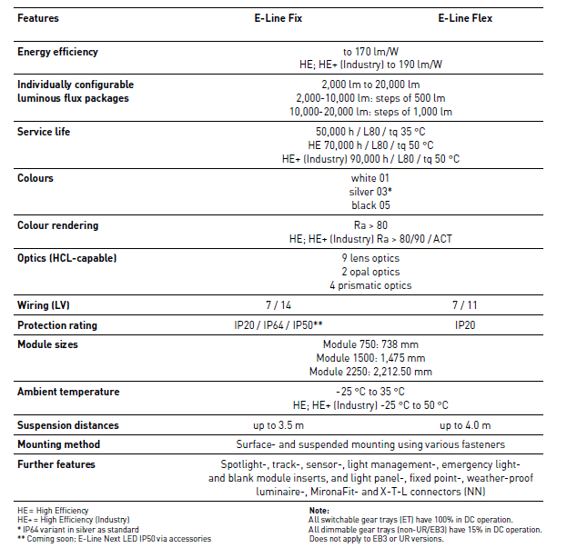
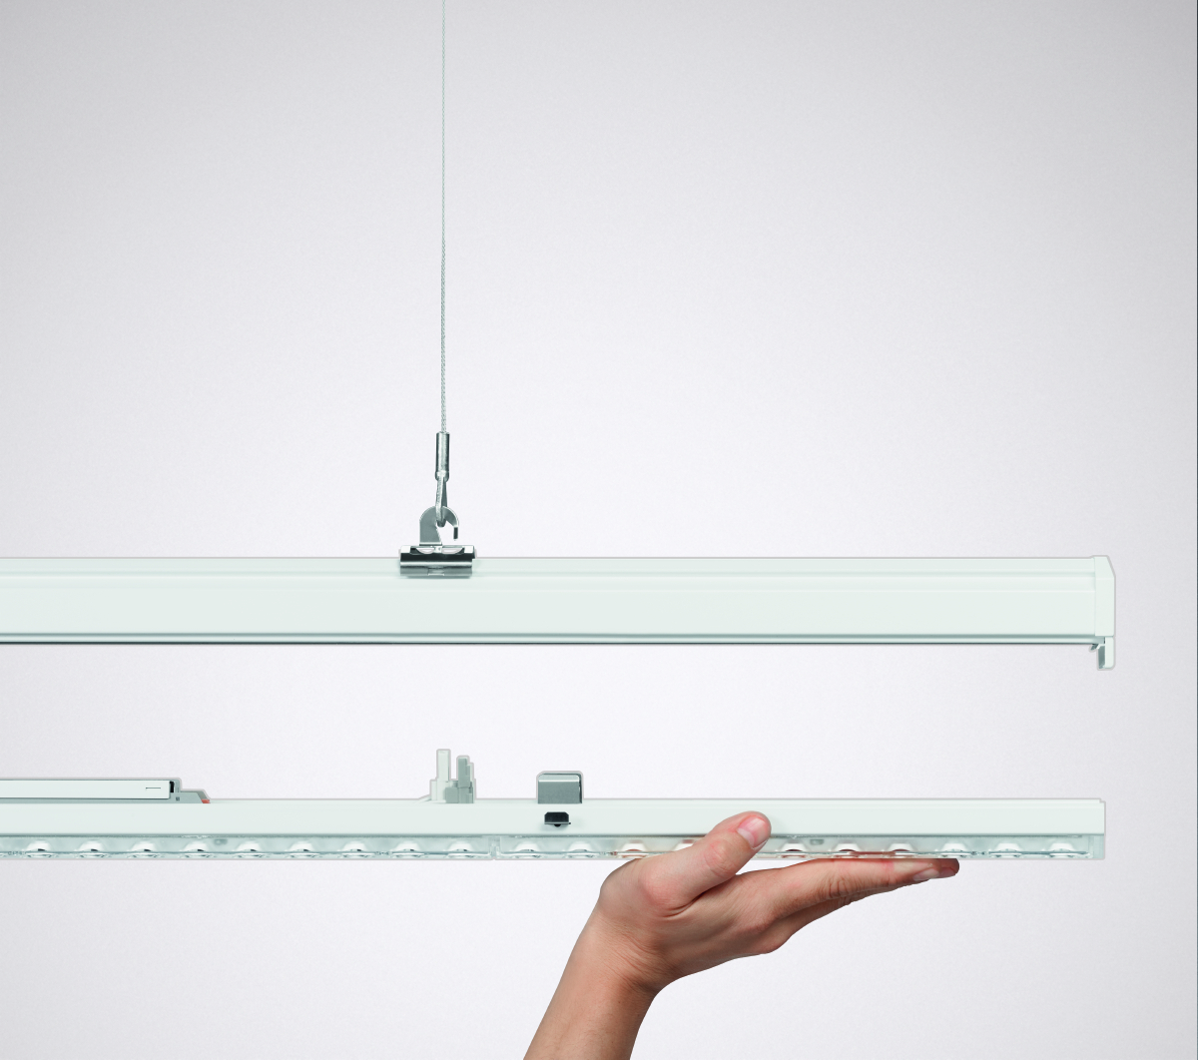
Technical features

Slide 32
INDUStry
The pioneering modular system: With 15 optics and luminous flux packages from 2,000 to 20,000 lumens, E-Line Next LED can be adapted to any application with unique precision. Sophisticated lighting technologies mean that light points can be saved. Quality of light and energy efficiency (up to 190 lm/W) set new standards. All modules are HCL-capable to e.g. support the well-being of employees, especially during shift work.

Slide 33
SHOP AND RETAIl
Perfectly illuminated aisles and shelves, an attractive checkout area and a high quality ambience. With a colour rendering index of Ra>90 and different application-specific optics and spotlights, E-Line Next LED offers unique flexibility with illumination and accentuation, e.g. with two double asymmetric optics for different aisle widths and heights.

Slide 34
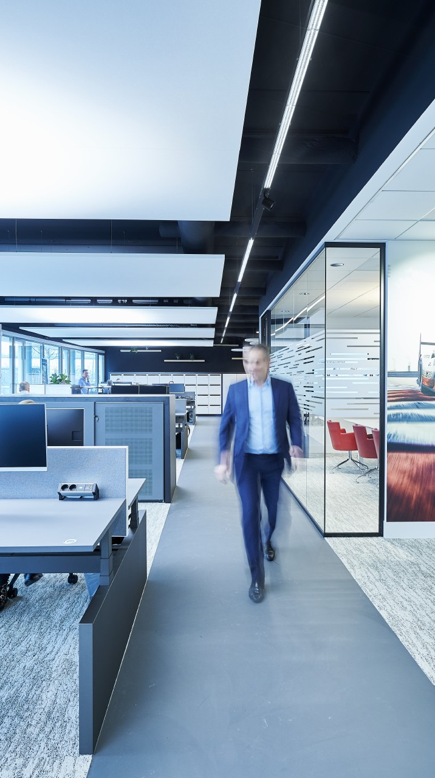
office
E-Line Next LED is the answer to the trend towards linear lighting systems in modern offices. With two different HCL-capable, VDU-compliant optics and spotlights and a colour rendering index of Ra>90, the system ensures maximum visual comfort and employee well-being. Its attractive design, for example, is particularly well suited to office concepts with an industrial look.

Slide 35
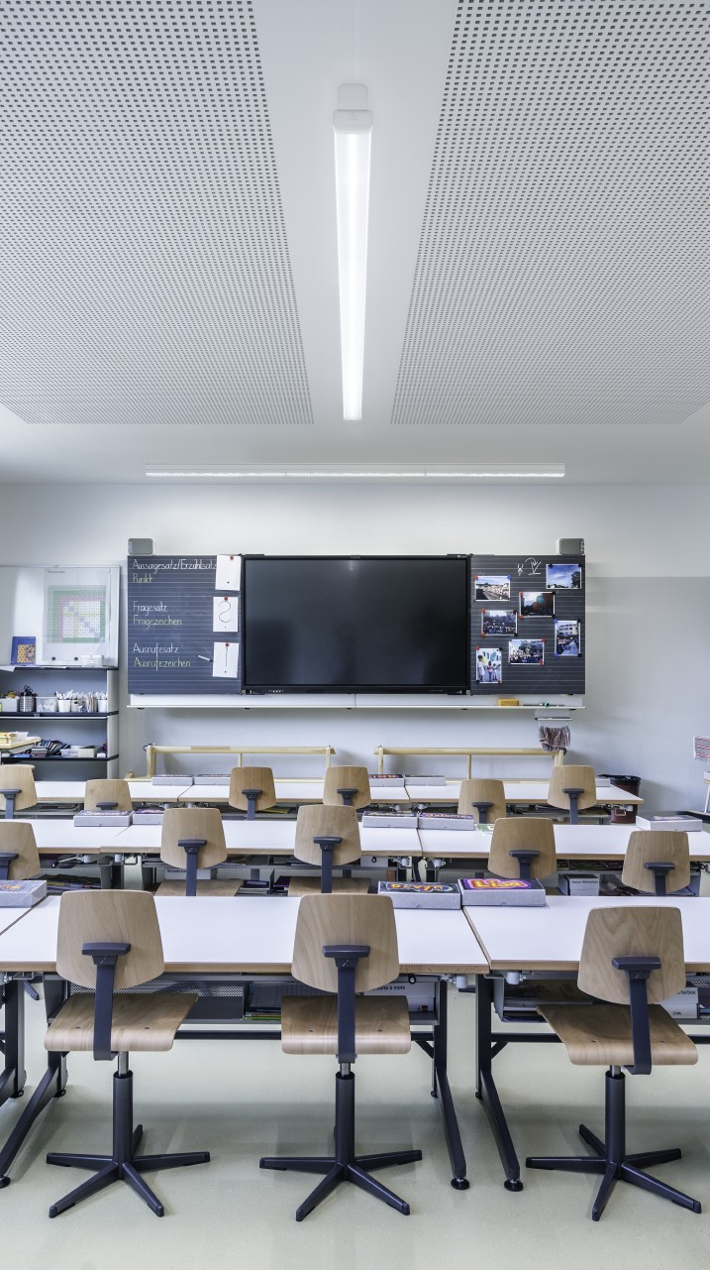
education
See everything in a new light: E-Line Next LED is a real all-rounder with different application-specific optics and spotlights. Whether shelf lighting in libraries, classrooms or for blackboard- or accent lighting. The modular system provides excellent quality of light for maximum visual comfort. In addition, all variants are HCL-compliant. This prevents eye fatigue and improves the ability to concentrate.

Slide 36
Bullet points
Modular kit system
Extremely broad portfolio for maximum design flexibility in all applications
Flexible positioning of modules
Free positioning of the modules through continuous wiring with the Flex version
New module lengths
Three module lengths between 737,5 mm and 2.212,5 mm for perfect interior design
Luminous flux
Luminous flux packages between 2,000 lm and 20,000 lm. From 2,000 to 10,000 lm in steps of 500 lm and from 10,000 to 20,000 lm in steps of 1,000 lm
Human Centric Lighting for all applications
All variants also available as Active solution for HCL
Future-proof
Power supply available for additional consumers
Online Configurator
Continuous line configurations using online tool
Attractive
High quality design and workmanship for use in all applications
Protects the environment and budget New type of packaging concept minimises frustration, costs and waste
Accents and emotions Colour rendering Ra>90 and spotlight module B.VEO with 5 emission angles for ideal retail showcasing
Efficient Precise lighting solution planning thanks to configurable luminous flux options and maximum efficiency in the market with up to 190 lm/W

Slide 37
Thank you for your attention! www.trilux.com

