Slide 1
LiveLink SAMPLE KIT 2.0
SAMPLE KIT ONE

Slide 2
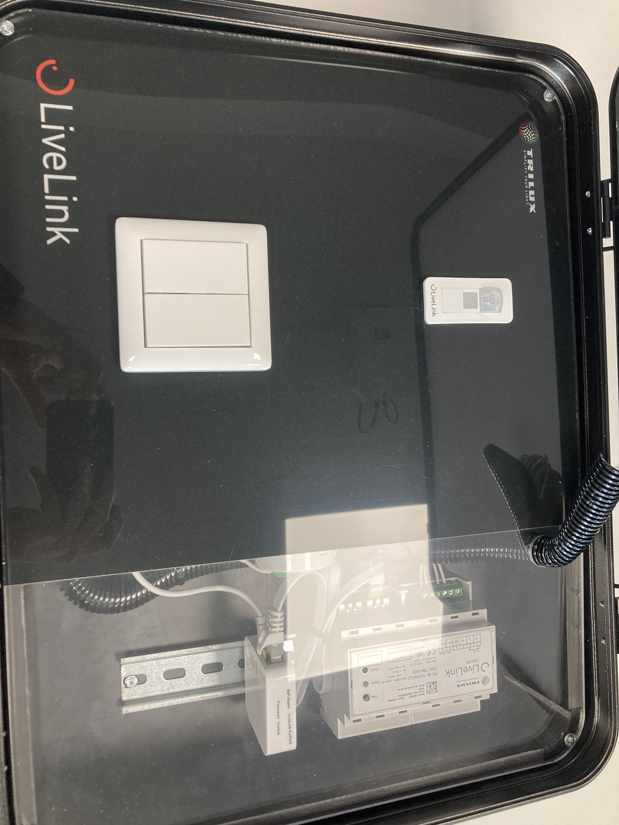
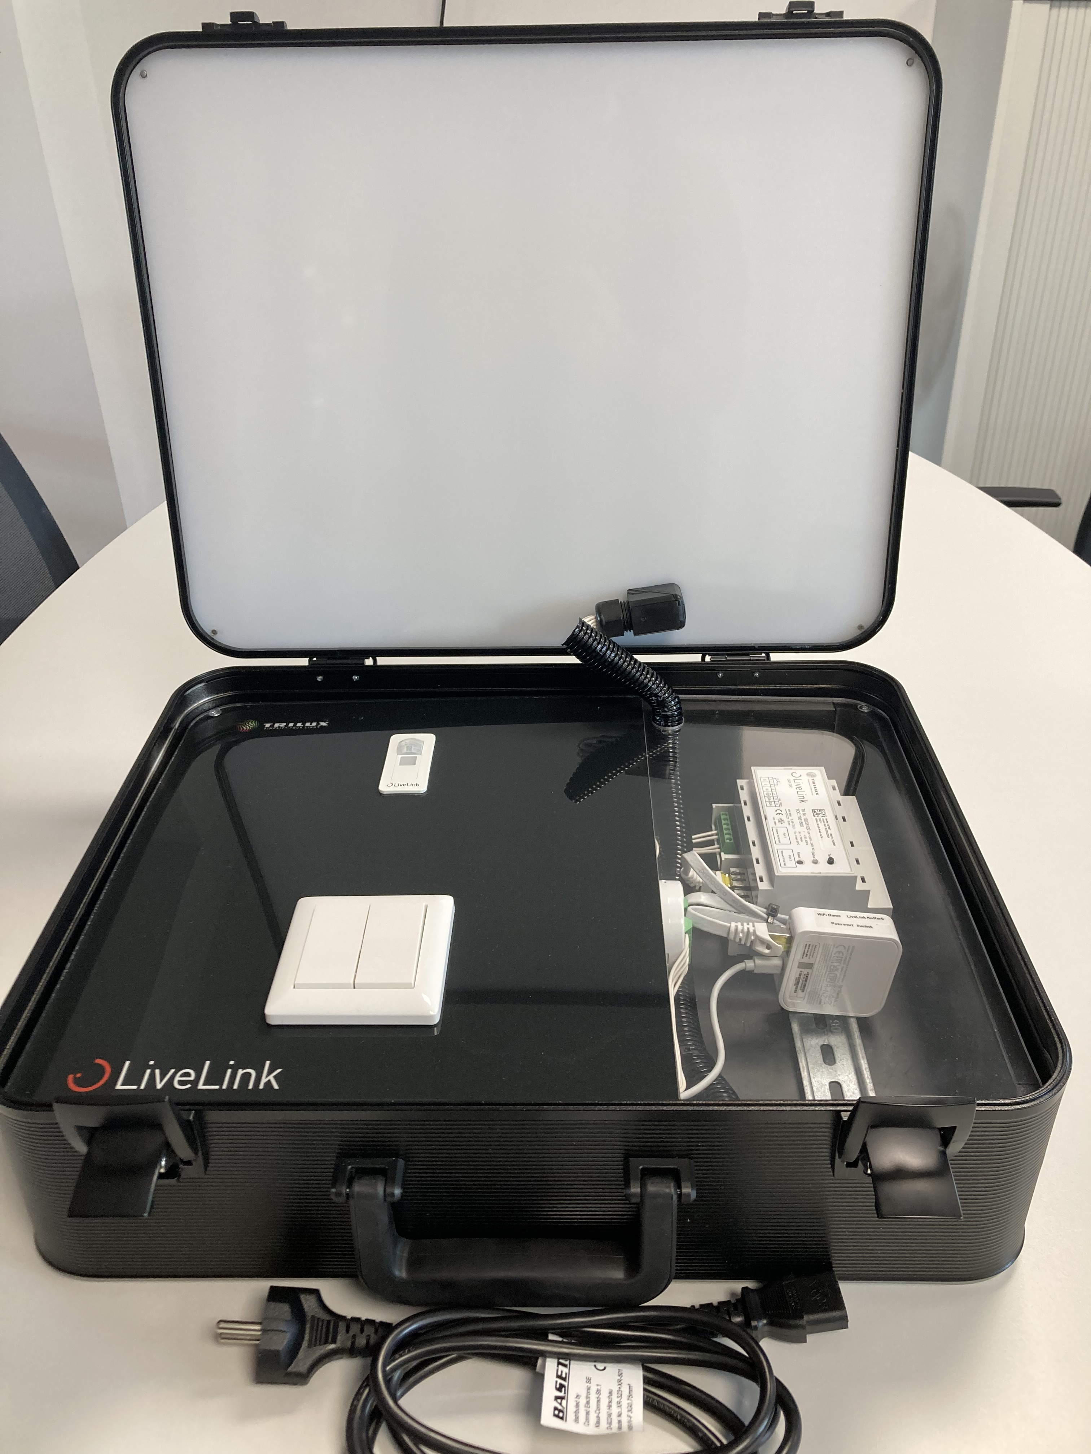
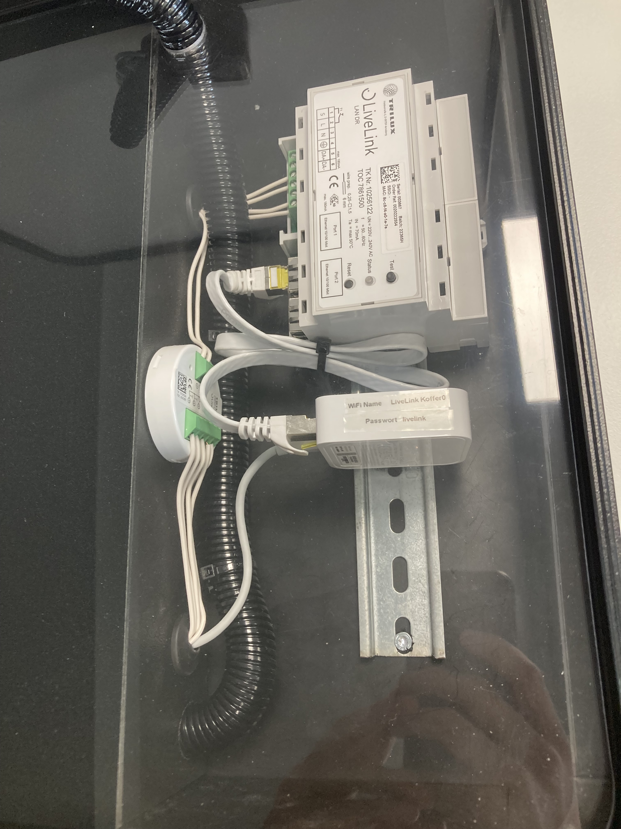
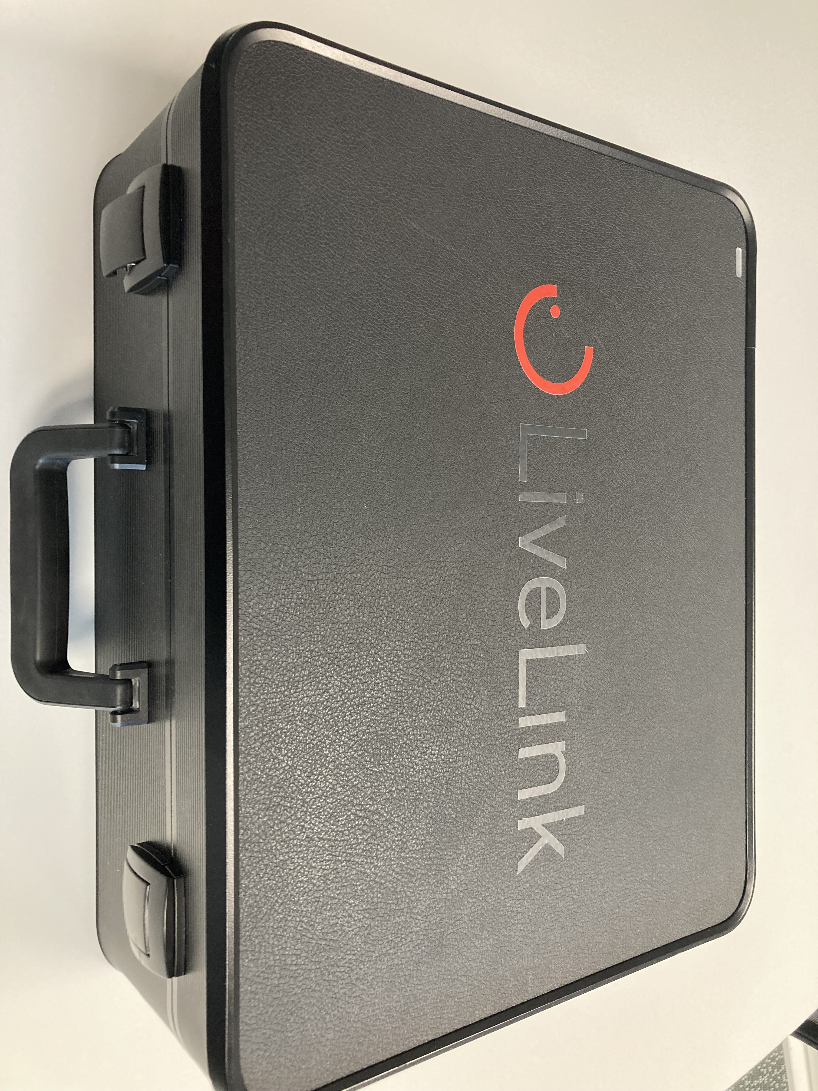
The New LiveLink Sample Kit

Slide 3
Delivery scope
New Design of the Case
6 HCL-Lamps
1 LiveLink Lan DR
1 Router
1 IR Micro Sensor
1 Fourfold Push-button
The New LiveLink Software: LiveLinkONE
➔ A Plug&Play Sample Kit

Slide 4
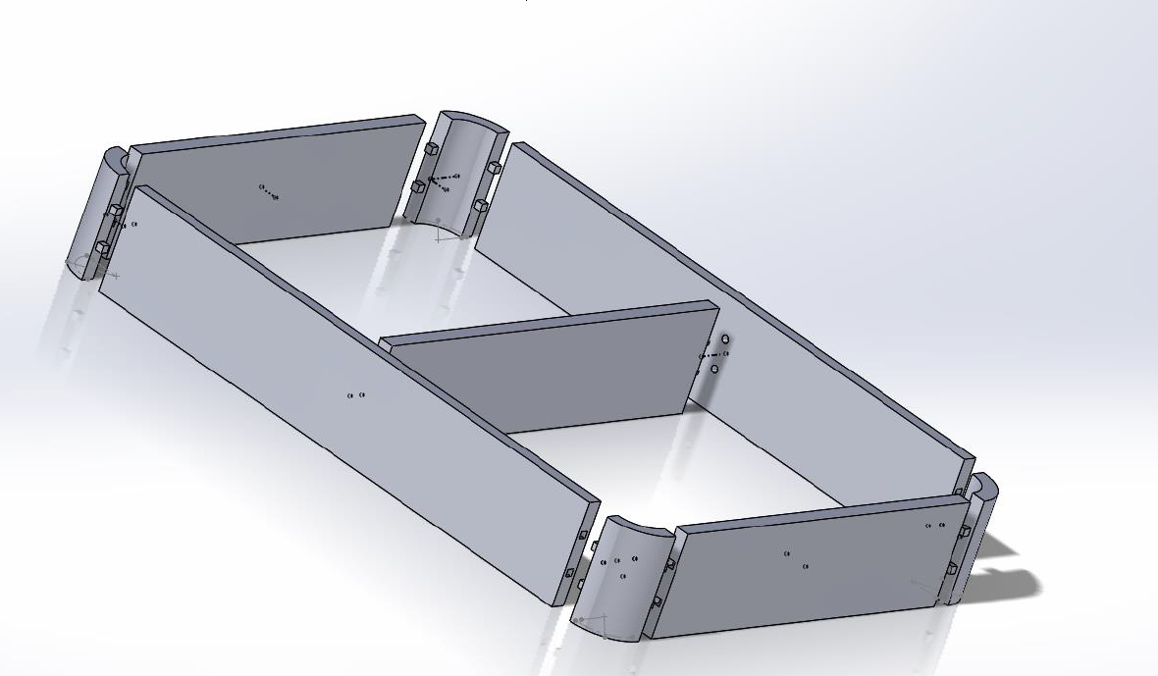

Slide 5
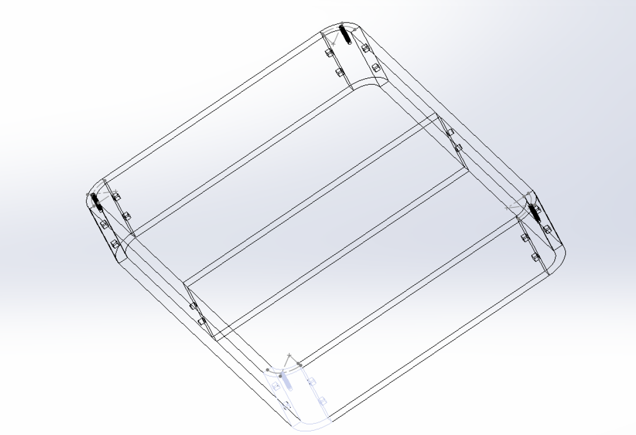

Slide 7
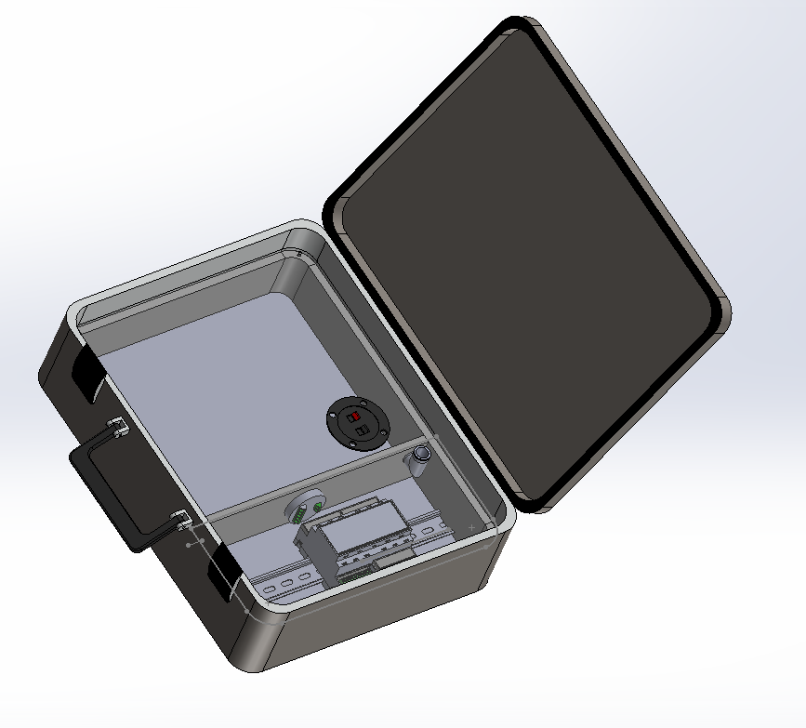

Slide 8
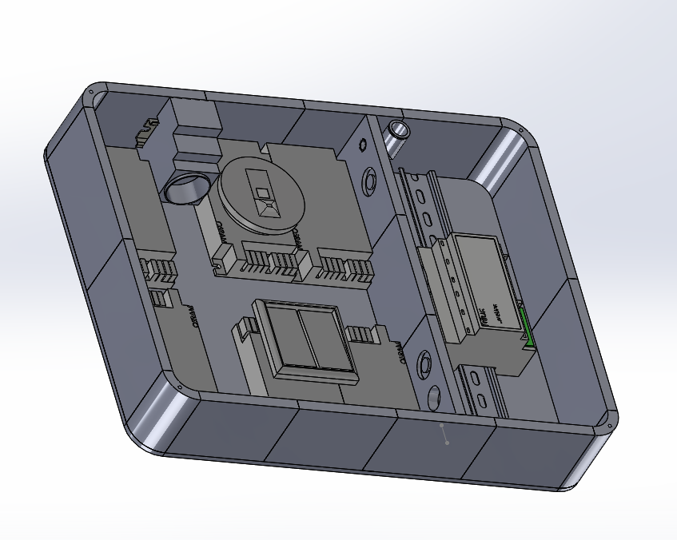

Slide 9
Basic Information
Cost: 1.000€
Next order delivery: Q1 2024
Deadline of next Ordering: KW43 2023
Contact:
Florian Schäfer Product Manager IoT Systems & Solutions TRILUX Vertrieb GmbH Heidestraße 4 - 59759 Arnsberg florian.schaefer@trilux.com

Slide 10
Thank you for your attention

